Slide 1
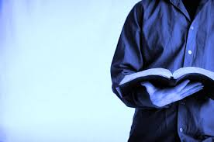
(1)Holy words, long preserved, for our work in this world, they resound with God's own heart, oh let the ancient words impart. (2)Words of life, words of hope, give us strength, help us cope, in this world where e're we roam, ancient words will guide us home.
(3)Holy words of our faith, handed down to this age, came to us through sacrifice, oh heed the faithful words of Christ..
Chorus: Ancient words, ever true changing me and changing you, we have come with open hearts, oh let the ancient words impart.

Slide 2
Nahum

Slide 3
1. Characteristics of Nahum 2. Chapter Summaries 3. Applications For Christians Today

