Slide 1
The LOCAL CHURCH

Slide 2
The LOCAL Church is…
“Fully Loyalty To God” (3rd )
“Built On Divine Communication” (10th)
“A Distinct And Special Body” (17th)
“Saints In Spiritual Service” (24th)
“Engaged” (March 3rd)

Slide 3
The LOCAL Church is…
“A Distinct And Special Body”

Slide 4
Our aim is to learn and understand the teachings of Christ, and follow them.
⁹ Everyone who goes on ahead and does not abide in the teaching of Christ, does not have God. Whoever abides in the teaching has both the Father and the Son. 2 John 1 ESV

Slide 5
Matt. 16:18
Acts 2:47
THE CHURCH
“on this rock, I will build My church, and the gates of Hades shall not prevail against it.”
“And the Lord added to the church daily those who were being saved.”
“Christ is head of the church; and He is the Savior of the body.”
“head over all things to the church, which is His body.”
Eph. 1:22-23
Eph. 5:23

Slide 6
Phil 1:1
1 Cor 1:2
Local Churches
The saints in Philippi with Elders and Deacons
church of God at Corinth
To the saints who are in Ephesus:
The churches of Christ greet you.
Romans 16:16
Eph. 1:1

Slide 7
And I also say to you that you are Peter, and on this rock I will build My church, and the gates of Hades shall not prevail against it. Mt. 16:18
Paul and Timothy, bondservants of Jesus Christ,
To all the saints in Christ Jesus who are in Philippi, with the bishops and deacons. Phil 1:1
²⁶ If anyone among you thinks he is religious, and does not bridle his tongue but deceives his own heart, this one’s religion is useless. James 1

Slide 8
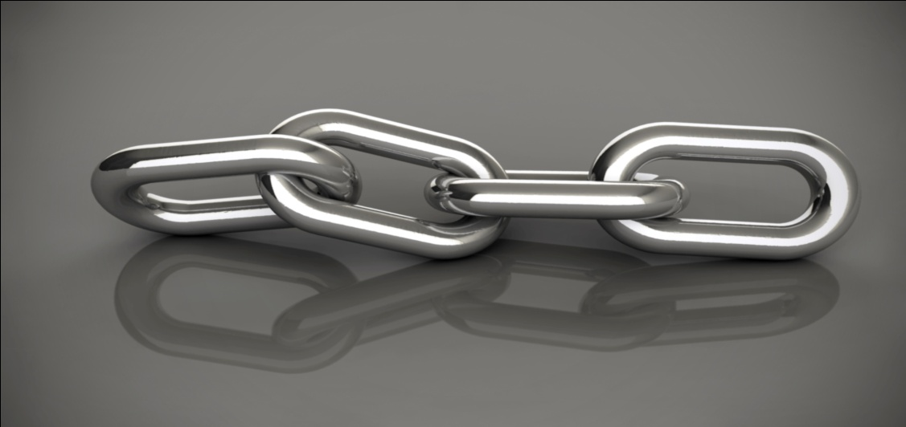
A. Differences
Different Works (1 Timothy 5:11-16)
Different Resources. (Acts 4:34-5:4)
Different Ways To Solve Issues (Matthew 18:15-17)
I. The Local Church &
The Individual Saint

Slide 9
B. Questions
1. Concerning Good Works, We Ask:
Is this work intended by God for individuals, for local churches, or for both?
2. Concerning Good Works: Why This Way?
We Will Have Great Thankfulness For God’s Wisdom!!!
I. The Local Church &
The Individual Saint

Slide 10
A. Different In Composition
(Hebrews 12:22-23) (1 Thessalonians 1:1)
B. Different In Number
(Ephesians 4:4) (Galatians 1:2, Romans 16:16)
C. Different In Date of Establishment
(Acts 2:41) (Acts 11:19-23)
II. The Local Church & The Universal Church

Slide 11
D. Different In How Members Are Added
(Acts 2:47) (Acts 9:26)
E. Different In How Membership Is Maintained
(2 Timothy 2:19) (3 John 1:10)
F. Different In How They Are Organized
(1 Corinthians 12:20) (Philippians 1:1)
II. The Local Church & The Universal Church

Slide 12
The LOCAL Church is…
“A Distinct And Special Body”

