Slide 1
Welcome to Northwood!

Slide 3
Evangelism Workshop:
Monday, February 13

Slide 4
The Fruit of the Spirit

Slide 5
October - Love
November - Joy
December - Peace
January - Patience
February - Kindness
March - Faithfulness
April - Gentleness
May - Self-control

Slide 7
“Blessed are the merciful, for they shall receive mercy.”
Matthew 5:7

Slide 8
“You have heard that it was said, ‘An eye for an eye and a tooth for a tooth.’ But I say to you, Do not resist the one who is evil. But if anyone slaps you on the right cheek, turn to him the other also. And if anyone would sue you and take your tunic, let him have your cloak as well. And if anyone forces you to go one mile, go with him two miles. Give to the one who begs from you, and do not refuse the one who would borrow from you.”
Matthew 5:38-42

Slide 9
“You have heard that it was said, ‘You shall love your neighbor and hate your enemy.’ But I say to you, Love your enemies and pray for those who persecute you, so that you may be sons of your Father who is in heaven. For he makes his sun rise on the evil and on the good, and sends rain on the just and on the unjust. For if you love those who love you, what reward do you have? Do not even the tax collectors do the same? And if you greet only your brothers, what more are you doing than others? Do not even the Gentiles do the same? You therefore must be perfect, as your heavenly Father is perfect.”
Matthew 5:43-48

Slide 10
“Beware of practicing your righteousness before other people in order to be seen by them, for then you will have no reward from your Father who is in heaven.
Thus, when you give to the needy, sound no trumpet before you, as the hypocrites do in the synagogues and in the streets, that they may be praised by others. Truly, I say to you, they have received their reward. But when you give to the needy, do not let your left hand know what your right hand is doing, so that your giving may be in secret. And your Father who sees in secret will reward you.”
Matthew 6:1-4

Slide 11
“Do not lay up for yourselves treasures on earth, where moth and rust destroy and where thieves break in and steal, but lay up for yourselves treasures in heaven, where neither moth nor rust destroys and where thieves do not break in and steal. For where your treasure is, there your heart will be also.”
Matthew 6:19-21

Slide 12
“So whatever you wish that others would do to you, do also to them, for this is the Law and the Prophets.”
Matthew 7:12

Slide 13
“When the Son of Man comes in his glory, and all the angels with him, then he will sit on his glorious throne. Before him will be gathered all the nations, and he will separate people one from another as a shepherd separates the sheep from the goats. And he will place the sheep on his right, but the goats on the left.”

Slide 14
“Then the King will say to those on his right, ‘Come, you who are blessed by my Father, inherit the kingdom prepared for you from the foundation of the world. For I was hungry and you gave me food. I was thirsty and you gave me drink. I was a stranger and you welcomed me, I was naked and you clothed me, I was sick and you visited me, I was in prison and you came to me.’”

Slide 15
“Then the righteous will answer him, saying, ‘Lord, when did we see you hungry and feed you, or thirsty and give you drink? And when did we see you a stranger and welcome you, or naked and clothe you? And when did we see you sick or in prison and visit you?’ And the King will answer them, ‘Truly, I say to you, as you did it to one of the least of these my brothers, you did it to me.’”

Slide 16
“Then he will say to those on his left, ‘Depart from me, you cursed, into the eternal fire prepared for the devil and his angels. For I was hungry and you gave me no food, I was thirsty and you gave me no drink, I was a stranger and you did not welcome me, naked and you did not clothe me, sick and in prison and you did not visit me.’”

Slide 17
“Then they also will answer, saying, ‘Lord, when did we see you hungry or thirsty or a stranger or naked or sick or in prison, and did not minister to you?”

Slide 18
“Then he will answer them, saying, ‘Truly, I say to you, as you did not do it to one of the least of these, you did not do it to me.’”

Slide 19
“And these will go away into eternal punishment, but the righteous into eternal life.”
Matthew 25:31-46

Slide 21
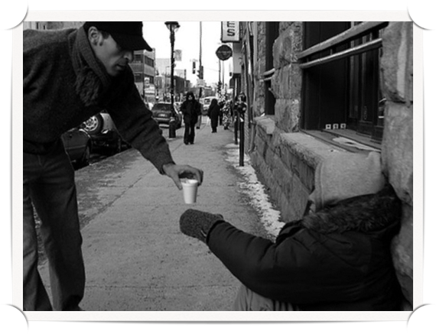
The priority of kindness

Slide 22
Love is patient and kind… 1 Cor 13:4
Put on then, as God’s chosen ones, holy and beloved, compassionate hearts, kindness… Colossians 3:12
But the fruit of the Spirit is love, joy, peace, patience, kindness… Galatians 5:22
Be kind to one another… Ephesians 4:32

Slide 23
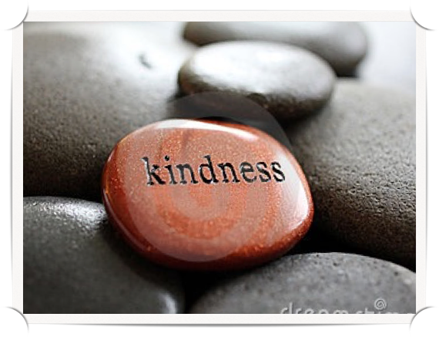
A characteristic of God

Slide 24
Or do your presume on the riches of his kindness and forbearance and patience, not knowing that God’s kindness is meant to lead you to repentance? Romans 2:4
… so that in the coming ages he might show the immeasurable riches of his grace in kindness toward us in Christ Jesus. Ephesians 2:7

Slide 25
But when the goodness and loving kindness of God our Savior appeared, he saved us… Titus 3:4-5
“But love your enemies, and do good, and lend, expecting nothing in return, and your reward will be great, and you will be sons of the Most High; for he is kind to the ungrateful and the evil. Be merciful, even as your Father is merciful.” Luke 6:35-36

Slide 26
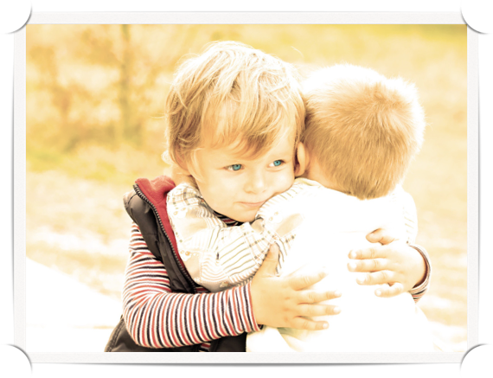
The nature of kindness

Slide 27
Kindness is thoughtful.
Yet it was kind of you to share in my trouble. Philippians 4:14
Love one another with brotherly affection. Outdo one another in showing honor. Romans 12:10

Slide 28
Kindness is opposed to anger.
Let all bitterness and wrath and anger and clamor and slander be put away from you, along with all malice. Be kind to one another… Ephesians 4:31-32
And if anyone would sue you and take your tunic, let him have your cloak as well. And if anyone forces you to go one mile, go with him two miles. Matthew 5:40-41

Slide 29
Kindness is opposed to anger.
If your enemy is hungry, feed him; if he is thirsty, give him something to drink… Do not be overcome by evil, but overcome evil with good. Romans 12:20-21

Slide 30
Kindness gives with no strings attached.
“…love your enemies, and do good, and lend, expecting nothing in return, and your reward will be great, and you will be sons of the Most High, for he is kind to the ungrateful and the evil. Luke 6:35

Slide 31
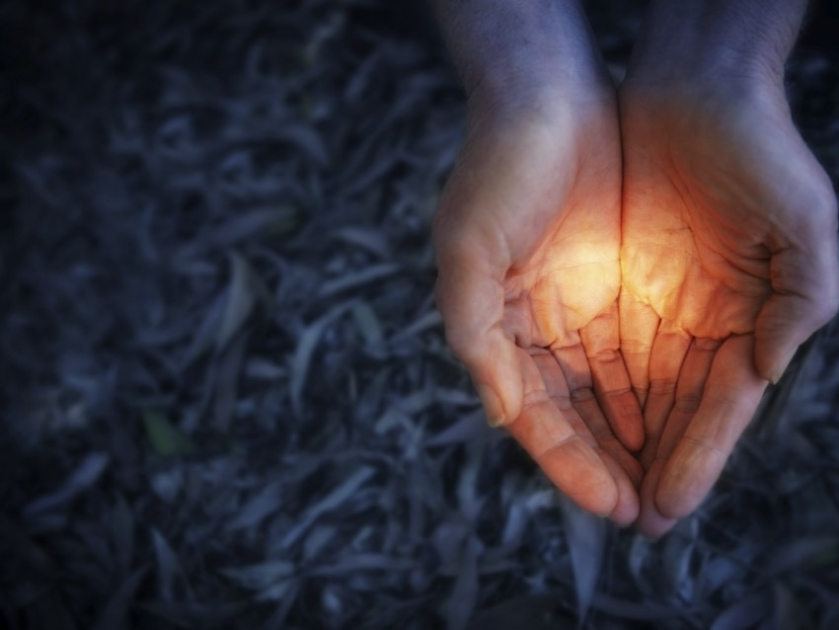
40 Days of Kindness
#40daysofkindness

Slide 32
