Slide 1
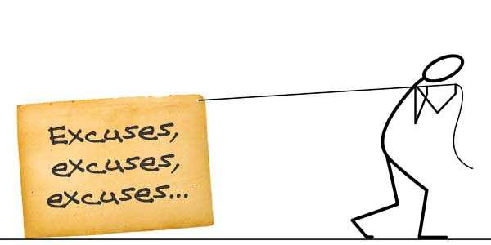
Excuses for Not Praying
Identifying and overcoming six excuses for prayerlessness in our lives

Slide 2
Too Busy!
Excuse #1:

Slide 3
Luke 10
38 Now as they went on their way, Jesus entered a village. And a woman named Martha welcomed him into her house. 39 And she had a sister called Mary, who sat at the Lord's feet and listened to his teaching. 40 But Martha was distracted with much serving. And she went up to him and said, “Lord, do you not care that my sister has left me to serve alone? Tell her then to help me.” 41 But the Lord answered her, “Martha, Martha, you are anxious and troubled about many things, 42 but one thing is necessary. Mary has chosen the good portion, which will not be taken away from her.”

Slide 4
Luke 10
38 Now as they went on their way, Jesus entered a village. And a woman named Martha welcomed him into her house. 39 And she had a sister called Mary, who sat at the Lord's feet and listened to his teaching. 40 But Martha was distracted with much serving. And she went up to him and said, “Lord, do you not care that my sister has left me to serve alone? Tell her then to help me.” 41 But the Lord answered her, “Martha, Martha, you are anxious and troubled about many things, 42 but one thing is necessary. Mary has chosen the good portion, which will not be taken away from her.”

Slide 5
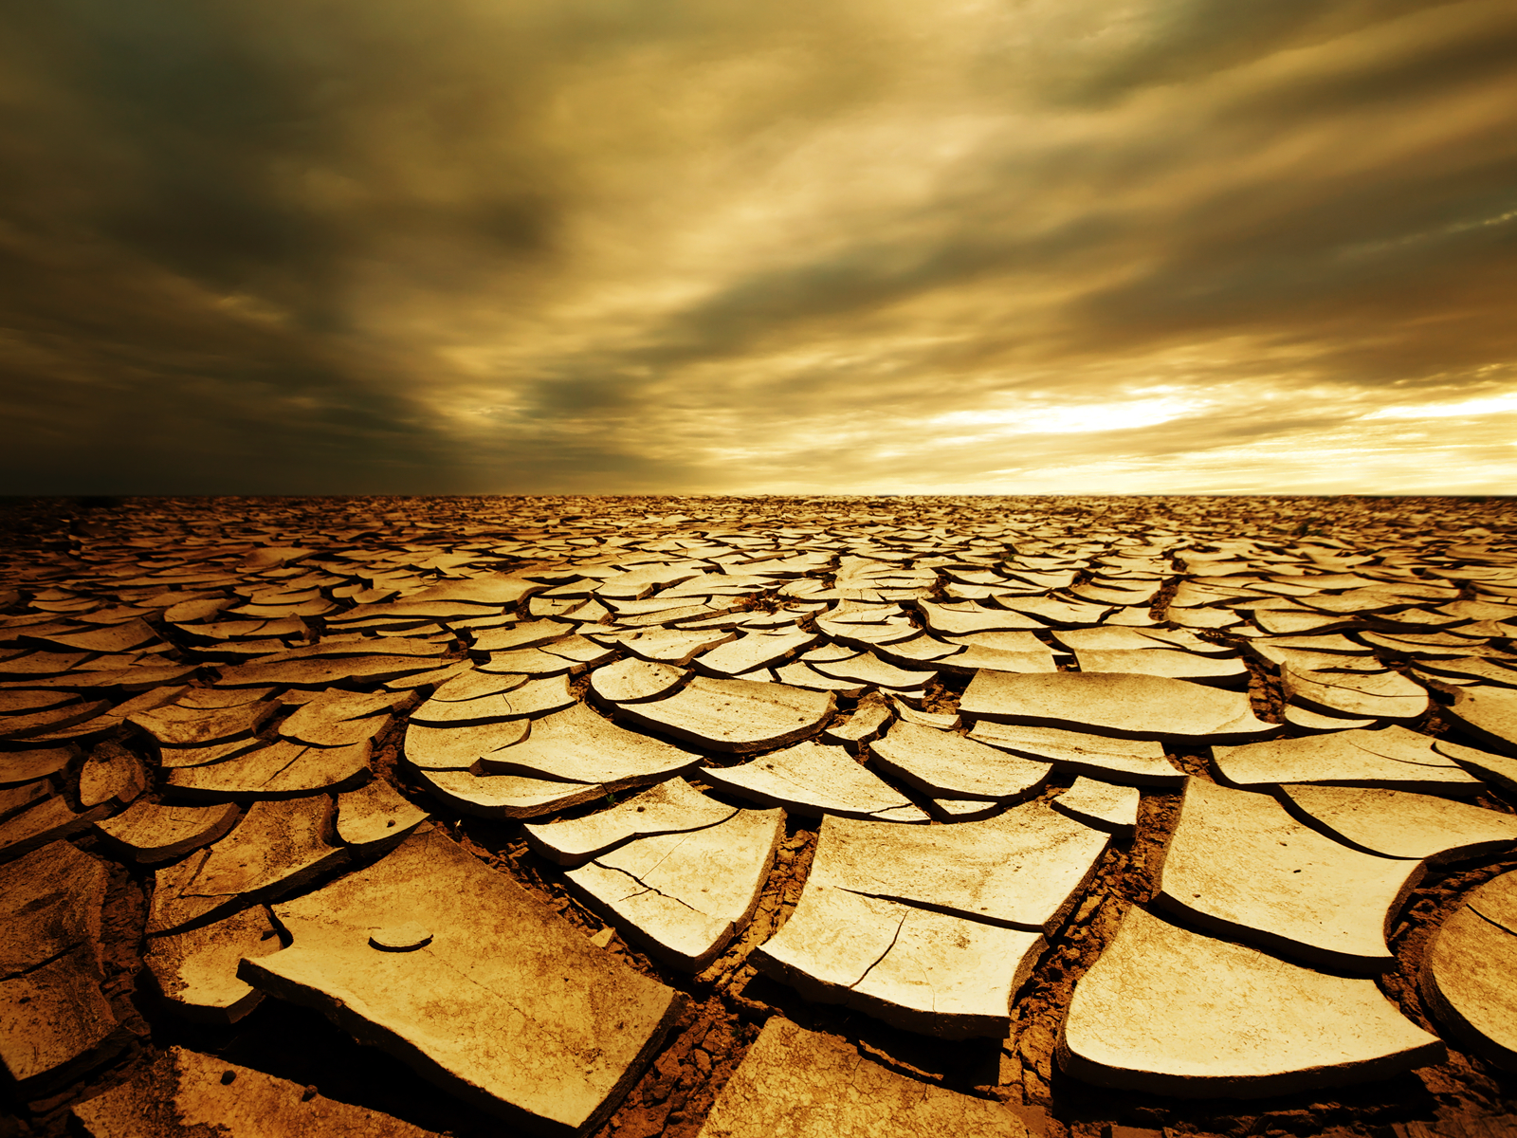
Too Dry Spiritually!
Excuse #2:

Slide 6
Luke 18
1 And he told them a parable to the effect that they ought always to pray and not lose heart. 2 He said, “In a certain city there was a judge who neither feared God nor respected man. 3 And there was a widow in that city who kept coming to him and saying, ‘Give me justice against my adversary.’ 4 For a while he refused, but afterward he said to himself, ‘Though I neither fear God nor respect man, 5 yet because this widow keeps bothering me, I will give her justice, so that she will not beat me down by her continual coming.’” 6 And the Lord said, “Hear what the unrighteous judge says. 7 And will not God give justice to his elect, who cry to him day and night? Will he delay long over them? 8 I tell you, he will give justice to them speedily. Nevertheless, when the Son of Man comes, will he find faith on earth?”

Slide 7
Luke 18
1 And he told them a parable to the effect that they ought always to pray and not lose heart. 2 He said, “In a certain city there was a judge who neither feared God nor respected man. 3 And there was a widow in that city who kept coming to him and saying, ‘Give me justice against my adversary.’ 4 For a while he refused, but afterward he said to himself, ‘Though I neither fear God nor respect man, 5 yet because this widow keeps bothering me, I will give her justice, so that she will not beat me down by her continual coming.’” 6 And the Lord said, “Hear what the unrighteous judge says. 7 And will not God give justice to his elect, who cry to him day and night? Will he delay long over them? 8 I tell you, he will give justice to them speedily. Nevertheless, when the Son of Man comes, will he find faith on earth?”

Slide 8
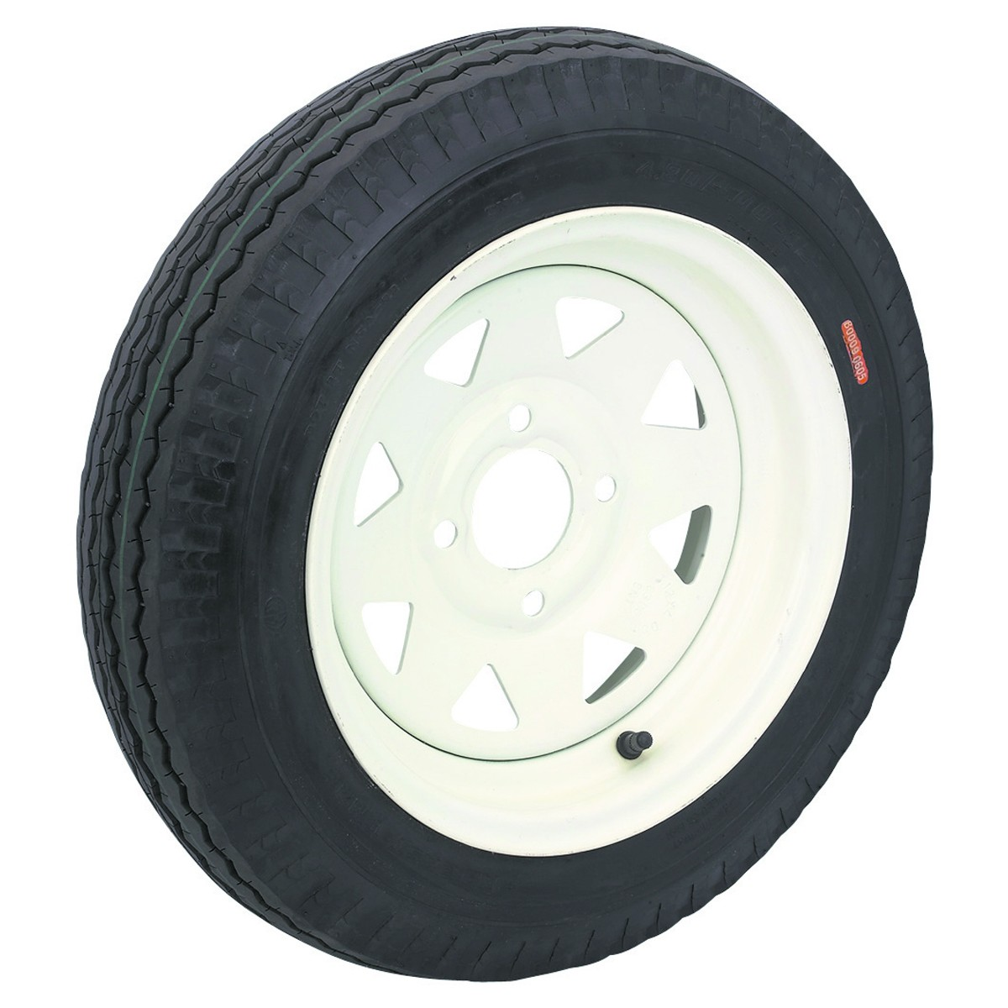
Feel No Need!
Excuse #3:

Slide 9
Joshua 9
14 So the men took some of their provisions, but did not ask counsel from the Lord. 15 And Joshua made peace with them and made a covenant with them, to let them live, and the leaders of the congregation swore to them.

Slide 10
Joshua 9
14 So the men took some of their provisions, but did not ask counsel from the Lord. 15 And Joshua made peace with them and made a covenant with them, to let them live, and the leaders of the congregation swore to them.

Slide 11
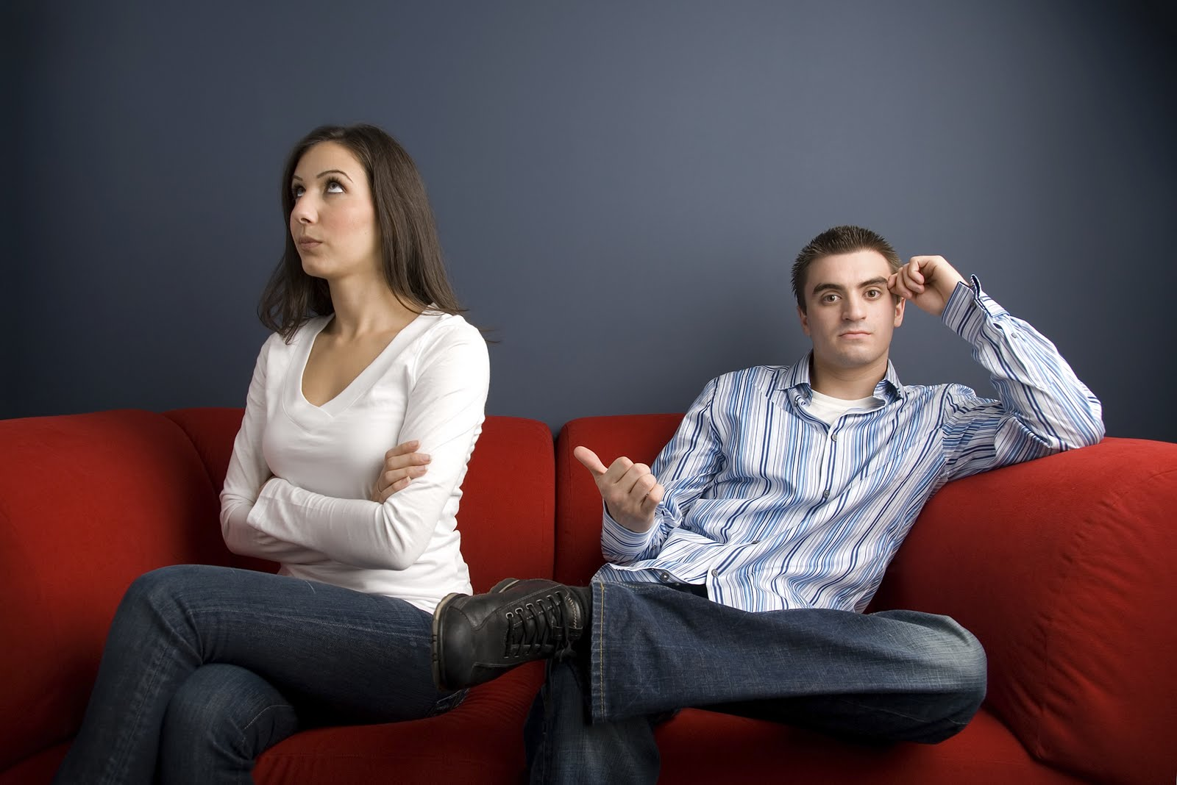
Too Bitter!
Excuse #4:

Slide 12
Matthew 6
14 For if you forgive others their trespasses, your heavenly Father will also forgive you, 15 but if you do not forgive others their trespasses, neither will your Father forgive your trespasses.

Slide 13
Matthew 6
14 For if you forgive others their trespasses, your heavenly Father will also forgive you, 15 but if you do not forgive others their trespasses, neither will your Father forgive your trespasses.

Slide 14
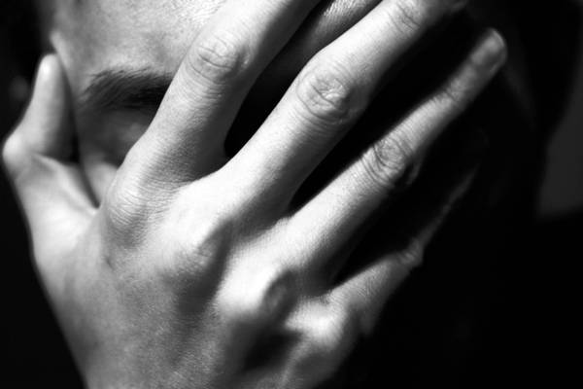
Too Ashamed!
Excuse #5:

Slide 15
Psalm 32
3 For when I kept silent, my bones wasted away
through my groaning all day long.
4 For day and night your hand was heavy upon me;
my strength was dried up as by the heat of summer.
5 I acknowledged my sin to you,
and I did not cover my iniquity;
I said, “I will confess my transgressions to the Lord,”
and you forgave the iniquity of my sin.

Slide 16
Psalm 32
3 For when I kept silent, my bones wasted away
through my groaning all day long.
4 For day and night your hand was heavy upon me;
my strength was dried up as by the heat of summer.
5 I acknowledged my sin to you,
and I did not cover my iniquity;
I said, “I will confess my transgressions to the Lord,”
and you forgave the iniquity of my sin.

Slide 17
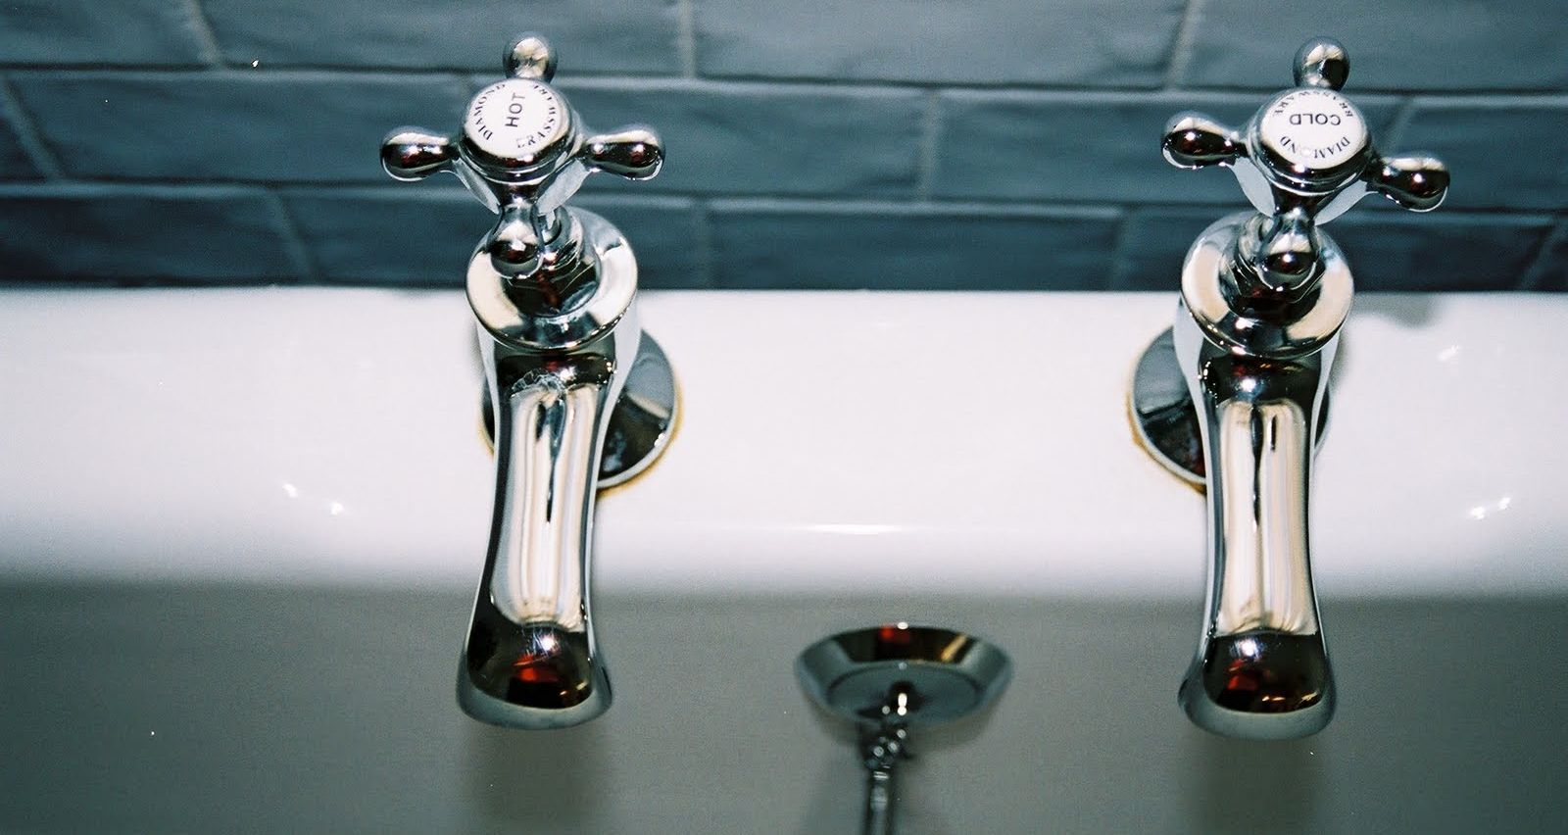
Content with Mediocrity!
Excuse #6:

Slide 18
Revelation 3
15 “‘I know your works: you are neither cold nor hot. Would that you were either cold or hot! 16 So, because you are lukewarm, and neither hot nor cold, I will spit you out of my mouth. 17 For you say, I am rich, I have prospered, and I need nothing, not realizing that you are wretched, pitiable, poor, blind, and naked. 18 I counsel you to buy from me gold refined by fire, so that you may be rich, and white garments so that you may clothe yourself and the shame of your nakedness may not be seen, and salve to anoint your eyes, so that you may see. 19 Those whom I love, I reprove and discipline, so be zealous and repent.

Slide 19
Revelation 3
15 “‘I know your works: you are neither cold nor hot. Would that you were either cold or hot! 16 So, because you are lukewarm, and neither hot nor cold, I will spit you out of my mouth. 17 For you say, I am rich, I have prospered, and I need nothing, not realizing that you are wretched, pitiable, poor, blind, and naked. 18 I counsel you to buy from me gold refined by fire, so that you may be rich, and white garments so that you may clothe yourself and the shame of your nakedness may not be seen, and salve to anoint your eyes, so that you may see. 19 Those whom I love, I reprove and discipline, so be zealous and repent.

