Slide 1
Welcome to Northwood!

Slide 2
Luke, the Beloved Historian
Luke 1:1-4

Slide 3
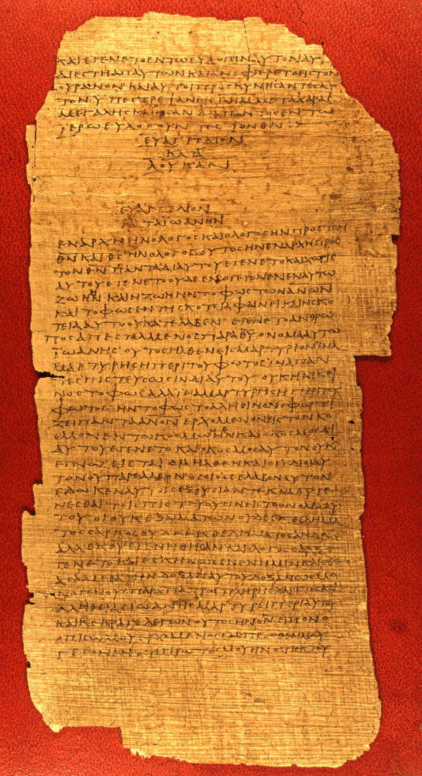
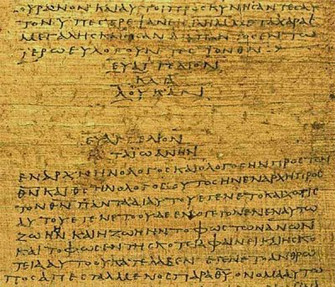

Slide 4
Luke’s Sources
Inasmuch as many have undertaken to compile a narrative of the things that have been accomplished among us, just as those who from the beginning were eyewitnesses and ministers of the word have delivered them to us, it seemed good to me also, having followed all things closely for some time past, to write an orderly account for you, most excellent Theophilus, that you may have certainty concerning the things you have been taught.

Slide 5
Luke’s Sources
Inasmuch as many have undertaken to compile a narrative of the things that have been accomplished among us, just as those who from the beginning were eyewitnesses and ministers of the word have delivered them to us, it seemed good to me also, having followed all things closely for some time past, to write an orderly account for you, most excellent Theophilus, that you may have certainty concerning the things you have been taught.

Slide 6
Luke’s Sources
Inasmuch as many have undertaken to compile a narrative of the things that have been accomplished among us, just as those who from the beginning were eyewitnesses and ministers of the word have delivered them to us, it seemed good to me also, having followed all things closely for some time past, to write an orderly account for you, most excellent Theophilus, that you may have certainty concerning the things you have been taught.

Slide 7
Luke’s Sources
Inasmuch as many have undertaken to compile a narrative of the things that have been accomplished among us, just as those who from the beginning were eyewitnesses and ministers of the word have delivered them to us, it seemed good to me also, having followed all things closely for some time past, to write an orderly account for you, most excellent Theophilus, that you may have certainty concerning the things you have been taught.

Slide 8
Possible Sources
When we had come to Jerusalem, the brothers received us gladly. On the following day Paul went in with us to James, and all the elders were present. Acts 21:17-18
But Mary treasured up all these things, pondering them in her heart. Luke 2:19
Aristarchus my fellow prisoner greets you, and Mark the cousin of Barnabas… Luke the beloved physician greets you… Col 4:10, 14

Slide 9
Possible Sources
After these days we got ready and went up to Jerusalem. And some of the disciples from Caesarea went with us, bringing us to the house of Mnason of Cyprus, an early disciple, with whom we should lodge. Acts 21:15-16
Then he appeared to more than five hundred brothers at one time, most of whom are still alive, though some have fallen asleep… 1 Cor 15:6

Slide 10
Luke’s Method
Inasmuch as many have undertaken to compile a narrative of the things that have been accomplished among us, just as those who from the beginning were eyewitnesses and ministers of the word have delivered them to us, it seemed good to me also, having followed all things closely for some time past, to write an orderly account for you, most excellent Theophilus, that you may have certainty concerning the things you have been taught.

Slide 11
Luke’s Sources
Inasmuch as many have undertaken to compile a narrative of the things that have been accomplished among us, just as those who from the beginning were eyewitnesses and ministers of the word have delivered them to us, it seemed good to me also, having followed all things closely for some time past, to write an orderly account for you, most excellent Theophilus, that you may have certainty concerning the things you have been taught.

Slide 12
“From the very first”
Circumstances of John’s birth
Gabriel’s appearance to Mary
Mary’s visit with Elizabeth
Shepherd’s worship of Christ
Visit to the temple
Testimony of Simeon & Anna
The 12 year old Jesus in the temple

Slide 13
Luke’s Sources
Inasmuch as many have undertaken to compile a narrative of the things that have been accomplished among us, just as those who from the beginning were eyewitnesses and ministers of the word have delivered them to us, it seemed good to me also, having followed all things closely for some time past, to write an orderly account for you, most excellent Theophilus, that you may have certainty concerning the things you have been taught.

Slide 14
Incredible Precision
Registration for taxation (Lk 2:1-2)
Six political figures and jurisdictions (Lk 3:1-3)
32 countries, 54 cities, 9 Mediterranean islands
Precise political terminology (specialized titles)
“The present writer takes the view that Luke’s history is unsurpassed in respect of its trustworthiness” (William Ramsay, The Bearing of Discovery on the Trustworthiness of the New Testament, pg 81)

Slide 15
Luke’s Sources
Inasmuch as many have undertaken to compile a narrative of the things that have been accomplished among us, just as those who from the beginning were eyewitnesses and ministers of the word have delivered them to us, it seemed good to me also, having followed all things closely for some time past, to write an orderly account for you, most excellent Theophilus, that you may have certainty concerning the things you have been taught.

