Slide 1
Welcome to Northwood

Slide 2
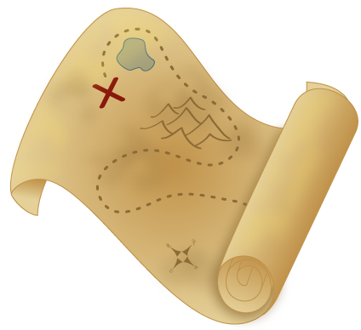
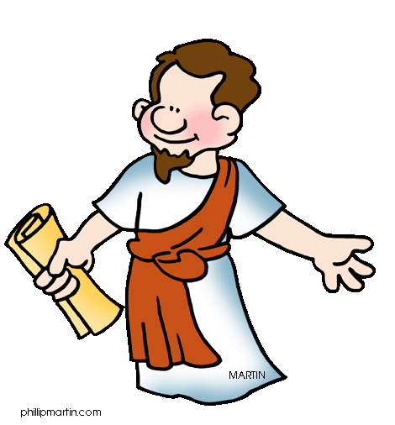
VBS: Journey with Paul
June 29-July 1
9:30-11:00 a.m.
1 year-6th grade
Northwood church of Christ
4601 Northwood Estates Dr.
northwoodchurchofchrist.org
To register or for more info contact Sarah Wright at sarah.wright84@gmail.com

Slide 3
PAUL’S MISSION

Slide 4
PAUL’S MISSION & Me

Slide 5
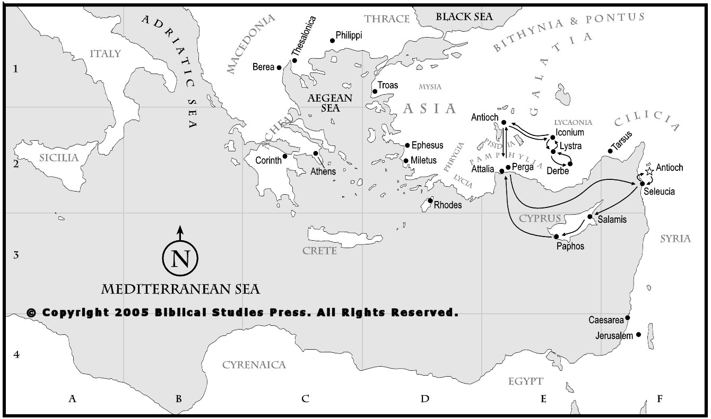
When they had preached the gospel to that city and had made many disciples, they returned to Lystra and to Iconium and to Antioch, strengthening the souls of the disciples, encouraging them to continue in the faith… Acts 14:21-22

Slide 7
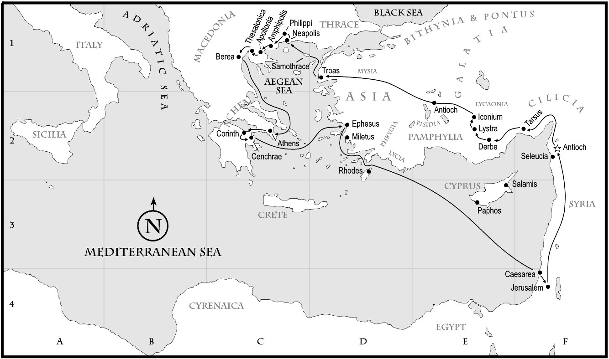

Slide 15
After this, Paul stayed many days longer and then took leave of the brothers and set sail for Syria...
Acts 18:18

Slide 16
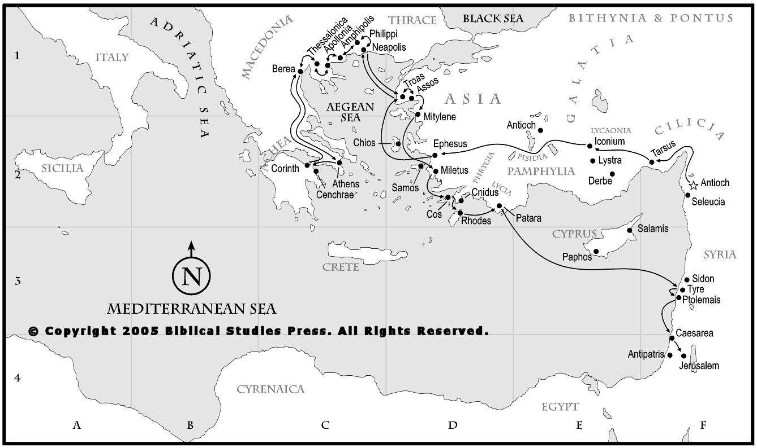
After spending some time there, he departed and went from one place to the next through the region of Galatia and Phrygia, strengthening the disciples.
Acts 18:23

Slide 21
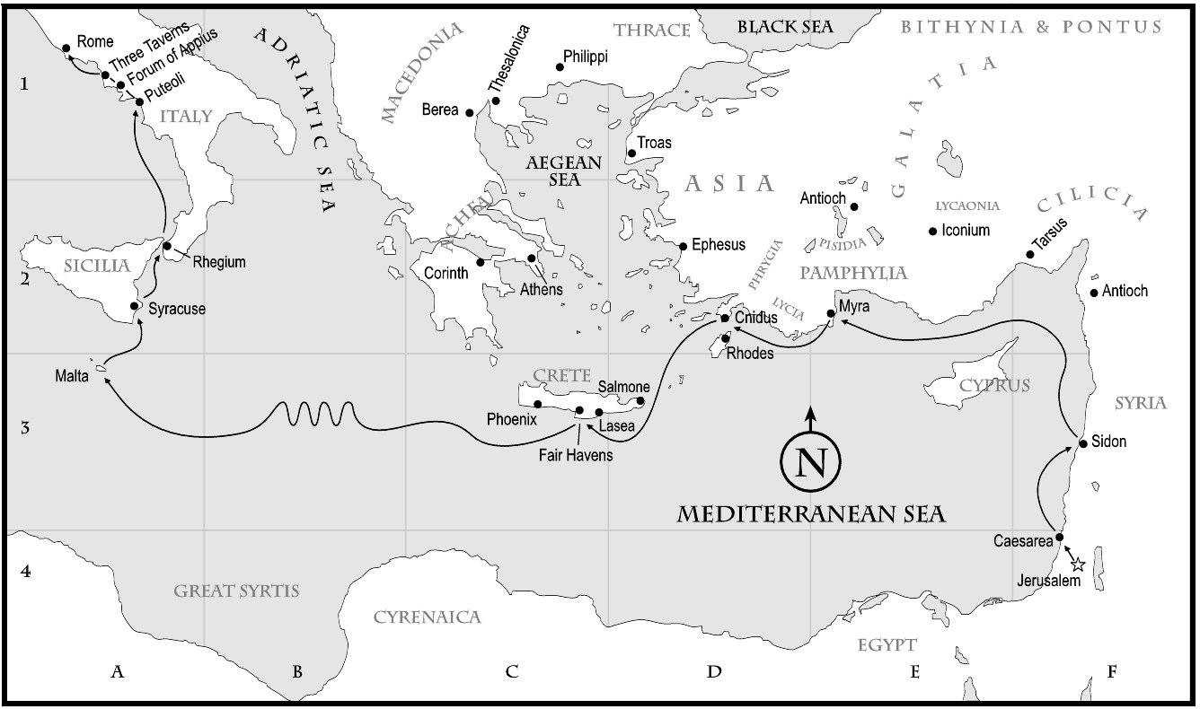

Slide 24
1. Mission calls us out of the safe and comfortable
Paul’s Mission & Me

Slide 25
Acts 13
1 Now there were in the church at Antioch prophets and teachers, Barnabas, Simeon who was called Niger, Lucius of Cyrene, Manaen a lifelong friend of Herod the tetrarch, and Saul. 2 While they were worshiping the Lord and fasting, the Holy Spirit said, “Set apart for me Barnabas and Saul for the work to which I have called them.” 3 Then after fasting and praying they laid their hands on them and sent them off.

Slide 26
Acts 13
1 Now there were in the church at Antioch prophets and teachers, Barnabas, Simeon who was called Niger, Lucius of Cyrene, Manaen a lifelong friend of Herod the tetrarch, and Saul. 2 While they were worshiping the Lord and fasting, the Holy Spirit said, “Set apart for me Barnabas and Saul for the work to which I have called them.” 3 Then after fasting and praying they laid their hands on them and sent them off.

Slide 27
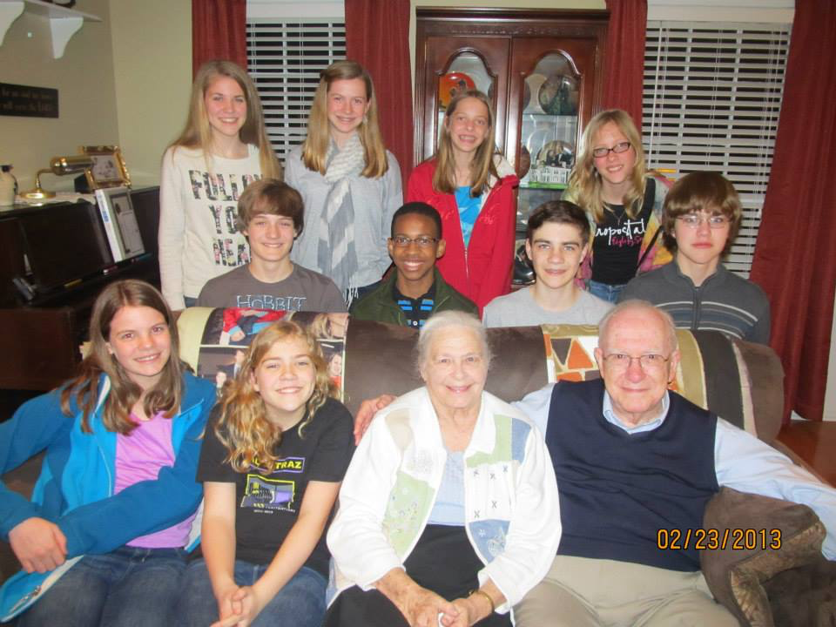

Slide 28
2. Mission begins at home
Paul’s Mission & Me

Slide 29
Acts 13
1 Now there were in the church at Antioch prophets and teachers, Barnabas, Simeon who was called Niger, Lucius of Cyrene, Manaen a lifelong friend of Herod the tetrarch, and Saul. 2 While they were worshiping the Lord and fasting, the Holy Spirit said, “Set apart for me Barnabas and Saul for the work to which I have called them.” 3 Then after fasting and praying they laid their hands on them and sent them off.

Slide 30
Acts 13
1 Now there were in the church at Antioch prophets and teachers, Barnabas, Simeon who was called Niger, Lucius of Cyrene, Manaen a lifelong friend of Herod the tetrarch, and Saul. 2 While they were worshiping the Lord and fasting, the Holy Spirit said, “Set apart for me Barnabas and Saul for the work to which I have called them.” 3 Then after fasting and praying they laid their hands on them and sent them off.

Slide 31
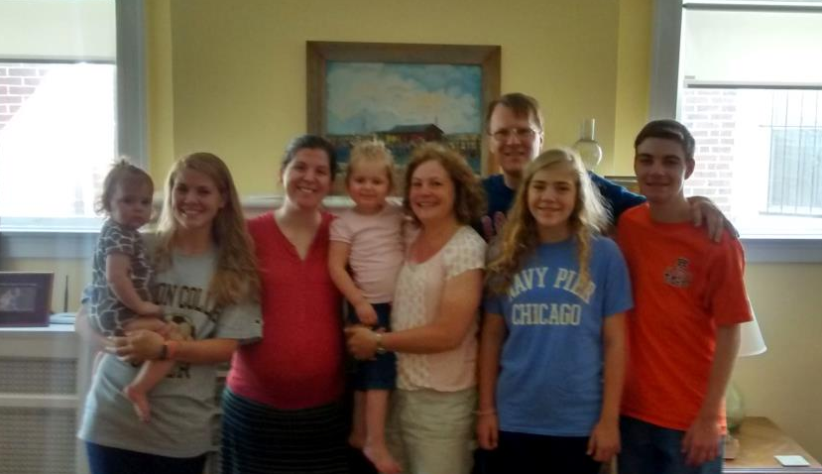

Slide 32
3. Mission is an outgrowth of healthy, growing churches
Paul’s Mission & Me

Slide 33
Acts 13
1 Now there were in the church at Antioch prophets and teachers, Barnabas, Simeon who was called Niger, Lucius of Cyrene, Manaen a lifelong friend of Herod the tetrarch, and Saul. 2 While they were worshiping the Lord and fasting, the Holy Spirit said, “Set apart for me Barnabas and Saul for the work to which I have called them.” 3 Then after fasting and praying they laid their hands on them and sent them off.

Slide 34
Acts 13
1 Now there were in the church at Antioch prophets and teachers, Barnabas, Simeon who was called Niger, Lucius of Cyrene, Manaen a lifelong friend of Herod the tetrarch, and Saul. 2 While they were worshiping the Lord and fasting, the Holy Spirit said, “Set apart for me Barnabas and Saul for the work to which I have called them.” 3 Then after fasting and praying they laid their hands on them and sent them off.

Slide 35
Acts 13
1 Now there were in the church at Antioch prophets and teachers, Barnabas, Simeon who was called Niger, Lucius of Cyrene, Manaen a lifelong friend of Herod the tetrarch, and Saul. 2 While they were worshiping the Lord and fasting, the Holy Spirit said, “Set apart for me Barnabas and Saul for the work to which I have called them.” 3 Then after fasting and praying they laid their hands on them and sent them off.

Slide 36
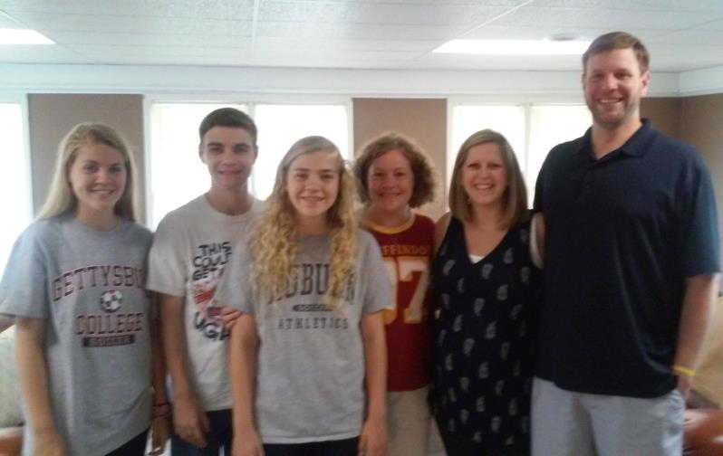

Slide 37
4. Mission tests your commitment
Paul’s Mission & Me

Slide 38
Acts 13
13 Now Paul and his companions set sail from Paphos and came to Perga in Pamphylia. And John left them and returned to Jerusalem, 14 but they went on from Perga and came to Antioch in Pisidia.

Slide 39
Acts 13
12 When we heard this, we and the people there urged him not to go up to Jerusalem. 13 Then Paul answered, “What are you doing, weeping and breaking my heart? For I am ready not only to be imprisoned but even to die in Jerusalem for the name of the Lord Jesus.”

Slide 40
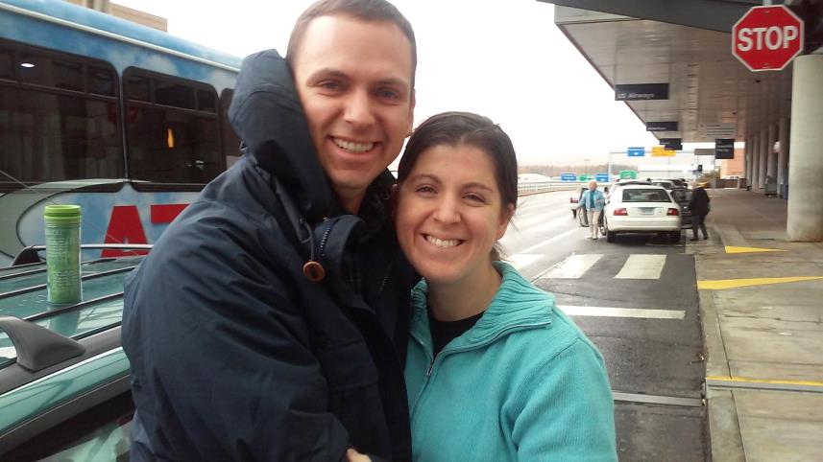

Slide 41
5. Mission makes us like Jesus
Paul’s Mission & Me

Slide 42
The Trials
Jesus | Paul
Sanhedrin, Lk 22:54-71 | Sanhedrin, Acts 22:30-23:10
Pilate, Lk 23:1-5 | Felix, Acts 24:1-27
Herod, Lk 23:6-16 | Festus, Acts 25:1-12
Pilate, Lk 23:17-25 | Herod, Acts 25:13-26:32

Slide 43
The Accusations
Jesus | Paul
Misleading people, Lk 23:2 | Misleading people, Acts 24:5
Opposes Caesar’s decrees, Lk 23:2 | Opposes Caesar’s decrees, Acts 17:7
Stirs up people, Lk 23:5 | Stirs up people, Acts 24:5
Claiming authority of Christ as threat to Caesar, Lk 23:2 | Claiming authority of Christ as threat to Caesar, Acts 17:7

Slide 44
The Verdicts
Jesus | Paul
Pilate – not guilty, Lk 23:4 | Claudius Lysias – not guilty, Acts 23:29
Pilate – not guilty, Lk 23:14 | Pharisees – nothing wrong, Acts 23:9
Pilate – nothing deserving death, Lk 23:15 | Festus – nothing deserving death, Acts 25:25
Pilate – would have released, Lk 23:16, 20 | Agrippa – would have released, Acts 26:32

Slide 45
The Cry of the Multitude
Jesus | Paul
“Away with this man, and release to us Barabbas” Lk 23:18 | “Away with him” Acts 21:36
“Crucify, crucify him!” Lk 23:21 | “Away with such a fellow from the earth! For he should not be allowed to live.” Acts 22:22

Slide 46
Their Foreknowledge
Jesus | Paul
Son of Man delivered into hands of men Lk 9:44 | Agabus predicts delivered to Gentiles Acts 21:10-11
Mocked, shamefully treated, spit upon, flogged, killed Lk 18:32-33 | Imprisonment & afflictions Acts 20:22-23

Slide 47
Their Determination
Jesus | Paul
When the days drew near for him to be taken up, he set his face to go to Jerusalem. Lk 9:51 | Paul resolved in the Spirit to… go to Jerusalem Acts 19:21
Mocked, shamefully treated, spit upon, flogged, killed Lk 18:32-33 | Imprisonment & afflictions Acts 20:22-23

Slide 48
Acts 20
22 And now, behold, I am going to Jerusalem, constrained by the Spirit, not knowing what will happen to me there, 23 except that the Holy Spirit testifies to me in every city that imprisonment and afflictions await me.

Slide 49
Acts 20
22 And now, behold, I am going to Jerusalem, constrained by the Spirit, not knowing what will happen to me there, 23 except that the Holy Spirit testifies to me in every city that imprisonment and afflictions await me.

Slide 50
Acts 21
13 Then Paul answered, “What are you doing, weeping and breaking my heart? For I am ready not only to be imprisoned but even to die in Jerusalem for the name of the Lord Jesus.” 14 And since he would not be persuaded, we ceased and said, “Let the will of the Lord be done.”

Slide 51
Acts 21
13 Then Paul answered, “What are you doing, weeping and breaking my heart? For I am ready not only to be imprisoned but even to die in Jerusalem for the name of the Lord Jesus.” 14 And since he would not be persuaded, we ceased and said, “Let the will of the Lord be done.”

Slide 52
Philippians 3
10 that I may know him and the power of his resurrection, and may share his sufferings, becoming like him in his death…

Slide 53
Reach out to someone who is different
Sign up for training opportunities at Northwood
“Adopt” someone in mission field

