Slide 1
The Wonderful
Grace Of Jesus
2 Corinthians 8-9

Slide 2
¹ Now, brethren, we wish to make known to you the grace of God which has been given in the churches of Macedonia, ² that in a great ordeal of affliction their abundance of joy and their deep poverty overflowed in the wealth of their liberality. ³ For I testify that according to their ability, and beyond their ability, they gave of their own accord, ⁴ begging us with much urging for the favor of participation in the support of the saints… ⁶ So we urged Titus that as he had previously made a beginning, so he would also complete in you this gracious work as well. ⁷ But just as you abound in everything, in faith and utterance and knowledge and in all earnestness and in the love we inspired in you, see that you abound in this gracious work also.
2 Corinthians 8

Slide 3
and not only this, but he has also been appointed by the churches to travel with us in this gracious work, which is being administered by us for the glory of the Lord Himself, and to show our readiness-
2 Cor. 8:19
And God is able to make all grace abound to you, so that always having all sufficiency in everything, you may have an abundance for every good deed;
2 Cor. 9:8

Slide 4
2 Corinthians 8:9
For you know the grace of our Lord Jesus Christ, that though He was rich, yet for your sake He became poor, so that you through His poverty might become rich.
NASB

Slide 5
1. You Are Familiar

Slide 6
2 Corinthians 8:9
For you know the grace of our Lord Jesus Christ, that though He was rich, yet for your sake He became poor, so that you through His poverty might become rich.
NASB

Slide 7
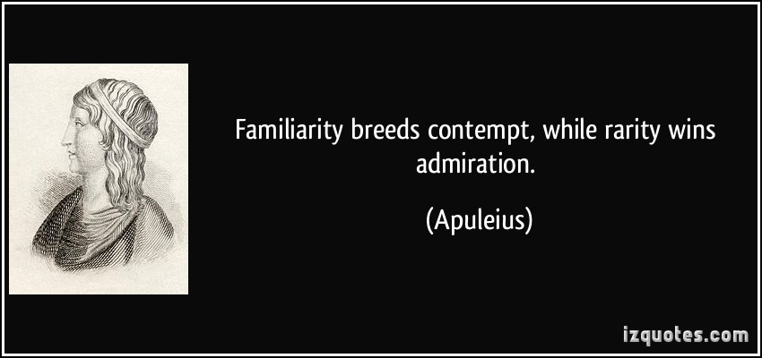

Slide 8
It should completely enrich and complete us- 1 Cor. 1:4-7

Slide 9
It should completely enrich and complete us- 1 Cor. 1:4-7
It can take away our respect and belief- Mk 6:1-6
³ Is not this the carpenter, the son of Mary, and brother of James and Joses and Judas and Simon? Are not His sisters here with us?” And they took offense at Him. ⁴ Jesus said to them, “A prophet is not without honor except in his hometown and among his own relatives and in his own household.” ⁵ And He could do no miracle there except that He laid His hands on a few sick people and healed them. ⁶ And He wondered at their unbelief. Mark 6

Slide 10
It should completely enrich and complete us- 1 Cor. 1:4-7
It can take away our respect and belief- Mk 6:1-6
It can cause us to forget who is with us- Lk. 15:29-32

Slide 11
²⁹ But he answered and said to his father, ‘Look! For so many years I have been serving you and I have never neglected a command of yours; and yet you have never given me a young goat, so that I might celebrate with my friends; ³⁰ but when this son of yours came, who has devoured your wealth with prostitutes, you killed the fattened calf for him.’
³¹ And he said to him, ‘Son, you have always been with me, and all that is mine is yours. ³² But we had to celebrate and rejoice, for this brother of yours was dead and has begun to live, and was lost and has been found.’” Luke 15

Slide 12
2. Jesus Christ Was Rich

Slide 13
2 Corinthians 8:9
For you know the grace of our Lord Jesus Christ, that though He was rich, yet for your sake He became poor, so that you through His poverty might become rich.
NASB

Slide 14
And Jesus said to him, "The foxes have holes and the birds of the air have nests, but the Son of Man has nowhere to lay His head.“ Luke 9:58
Luke 8:1-4- Several helped support Him

Slide 15
John 17
4 I glorified You on the earth, having accomplished the work which You have given Me to do.5 Now, Father, glorify Me together with Yourself, with the glory which I had with You before the world was.

Slide 16
John 17
24 Father, I desire that they also, whom You have given Me, be with Me where I am, so that they may see My glory which You have given Me, for You loved Me before the foundation of the world.

Slide 17
3. Jesus Became Poor.

Slide 18
2 Corinthians 8:9
For you know the grace of our Lord Jesus Christ, that though He was rich, yet for your sake He became poor, so that you through His poverty might become rich.
NASB

Slide 19
⁴ do not merely look out for your own personal interests, but also for the interests of others. ⁵ Have this attitude in yourselves which was also in Christ Jesus, ⁶ who, although He existed in the form of God, did not regard equality with God a thing to be grasped, ⁷ but emptied Himself, taking the form of a bond-servant, and being made in the likeness of men. ⁸ Being found in appearance as a man, He humbled Himself by becoming obedient to the point of death, even death on a cross.
Philippians 2

Slide 20
How did Jesus become poor? Philippians 2
Jesus became a human being. v7-8
Jesus became a servant. v7

Slide 21
4. We Can Be Rich.

Slide 22
2 Corinthians 8:9
For you know the grace of our Lord Jesus Christ, that though He was rich, yet for your sake He became poor, so that you through His poverty might become rich.
NASB

Slide 23
2 Corinthians 5:20-21
²⁰ Therefore, we are ambassadors for Christ, as though God were making an appeal through us; we beg you on behalf of Christ, be reconciled to God. ²¹ He made Him who knew no sin to be sin on our behalf, so that we might become the righteousness of God in Him…

Slide 24
2 Corinthians 6:1-2
1 and working together with him, we also urge you not to receive the grace of God in vain
² for he says, “at the acceptable time I listened to you, and on the day of salvation I helped you.” Behold, now is “the acceptable time,” behold, now is “the day of salvation”

Slide 25
But by the grace of God I am what I am, and His grace toward me did not prove vain; but I labored even more than all of them, yet not I, but the grace of God with me.
1 Cor. 15:10

Slide 26
1. His grace defines me
But by the grace of God I am what I am, and His grace toward me did not prove vain; but I labored even more than all of them, yet not I, but the grace of God with me.
1 Cor. 15:10

Slide 27
1 And you were dead in your trespasses and sins, 2 in which you formerly walked according to the course of this world, according to the prince of the power of the air, of the spirit that is now working in the sons of disobedience... 8 For by grace you have been saved through faith; and that not of yourselves, it is the gift of God; 9 not as a result of works, so that no one may boast. 10 For we are His workmanship, created in Christ Jesus for good works, which God prepared beforehand so that we would walk in them.
Ephesians 2

Slide 28
2. His grace will not be wasted
But by the grace of God I am what I am, and His grace toward me did not prove vain; but I labored even more than all of them, yet not I, but the grace of God with me.
1 Cor. 15:10

Slide 29
³ For through the grace given to me I say to everyone among you not to think more highly of himself than he ought to think; but to think so as to have sound judgment, as God has allotted to each a measure of faith. ⁴ For just as we have many members in one body and all the members do not have the same function, ⁵ so we, who are many, are one body in Christ, and individually members one of another. ⁶ Since we have gifts that differ according to the grace given to us, each of us is to exercise them accordingly:
Ephesians 2

Slide 30
9 as unknown yet well-known, as dying yet behold, we live; as punished yet not put to death,
10 as sorrowful yet always rejoicing, as poor yet making many rich, as having nothing yet possessing all things.
2 Corinthians 6

Slide 31
3. His grace motivates me
But by the grace of God I am what I am, and His grace toward me did not prove vain; but I labored even more than all of them, yet not I, but the grace of God with me.
1 Cor. 15:10

Slide 32
How much severer punishment do you think he will deserve who has trampled under foot the Son of God, and has regarded as unclean the blood of the covenant by which he was sanctified, and has insulted the Spirit of grace?
Hebrews 10:29

Slide 33
⁷ But whatever things were gain to me, those things I have counted as loss for the sake of Christ. ⁸ More than that, I count all things to be loss in view of the surpassing value of knowing Christ Jesus my Lord, for whom I have suffered the loss of all things, and count them but rubbish so that I may gain Christ, ⁹ and may be found in Him, not having a righteousness of my own derived from the Law, but that which is through faith in Christ, the righteousness which comes from God on the basis of faith,
Philippians 3

Slide 34
Do we want to go heaven more than anything else.
Does our excitement that God would let us overwhelm?
After all we have done against it…are we joyful to be a part of God’s plan
Why would we do anything other than give our life to our gracious God- Rom 12:2

