Slide 1
Welcome to Northwood

Slide 2
THE WEAPONS OF OUR WARFARE

Slide 3
We are in a spiritual conflict
The Weapons of Our Warfare

Slide 4
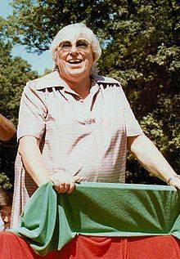
“I’ll tell you, Mr. Thomas, why some Christians are afraid of me. They’re not sure that what they believe is really true. If they were sure, I wouldn’t be a threat to them at all.”
Madeline Murray O’Hair

Slide 5
3 For though we walk in the flesh, we are not waging war according to the flesh. 4 For the weapons of our warfare are not of the flesh but have divine power to destroy strongholds.

Slide 6
3 For though we walk in the flesh, we are not waging war according to the flesh. 4 For the weapons of our warfare are not of the flesh but have divine power to destroy strongholds.

Slide 7
3 For though we walk in the flesh, we are not waging war according to the flesh. 4 For the weapons of our warfare are not of the flesh but have divine power to destroy strongholds.

Slide 8
3 For though we walk in the flesh, we are not waging war according to the flesh. 4 For the weapons of our warfare are not of the flesh but have divine power to destroy strongholds.

Slide 9
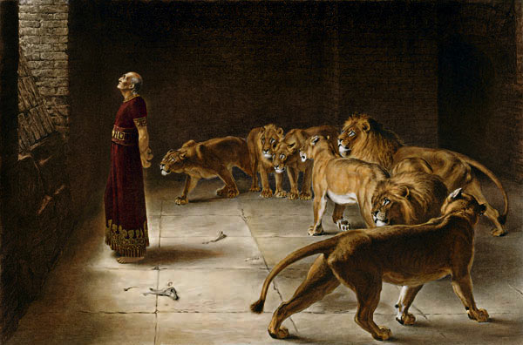

Slide 10
The battle is for the mind
The Weapons of Our Warfare

Slide 11
“At least in the beginning we are seeking public desensitization and nothing more. We do not need and cannot expect full ‘appreciation’ or ‘understanding’ of homosexuality from the average American. You can forget about trying to persuade the masses that homosexuality is a good thing. But if you can only get them to think that is just another thing, with a shrug of the shoulders, then your battle for legal and social rights is virtually won.”

Slide 12
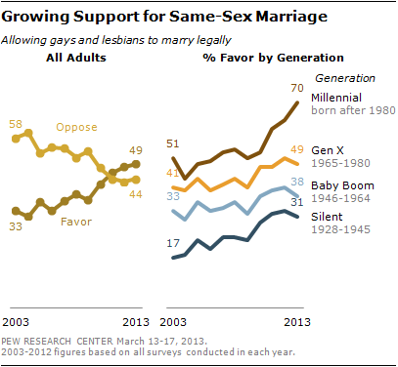

Slide 13
5 We destroy arguments and every lofty opinion raised against the knowledge of God, and take every thought captive to obey Christ…

Slide 14
5 We destroy arguments and every lofty opinion raised against the knowledge of God, and take every thought captive to obey Christ…

Slide 15
5 We destroy arguments and every lofty opinion raised against the knowledge of God, and take every thought captive to obey Christ…

Slide 16
5 We destroy arguments and every lofty opinion raised against the knowledge of God, and take every thought captive to obey Christ…

Slide 17
5 We destroy arguments and every lofty opinion raised against the knowledge of God, and take every thought captive to obey Christ…

Slide 18
We win with Christ, not the flesh
The Weapons of Our Warfare

Slide 19
1 I, Paul, myself entreat you, by the meekness and gentleness of Christ

Slide 20
“In short, the practice of compassion a century ago and today, means giving a woman undergoing a crisis pregnancy a physical home and a spiritual rock. It means the adoption of hard-to-place children. It means counseling and standing by desperate women. Particularly in a politics-obsessed age, the one-to-one practice of compassion may be less thrilling and may seem less important than dramatic protests or power politicking, but it is the major way in which lives have been saved… yes, protective laws and enforcement help, but the most effective pro-life efforts have always concentrated on one life at a time.” (Marvin Olasky, Abortion Rites: A Social History of Abortion in America)

Slide 21
“In short, the practice of compassion a century ago and today, means giving a woman undergoing a crisis pregnancy a physical home and a spiritual rock. It means the adoption of hard-to-place children. It means counseling and standing by desperate women. Particularly in a politics-obsessed age, the one-to-one practice of compassion may be less thrilling and may seem less important than dramatic protests or power politicking, but it is the major way in which lives have been saved… yes, protective laws and enforcement help, but the most effective pro-life efforts have always concentrated on one life at a time.” (Marvin Olasky, Abortion Rites: A Social History of Abortion in America)

Slide 22
“In short, the practice of compassion a century ago and today, means giving a woman undergoing a crisis pregnancy a physical home and a spiritual rock. It means the adoption of hard-to-place children. It means counseling and standing by desperate women. Particularly in a politics-obsessed age, the one-to-one practice of compassion may be less thrilling and may seem less important than dramatic protests or power politicking, but it is the major way in which lives have been saved… yes, protective laws and enforcement help, but the most effective pro-life efforts have always concentrated on one life at a time.” (Marvin Olasky, Abortion Rites: A Social History of Abortion in America)

Slide 23
Speak the truth in love
Seek approval of Divine Judge
Love all our neighbors
Be at peace with all men
Shine your light in the world

