Slide 1
Welcome to Northwood

Slide 2
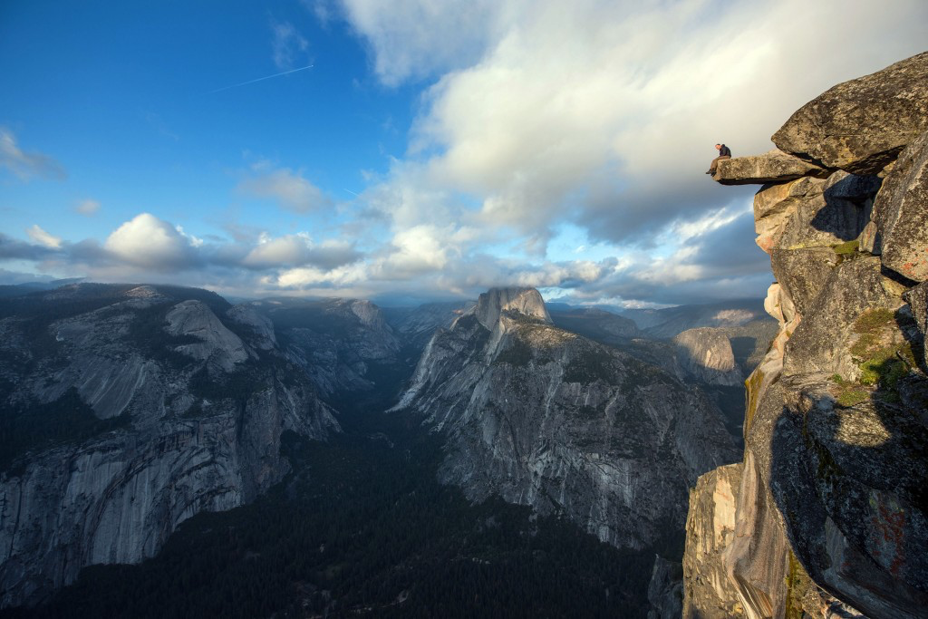
I Have Been
Crucified
With Christ

Slide 3
The action
I Have Been Crucified With Christ

Slide 4
I have been crucified with Christ.

Slide 5
I have been crucified with Christ.

Slide 6
And he said to all, “If anyone would come after me, let him deny himself and take up his cross daily and follow me.”
Luke 9:23

Slide 7
And those who belong to Christ Jesus have crucified the flesh with its passions and desires.
Galatians 6:24

Slide 8
Put to death therefore what is earthly in you…
Colossians 3:5

Slide 9
The result
I Have Been Crucified With Christ

Slide 10
It is no longer I who live, but Christ who lives in me.

Slide 11
It is no longer I who live, but Christ who lives in me.

Slide 12
It is no longer I who live, but Christ who lives in me.
Greek: EGO

Slide 13
For the desires of the flesh are against the Spirit, and the desires of the Spirit are against the flesh, for these are opposed to each other, to keep you from doing the things you want to do.
Galatians 5:17

Slide 14
Do not lie to one another, seeing that you have put off the old self with its practices and have put on the new self, which is being renewed in knowledge after the image of its creator.
Colossians 3:9-10

Slide 15
To them God chose to make known how great among the Gentiles are the riches of the glory of this mystery, which is Christ in you, the hope of glory.
Colossians 1:27

Slide 16
The motivation
I Have Been Crucified With Christ

Slide 17
And the life I now live in the flesh I live by faith in the Son of God, who loved me and gave himself for me.

Slide 18
And the life I now live in the flesh I live by faith in the Son of God, who loved me and gave himself for me.

Slide 19
And the life I now live in the flesh I live by faith in the Son of God, who loved me and gave himself for me.

Slide 20
And the life I now live in the flesh I live by faith in the Son of God, who loved me and gave himself for me.

Slide 21
For the love of Christ controls us, because we have concluded this: that one has died for all, therefore all have died; and he died for all, that those who live might no longer live for themselves but for him who for their sake died and was raised.
2 Corinthians 5:14-15

Slide 22
For the love of Christ controls us, because we have concluded this: that one has died for all, therefore all have died; and he died for all, that those who live might no longer live for themselves but for him who for their sake died and was raised.
2 Corinthians 5:14-15

Slide 23
For the love of Christ controls us, because we have concluded this: that one has died for all, therefore all have died; and he died for all, that those who live might no longer live for themselves but for him who for their sake died and was raised.
2 Corinthians 5:14-15

Slide 24
Accept the fact that you are nothing without Him.
Look for remnants of the old self that have refused to die.
Kill every last part of the old self. Do whatever it takes. Be violent!
Let His love take control!

