Slide 1
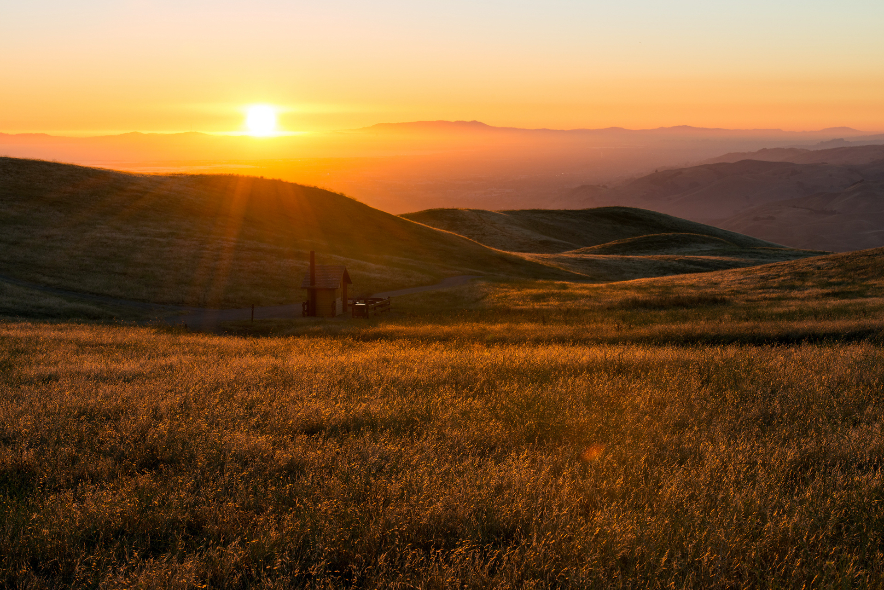
Welcome to Northwood!

Slide 2
12
minor
Prophets
Hosea Joel Amos Obadiah Jonah Micah
Nahum Habakkuk Zephaniah Haggai Zechariah Malachi

Slide 3
OBADIAH
THE MINOR PROPHETS
JOEL
(who preached a MAJOR message!)
JONAH
NAHUM
AMOS
ZEPHANIAH
HOSEA
HABAKKUK
MICAH
HAGGAI
931
721
ZECHARIAH
586
MALACHI
Assyrian captivity
597
539
516
445
605
520
Jerusalem
destroyed
Walls
rebuilt
Kingdom divided
Temple work
resumed
2nd Deportation: Ezekiel
Cyrus’ decree
Temple
completed
1st Deportation: Daniel

Slide 4
Who Said That?
“Behold, I send my messenger, and he will prepare the way before me. And the Lord whom you seek will suddenly come to his temple; and the messenger of the covenant in whom you delight, behold, he is coming, says the Lord of hosts.”
3:1
MALACHI

Slide 5
Who Said That?
“When Israel was a child, I loved him,
and out of Egypt I called my son.”
11:1
HOSEA

Slide 6
Who Said That?
“…when they look on me, on him whom they have pierced, they shall mourn for him, as one mourns for an only child, and weep bitterly over him, as one weeps over a firstborn.”
12:10
ZECHARIAH

Slide 7
Who Said That?
“And it shall come to pass afterward,
that I will pour out my Spirit on all flesh;
your sons and your daughters shall prophesy,
your old men shall dream dreams,
and your young men shall see visions.
Even on the male and female servants
in those days I will pour out my Spirit.”
2:28-29
JOEL

Slide 8
Who Said That?
“Prepare to meet your God, O Israel!”
4:12
AMOS

Slide 9
Who Said That?
“But you, O Bethlehem Ephrathah,
who are too little to be among the clans of Judah,
from you shall come forth for me
one who is to be ruler in Israel,
whose coming forth is from of old,
from ancient days.”
5:2
MICAH

Slide 10
Who Said That?
“The latter glory of this house shall be greater than the former, says the Lord of hosts. And in this place I will give peace, declares the Lord of hosts.”
2:9
HAGGAI

Slide 11
Who Said That?
“…the just shall live by his faith.”
2:9 (KJV)
HABAKKUK

Slide 12
Who Said That?
“And he prayed to the Lord and said, “O Lord, is not this what I said when I was yet in my country? That is why I made haste to flee to Tarshish; for I knew that you are a gracious God and merciful, slow to anger and abounding in steadfast love, and relenting from disaster.”
4:2
JONAH

Slide 13
Who Said That?
“The pride of your heart has deceived you,
you who live in the clefts of the rock,
in your lofty dwelling,
who say in your heart,
“Who will bring me down to the ground?””
1:3
OBADIAH

Slide 14
Who Said That?
“The Lord is good,
a stronghold in the day of trouble;
he knows those who take refuge in him.
But with an overflowing flood
he will make a complete end of the adversaries,
and will pursue his enemies into darkness.”
1:7-8
NAHUM

Slide 15
Who Said That?
“At that time I will search Jerusalem with lamps,
and I will punish the men
who are complacent,
those who say in their hearts,
‘The Lord will not do good,
nor will he do ill.’”
1:12
ZEPHANIAH

Slide 16
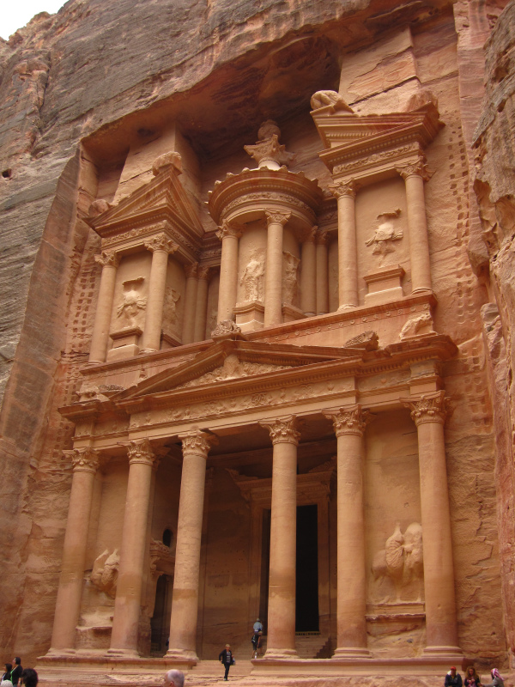
Obadiah
Pride Goes Before a Fall

Slide 17
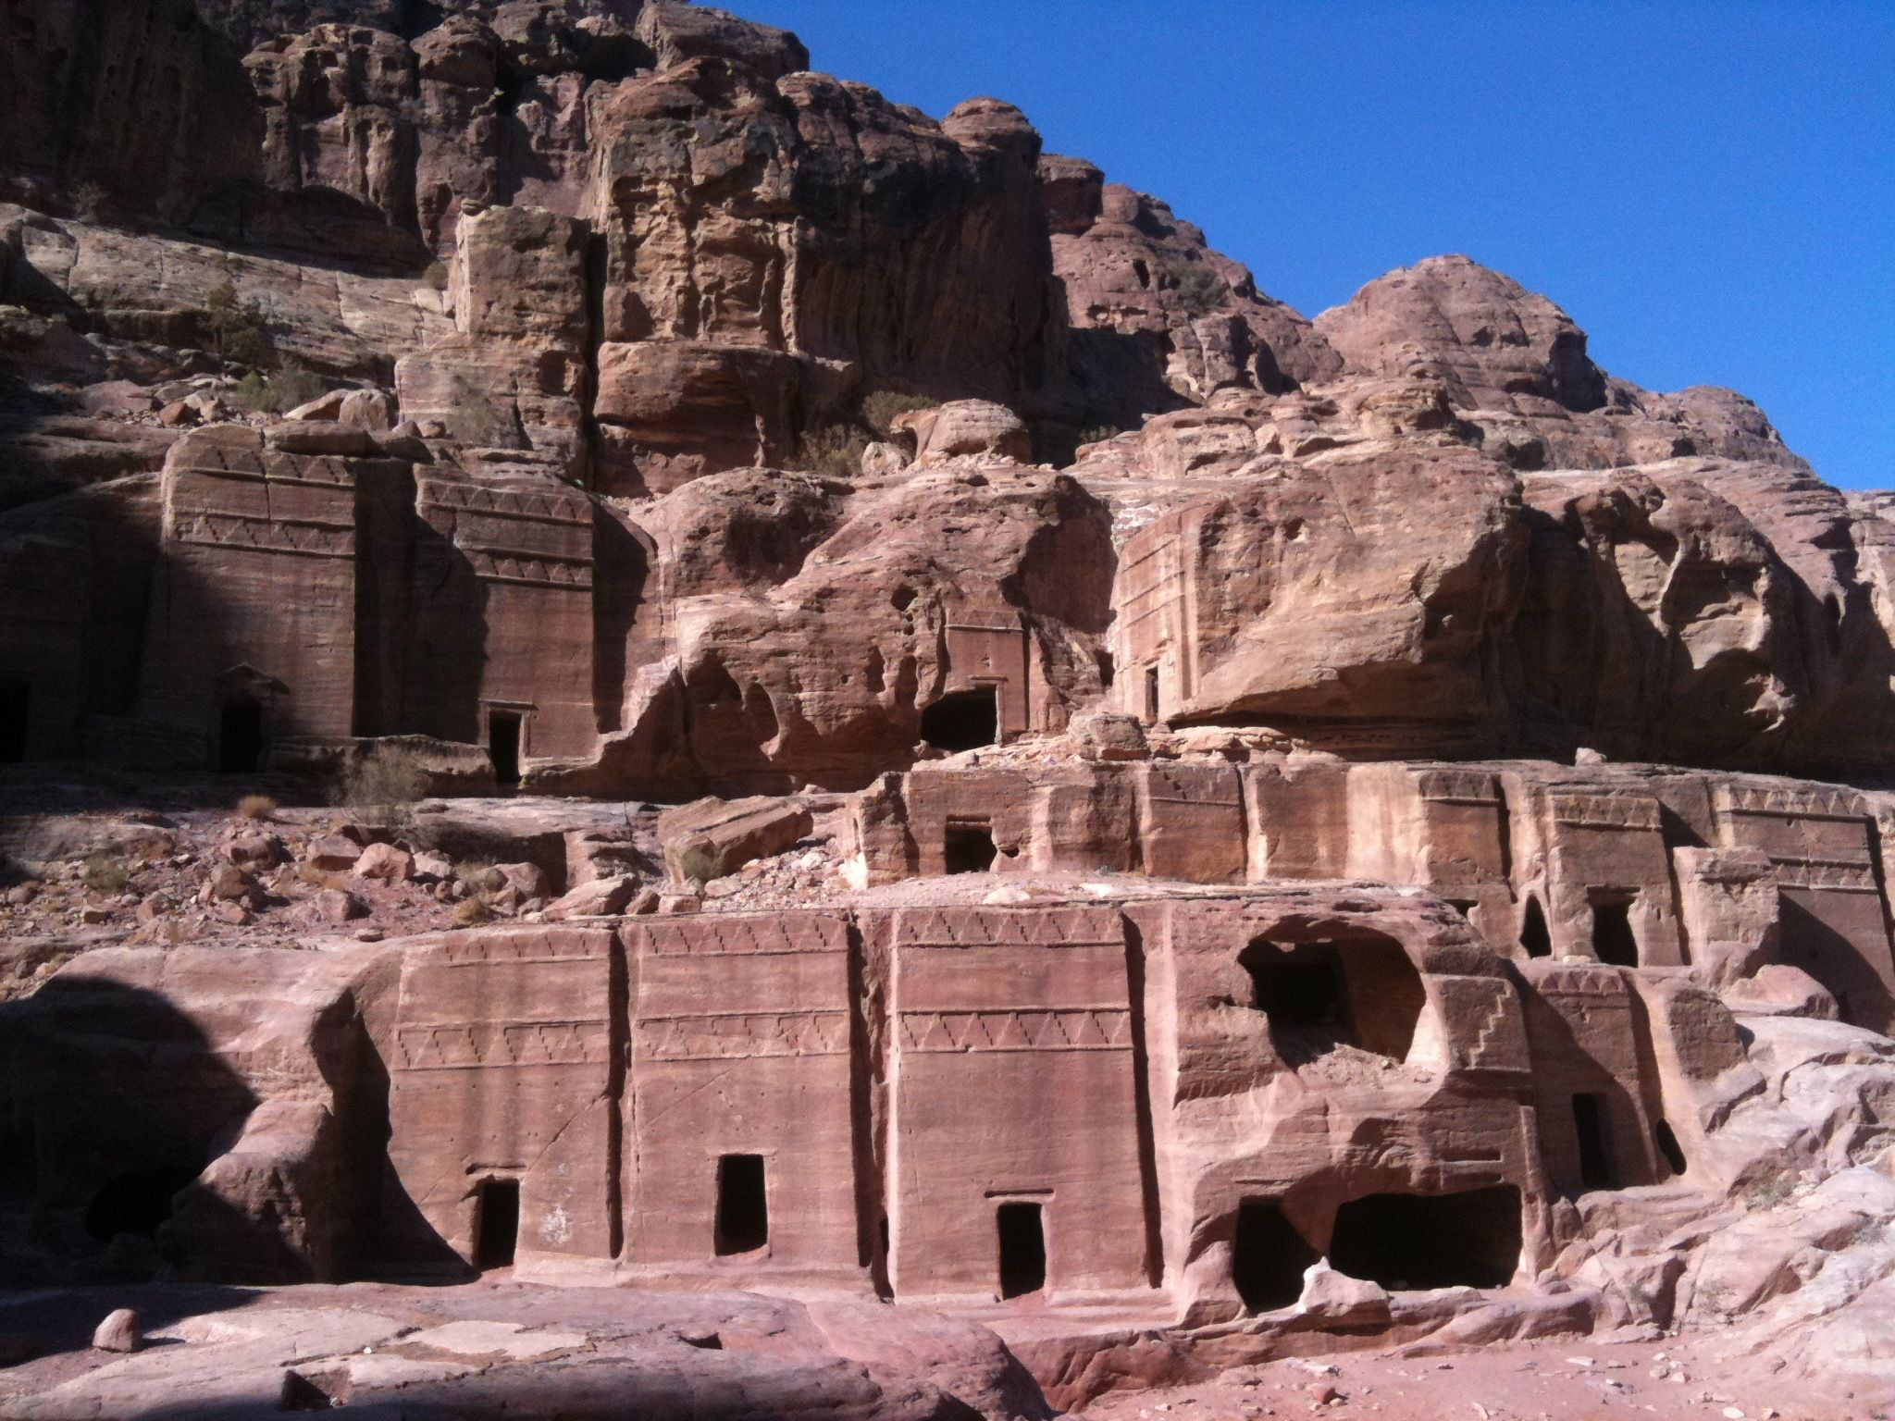

Slide 18
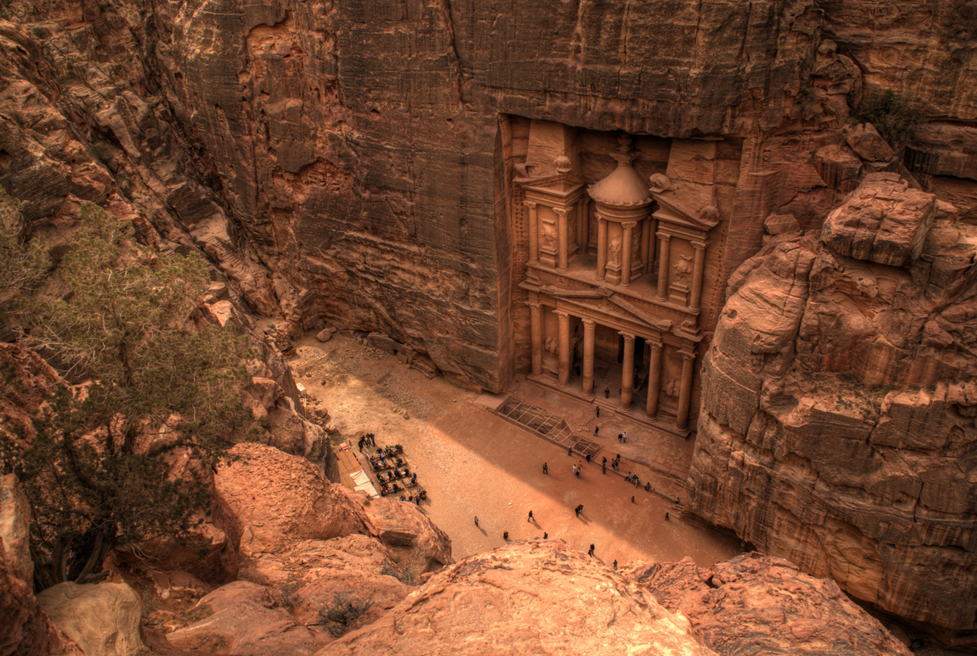

Slide 19
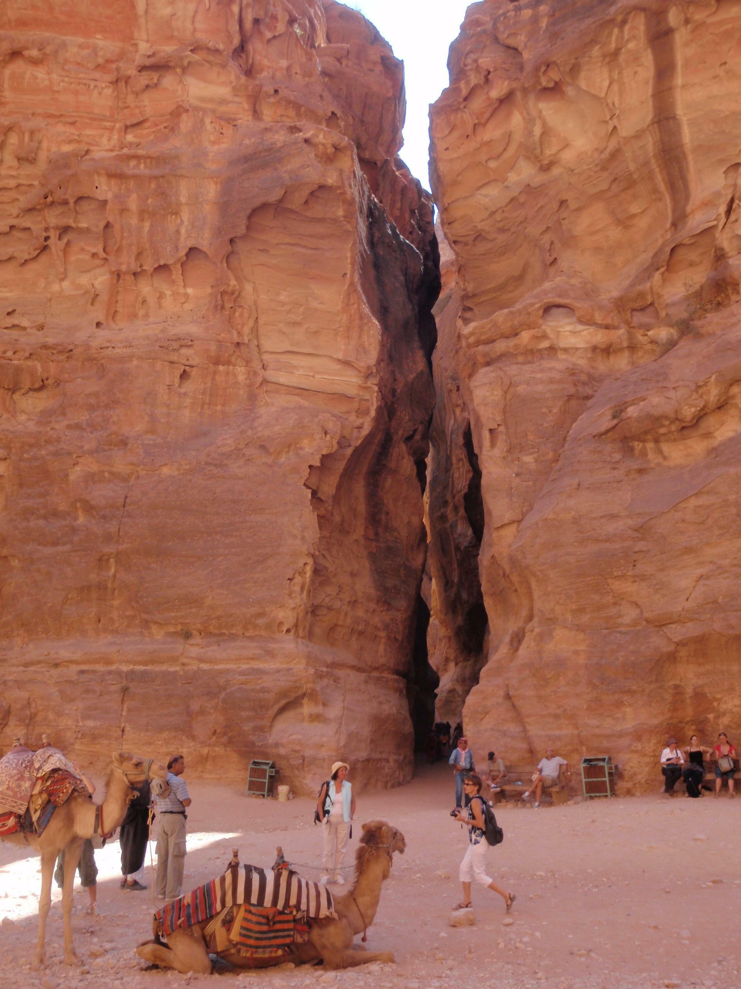

Slide 20
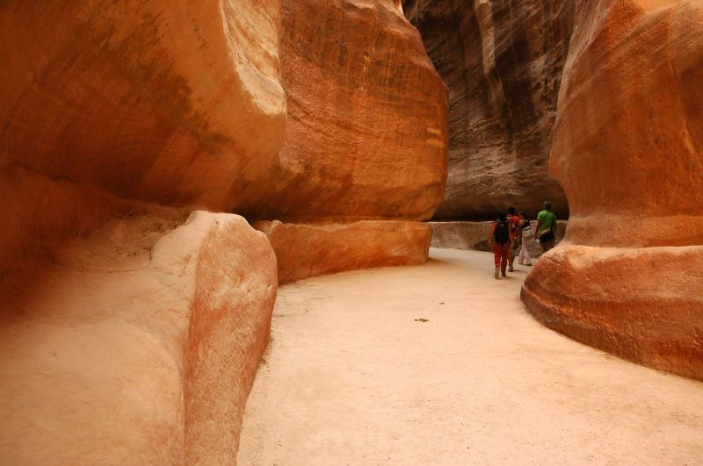

Slide 21
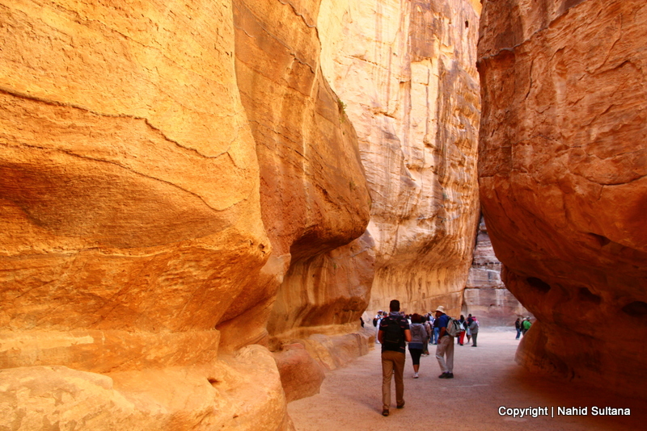

Slide 22
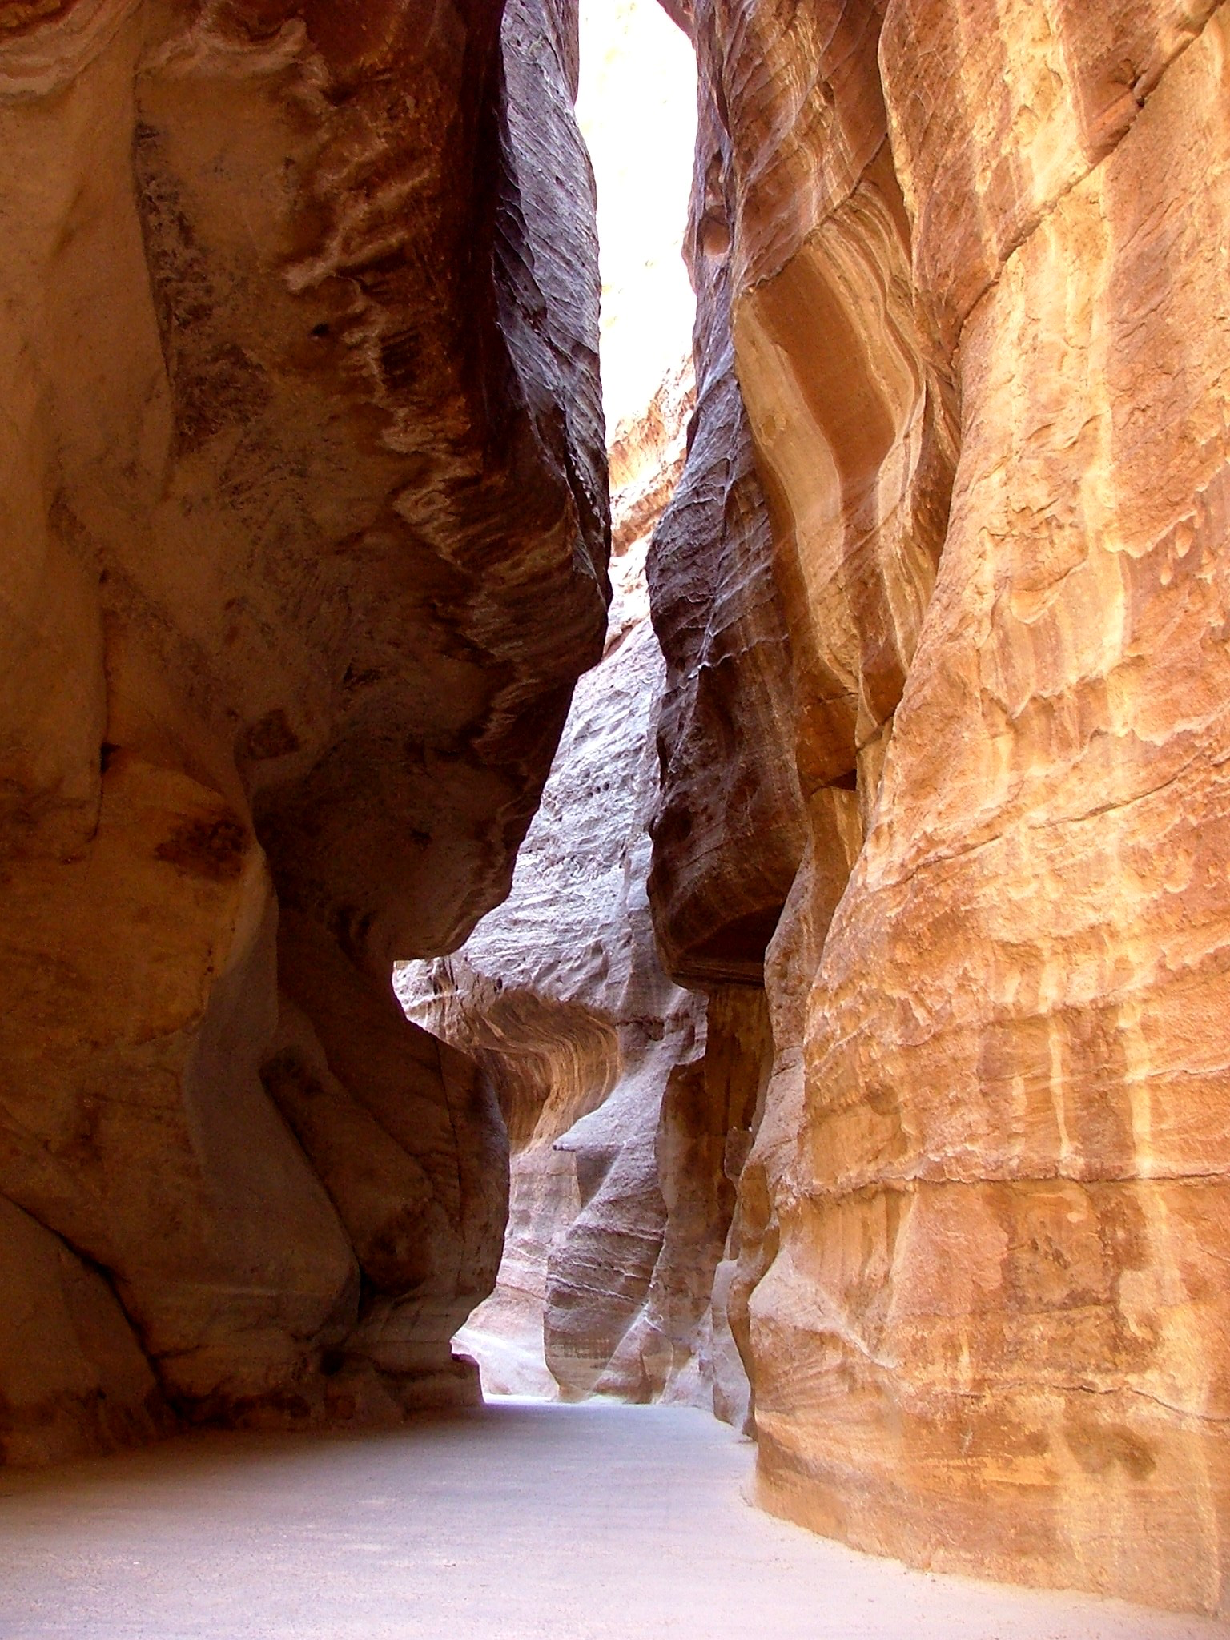

Slide 23
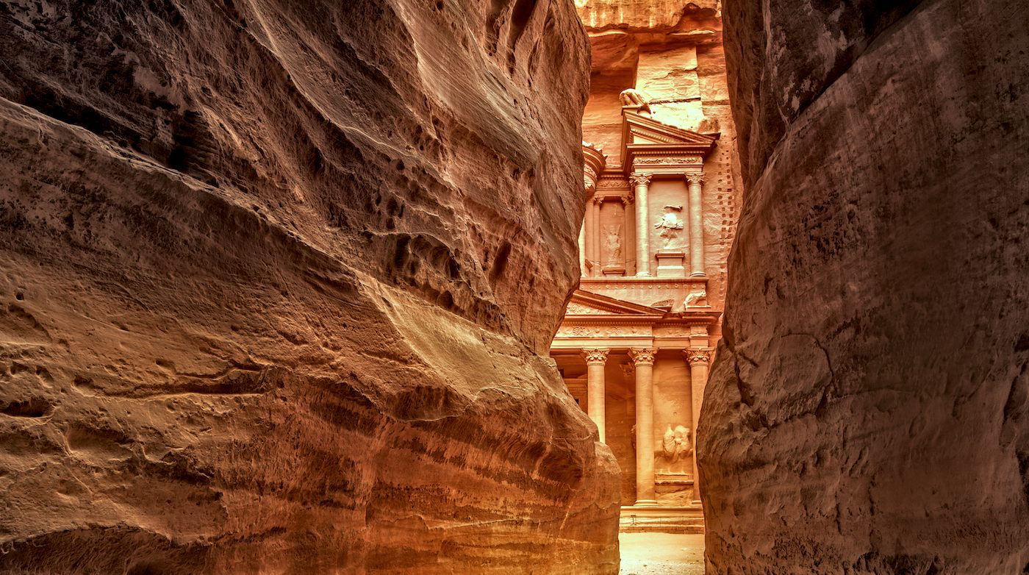

Slide 24
A devastating side effect of pride
Obadiah: Pride Goes Before a Fall

Slide 25
Obadiah 3
The pride of your heart has deceived you, you who live in the clefts of the rock, in your lofty dwelling, who say in your heart, “Who will bring me down to the ground?”

Slide 26
The things in which edom took pride
Obadiah: Pride Goes Before a Fall

Slide 27
How Esau has been pillaged, his treasures sought out! (v 6)
All your allies have driven you to your border… (v 7)
Will I not on that day, declares the Lord, destroy the wise men of Edom…? (v 8)
And your mighty men shall be dismayed, O Teman… (v 9)

Slide 28
The reason edom was judged
Obadiah: Pride Goes Before a Fall

Slide 29
On the day that you stood aloof… (v 11)
But do not gloat over the day of your brother in the day of his misfortune; do not rejoice over the people of Judah in the day of their ruin; do not boast in the day of distress. (v 12)
Do not enter the gate of my people in the day of their calamity; do not gloat over his disaster in the day of calamity; do not loot his wealth in the day of his calamity. (v 13)
Do not stand at the crossroads to hand over his fugitives… (v 14)

Slide 30
The problem: Pride & Indifference

Slide 31
What motivated their sin?
Obadiah: Pride Goes Before a Fall

Slide 32
Obadiah 10
Because of the violence done to your brother Jacob…

Slide 34
The problem: Pride & Indifference
The solution: Brokenness & Vulnerability

Slide 35
Which mountain will stand?
Obadiah: Pride Goes Before a Fall

Slide 36
Obadiah 18
The house of Jacob shall be a fire, and the house of Joseph a flame, and the house of Esau stubble; they shall burn them and consume them, and there shall be no survivor for the house of Esau, for the Lord has spoken.

Slide 37
Obadiah 21
Saviors shall go up to Mount Zion to rule Mount Esau, and the kingdom shall be the Lord’s.

Slide 38
The problem: Pride & Indifference
The solution: Brokenness & Vulnerability

