Slide 1
Welcome to Northwood!

Slide 2
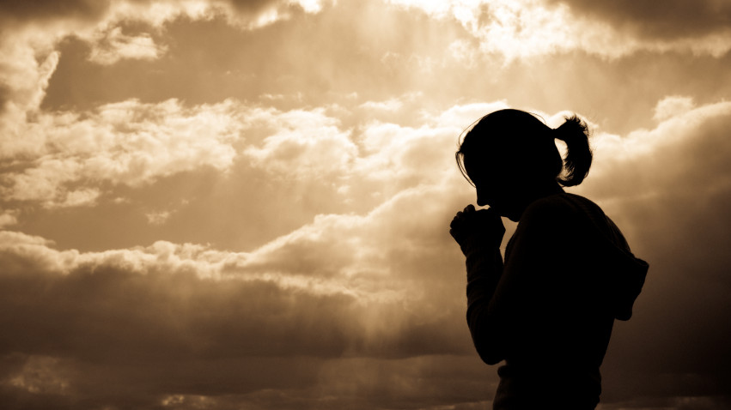
Breaking Free from the
Pharisee in Me

Slide 3
Shutting the door of the kingdom
Woe #1

Slide 4
Matthew 23:13
“But woe to you, scribes and Pharisees, hypocrites! For you shut the kingdom of heaven in people's faces. For you neither enter yourselves nor allow those who would enter to go in.”

Slide 5
Matthew 23:13
“But woe to you, scribes and Pharisees, hypocrites! For you shut the kingdom of heaven in people's faces. For you neither enter yourselves nor allow those who would enter to go in.”

Slide 6
Negative evangelism
Woe #2

Slide 7
Matthew 23:15
Woe to you, scribes and Pharisees, hypocrites! For you travel across sea and land to make a single proselyte, and when he becomes a proselyte, you make him twice as much a child of hell as yourselves.

Slide 8
Matthew 23:15
Woe to you, scribes and Pharisees, hypocrites! For you travel across sea and land to make a single proselyte, and when he becomes a proselyte, you make him twice as much a child of hell as yourselves.

Slide 9
Creative lying
Woe #3

Slide 10
Matthew 23:16-17
“Woe to you, blind guides, who say, ‘If anyone swears by the temple, it is nothing, but if anyone swears by the gold of the temple, he is bound by his oath.’ You blind fools! For which is greater, the gold or the temple that has made the gold sacred?

Slide 11
Matthew 23:16-17
“Woe to you, blind guides, who say, ‘If anyone swears by the temple, it is nothing, but if anyone swears by the gold of the temple, he is bound by his oath.’ You blind fools! For which is greater, the gold or the temple that has made the gold sacred?

Slide 12
Matthew 23:16-17
“Woe to you, blind guides, who say, ‘If anyone swears by the temple, it is nothing, but if anyone swears by the gold of the temple, he is bound by his oath.’ You blind fools! For which is greater, the gold or the temple that has made the gold sacred?

Slide 13
Straining gnats and swallowing camels
Woe #4

Slide 14
Matthew 23:23
“Woe to you, scribes and Pharisees, hypocrites! For you tithe mint and dill and cumin, and have neglected the weightier matters of the law: justice and mercy and faithfulness. These you ought to have done, without neglecting the others.”

Slide 15
Matthew 23:23
“Woe to you, scribes and Pharisees, hypocrites! For you tithe mint and dill and cumin, and have neglected the weightier matters of the law: justice and mercy and faithfulness. These you ought to have done, without neglecting the others.”

Slide 16
Putting on a good show
Woe #5

Slide 17
Matthew 23:25-26
“Woe to you, scribes and Pharisees, hypocrites! For you clean the outside of the cup and the plate, but inside they are full of greed and self-indulgence. You blind Pharisee! First clean the inside of the cup and the plate, that the outside also may be clean.”

Slide 18
Matthew 23:25-26
“Woe to you, scribes and Pharisees, hypocrites! For you clean the outside of the cup and the plate, but inside they are full of greed and self-indulgence. You blind Pharisee! First clean the inside of the cup and the plate, that the outside also may be clean.”

Slide 19
Putting on a good show (part 2)
Woe #6

Slide 20
Matthew 23:27-28
“Woe to you, scribes and Pharisees, hypocrites! For you are like whitewashed tombs, which outwardly appear beautiful, but within are full of dead people's bones and all uncleanness. So you also outwardly appear righteous to others, but within you are full of hypocrisy and lawlessness.”

Slide 21
Matthew 23:27-28
“Woe to you, scribes and Pharisees, hypocrites! For you are like whitewashed tombs, which outwardly appear beautiful, but within are full of dead people's bones and all uncleanness. So you also outwardly appear righteous to others, but within you are full of hypocrisy and lawlessness.”

Slide 22
Persecuting those who point out your sins
Woe #7

Slide 23
Matthew 23:29-31
“Woe to you, scribes and Pharisees, hypocrites! For you build the tombs of the prophets and decorate the monuments of the righteous, saying, ‘If we had lived in the days of our fathers, we would not have taken part with them in shedding the blood of the prophets.’ Thus you witness against yourselves that you are sons of those who murdered the prophets.”

Slide 24
Matthew 23:29-31
“Woe to you, scribes and Pharisees, hypocrites! For you build the tombs of the prophets and decorate the monuments of the righteous, saying, ‘If we had lived in the days of our fathers, we would not have taken part with them in shedding the blood of the prophets.’ Thus you witness against yourselves that you are sons of those who murdered the prophets.”

Slide 25
Humble yourself in honest confession about your brokenness.
Ask God to expose your pride.
Do justice, love kindness, and walk humbly with your God.

