Slide 1
Making Disciples
The Call to Make Disciples (Part 1)

Slide 2
Matthew 28:18-20
“All authority has been given to Me in heaven and on earth. Go therefore and make disciples of all the nations baptizing them in the name of the Father and the Son and the Holy Spirit, teaching them to observe all that I commanded you.”

Slide 3
“Go”

Slide 4
“Make Disciples”

Slide 5
“of all the nations”

Slide 6
“Baptizing them in the name of the Father, and the Son, and the Holy Spirit”

Slide 7
“teaching them to observe all that I commanded you;”

Slide 8
“And lo, I am with you always even to the end of the age.”

Slide 9
Making Disciples
The Call to Make Disciples (Part 1)

Slide 10
Making Disciples in NYC
Matthew 28:18-20
Where & How to Start Sharing in Evangelism

Slide 11
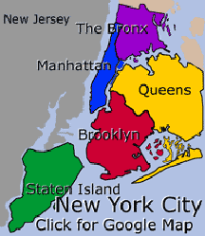
New York City
8.5 million people
305 sq. miles
5 Boroughs:
Manhattan
Queens
Brooklyn
Staten Island
Bronx
All are on islands except The Bronx.

Slide 12
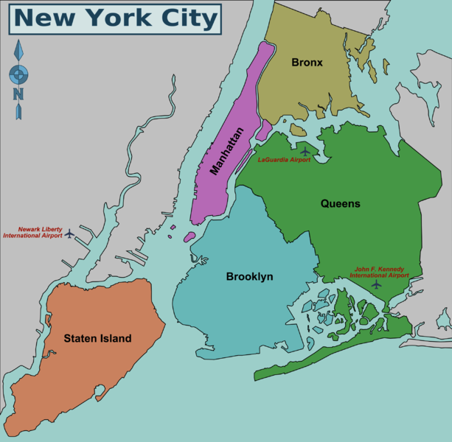

Slide 14
Downtown Manhattan

Slide 15
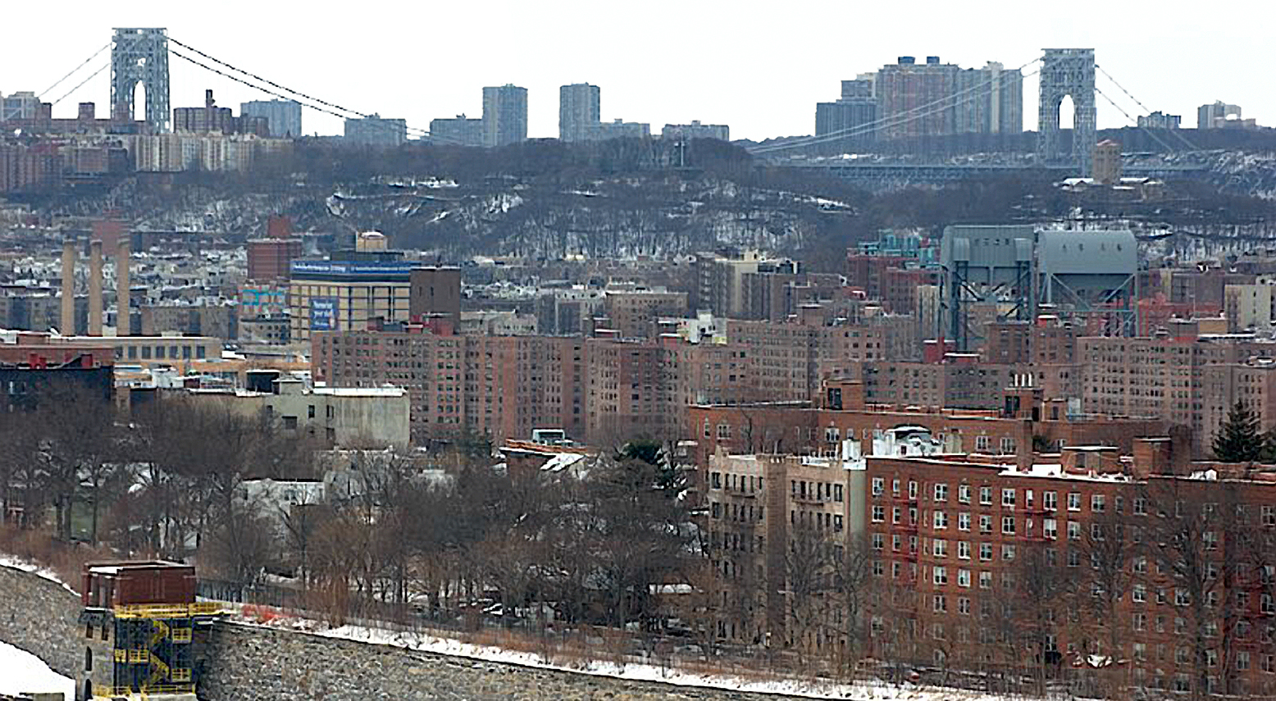
Uptown Manhattan & the Bronx

Slide 16
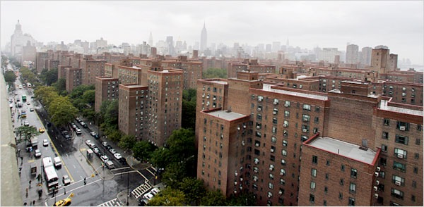

Slide 17
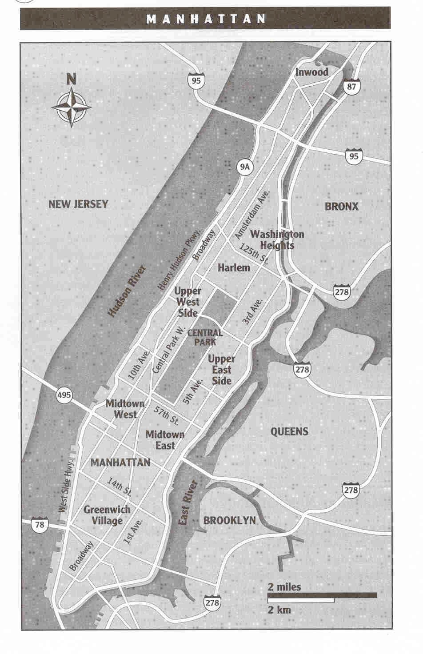
West Harlem
church of Christ
Manhattan –
the most famous
part of NY, an island
with Central Park
In the center.
Notes:
Note all the tourist stuff!
Note the church’s location.
On an island 13 miles long & a couple wide at the widest.
You see Central Park.

Slide 18
Where Do We Go to Evangelize
Where Should I Start?

Slide 19
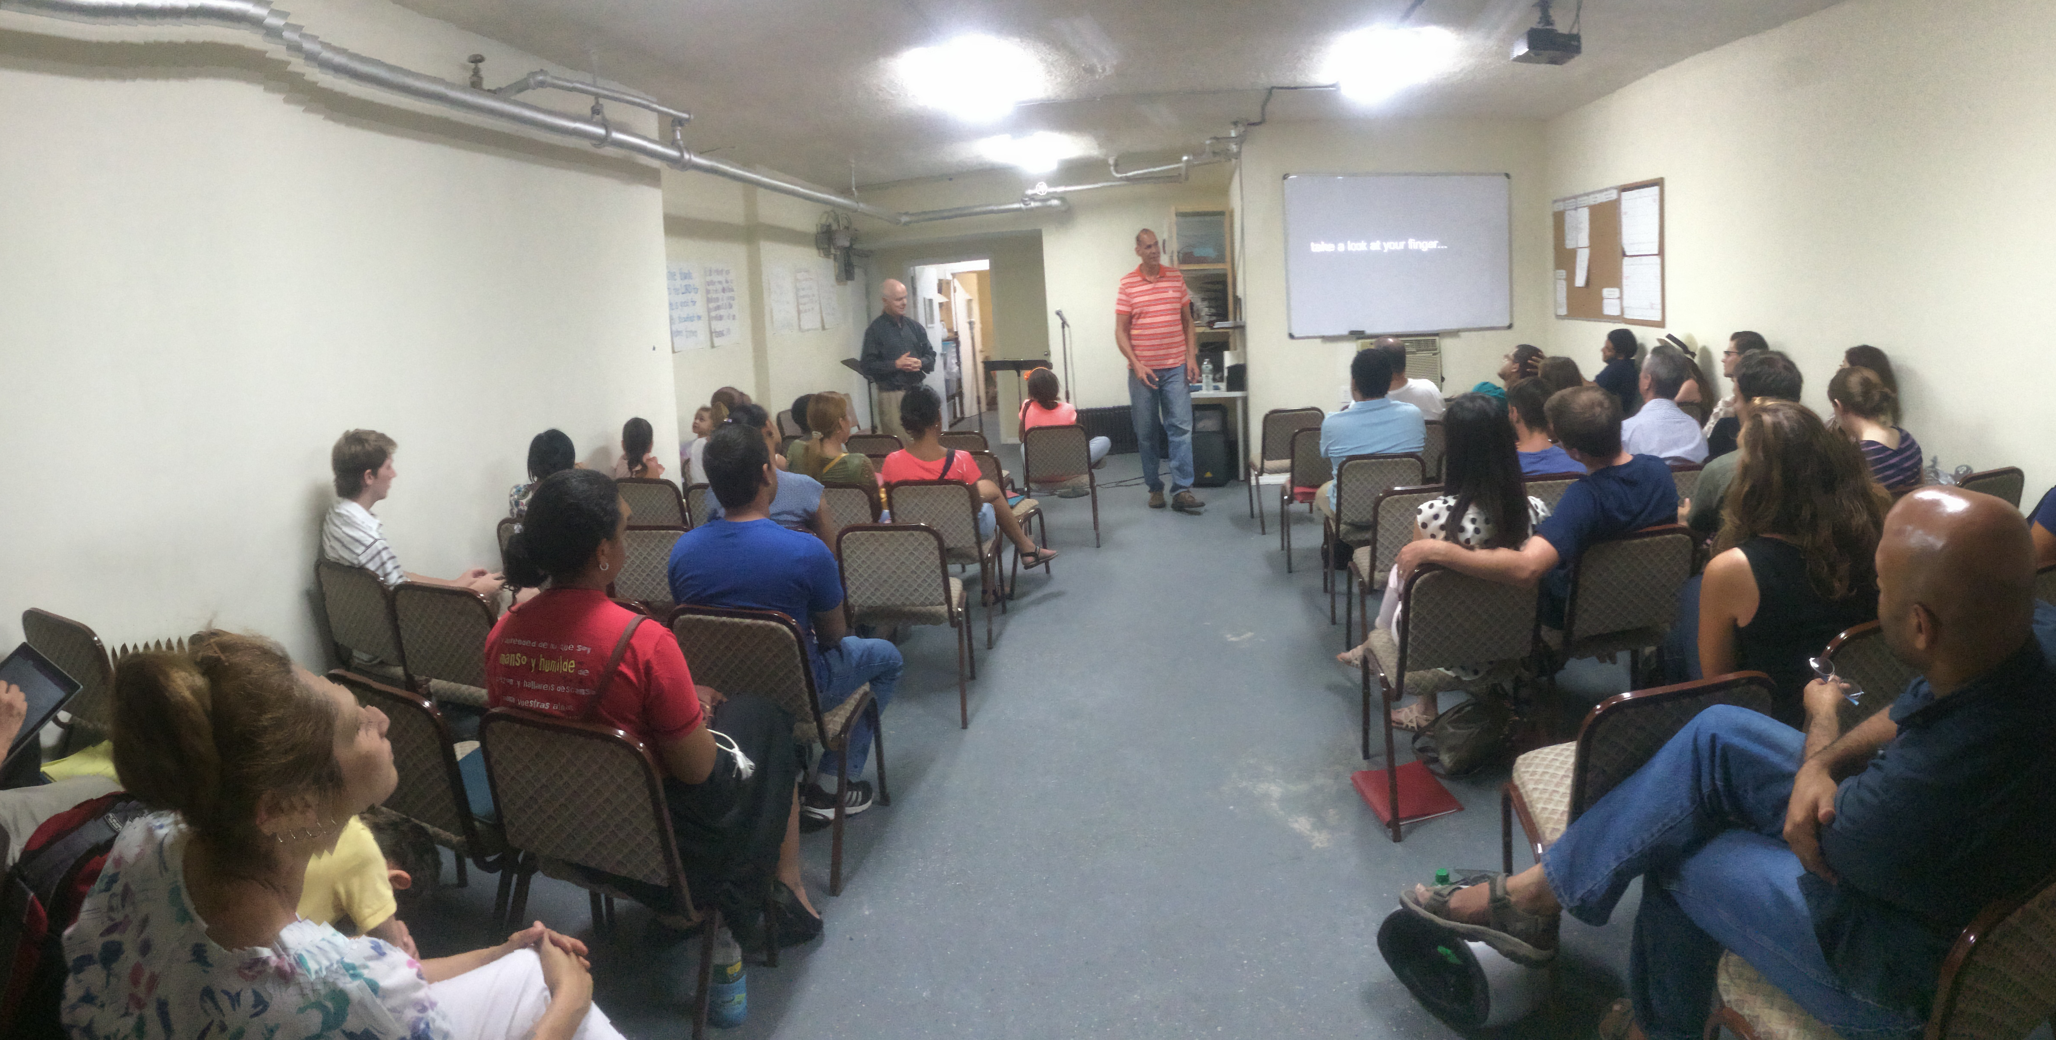
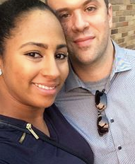
Church Evangelism
Matthew 4:23 “Jesus was going throughout all Galilee, teaching in their synagogues, and proclaiming the gospel..”

Slide 20
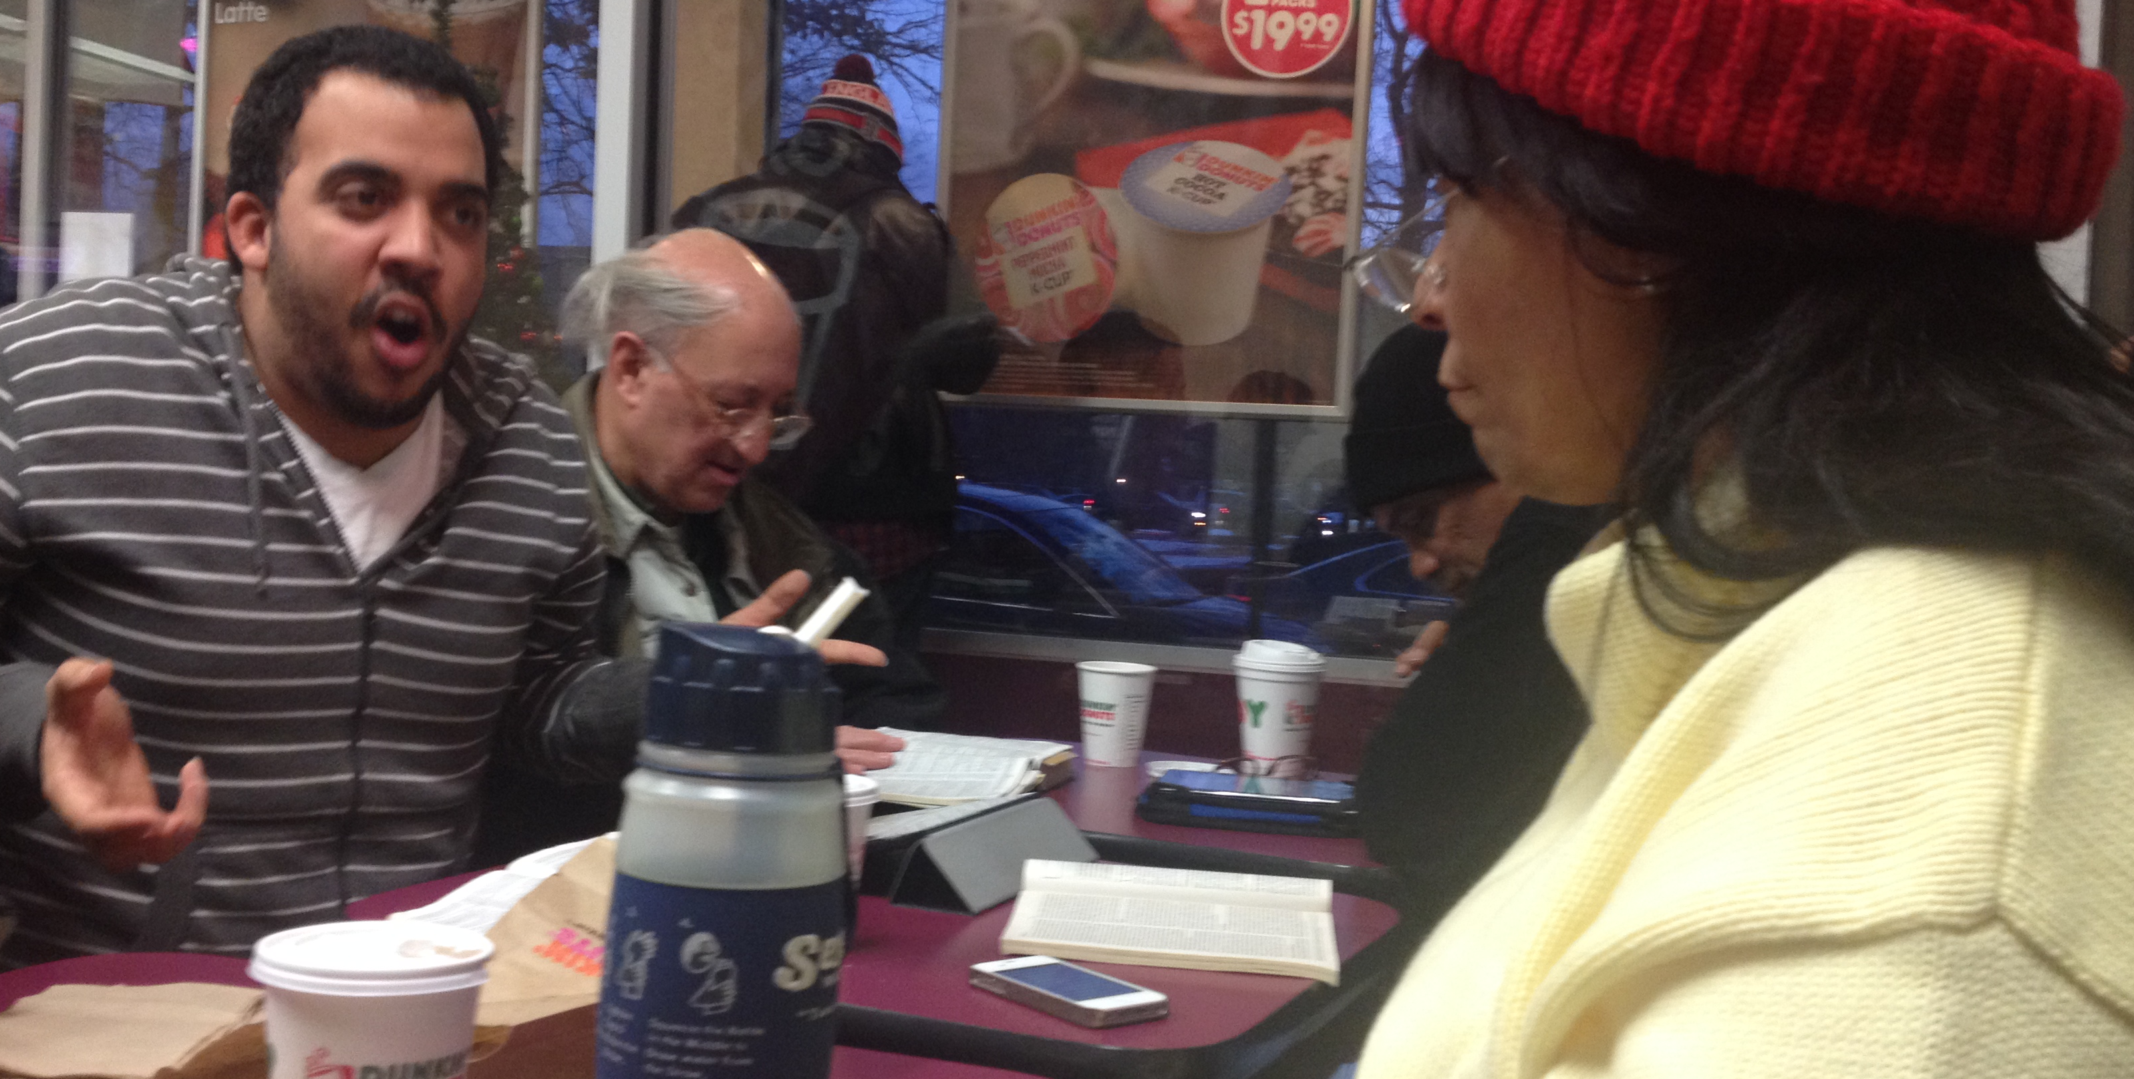
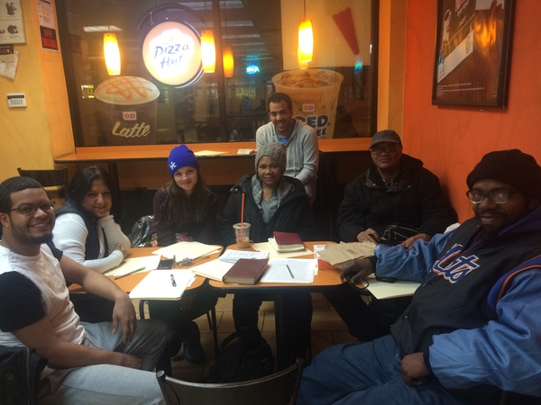
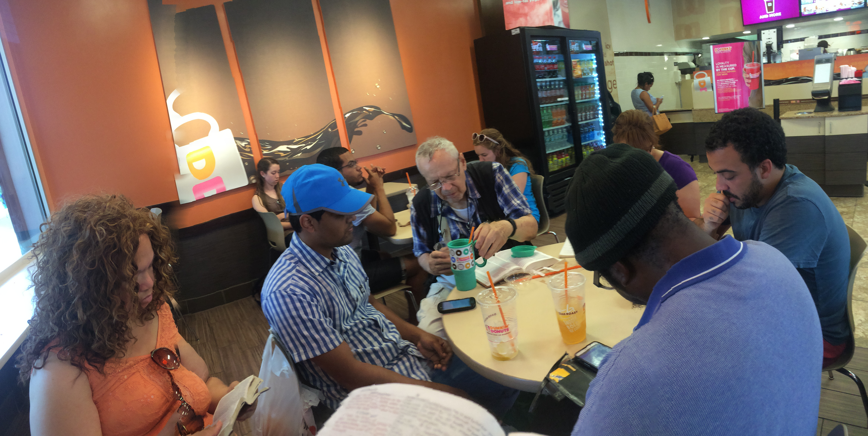
Public Evangelism
Matthew 5:1-2, 13:1-2,

Slide 21
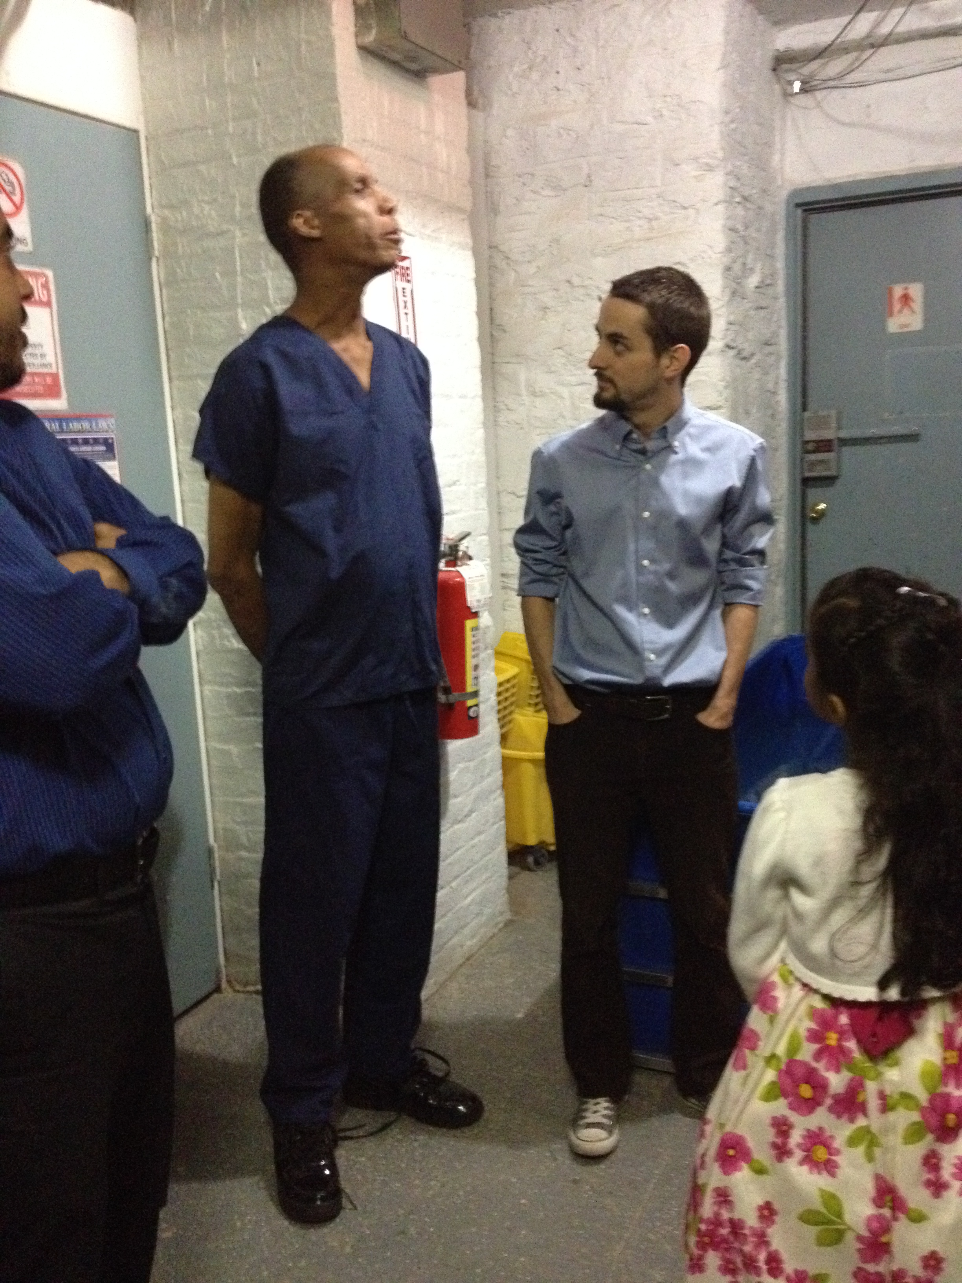
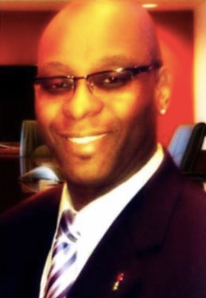
Marketplace (Street) Evangelism
Matthew 9:9; Acts 17:17 “Paul was reasoning..in the market place every day with those who happened to be present.”

Slide 22
Encounter (Opportunity) Evangelism
John 3:1-2, 4:7

Slide 23
Sharing in Evangelism
How to Get / Stay Involved in the Work of Evangelism

Slide 24
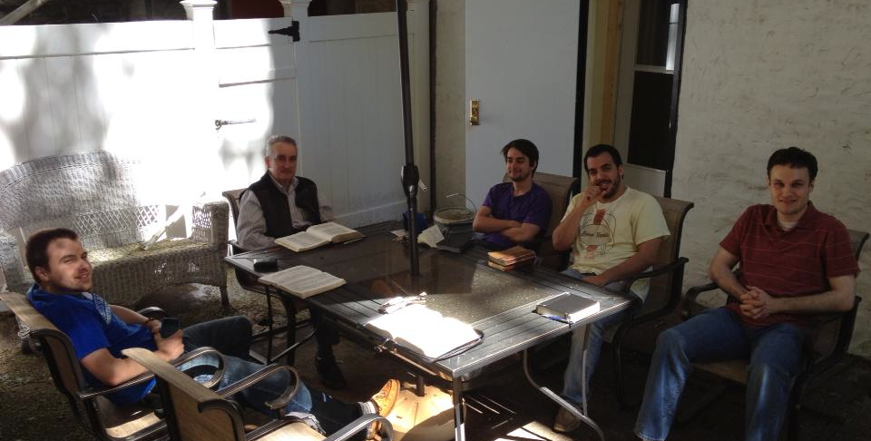
1. Persevere in Prayer (Colossians 4:2-4)

Slide 25
2. Make the Most of Every Opportunity
(Colossians 4:5-6)

Slide 26
Making Disciples in NYC
Matthew 28:18-20
Where & How to Start Sharing in Evangelism

Slide 27
Making Disciples
The Purpose & Process of Making Disciples

Slide 28
The Purpose of Making Disciples

Slide 29
The Process of Making Disciples

Slide 30
1. Equip or Get Equipped
Ephesians 4:11-12

Slide 31
2. Speak truth in love
Ephesians 4:15

Slide 32
3. Every joint supplies
Ephesians 4:15-16

Slide 33
Making Disciples
The Purpose & Process of Making Disciples

