Slide 1
Welcome to Northwood

Slide 2
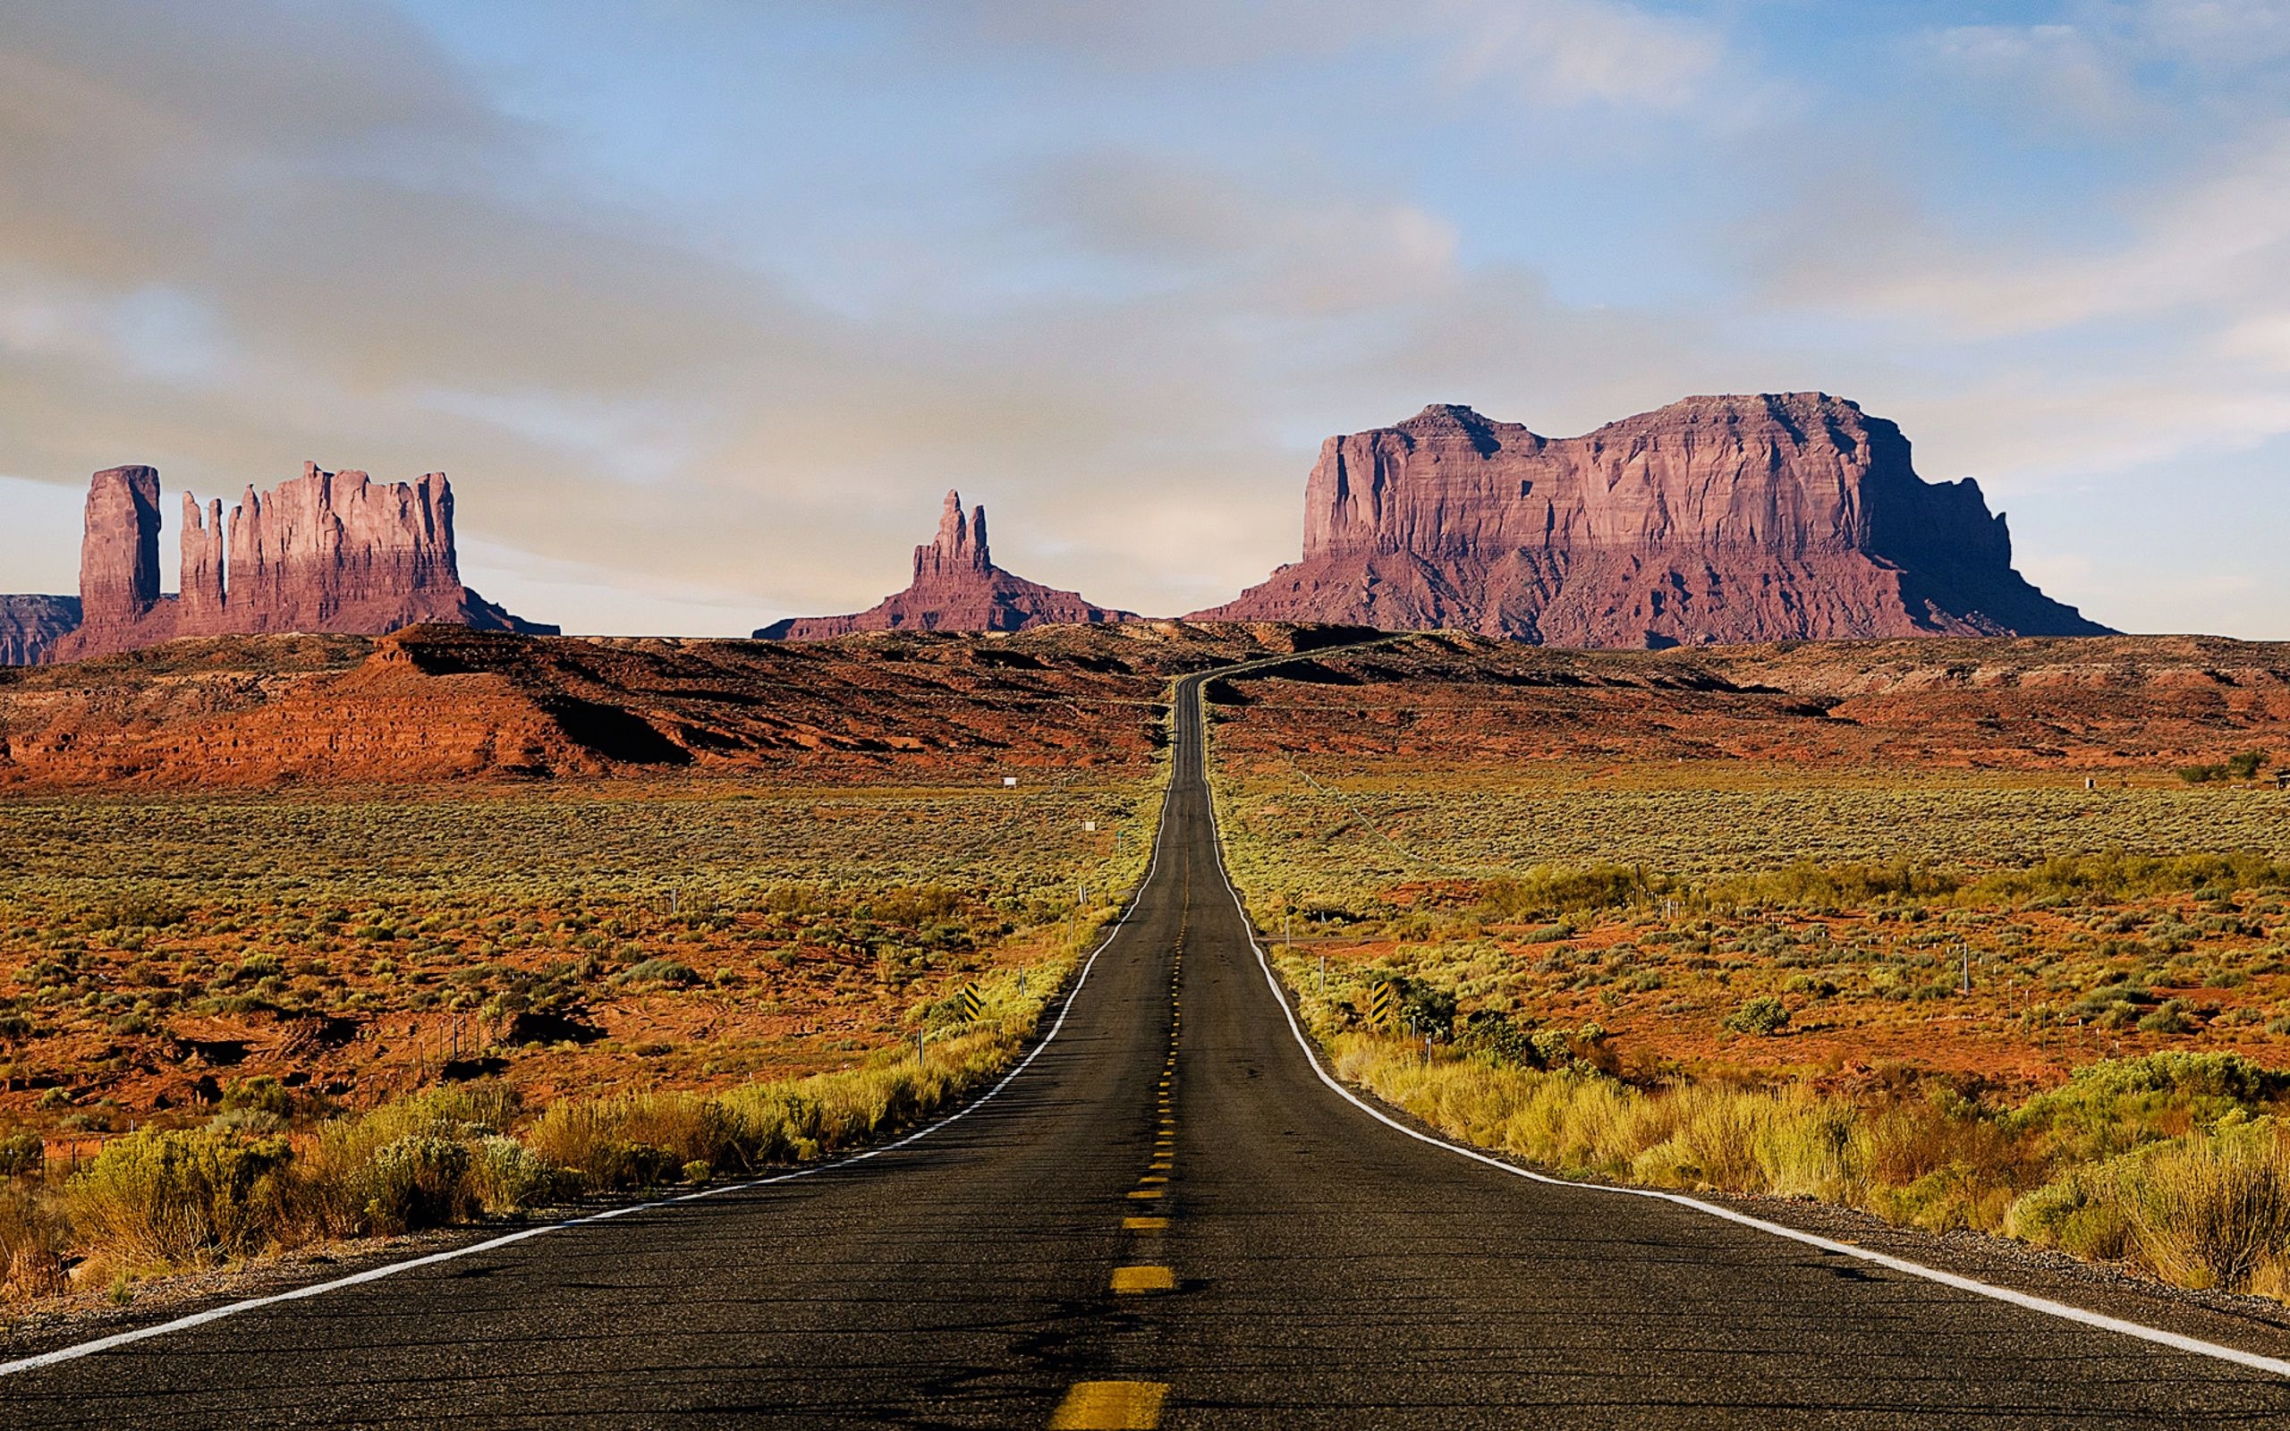
EVANGELISM IN EXILE

Slide 3
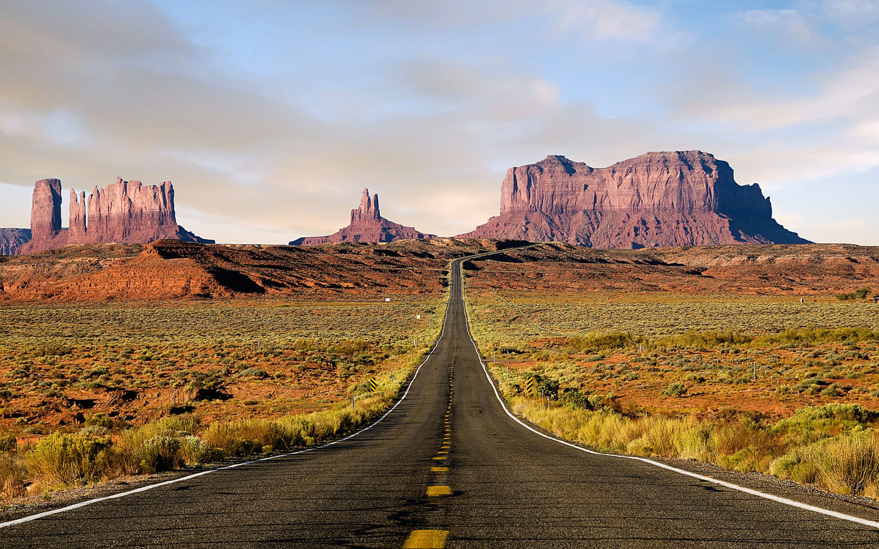
JUNE: WHAT EVERYBODY WANTS 1 PET 1:1-12 JULY: DIFFERENT PEOPLE MAKE A DIFFERENCE 1 PET 1:13-2:3 AUG: A HOLY PRIESTHOOD 1 PET 2:4-12 SEPT: EVANGELISM WITHOUT WORDS 1 PET 2:13-3:7 OCT: A MEEK DEFENSE 1 PET 3:8-17 NOV: A COUNTER-CULTURAL VIEW 1 PET 3:18-4:11 DEC: SUFFERING & EVANGELISM 1 PET 4:12-5:14

Slide 4
Be Subject
Citizens (2:13)
Slaves (2:18)
Wives (3:1)

Slide 5
Be Subject
In midst of suffering
For God’s sake
To display gospel

Slide 6
Submission in face of suffering
Evangelism Without Words

Slide 7
2:15 For this is the will of God, that by doing good you should put to silence the ignorance of foolish people.

Slide 8
2:18 Servants, be subject to your masters with all respect, not only to the good and gentle but also to the unjust.

Slide 9
3:6 And you are her children, if you do good and do not fear anything that is frightening.

Slide 10
2:21 For to this you have been called, because Christ also suffered for you, leaving you an example, so that you might follow in his steps.

Slide 11
Submission to the glory of god
Evangelism Without Words

Slide 12
2:13 Be subject for the Lord's sake to every human institution, whether it be to the emperor as supreme, 14 or to governors as sent by him to punish those who do evil and to praise those who do good. 15 For this is the will of God, that by doing good you should put to silence the ignorance of foolish people. 16 Live as people who are free, not using your freedom as a cover-up for evil, but living as servants of God.

Slide 13
2:13 Be subject for the Lord's sake to every human institution, whether it be to the emperor as supreme, 14 or to governors as sent by him to punish those who do evil and to praise those who do good. 15 For this is the will of God, that by doing good you should put to silence the ignorance of foolish people. 16 Live as people who are free, not using your freedom as a cover-up for evil, but living as servants of God.

Slide 14
2:13 Be subject for the Lord's sake to every human institution, whether it be to the emperor as supreme, 14 or to governors as sent by him to punish those who do evil and to praise those who do good. 15 For this is the will of God, that by doing good you should put to silence the ignorance of foolish people. 16 Live as people who are free, not using your freedom as a cover-up for evil, but living as servants of God.

Slide 15
2:13 Be subject for the Lord's sake to every human institution, whether it be to the emperor as supreme, 14 or to governors as sent by him to punish those who do evil and to praise those who do good. 15 For this is the will of God, that by doing good you should put to silence the ignorance of foolish people. 16 Live as people who are free, not using your freedom as a cover-up for evil, but living as servants of God.

Slide 16
1 Peter 2:17
Honor everyone.
Love the brotherhood.
Fear God.
Honor the emporer.

Slide 17
1 Peter 2:17
Honor everyone.
Love the brotherhood.
Fear God.
Honor the emporer.

Slide 18
1 Peter 2:17
Honor everyone.
Love the brotherhood.
Fear God.
Honor the emporer.

Slide 19
1 Peter 2:17
Honor everyone.
Love the brotherhood.
Fear God.
Honor the emporer.

Slide 20
1 Peter 2:17
Honor everyone.
Love the brotherhood.
Fear God.
Honor the emporer.

Slide 21
1 Peter 2:17
Honor everyone.
Love the brotherhood.
Fear God.
Honor the emporer.

Slide 22
1 Peter 2:17
Honor everyone.
Love the brotherhood.
Fear God.
Honor the emporer.

Slide 23
1 Peter 2:17
Honor everyone.
Love the brotherhood.
Fear God.
Honor the emporer.

Slide 24
1 Peter 2:17
Honor everyone.
Love the brotherhood.
Fear God.
Honor the emporer.

Slide 25
2:18 Servants, be subject to your masters with all respect, not only to the good and gentle but also to the unjust. 19 For this is a gracious thing, when, mindful of God, one endures sorrows while suffering unjustly. 20 For what credit is it if, when you sin and are beaten for it, you endure? But if when you do good and suffer for it you endure, this is a gracious thing in the sight of God.

Slide 26
2:18 Servants, be subject to your masters with all respect, not only to the good and gentle but also to the unjust. 19 For this is a gracious thing, when, mindful of God, one endures sorrows while suffering unjustly. 20 For what credit is it if, when you sin and are beaten for it, you endure? But if when you do good and suffer for it you endure, this is a gracious thing in the sight of God.

Slide 27
2:18 Servants, be subject to your masters with all respect, not only to the good and gentle but also to the unjust. 19 For this is a gracious thing, when, mindful of God, one endures sorrows while suffering unjustly. 20 For what credit is it if, when you sin and are beaten for it, you endure? But if when you do good and suffer for it you endure, this is a gracious thing in the sight of God.

Slide 28
3:1 Likewise, wives, be subject to your own husbands, so that even if some do not obey the word, they may be won without a word by the conduct of their wives, 2 when they see your respectful and pure conduct. 3 Do not let your adorning be external—the braiding of hair and the putting on of gold jewelry, or the clothing you wear— 4 but let your adorning be the hidden person of the heart with the imperishable beauty of a gentle and quiet spirit, which in God's sight is very precious.

Slide 29
3:1 Likewise, wives, be subject to your own husbands, so that even if some do not obey the word, they may be won without a word by the conduct of their wives, 2 when they see your respectful and pure conduct. 3 Do not let your adorning be external—the braiding of hair and the putting on of gold jewelry, or the clothing you wear— 4 but let your adorning be the hidden person of the heart with the imperishable beauty of a gentle and quiet spirit, which in God's sight is very precious.

Slide 30
3:5 For this is how the holy women who hoped in God used to adorn themselves, by submitting to their own husbands, 6 as Sarah obeyed Abraham, calling him lord. And you are her children, if you do good and do not fear anything that is frightening.

Slide 31
3:5 For this is how the holy women who hoped in God used to adorn themselves, by submitting to their own husbands, 6 as Sarah obeyed Abraham, calling him lord. And you are her children, if you do good and do not fear anything that is frightening.

Slide 32
2:21 For to this you have been called, because Christ also suffered for you, leaving you an example, so that you might follow in his steps. 22 He committed no sin, neither was deceit found in his mouth. 23 When he was reviled, he did not revile in return; when he suffered, he did not threaten, but continued entrusting himself to him who judges justly.

Slide 33
Submission as an expression of the gospel
Evangelism Without Words

Slide 34
2:24 He himself bore our sins in his body on the tree, that we might die to sin and live to righteousness. By his wounds you have been healed. For you were straying like sheep, but have no returned to the Shepherd and Overseer of your souls.
3:1 Likewise, wives, be subject to your own husbands, so that even if some do not obey the word, they may be won without a word by the conduct of their wives…

Slide 35
2:24 He himself bore our sins in his body on the tree, that we might die to sin and live to righteousness. By his wounds you have been healed. For you were straying like sheep, but have now returned to the Shepherd and Overseer of your souls.
3:1 Likewise, wives, be subject to your own husbands, so that even if some do not obey the word, they may be won without a word by the conduct of their wives…

Slide 36
2:24 He himself bore our sins in his body on the tree, that we might die to sin and live to righteousness. By his wounds you have been healed. For you were straying like sheep, but have now returned to the Shepherd and Overseer of your souls.
3:1 Likewise, wives, be subject to your own husbands, so that even if some do not obey the word, they may be won without a word by the conduct of their wives…

Slide 37
2:24 He himself bore our sins in his body on the tree, that we might die to sin and live to righteousness. By his wounds you have been healed. For you were straying like sheep, but have now returned to the Shepherd and Overseer of your souls.
3:1 Likewise, wives, be subject to your own husbands, so that even if some do not obey the word, they may be won without a word by the conduct of their wives…

Slide 38
2:24 He himself bore our sins in his body on the tree, that we might die to sin and live to righteousness. By his wounds you have been healed. For you were straying like sheep, but have now returned to the Shepherd and Overseer of your souls.
3:1 Likewise, wives, be subject to your own husbands, so that even if some do not obey the word, they may be won without a word by the conduct of their wives…

Slide 39
Put God first!
(Give up your rights.)

Slide 40
Focus on Jesus!
(Forget about the crime.)

Slide 41
Be still!
(Let God deal with injustice.)

Slide 42
Preach the gospel!
(Without saying a word.)

