Slide 1
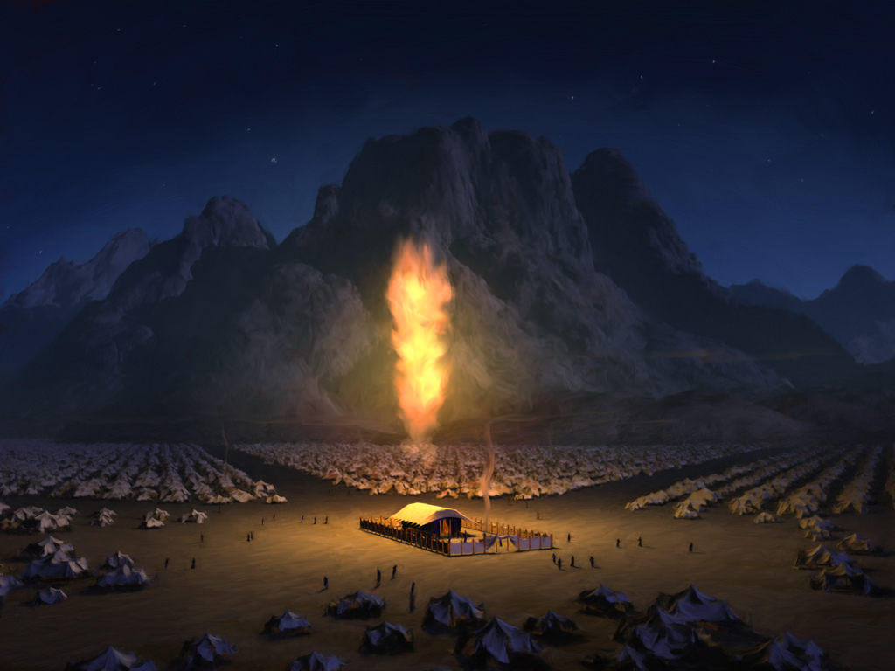
Entering
THE HOLY PLACES

Slide 2
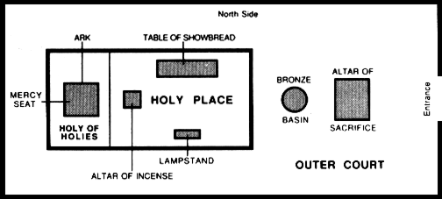
Entering
THE HOLY PLACES

Slide 3
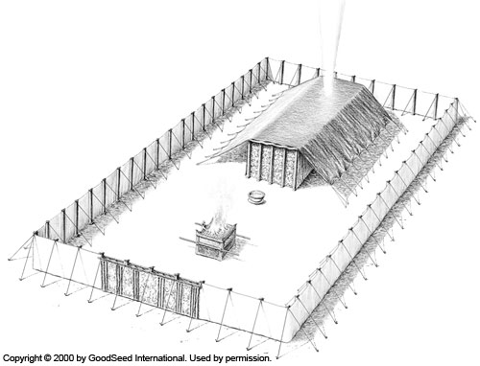
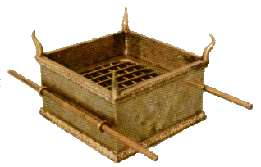
The Altar of Sacrifice

Slide 4
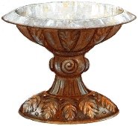
The Wash Basin

Slide 5
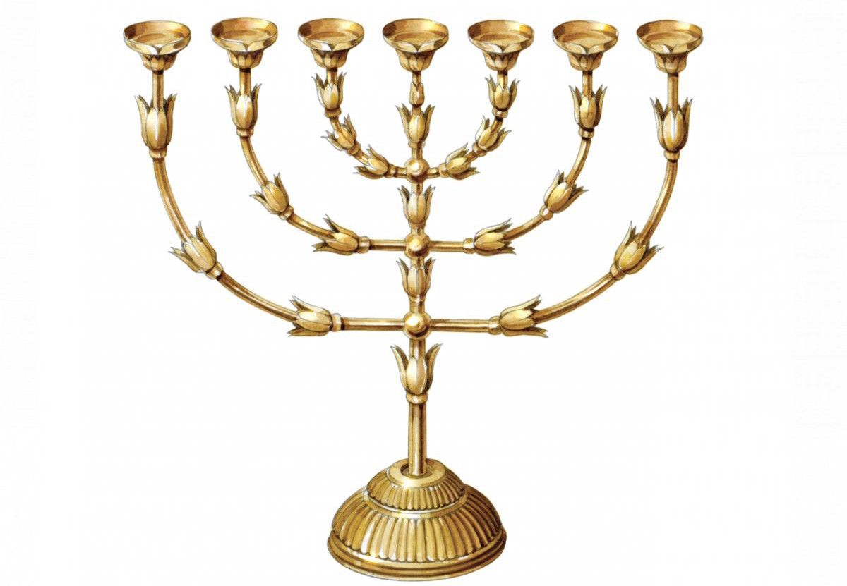
The Lampstand

Slide 6
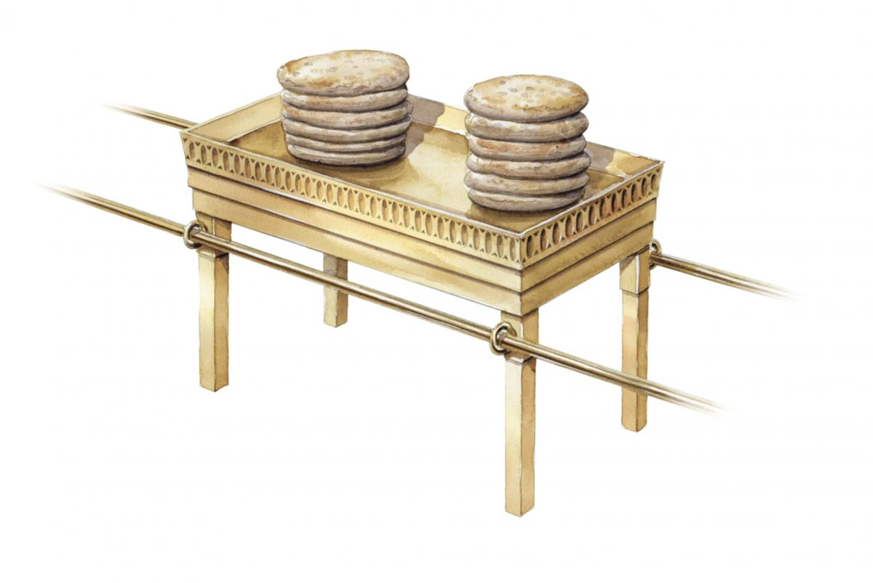
The Bread of the Presence

Slide 7
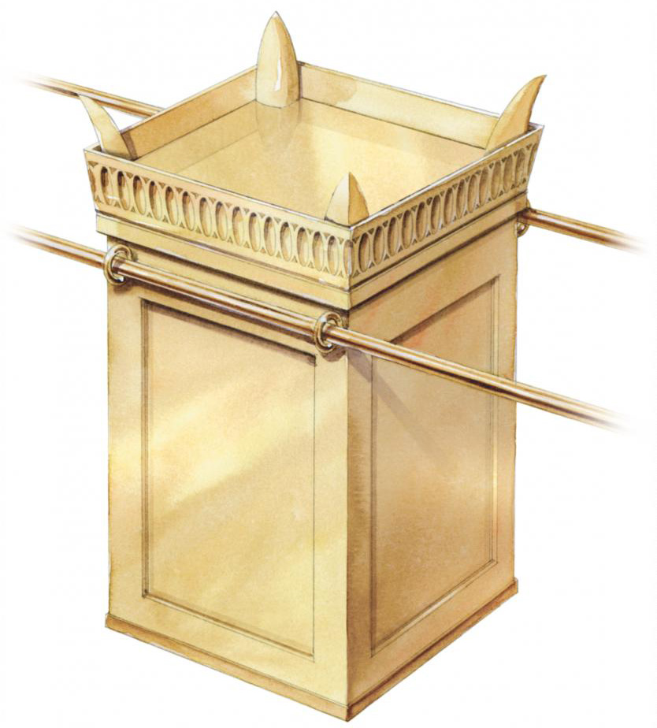
The Altar of Incense

Slide 8
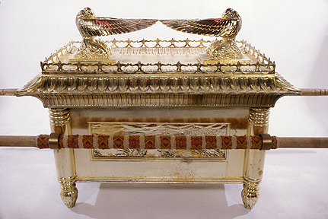
The Holy of Holies

Slide 9
