Slide 1
Welcome to Northwood!

Slide 2
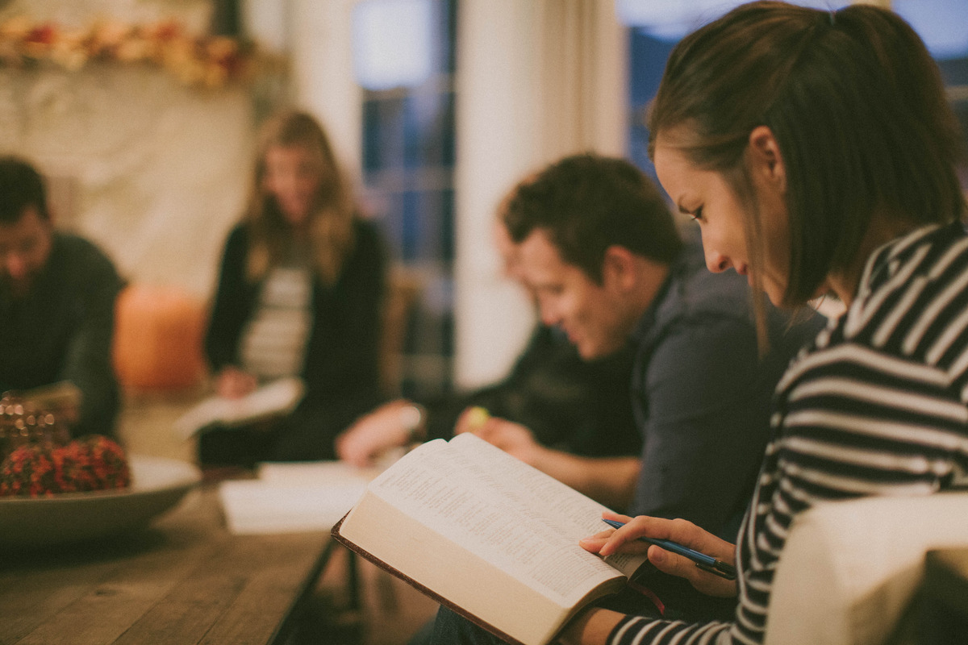
Why Do We Have Bible Classes?

Slide 3
To guard against apostacy
Why do we have Bible classes?

Slide 4
For it is impossible, in the case of those who have once been enlightened, who have tasted the heavenly gift, and have shared in the Holy Spirit, and have tasted the goodness of the word of God and the powers of the age to come, and then have fallen away, to restore them again to repentance, since they are crucifying once again the Son of God to their own harm and holding him up to contempt.
Hebrews 6:4-6

Slide 5
For it is impossible, in the case of those who have once been enlightened, who have tasted the heavenly gift, and have shared in the Holy Spirit, and have tasted the goodness of the word of God and the powers of the age to come, and then have fallen away, to restore them again to repentance, since they are crucifying once again the Son of God to their own harm and holding him up to contempt.
Hebrews 6:4-6

Slide 6
For it is impossible, in the case of those who have once been enlightened, who have tasted the heavenly gift, and have shared in the Holy Spirit, and have tasted the goodness of the word of God and the powers of the age to come, and then have fallen away, to restore them again to repentance, since they are crucifying once again the Son of God to their own harm and holding him up to contempt.
Hebrews 6:4-6

Slide 7
For it is impossible, in the case of those who have once been enlightened, who have tasted the heavenly gift, and have shared in the Holy Spirit, and have tasted the goodness of the word of God and the powers of the age to come, and then have fallen away, to restore them again to repentance, since they are crucifying once again the Son of God to their own harm and holding him up to contempt.
Hebrews 6:4-6

Slide 8
For it is impossible, in the case of those who have once been enlightened, who have tasted the heavenly gift, and have shared in the Holy Spirit, and have tasted the goodness of the word of God and the powers of the age to come, and then have fallen away, to restore them again to repentance, since they are crucifying once again the Son of God to their own harm and holding him up to contempt.
Hebrews 6:4-6

Slide 9
For it is impossible, in the case of those who have once been enlightened, who have tasted the heavenly gift, and have shared in the Holy Spirit, and have tasted the goodness of the word of God and the powers of the age to come, and then have fallen away, to restore them again to repentance, since they are crucifying once again the Son of God to their own harm and holding him up to contempt.
Hebrews 6:4-6

Slide 10
For it is impossible, in the case of those who have once been enlightened, who have tasted the heavenly gift, and have shared in the Holy Spirit, and have tasted the goodness of the word of God and the powers of the age to come, and then have fallen away, to restore them again to repentance, since they are crucifying once again the Son of God to their own harm and holding him up to contempt.
Hebrews 6:4-6

Slide 11
For it is impossible, in the case of those who have once been enlightened, who have tasted the heavenly gift, and have shared in the Holy Spirit, and have tasted the goodness of the word of God and the powers of the age to come, and then have fallen away, to restore them again to repentance, since they are crucifying once again the Son of God to their own harm and holding him up to contempt.
Hebrews 6:4-6

Slide 12
For it is impossible, in the case of those who have once been enlightened, who have tasted the heavenly gift, and have shared in the Holy Spirit, and have tasted the goodness of the word of God and the powers of the age to come, and then have fallen away, to restore them again to repentance, since they are crucifying once again the Son of God to their own harm and holding him up to contempt.
Hebrews 6:4-6

Slide 13
For it is impossible, in the case of those who have once been enlightened, who have tasted the heavenly gift, and have shared in the Holy Spirit, and have tasted the goodness of the word of God and the powers of the age to come, and then have fallen away, to restore them again to repentance, since they are crucifying once again the Son of God to their own harm and holding him up to contempt.
Hebrews 6:4-6

Slide 14
To grow & mature in Christ
Why do we have Bible classes?

Slide 15
11 About this we have much to say, and it is hard to explain, since you have become dull of hearing. 12 For though by this time you ought to be teachers, you need someone to teach you again the basic principles of the oracles of God. You need milk, not solid food, 13 for everyone who lives on milk is unskilled in the word of righteousness, since he is a child. 14 But solid food is for the mature, for those who have their powers of discernment trained by constant practice to distinguish good from evil.

Slide 16
11 About this we have much to say, and it is hard to explain, since you have become dull of hearing. 12 For though by this time you ought to be teachers, you need someone to teach you again the basic principles of the oracles of God. You need milk, not solid food, 13 for everyone who lives on milk is unskilled in the word of righteousness, since he is a child. 14 But solid food is for the mature, for those who have their powers of discernment trained by constant practice to distinguish good from evil.

Slide 17
11 About this we have much to say, and it is hard to explain, since you have become dull of hearing. 12 For though by this time you ought to be teachers, you need someone to teach you again the basic principles of the oracles of God. You need milk, not solid food, 13 for everyone who lives on milk is unskilled in the word of righteousness, since he is a child. 14 But solid food is for the mature, for those who have their powers of discernment trained by constant practice to distinguish good from evil.

Slide 18
11 About this we have much to say, and it is hard to explain, since you have become dull of hearing. 12 For though by this time you ought to be teachers, you need someone to teach you again the basic principles of the oracles of God. You need milk, not solid food, 13 for everyone who lives on milk is unskilled in the word of righteousness, since he is a child. 14 But solid food is for the mature, for those who have their powers of discernment trained by constant practice to distinguish good from evil.

Slide 19
11 About this we have much to say, and it is hard to explain, since you have become dull of hearing. 12 For though by this time you ought to be teachers, you need someone to teach you again the basic principles of the oracles of God. You need milk, not solid food, 13 for everyone who lives on milk is unskilled in the word of righteousness, since he is a child. 14 But solid food is for the mature, for those who have their powers of discernment trained by constant practice to distinguish good from evil.

Slide 20
1 Therefore let us leave the elementary doctrine of Christ and go on to maturity, not laying again a foundation of repentance from dead works and of faith toward God, 2 and of instruction about washings, the laying on of hands, the resurrection of the dead, and eternal judgment. 3 And this we will do if God permits.

Slide 21
1 Therefore let us leave the elementary doctrine of Christ and go on to maturity, not laying again a foundation of repentance from dead works and of faith toward God, 2 and of instruction about washings, the laying on of hands, the resurrection of the dead, and eternal judgment. 3 And this we will do if God permits.

Slide 22
But solid food is for the mature, for those who have their
powers of discernment
trained by constant practice
to distinguish good from evil.

Slide 23
But solid food is for the mature, for those who have their
powers of discernment
trained by constant practice
to distinguish good from evil.

Slide 24
But solid food is for the mature, for those who have their
powers of discernment
trained by constant practice
to distinguish good from evil.

Slide 25
But solid food is for the mature, for those who have their
powers of discernment
trained by constant practice
to distinguish good from evil.

Slide 26
To produce teachers
Why do we have Bible classes?

Slide 27
11 About this we have much to say, and it is hard to explain, since you have become dull of hearing. 12 For though by this time you ought to be teachers, you need someone to teach you again the basic principles of the oracles of God. You need milk, not solid food, 13 for everyone who lives on milk is unskilled in the word of righteousness, since he is a child. 14 But solid food is for the mature, for those who have their powers of discernment trained by constant practice to distinguish good from evil.

Slide 28
11 About this we have much to say, and it is hard to explain, since you have become dull of hearing. 12 For though by this time you ought to be teachers, you need someone to teach you again the basic principles of the oracles of God. You need milk, not solid food, 13 for everyone who lives on milk is unskilled in the word of righteousness, since he is a child. 14 But solid food is for the mature, for those who have their powers of discernment trained by constant practice to distinguish good from evil.

Slide 29
Eat every day.
Be aware of empty calories.
Add more meat to your diet.
Exercise.
Increase accountability.
Feed others.

