Slide 1
Welcome to Northwood

Slide 2
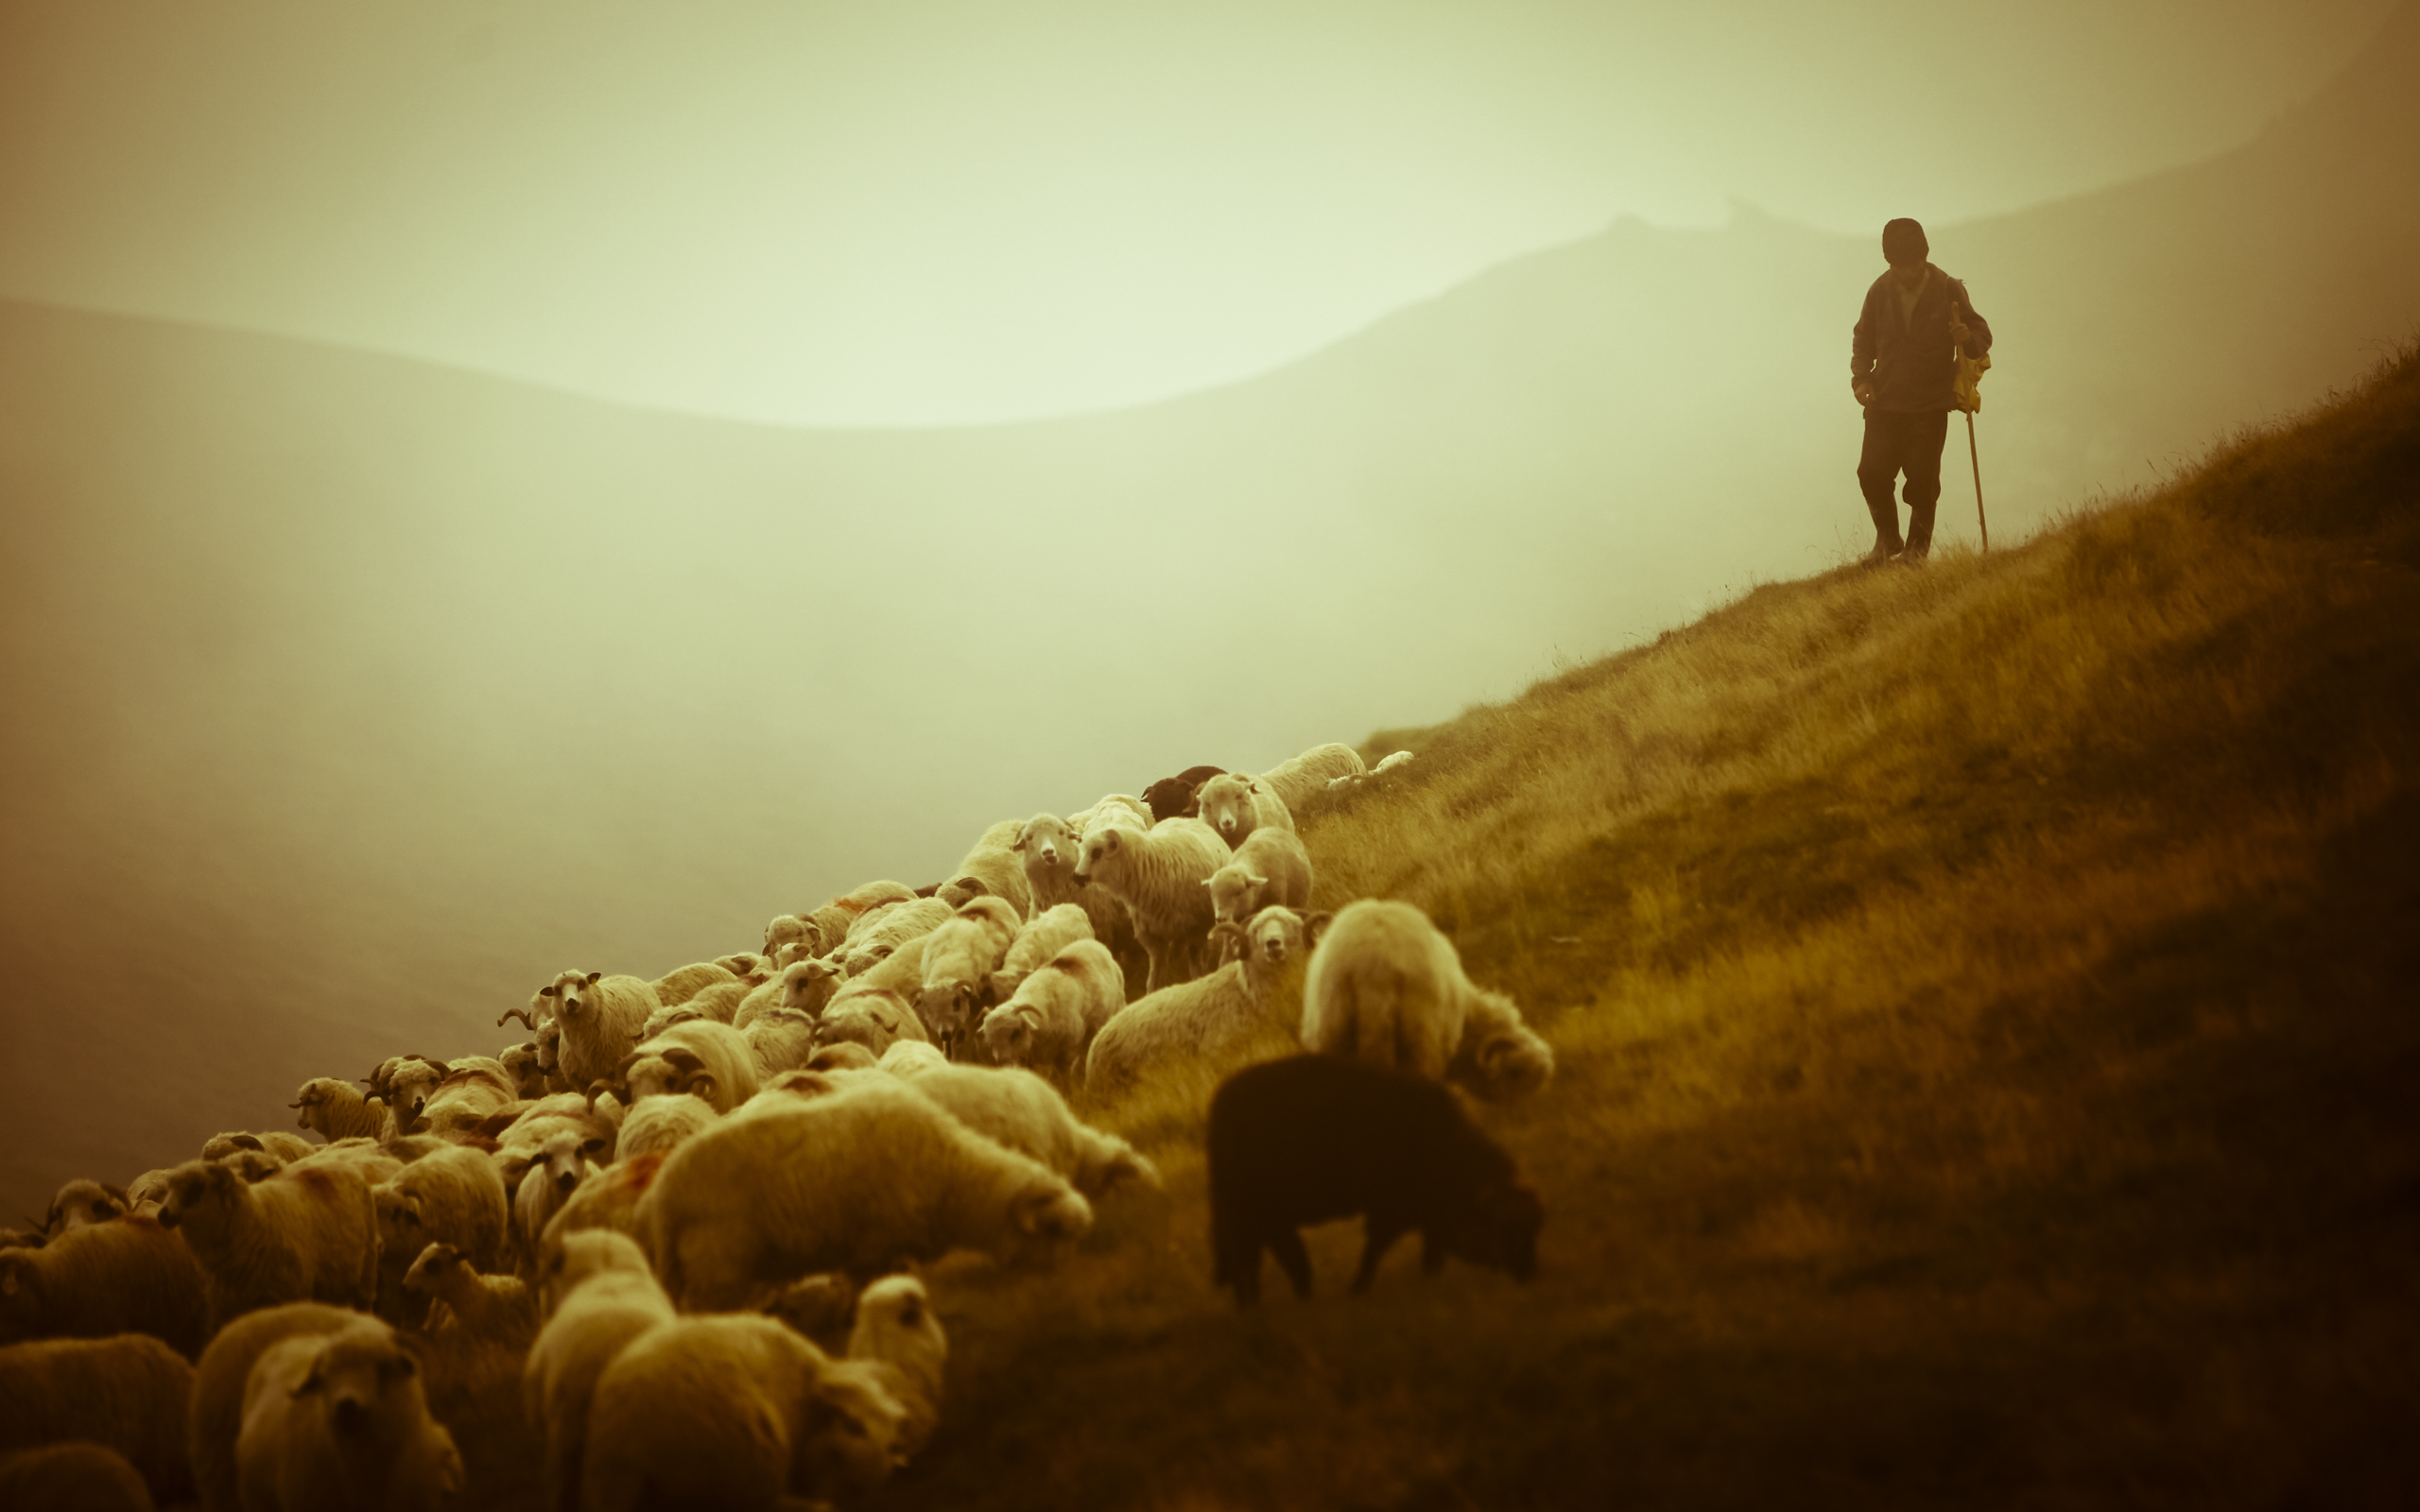
Shepherd the Flock of God
That Is Among You

Slide 3
New Testament organization
Changes after 1st century
Primary issues
Application

Slide 4
Acts 14:23
And when they had appointed elders for them in every church…

Slide 5
Ephesians 2:20
…built on the foundation of the apostles and prophets, Christ Jesus himself being the cornerstone…

Slide 6
Acts 20:17, 28
Now from Miletus he sent to Ephesus and called the elders of the church to come to him.
Pay careful attention to yourselves and to all the flock, in which the Holy Spirit has made you overseers…

Slide 7
Titus 1:5, 7
This is why I left you in Crete, so that you might put what remained into order, and appoint elders in every town…
For an overseer, as God’s steward, must be above reproach.

Slide 8
Philippians 1:1
Paul and Timothy, servants of Chist Jesus,
To all the saints in Christ Jesus who are at Philippi, with the overseers and deacons…

Slide 13
Philippians 1:1
Paul and Timothy, servants of Chist Jesus,
To all the saints in Christ Jesus who are at Philippi, with the overseers and deacons…

Slide 14
Acts 17:25-26
When Peter entered, Cornelius met him and fell down at his feet and worshiped him. But Peter lifted him up, saying, “Stand up; I too am a man.”

Slide 15
1 Peter 5:1, 4
So I exhort the elders among you, as a fellow elder…
And when the chief Shepherd appears...

Slide 16
1 Peter 5:2
…shepherd the flock of God that is among you…

Slide 17
Hebrews 7:14
For it is evident that our Lord was descended from Judah, and in connection with that tribe Moses said nothing about priests.

Slide 18
Beware of self-appointed popes who seek to “protect” the church from error.
Beware of attempts to centralize funds.

