Slide 1
Welcome to Northwood

Slide 3
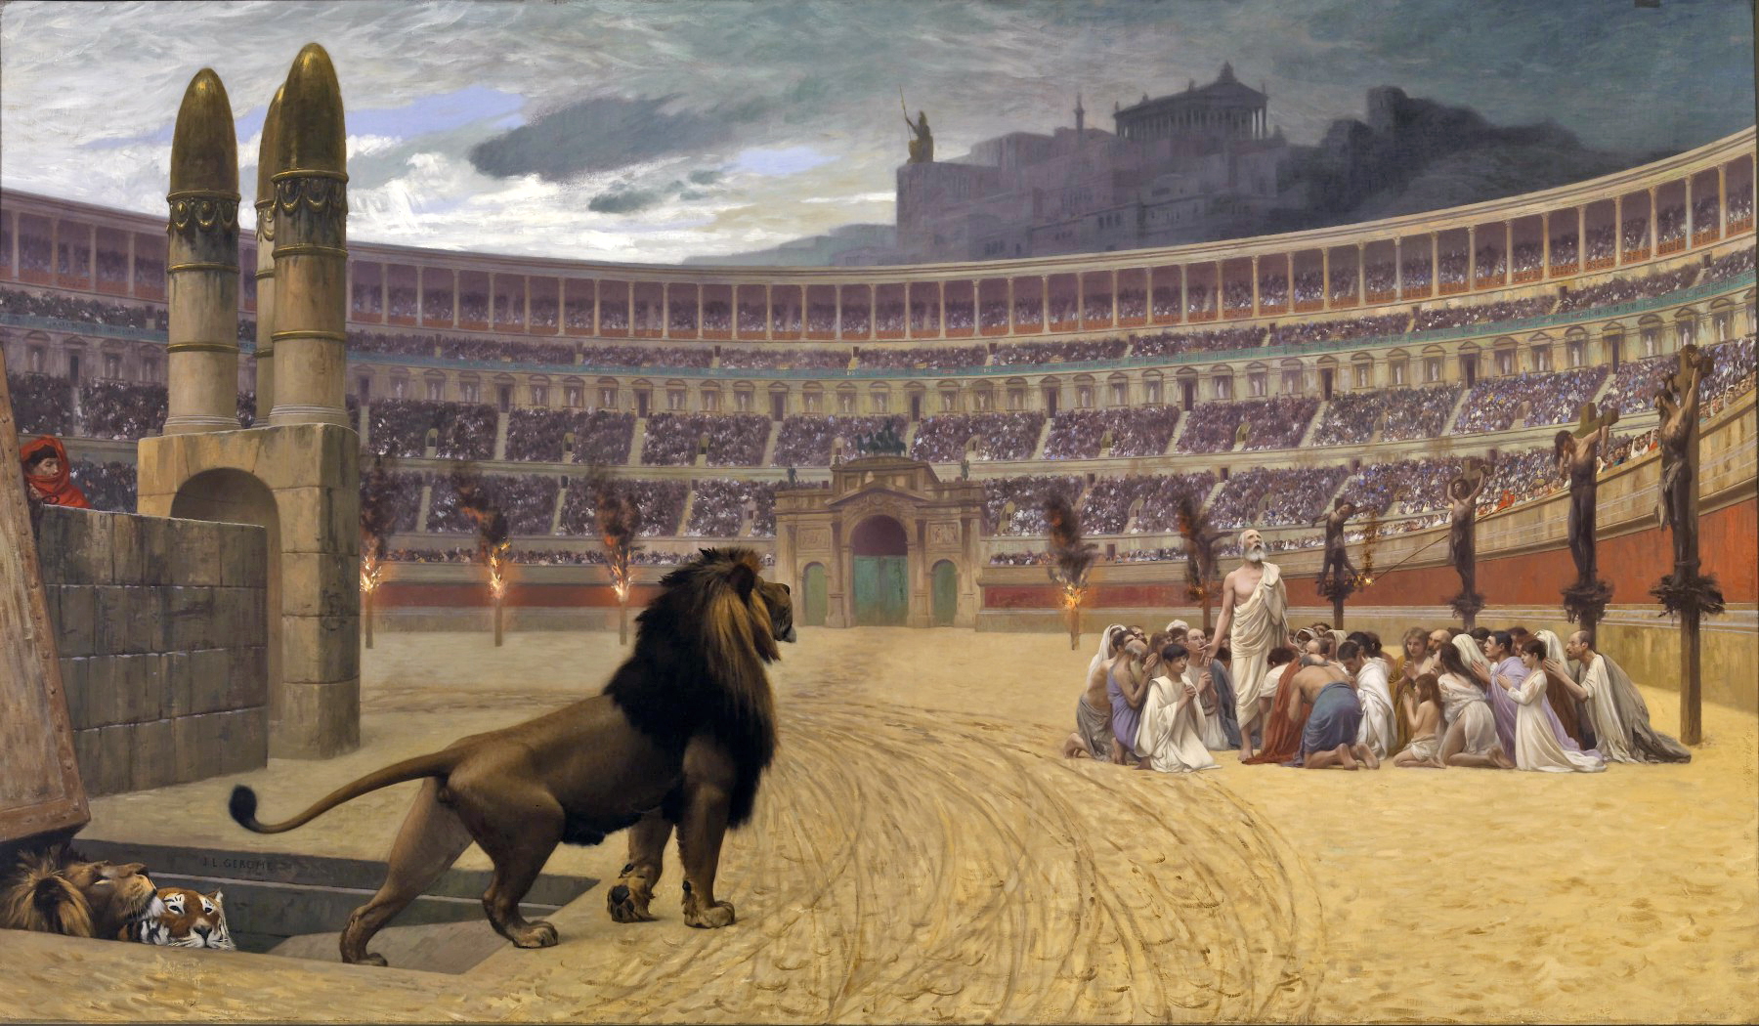
Not of This World

Slide 4
Rejection
Sanctification
Mission

Slide 5
Rejection
“The world has hated them because they are not of the world.” John 17:14

Slide 6
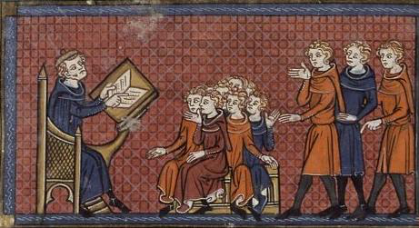
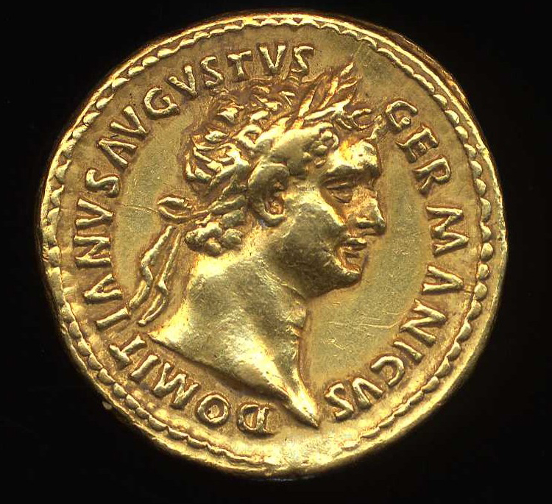
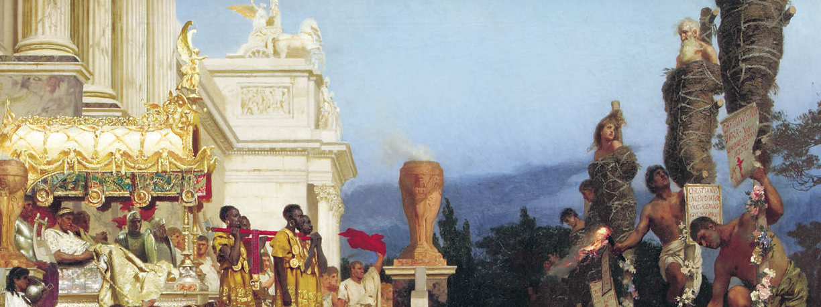
Nero
(54-68)
Domitian
(81-96)
Trajan
(98-117)
Marcus Aurelius
(161-180)

Slide 7
John 17:14
“The world has hated them because they are not of the world.”

Slide 8
John 17:14
“The world has hated them because they are not of the world.”

Slide 9
sanctification
“Sanctify them in the truth; your word is truth.” John 17:17

Slide 10
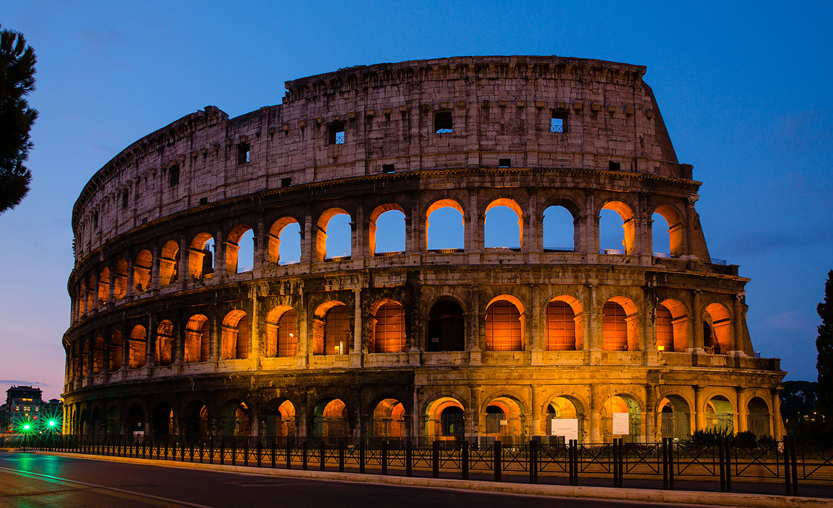
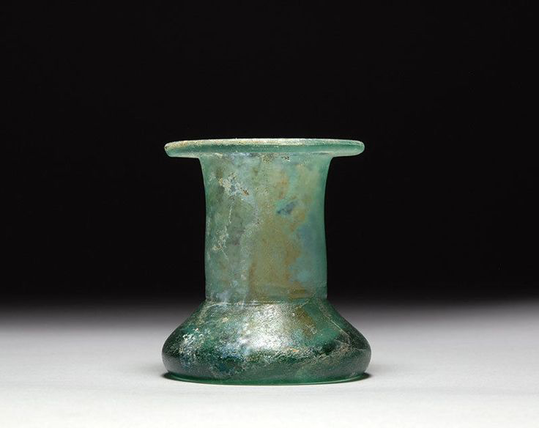
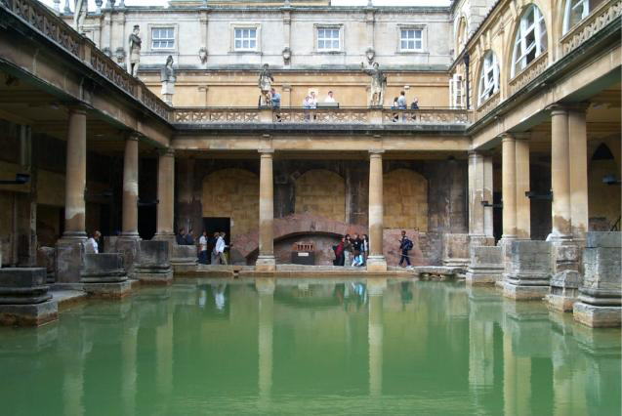
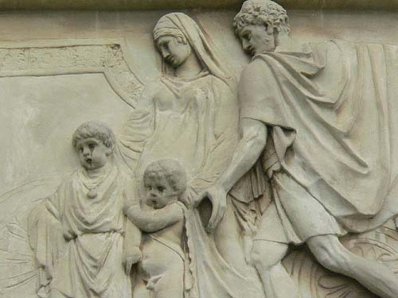
Divorce
Abortion
Modesty
Entertainment

Slide 11
mission
“As you have sent me into the world, so I have sent them into the world.” John 17:18

Slide 12
Private conversation
Godly living
Martyrdom

Slide 13
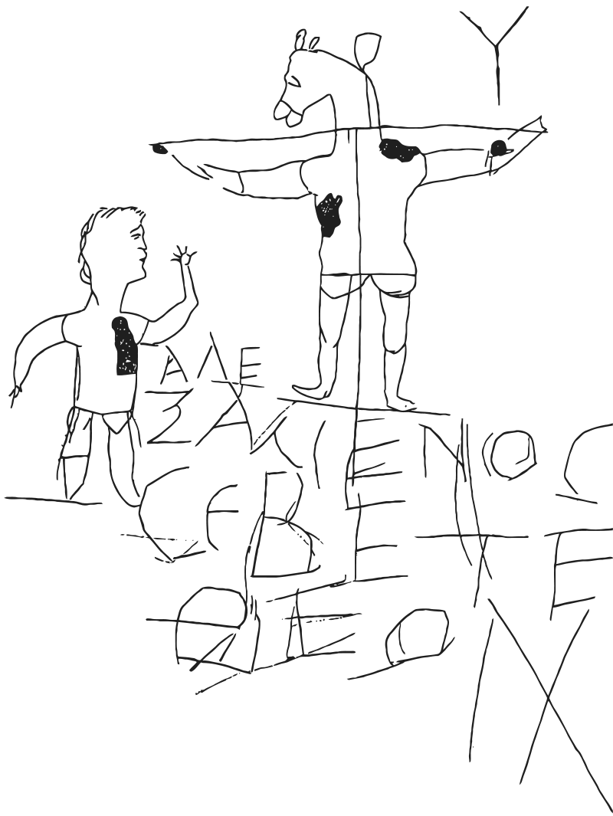
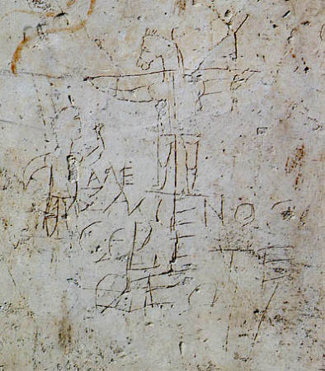

Slide 14
We need leaders who are willing to sacrifice all to follow Christ.
We need parents who are willing to let their children suffer.

