Slide 1
Welcome to Northwood

Slide 2
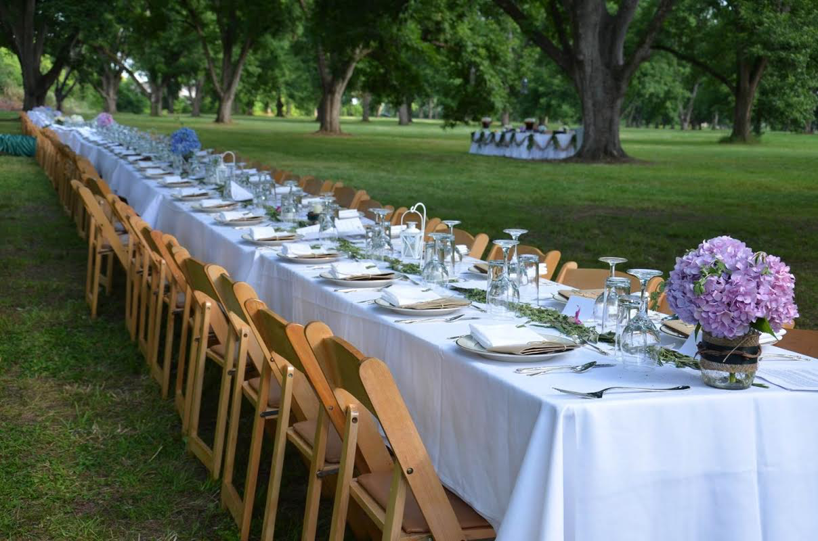
An Invitation to All

Slide 3
Invitation
Excuses
Inclusion
Exclusion

Slide 4
Luke 14:16
But he said to him, “A man once gave a great banquet and invited many.”

Slide 5
Luke 14:16
But he said to him, “A man once gave a great banquet and invited many.”

Slide 6
Luke 14:16
But he said to him, “A man once gave a great banquet and invited many.”

Slide 7
Luke 14:18-20
“But they all alike began to make excuses. The first said to him, ‘I have bought a field, and I must go out and see it. Please have me excused.’ And another said, ‘I have bought five yoke of oxen, and I go to examine them. Please have me excused.’ And another said, ‘I have married a wife, and therefore I cannot come.’”

Slide 8
Luke 14:18-20
“But they all alike began to make excuses. The first said to him, ‘I have bought a field, and I must go out and see it. Please have me excused.’ And another said, ‘I have bought five yoke of oxen, and I go to examine them. Please have me excused.’ And another said, ‘I have married a wife, and therefore I cannot come.’”

Slide 9
Luke 14:18-20
“But they all alike began to make excuses. The first said to him, ‘I have bought a field, and I must go out and see it. Please have me excused.’ And another said, ‘I have bought five yoke of oxen, and I go to examine them. Please have me excused.’ And another said, ‘I have married a wife, and therefore I cannot come.’”

Slide 10
Luke 14:18-20
“But they all alike began to make excuses. The first said to him, ‘I have bought a field, and I must go out and see it. Please have me excused.’ And another said, ‘I have bought five yoke of oxen, and I go to examine them. Please have me excused.’ And another said, ‘I have married a wife, and therefore I cannot come.’”

Slide 11
Luke 14:21
“So the servant came and reported these things to his master. Then the master of he house became angry and said to his servant, ‘Go out quickly to the streets and lanes of the city, and bring in the poor and crippled and blind and lame.’”

Slide 12
Luke 14:21
“So the servant came and reported these things to his master. Then the master of the house became angry and said to his servant, ‘Go out quickly to the streets and lanes of the city, and bring in the poor and crippled and blind and lame.’”

Slide 13
Luke 14:22-23
“And the servant said, ‘Sir, what you commanded has been done, and still there is room.’ And the master said to the servant, ‘Go out to the highways and the hedges and compel people to come in, that my house may be filled.’”

Slide 14
Luke 14:22-23
“And the servant said, ‘Sir, what you commanded has been done, and still there is room.’ And the master said to the servant, ‘Go out to the highways and the hedges and compel people to come in, that my house may be filled.’”

Slide 15
Luke 14:22-23
“And the servant said, ‘Sir, what you commanded has been done, and still there is room.’ And the master said to the servant, ‘Go out to the highways and the hedges and compel people to come in, that my house may be filled.’”

Slide 16
Luke 14:22-23
“And the servant said, ‘Sir, what you commanded has been done, and still there is room.’ And the master said to the servant, ‘Go out to the highways and the hedges and compel people to come in, that my house may be filled.’”

Slide 17
Luke 14:24
“For I tell you, none of those men who were invited shall taste my banquet.”

Slide 18
Luke 14:24
“For I tell you, none of those men who were invited shall taste my banquet.”

Slide 19
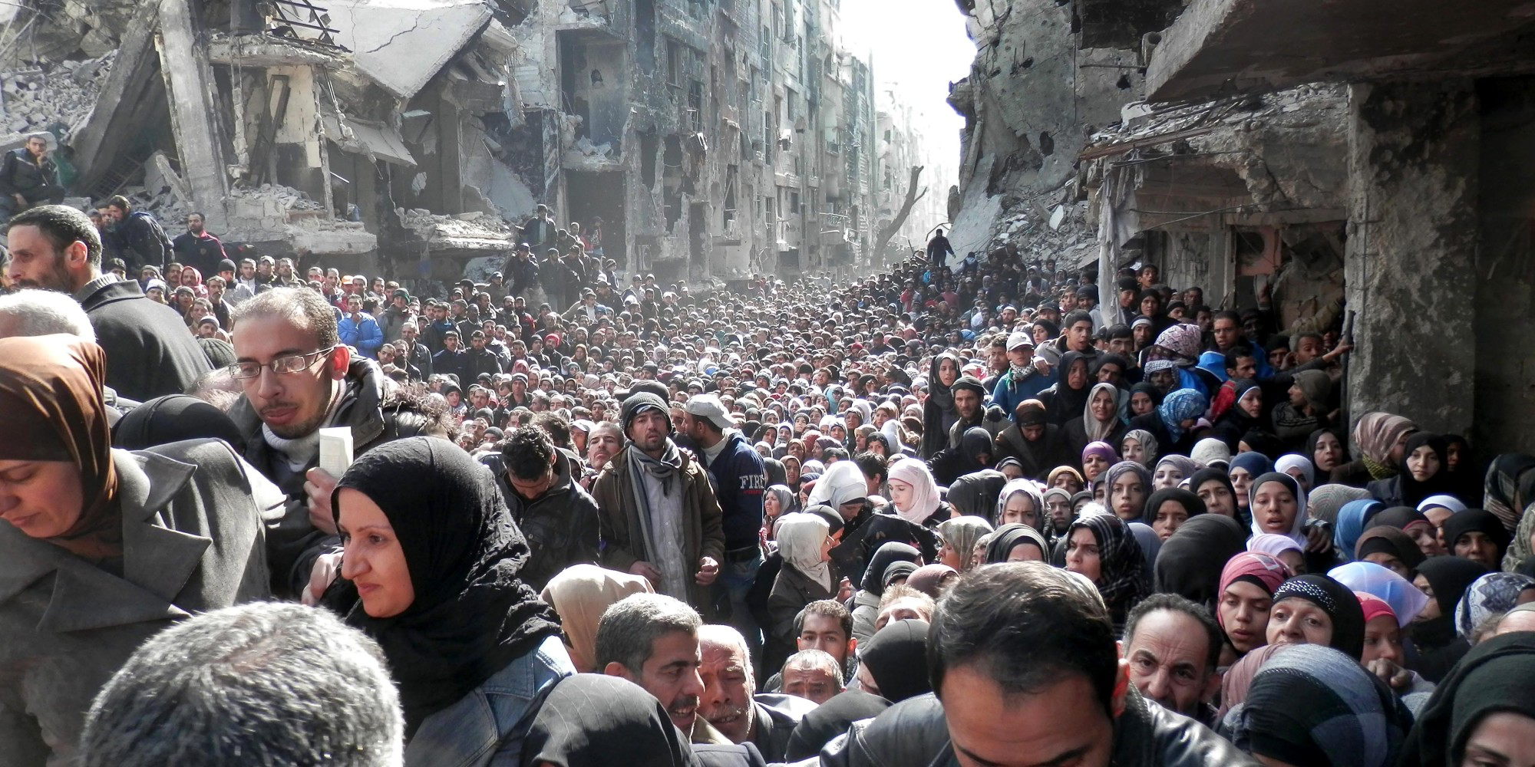

Slide 20
Your Table
Luke 14:21
“bring in the poor and crippled and blind and lame.”
Luke 14:13
“But when you give a feast, invite the poor, the crippled, the lame, the blind…”
God’s Table

Slide 21
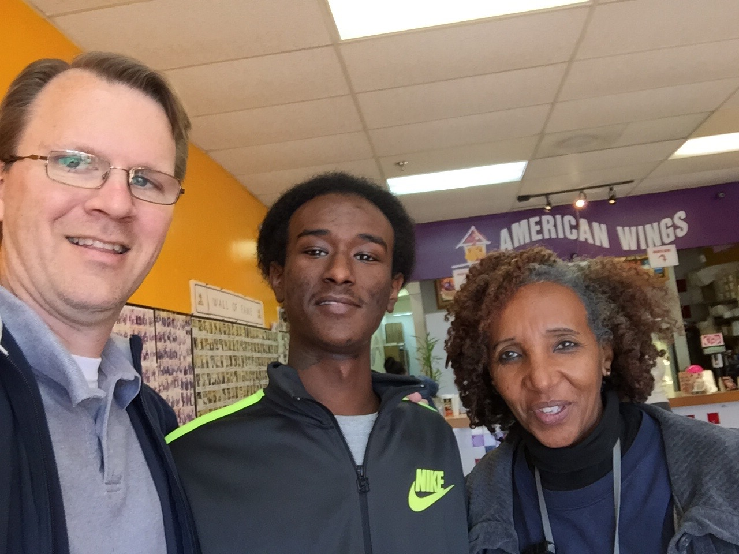

Slide 22
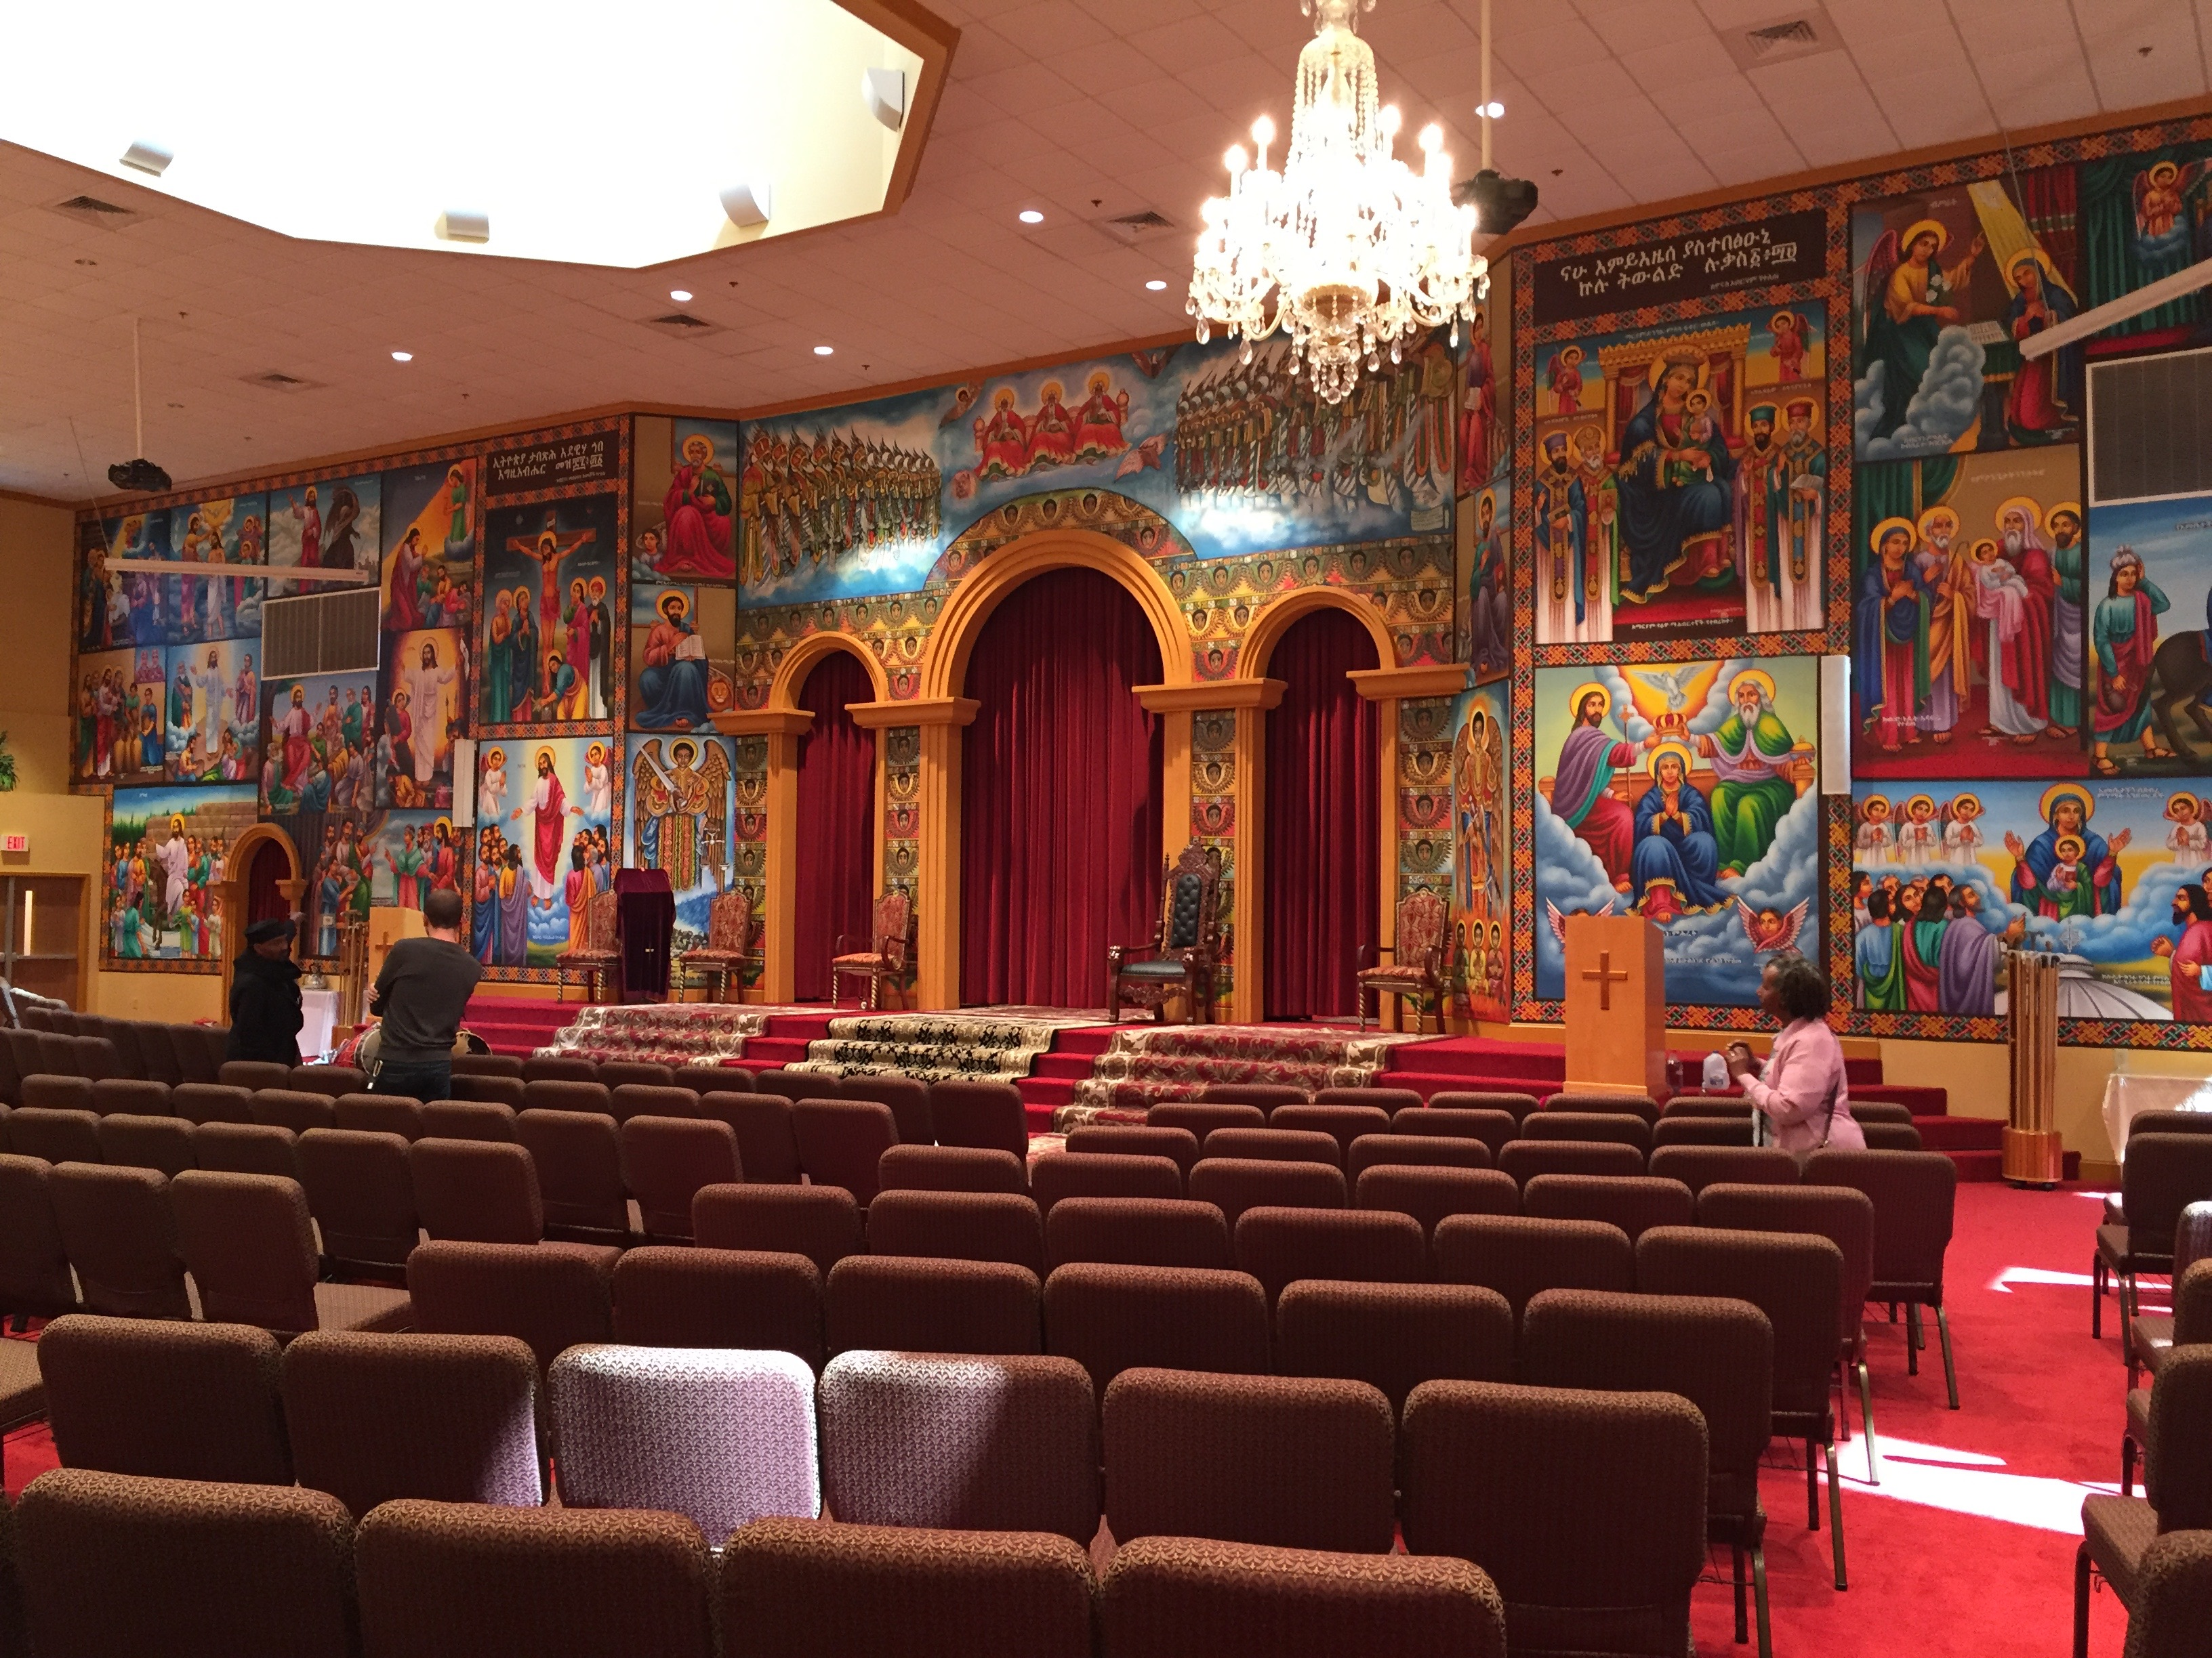

Slide 23
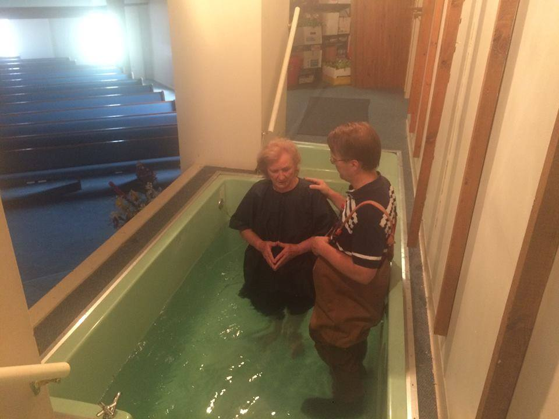

Slide 24
Develop a welcoming attitude toward the outsider.
Practice true hospitality at church, at school, and in the community.

