Slide 1
Welcome to Northwood

Slide 2
Save These Dates!
Child training workshop – Jan 22-24
Ladies’ Bible study – Feb 5-6
Weekend Bible study – Mar 25-27
Fall Focus – Sept 18-21

Slide 3
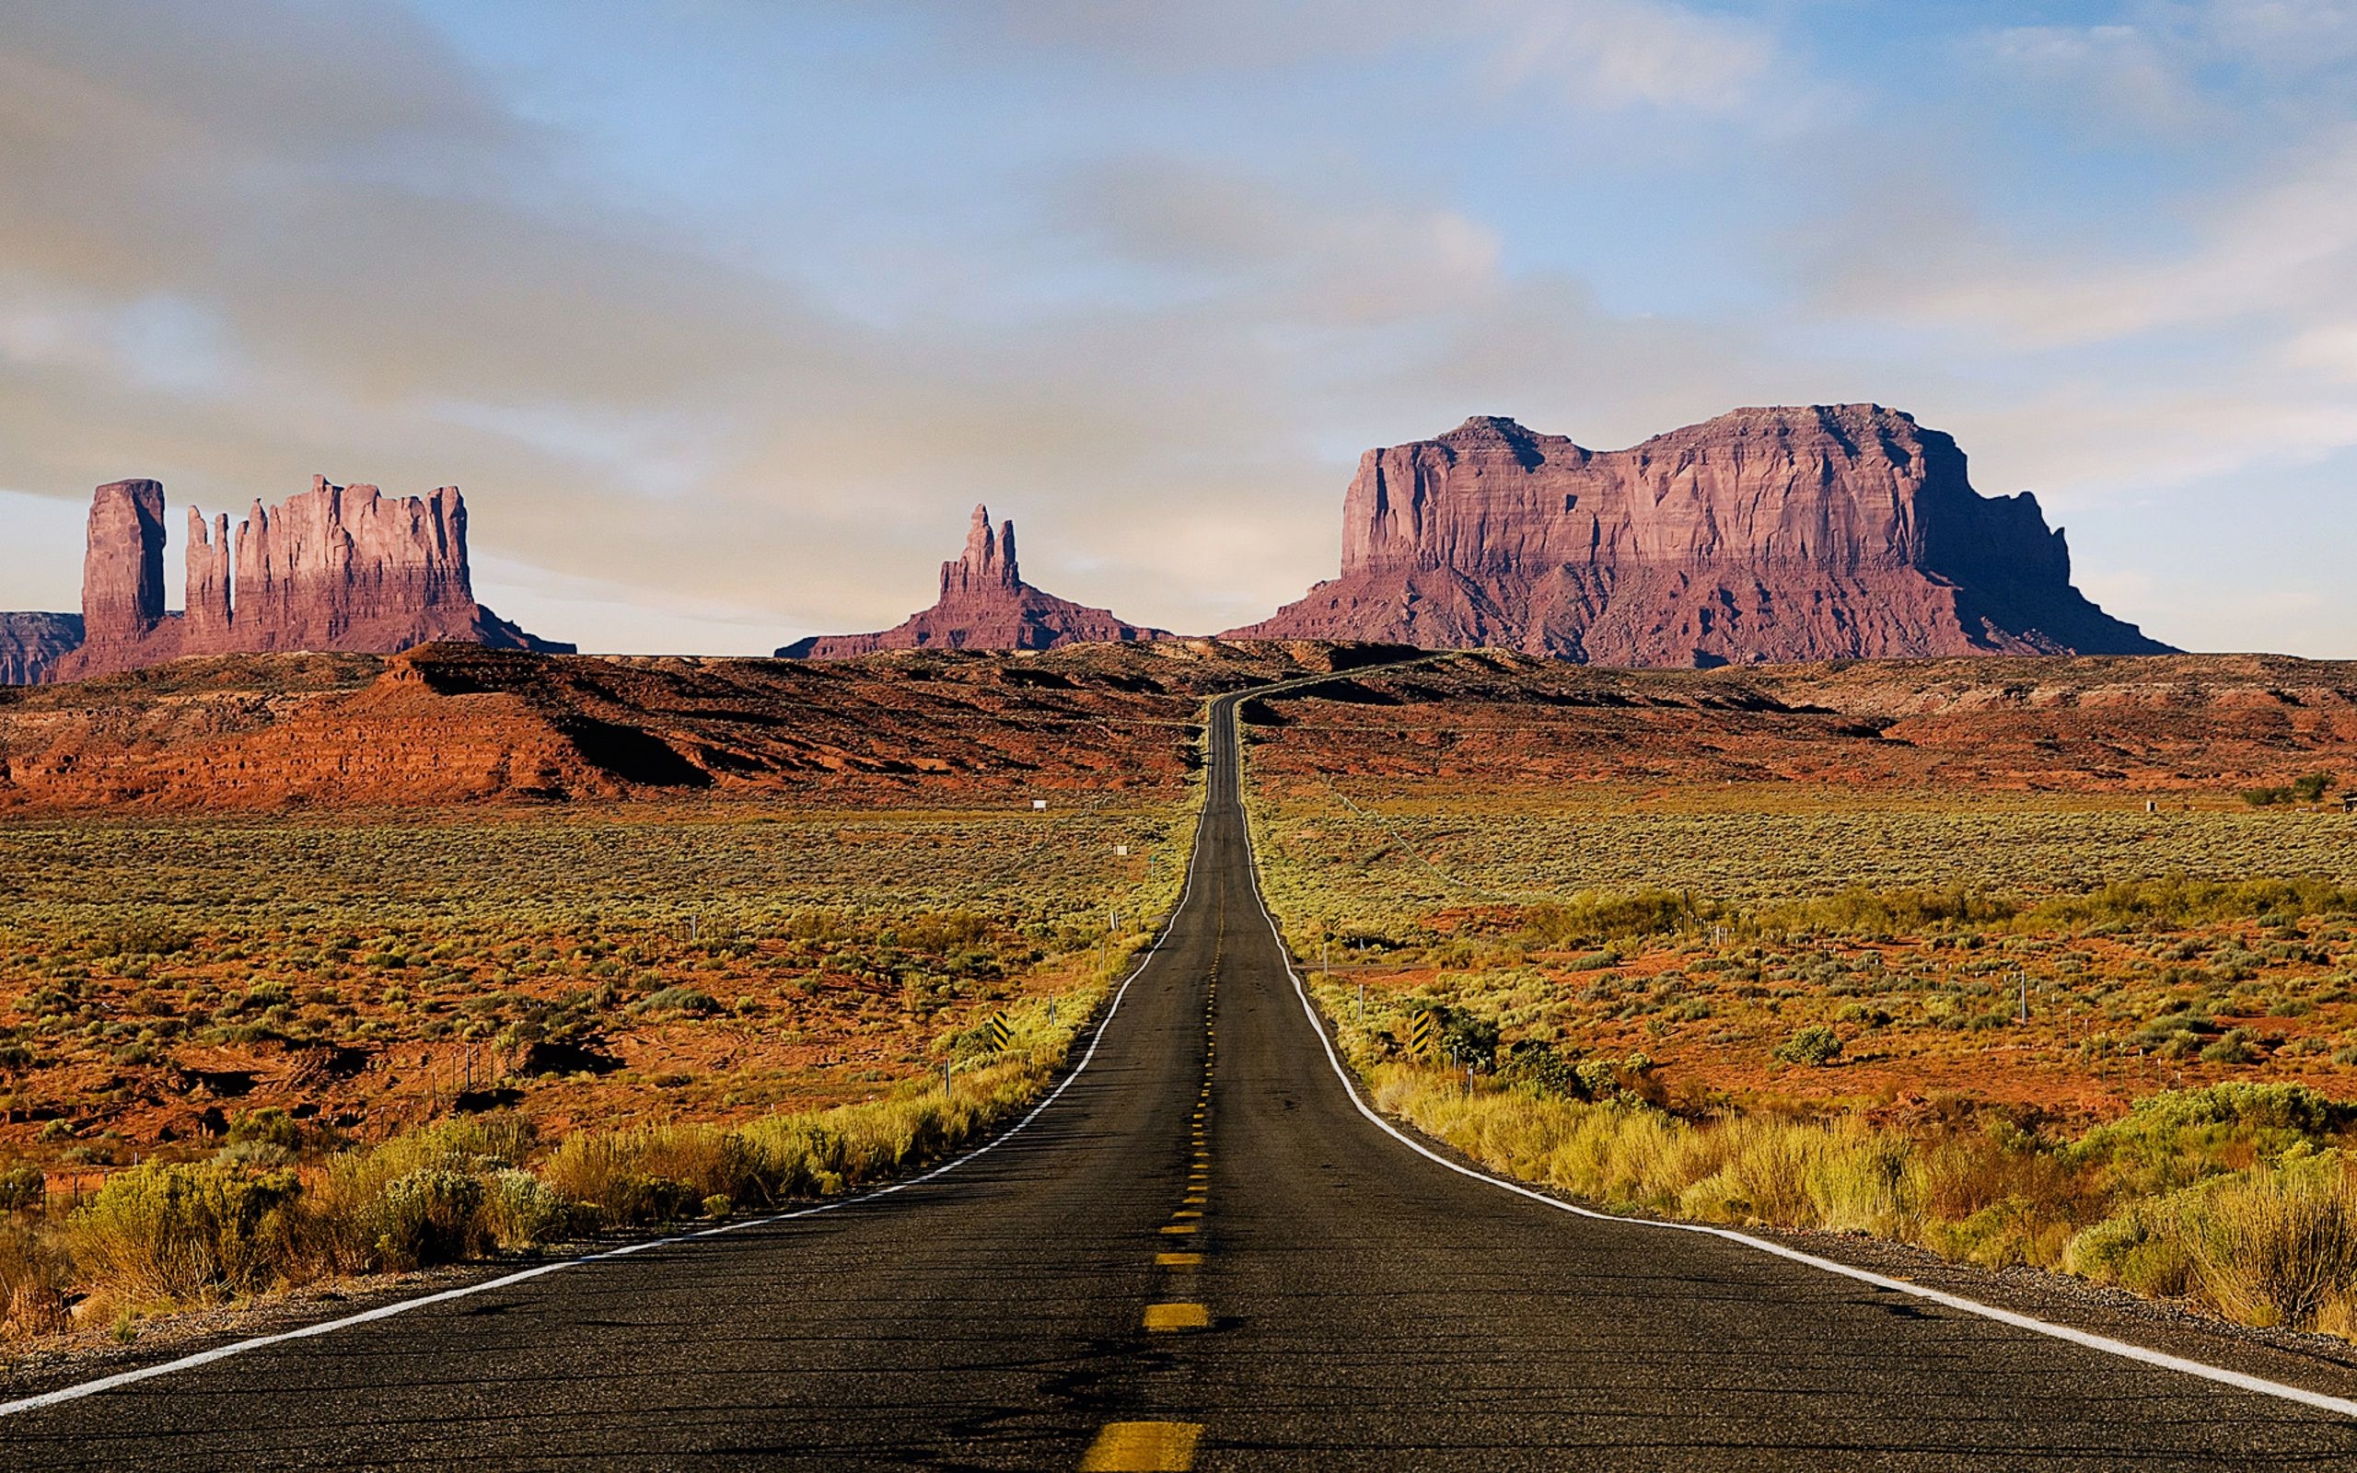
EVANGELISM IN EXILE

Slide 4
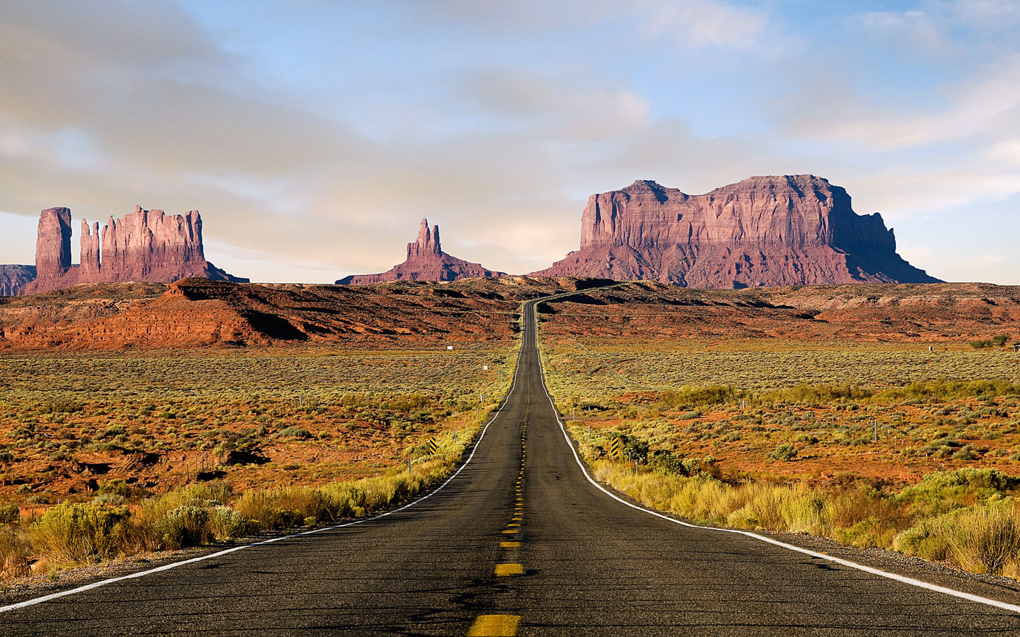
JUNE: WHAT EVERYBODY WANTS 1 PET 1:1-12 JULY: DIFFERENT PEOPLE MAKE A DIFFERENCE 1 PET 1:13-2:3 AUG: A HOLY PRIESTHOOD 1 PET 2:4-12 SEPT: EVANGELISM WITHOUT WORDS 1 PET 2:13-3:7 OCT: A MEEK DEFENSE 1 PET 3:8-17 NOV: A COUNTER-CULTURAL VIEW 1 PET 3:18-4:11 DEC: THIS IS THE TRUE GRACE OF GOD 1 PET 4:12-5:14

Slide 5
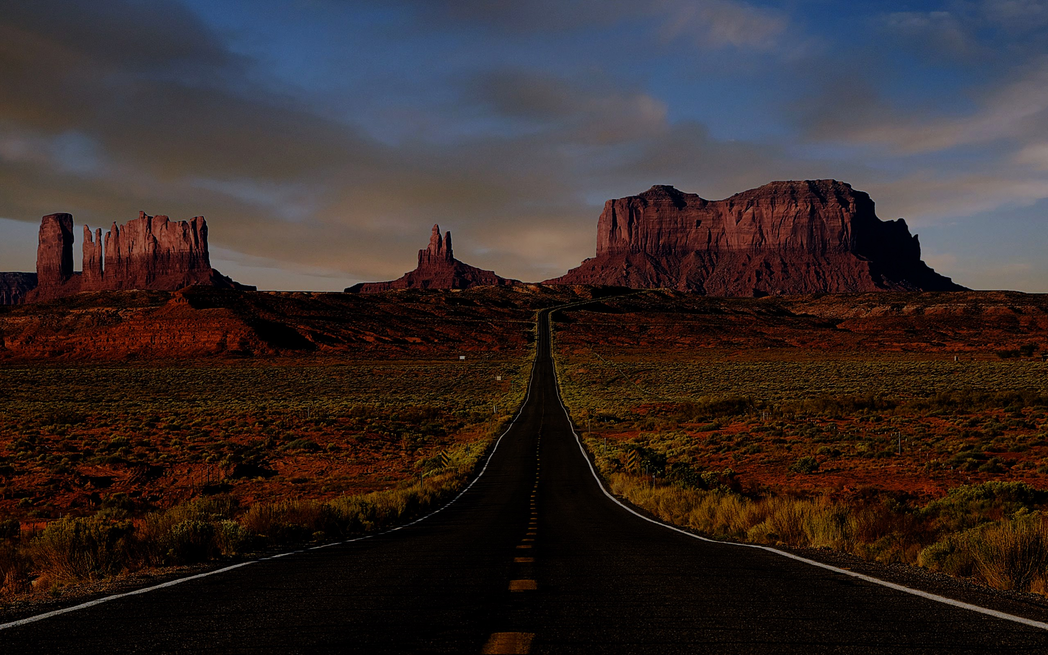
A counterculture MENTALITY
A counterculture COMMUNITY

Slide 6
Since therefore Christ suffered in the flesh, arm yourselves with the same way of thinking, for whoever has suffered in the flesh has ceased from sin, so as to live for the rest of the time in the flesh no longer for human passions but for the will of God.

Slide 7
Since therefore Christ suffered in the flesh, arm yourselves with the same way of thinking, for whoever has suffered in the flesh has ceased from sin, so as to live for the rest of the time in the flesh no longer for human passions but for the will of God.

Slide 8
Since therefore Christ suffered in the flesh, arm yourselves with the same way of thinking, for whoever has suffered in the flesh has ceased from sin, so as to live for the rest of the time in the flesh no longer for human passions but for the will of God.

Slide 9
Since therefore Christ suffered in the flesh, arm yourselves with the same way of thinking, for whoever has suffered in the flesh has ceased from sin, so as to live for the rest of the time in the flesh no longer for human passions but for the will of God.

Slide 10
A counterculture MENTALITY
A counterculture COMMUNITY

Slide 11
Above all, keep loving one another earnestly, since love covers a multitude of sins. Show hospitality to one another without grumbling. As each has received a gift, use it to serve one another, as good stewards of God’s varied grace...

Slide 12
Above all, keep loving one another earnestly, since love covers a multitude of sins. Show hospitality to one another without grumbling. As each has received a gift, use it to serve one another, as good stewards of God’s varied grace...

Slide 13
Above all, keep loving one another earnestly, since love covers a multitude of sins. Show hospitality to one another without grumbling. As each has received a gift, use it to serve one another, as good stewards of God’s varied grace...

Slide 14
Above all, keep loving one another earnestly, since love covers a multitude of sins. Show hospitality to one another without grumbling. As each has received a gift, use it to serve one another, as good stewards of God’s varied grace...

Slide 15
…whoever speaks, as one who speaks oracles of God; whoever serves, as one who serves by the strength which God supplies—in order that in everything God may be glorified through Jesus Christ. To him belong glory and dominion forever and ever. Amen.

Slide 16
…whoever speaks, as one who speaks oracles of God; whoever serves, as one who serves by the strength which God supplies—in order that in everything God may be glorified through Jesus Christ. To him belong glory and dominion forever and ever. Amen.

Slide 17
…whoever speaks, as one who speaks oracles of God; whoever serves, as one who serves by the strength which God supplies—in order that in everything God may be glorified through Jesus Christ. To him belong glory and dominion forever and ever. Amen.

Slide 18
Be firm and gentle when resisting sin.
Avoid those liberties which send the wrong message.
Seek creative ways to show hospitality.

