Slide 1
Welcome to
Northwood

Slide 2
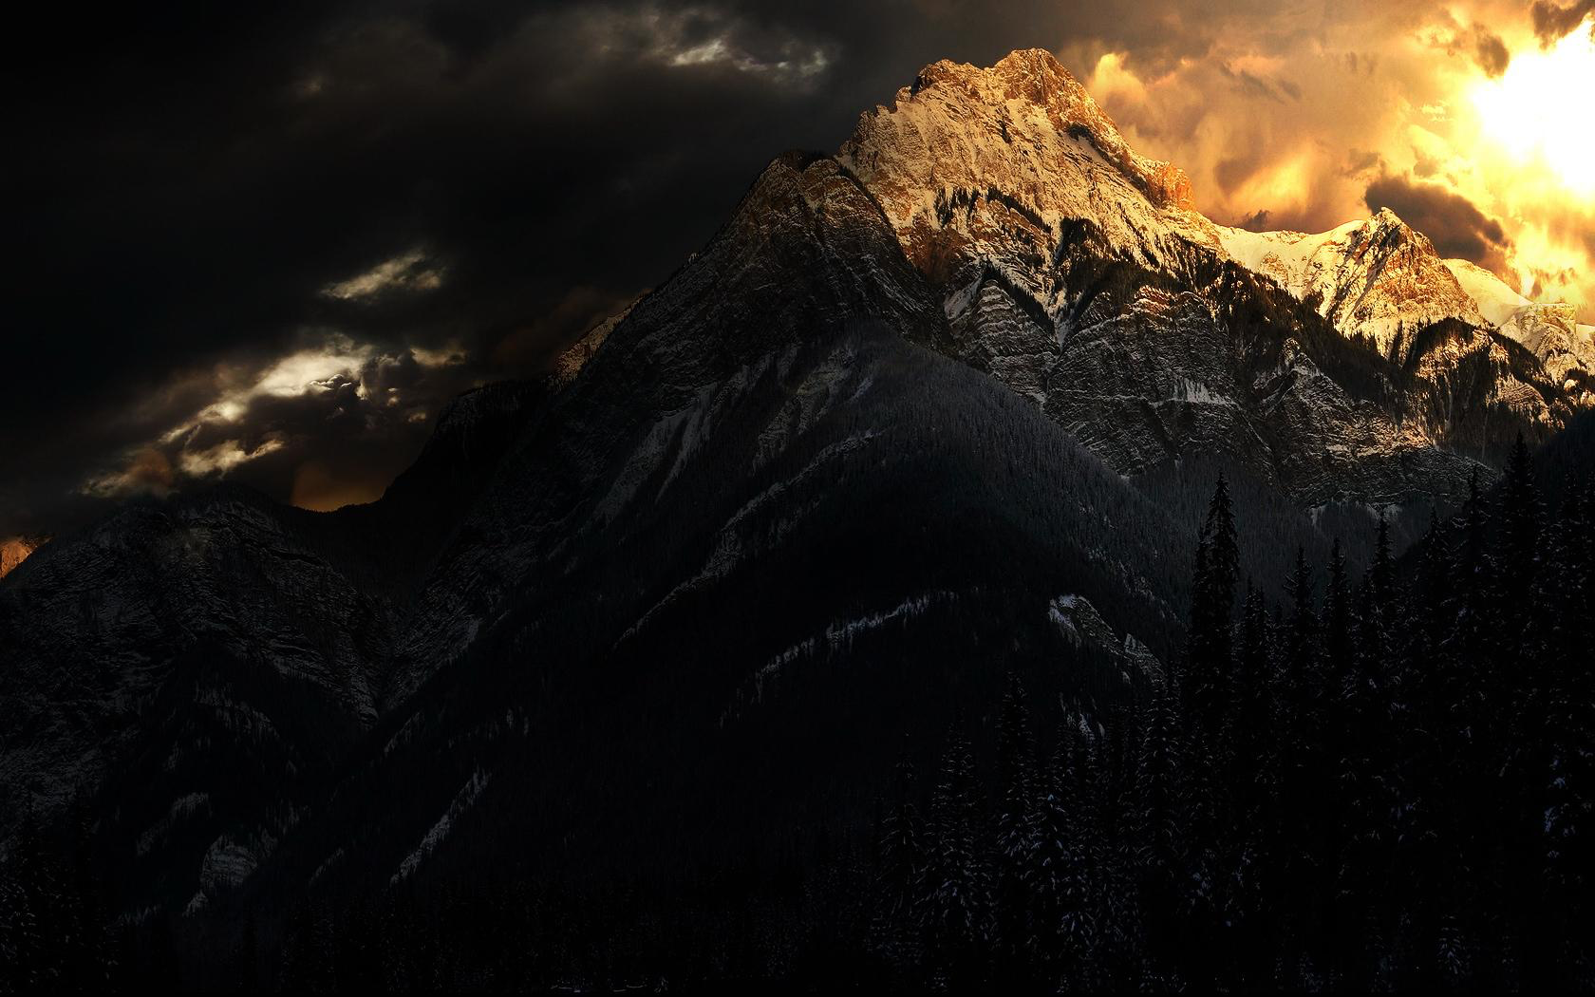
Revelation
The Constant Struggle Between Good and Evil

Slide 3
“I will put enmity between you and the woman,
and between your offspring and her offspring;
he shall bruise your head,
and you shall bruise his heel.”
Genesis 3:15

Slide 4
God preserves his people
God expels his enemy
Satan persecutes God’s people

Slide 5
Revelation 12
1 And a great sign appeared in heaven: a woman clothed with the sun, with the moon under her feet, and on her head a crown of twelve stars. 2 She was pregnant and was crying out in birth pains and the agony of giving birth. 3 And another sign appeared in heaven: behold, a great red dragon, with seven heads and ten horns, and on his heads seven diadems.

Slide 6
Revelation 12
1 And a great sign appeared in heaven: a woman clothed with the sun, with the moon under her feet, and on her head a crown of twelve stars. 2 She was pregnant and was crying out in birth pains and the agony of giving birth. 3 And another sign appeared in heaven: behold, a great red dragon, with seven heads and ten horns, and on his heads seven diadems.

Slide 7
Revelation 12
1 And a great sign appeared in heaven: a woman clothed with the sun, with the moon under her feet, and on her head a crown of twelve stars. 2 She was pregnant and was crying out in birth pains and the agony of giving birth. 3 And another sign appeared in heaven: behold, a great red dragon, with seven heads and ten horns, and on his heads seven diadems.
Writhe and groan, O daughter of Zion, like a woman in labor, for now you shall go out from the city and dwell in the open country; you shall go to Babylon. There you shall be rescued; there the LORD will redeem you from the hand of your enemies. Micah 4:10

Slide 8
Revelation 12
1 And a great sign appeared in heaven: a woman clothed with the sun, with the moon under her feet, and on her head a crown of twelve stars. 2 She was pregnant and was crying out in birth pains and the agony of giving birth. 3 And another sign appeared in heaven: behold, a great red dragon, with seven heads and ten horns, and on his heads seven diadems.
“Behold, the sun, the moon, and eleven stars were bowing down to me.” Genesis 37:10

Slide 9
Revelation 12
1 And a great sign appeared in heaven: a woman clothed with the sun, with the moon under her feet, and on her head a crown of twelve stars. 2 She was pregnant and was crying out in birth pains and the agony of giving birth. 3 And another sign appeared in heaven: behold, a great red dragon, with seven heads and ten horns, and on his heads seven diadems.

Slide 10
Revelation 12
1 And a great sign appeared in heaven: a woman clothed with the sun, with the moon under her feet, and on her head a crown of twelve stars. 2 She was pregnant and was crying out in birth pains and the agony of giving birth. 3 And another sign appeared in heaven: behold, a great red dragon, with seven heads and ten horns, and on his heads seven diadems.

Slide 11
Revelation 12
1 And a great sign appeared in heaven: a woman clothed with the sun, with the moon under her feet, and on her head a crown of twelve stars. 2 She was pregnant and was crying out in birth pains and the agony of giving birth. 3 And another sign appeared in heaven: behold, a great red dragon, with seven heads and ten horns, and on his heads seven diadems.

Slide 12
Revelation 12
1 And a great sign appeared in heaven: a woman clothed with the sun, with the moon under her feet, and on her head a crown of twelve stars. 2 She was pregnant and was crying out in birth pains and the agony of giving birth. 3 And another sign appeared in heaven: behold, a great red dragon, with seven heads and ten horns, and on his heads seven diadems.
We know that we are from God, and the whole world lies in the power of the evil one. 1 John 5:19

Slide 13
4 His tail swept down a third of the stars of heaven and cast them to the earth. And the dragon stood before the woman who was about to give birth, so that when she bore her child he might devour it. 5 She gave birth to a male child, one who is to rule all the nations with a rod of iron, but her child was caught up to God and to his throne, 6 and the woman fled into the wilderness, where she has a place prepared by God, in which she is to be nourished for 1,260 days.
“When you serve as midwife to the Hebrew women and see them on the birthstool, if it is a son, you shall kill him…” Ex 3:16

Slide 14
4 His tail swept down a third of the stars of heaven and cast them to the earth. And the dragon stood before the woman who was about to give birth, so that when she bore her child he might devour it. 5 She gave birth to a male child, one who is to rule all the nations with a rod of iron, but her child was caught up to God and to his throne, 6 and the woman fled into the wilderness, where she has a place prepared by God, in which she is to be nourished for 1,260 days.

Slide 15
4 His tail swept down a third of the stars of heaven and cast them to the earth. And the dragon stood before the woman who was about to give birth, so that when she bore her child he might devour it. 5 She gave birth to a male child, one who is to rule all the nations with a rod of iron, but her child was caught up to God and to his throne, 6 and the woman fled into the wilderness, where she has a place prepared by God, in which she is to be nourished for 1,260 days.

Slide 16
4 His tail swept down a third of the stars of heaven and cast them to the earth. And the dragon stood before the woman who was about to give birth, so that when she bore her child he might devour it. 5 She gave birth to a male child, one who is to rule all the nations with a rod of iron, but her child was caught up to God and to his throne, 6 and the woman fled into the wilderness, where she has a place prepared by God, in which she is to be nourished for 1,260 days.
“You shall break them with a rod of iron and dash them in pieces like a potter’s vessel.” Psalm 2:9

Slide 17
4 His tail swept down a third of the stars of heaven and cast them to the earth. And the dragon stood before the woman who was about to give birth, so that when she bore her child he might devour it. 5 She gave birth to a male child, one who is to rule all the nations with a rod of iron, but her child was caught up to God and to his throne, 6 and the woman fled into the wilderness, where she has a place prepared by God, in which she is to be nourished for 1,260 days.
The LORD says to my Lord: “Sit at my right hand, until I make your enemies your footstool.” Psa 110:1

Slide 18
4 His tail swept down a third of the stars of heaven and cast them to the earth. And the dragon stood before the woman who was about to give birth, so that when she bore her child he might devour it. 5 She gave birth to a male child, one who is to rule all the nations with a rod of iron, but her child was caught up to God and to his throne, 6 and the woman fled into the wilderness, where she has a place prepared by God, in which she is to be nourished for 1,260 days.

Slide 19
7 Now war arose in heaven, Michael and his angels fighting against the dragon. And the dragon and his angels fought back, 8 but he was defeated, and there was no longer any place for them in heaven. 9 And the great dragon was thrown down, that ancient serpent, who is called the devil and Satan, the deceiver of the whole world—he was thrown down to the earth, and his angels were thrown down with him.

Slide 20
7 Now war arose in heaven, Michael and his angels fighting against the dragon. And the dragon and his angels fought back, 8 but he was defeated, and there was no longer any place for them in heaven. 9 And the great dragon was thrown down, that ancient serpent, who is called the devil and Satan, the deceiver of the whole world—he was thrown down to the earth, and his angels were thrown down with him.

Slide 21
7 Now war arose in heaven, Michael and his angels fighting against the dragon. And the dragon and his angels fought back, 8 but he was defeated, and there was no longer any place for them in heaven. 9 And the great dragon was thrown down, that ancient serpent, who is called the devil and Satan, the deceiver of the whole world—he was thrown down to the earth, and his angels were thrown down with him.

Slide 22
7 Now war arose in heaven, Michael and his angels fighting against the dragon. And the dragon and his angels fought back, 8 but he was defeated, and there was no longer any place for them in heaven. 9 And the great dragon was thrown down, that ancient serpent, who is called the devil and Satan, the deceiver of the whole world—he was thrown down to the earth, and his angels were thrown down with him.
“…on this rock I will build my church, and the gates of hell shall not prevail against it…” Matthew 16:18

Slide 23
7 Now war arose in heaven, Michael and his angels fighting against the dragon. And the dragon and his angels fought back, 8 but he was defeated, and there was no longer any place for them in heaven. 9 And the great dragon was thrown down, that ancient serpent, who is called the devil and Satan, the deceiver of the whole world—he was thrown down to the earth, and his angels were thrown down with him.

Slide 24
7 Now war arose in heaven, Michael and his angels fighting against the dragon. And the dragon and his angels fought back, 8 but he was defeated, and there was no longer any place for them in heaven. 9 And the great dragon was thrown down, that ancient serpent, who is called the devil and Satan, the deceiver of the whole world—he was thrown down to the earth, and his angels were thrown down with him.
“Now is the judgment of this world; now will the ruler of this world be cast out. And I when I am lifted up from the earth, will draw all people to myself.” John 12:31-32

Slide 25
10 And I heard a loud voice in heaven, saying, “Now the salvation and the power and the kingdom of our God and the authority of his Christ have come, for the accuser of our brothers has been thrown down, who accuses them day and night before our God. 11 And they have conquered him by the blood of the Lamb and by the word of their testimony, for they loved not their lives even unto death.

Slide 26
10 And I heard a loud voice in heaven, saying, “Now the salvation and the power and the kingdom of our God and the authority of his Christ have come, for the accuser of our brothers has been thrown down, who accuses them day and night before our God. 11 And they have conquered him by the blood of the Lamb and by the word of their testimony, for they loved not their lives even unto death.
“All authority in heaven and on earth has been given to me.” Matthew 28:18

Slide 27
10 And I heard a loud voice in heaven, saying, “Now the salvation and the power and the kingdom of our God and the authority of his Christ have come, for the accuser of our brothers has been thrown down, who accuses them day and night before our God. 11 And they have conquered him by the blood of the Lamb and by the word of their testimony, for they loved not their lives even unto death.
He disarmed the rulers and authorities and put them to open shame, by triumphing over them in him. Colossians 2:15

Slide 28
10 And I heard a loud voice in heaven, saying, “Now the salvation and the power and the kingdom of our God and the authority of his Christ have come, for the accuser of our brothers has been thrown down, who accuses them day and night before our God. 11 And they have conquered him by the blood of the Lamb and by the word of their testimony, for they loved not their lives even unto death.

Slide 29
10 And I heard a loud voice in heaven, saying, “Now the salvation and the power and the kingdom of our God and the authority of his Christ have come, for the accuser of our brothers has been thrown down, who accuses them day and night before our God. 11 And they have conquered him by the blood of the Lamb and by the word of their testimony, for they loved not their lives even unto death.
…through death he might destroy the one who has the power of death, that is, the devil… Heb 2:14

Slide 30
10 And I heard a loud voice in heaven, saying, “Now the salvation and the power and the kingdom of our God and the authority of his Christ have come, for the accuser of our brothers has been thrown down, who accuses them day and night before our God. 11 And they have conquered him by the blood of the Lamb and by the word of their testimony, for they loved not their lives even unto death.

Slide 31
10 And I heard a loud voice in heaven, saying, “Now the salvation and the power and the kingdom of our God and the authority of his Christ have come, for the accuser of our brothers has been thrown down, who accuses them day and night before our God. 11 And they have conquered him by the blood of the Lamb and by the word of their testimony, for they loved not their lives even unto death.
“Be faithful unto death, and I will give you the crown of life.” Revelation 2:10

Slide 32
12 Therefore, rejoice, O heavens and you who dwell in them! But woe to you, O earth and sea, for the devil has come down to you in great wrath, because he knows that his time is short!”

Slide 33
12 Therefore, rejoice, O heavens and you who dwell in them! But woe to you, O earth and sea, for the devil has come down to you in great wrath, because he knows that his time is short!”
…and raised us up with him and seated us with him in the heavenly places in Christ Jesus… Ephesians 2:6

Slide 34
12 Therefore, rejoice, O heavens and you who dwell in them! But woe to you, O earth and sea, for the devil has come down to you in great wrath, because he knows that his time is short!”

Slide 35
13 And when the dragon saw that he had been thrown down to the earth, he pursued the woman who had given birth to the male child. 14 But the woman was given the two wings of the great eagle so that she might fly from the serpent into the wilderness, to the place where she is to be nourished for a time, and times, and half a time.

Slide 36
13 And when the dragon saw that he had been thrown down to the earth, he pursued the woman who had given birth to the male child. 14 But the woman was given the two wings of the great eagle so that she might fly from the serpent into the wilderness, to the place where she is to be nourished for a time, and times, and half a time.

Slide 37
“but they who wait for the LORD shall renew their strength; they shall mount up with wings like eagles…” Isaiah 40:31
13 And when the dragon saw that he had been thrown down to the earth, he pursued the woman who had given birth to the male child. 14 But the woman was given the two wings of the great eagle so that she might fly from the serpent into the wilderness, to the place where she is to be nourished for a time, and times, and half a time.

Slide 38
15 The serpent poured water like a river out of his mouth after the woman, to sweep her away with a flood. 16 But the earth came to the help of the woman, and the earth opened its mouth and swallowed the river that the dragon had poured from his mouth.

Slide 39
17 Then the dragon became furious with the woman and went off to make war on the rest of her offspring, on those who keep the commandments of God and hold to the testimony of Jesus. And he stood on the sand of the sea.

Slide 40
17 Then the dragon became furious with the woman and went off to make war on the rest of her offspring, on those who keep the commandments of God and hold to the testimony of Jesus. And he stood on the sand of the sea.
“You are of your father the devil… He was a murderer from the beginning…” Jn 8:44

Slide 42
For we do not wrestle against flesh and blood, but against the rulers, against the authorities, against the cosmic powers over this present darkness, against the spiritual forces of evil in the heavenly places. Ephesians 6:12

Slide 43
The blood of the Lamb
The word of their testimony
They loved not their lives even unto death

