Slide 1
Welcome to Northwood

Slide 2
Epaphroditus
Reckless Love

Slide 3
Five exalted titles
An example of true selflessness
How to receive a gift
The appropriate response to humble servants
How to give a gift

Slide 4
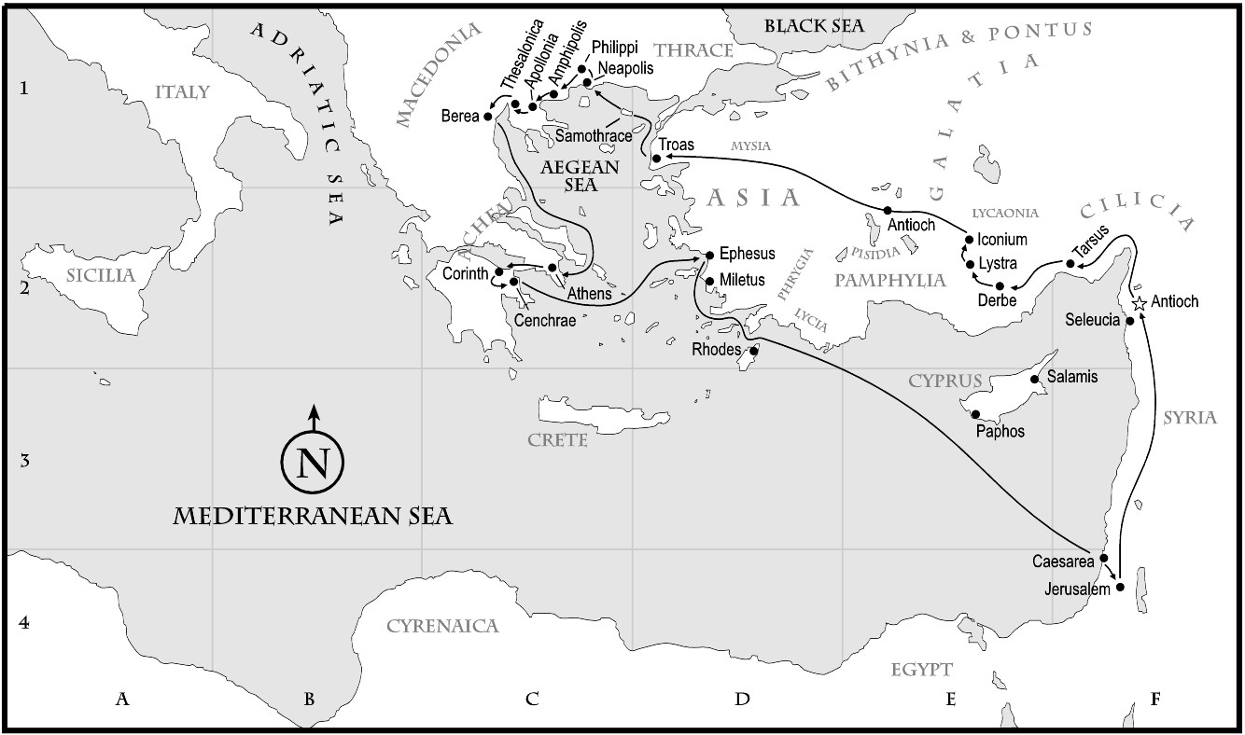

Slide 5
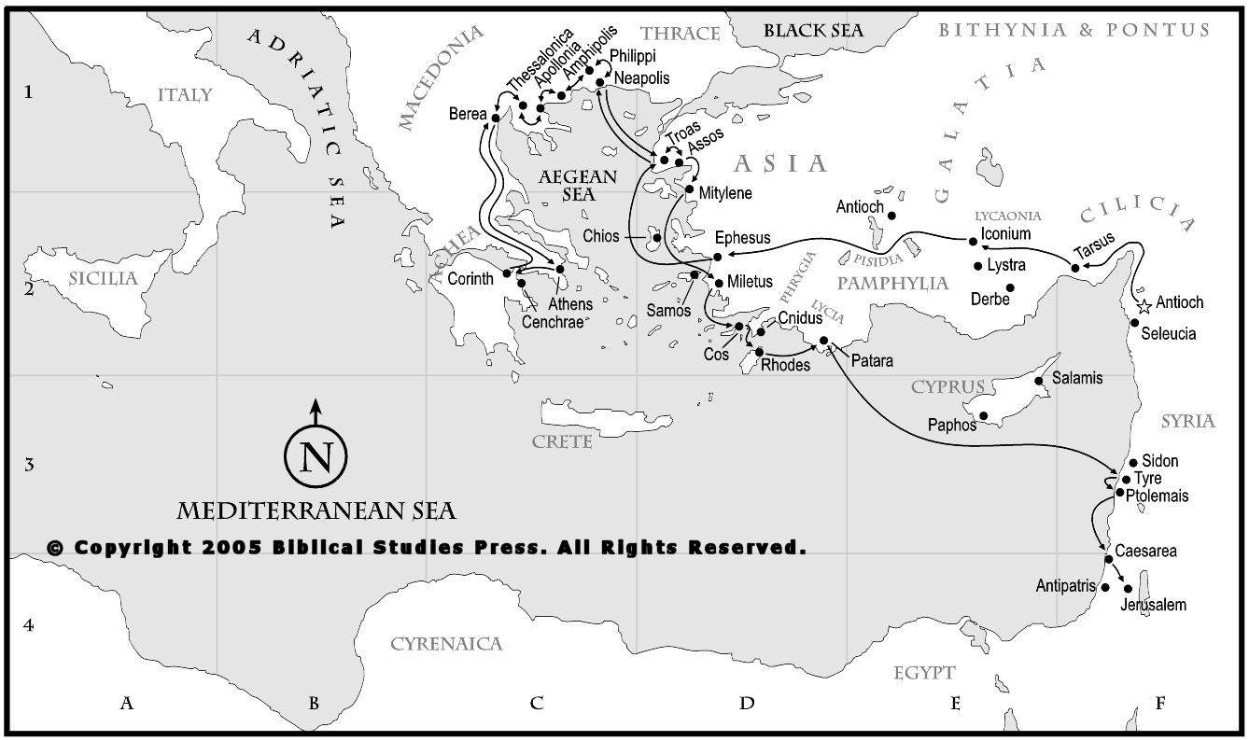

Slide 7
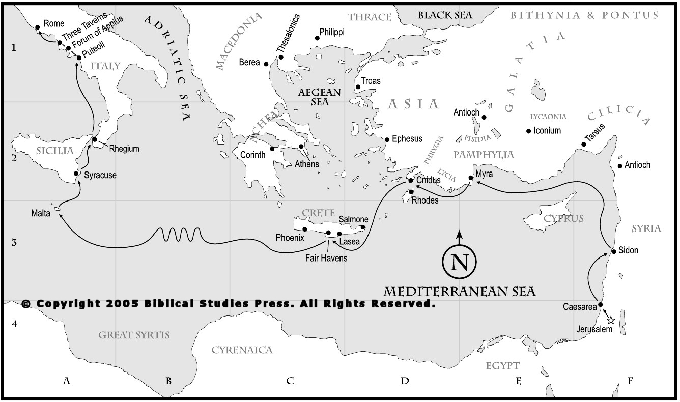

Slide 8
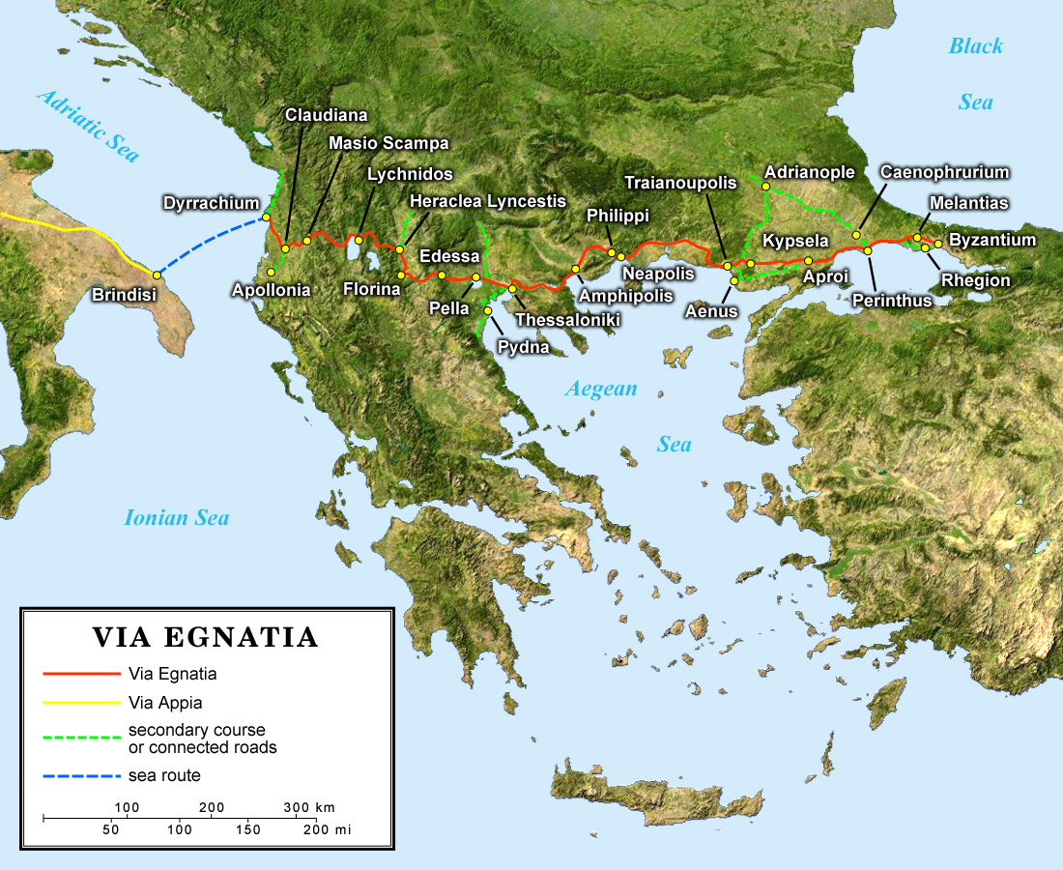

Slide 10
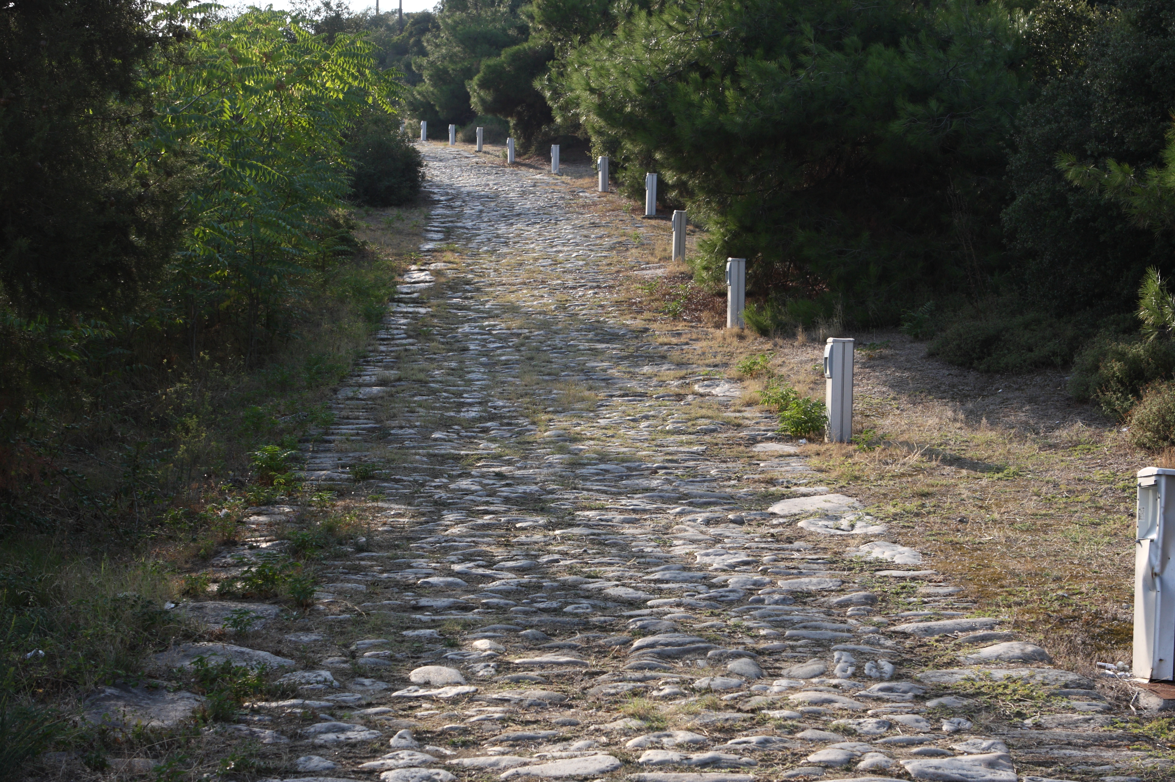

Slide 11
Philippians 2
25 I have thought it necessary to send to you Epaphroditus my brother and fellow worker and fellow soldier, and your messenger and minister to my need, 26 for he has been longing for you all and has been distressed because you heard that he was ill.

Slide 12
Philippians 2
25 I have thought it necessary to send to you Epaphroditus my brother and fellow worker and fellow soldier, and your messenger and minister to my need, 26 for he has been longing for you all and has been distressed because you heard that he was ill.
“A favorite of Aphrodite”

Slide 13
Philippians 2
25 I have thought it necessary to send to you Epaphroditus my brother and fellow worker and fellow soldier, and your messenger and minister to my need, 26 for he has been longing for you all and has been distressed because you heard that he was ill.

Slide 14
Philippians 2
25 I have thought it necessary to send to you Epaphroditus my brother and fellow worker and fellow soldier, and your messenger and minister to my need, 26 for he has been longing for you all and has been distressed because you heard that he was ill.

Slide 15
Philippians 2
25 I have thought it necessary to send to you Epaphroditus my brother and fellow worker and fellow soldier, and your messenger and minister to my need, 26 for he has been longing for you all and has been distressed because you heard that he was ill.

Slide 16
Philippians 2
25 I have thought it necessary to send to you Epaphroditus my brother and fellow worker and fellow soldier, and your messenger and minister to my need, 26 for he has been longing for you all and has been distressed because you heard that he was ill.

Slide 17
Philippians 2
25 I have thought it necessary to send to you Epaphroditus my brother and fellow worker and fellow soldier, and your messenger and minister to my need, 26 for he has been longing for you all and has been distressed because you heard that he was ill.

Slide 18
Philippians 2
25 I have thought it necessary to send to you Epaphroditus my brother and fellow worker and fellow soldier, and your messenger and minister to my need, 26 for he has been longing for you all and has been distressed because you heard that he was ill.

Slide 19
Philippians 2
25 I have thought it necessary to send to you Epaphroditus my brother and fellow worker and fellow soldier, and your messenger and minister to my need, 26 for he has been longing for you all and has been distressed because you heard that he was ill.

Slide 20
Philippians 2
27 Indeed he was ill, near to death. But God had mercy on him, and not only on him but on me also, lest I should have sorrow upon sorrow. 28 I am the more eager to send him, therefore, that you may rejoice at seeing him again, and that I may be less anxious.

Slide 21
Philippians 2
27 Indeed he was ill, near to death. But God had mercy on him, and not only on him but on me also, lest I should have sorrow upon sorrow. 28 I am the more eager to send him, therefore, that you may rejoice at seeing him again, and that I may be less anxious.

Slide 22
Philippians 2
27 Indeed he was ill, near to death. But God had mercy on him, and not only on him but on me also, lest I should have sorrow upon sorrow. 28 I am the more eager to send him, therefore, that you may rejoice at seeing him again, and that I may be less anxious.

Slide 23
Philippians 2
27 Indeed he was ill, near to death. But God had mercy on him, and not only on him but on me also, lest I should have sorrow upon sorrow. 28 I am the more eager to send him, therefore, that you may rejoice at seeing him again, and that I may be less anxious.

Slide 24
Philippians 2
27 Indeed he was ill, near to death. But God had mercy on him, and not only on him but on me also, lest I should have sorrow upon sorrow. 28 I am the more eager to send him, therefore, that you may rejoice at seeing him again, and that I may be less anxious.

Slide 25
Philippians 4
17 Not that I seek the gift, but I seek the fruit that increases to your credit. 18 I have received full payment, and more. I am well supplied, having received from Epaphroditus the gifts you sent, a fragrant offering, a sacrifice acceptable and pleasing to God.

Slide 26
Philippians 4
17 Not that I seek the gift, but I seek the fruit that increases to your credit. 18 I have received full payment, and more. I am well supplied, having received from Epaphroditus the gifts you sent, a fragrant offering, a sacrifice acceptable and pleasing to God.

Slide 27
Philippians 4
17 Not that I seek the gift, but I seek the fruit that increases to your credit. 18 I have received full payment, and more. I am well supplied, having received from Epaphroditus the gifts you sent, a fragrant offering, a sacrifice acceptable and pleasing to God.

Slide 28
Philippians 2
29 So receive him in the Lord with all joy, and honor such men, 30 for he nearly died for the work of Christ, risking his life to complete what was lacking in your service to me.

Slide 29
Philippians 2
29 So receive him in the Lord with all joy, and honor such men, 30 for he nearly died for the work of Christ, risking his life to complete what was lacking in your service to me.

Slide 30
Philippians 2
29 So receive him in the Lord with all joy, and honor such men, 30 for he nearly died for the work of Christ, risking his life to complete what was lacking in your service to me.

Slide 31
Give a gift that is costly,
risky,
non-material,
and without strings

