Slide 1
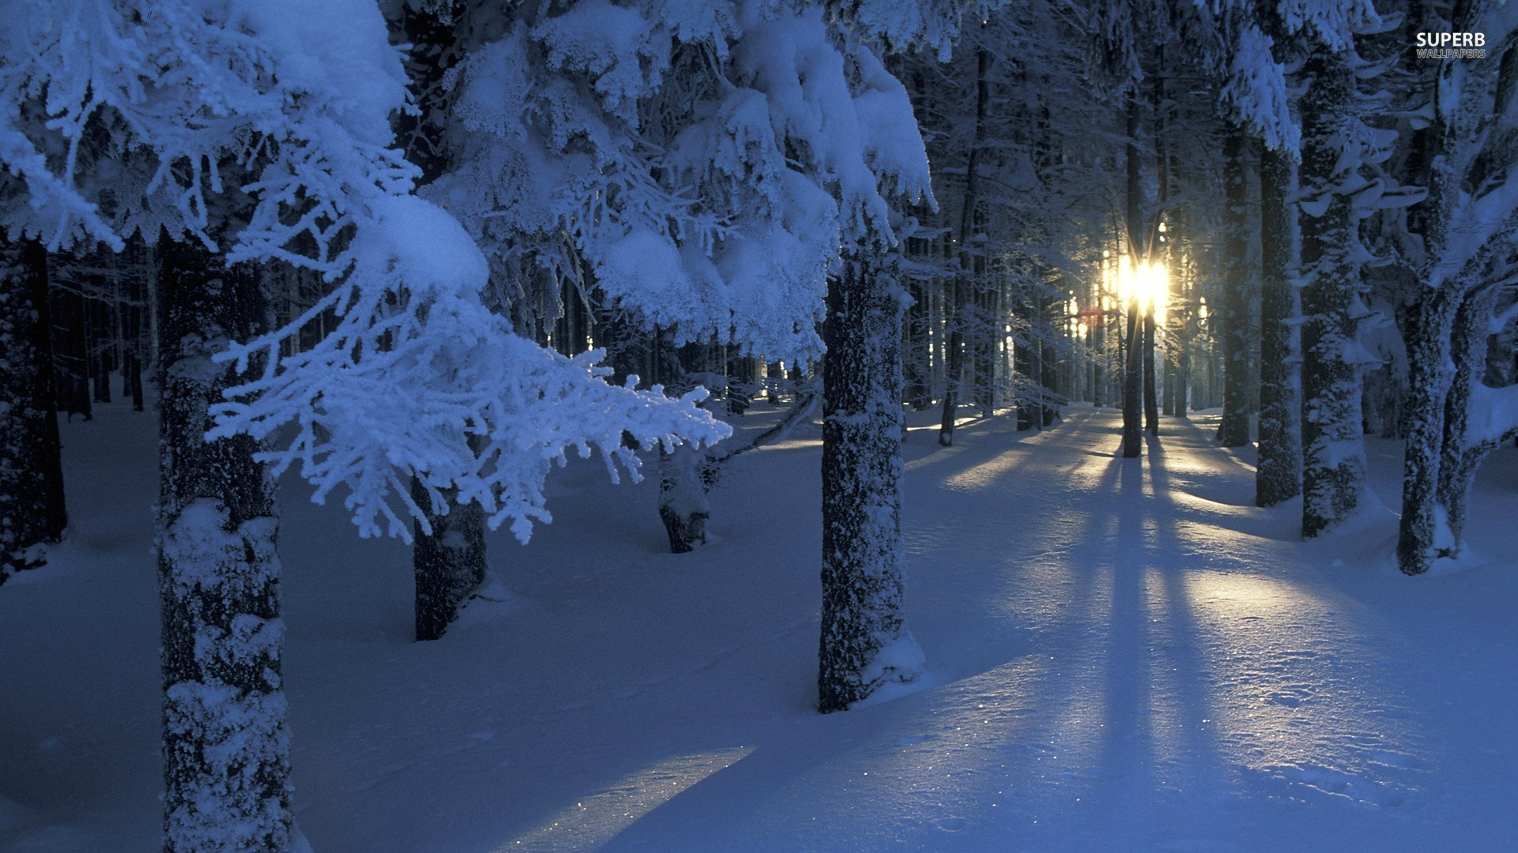
Welcome to Northwood

Slide 2
Our Eyes Are On You
Our Commitment to Prayer in 2016

Slide 3
A definition of prayer
Preparation for prayer
A community in prayer
The results of prayer
How to use a prayer journal

Slide 4
2 Chronicles 20:1-2
After this the Moabites and Ammonites, and with them some of the Meunites, came against Jehoshaphat for battle. Some men came and told Jehoshaphat, “A great multitude is coming against you from Edom, from beyond the sea; and, behold, they are in Hazazon-tamar” (that is, Engedi).

Slide 5
2 Chronicles 20:3-4
Then Jehoshaphat was afraid and set his face to seek the LORD, and proclaimed a fast throughout all Judah. And Judah assembled to seek help from the LORD; from all the cities of Judah they came to seek the LORD.

Slide 6
2 Chronicles 20:3-4
Then Jehoshaphat was afraid and set his face to seek the LORD, and proclaimed a fast throughout all Judah. And Judah assembled to seek help from the LORD; from all the cities of Judah they came to seek the LORD.

Slide 7
2 Chronicles 20:3-4
Then Jehoshaphat was afraid and set his face to seek the LORD, and proclaimed a fast throughout all Judah. And Judah assembled to seek help from the LORD; from all the cities of Judah they came to seek the LORD.

Slide 8
2 Chronicles 7:14
“if my people who are called by my name humble themselves, and pray and seek my face and turn from their wicked way, then I will hear from heaven and will forgive their sin and heal their land.”

Slide 9
2 Chronicles 20:3
Then Jehoshaphat was afraid and set his face to seek the LORD, and proclaimed a fast throughout all Judah.

Slide 10
2 Chronicles 20:3
Then Jehoshaphat was afraid and set his face to seek the LORD, and proclaimed a fast throughout all Judah.

Slide 11
2 Chronicles 20:3
Then Jehoshaphat was afraid and set his face to seek the LORD, and proclaimed a fast throughout all Judah.

Slide 12
2 Chronicles 20:5-7
And Jehoshaphat stood in the assembly of Judah and Jerusalem, in the house of the LORD, before the new court, and said, “O LORD, God of our fathers, are you not God in heaven? You rule over all the kingdoms of the nations. In your hand are power and might, so that none is able to withstand you. Did you not, our God, drive out the inhabitants of this land before your people Israel, and give it forever to the descendants of Abraham your friend?

Slide 13
2 Chronicles 20:5-7
And Jehoshaphat stood in the assembly of Judah and Jerusalem, in the house of the LORD, before the new court, and said, “O LORD, God of our fathers, are you not God in heaven? You rule over all the kingdoms of the nations. In your hand are power and might, so that none is able to withstand you. Did you not, our God, drive out the inhabitants of this land before your people Israel, and give it forever to the descendants of Abraham your friend?

Slide 14
2 Chronicles 20:5-7
And Jehoshaphat stood in the assembly of Judah and Jerusalem, in the house of the LORD, before the new court, and said, “O LORD, God of our fathers, are you not God in heaven? You rule over all the kingdoms of the nations. In your hand are power and might, so that none is able to withstand you. Did you not, our God, drive out the inhabitants of this land before your people Israel, and give it forever to the descendants of Abraham your friend?

Slide 15
2 Chronicles 20:5-7
And Jehoshaphat stood in the assembly of Judah and Jerusalem, in the house of the LORD, before the new court, and said, “O LORD, God of our fathers, are you not God in heaven? You rule over all the kingdoms of the nations. In your hand are power and might, so that none is able to withstand you. Did you not, our God, drive out the inhabitants of this land before your people Israel, and give it forever to the descendants of Abraham your friend?

Slide 16
2 Chronicles 20:5-7
And Jehoshaphat stood in the assembly of Judah and Jerusalem, in the house of the LORD, before the new court, and said, “O LORD, God of our fathers, are you not God in heaven? You rule over all the kingdoms of the nations. In your hand are power and might, so that none is able to withstand you. Did you not, our God, drive out the inhabitants of this land before your people Israel, and give it forever to the descendants of Abraham your friend?

Slide 17
2 Chronicles 20:5-7
And Jehoshaphat stood in the assembly of Judah and Jerusalem, in the house of the LORD, before the new court, and said, “O LORD, God of our fathers, are you not God in heaven? You rule over all the kingdoms of the nations. In your hand are power and might, so that none is able to withstand you. Did you not, our God, drive out the inhabitants of this land before your people Israel, and give it forever to the descendants of Abraham your friend?

Slide 18
2 Chronicles 20:5-7
And Jehoshaphat stood in the assembly of Judah and Jerusalem, in the house of the LORD, before the new court, and said, “O LORD, God of our fathers, are you not God in heaven? You rule over all the kingdoms of the nations. In your hand are power and might, so that none is able to withstand you. Did you not, our God, drive out the inhabitants of this land before your people Israel, and give it forever to the descendants of Abraham your friend?

Slide 19
2 Chronicles 20:8-9
And they have lived in it and have built for you in it a sanctuary for your name, saying, “If disaster comes upon us, the sword, judgment, or pestilence, or famine, we will stand before this house and before you—for your name is in this house—and cry out to you in our affliction, and you will hear and save.”

Slide 20
2 Chronicles 20:8-9
And they have lived in it and have built for you in it a sanctuary for your name, saying, “If disaster comes upon us, the sword, judgment, or pestilence, or famine, we will stand before this house and before you—for your name is in this house—and cry out to you in our affliction, and you will hear and save.”

Slide 21
2 Chronicles 20:4
And Judah assembled to seek help from the LORD; from all the cities of Judah they came to seek the LORD.

Slide 22
2 Chronicles 20:4
And Judah assembled to seek help from the LORD; from all the cities of Judah they came to seek the LORD.

Slide 23
2 Chronicles 20:4
And Judah assembled to seek help from the LORD; from all the cities of Judah they came to seek the LORD.

Slide 24
2 Chronicles 20:5
And Jehoshaphat stood in the assembly of Judah and Jerusalem, in the house of the LORD…

Slide 25
2 Chronicles 20:13
Meanwhile all Judah stood before the LORD, with their little ones, their wives, and their children.

Slide 26
2 Chronicles 20:13
Meanwhile all Judah stood before the LORD, with their little ones, their wives, and their children.

Slide 27
2 Chronicles 20:13
Meanwhile all Judah stood before the LORD, with their little ones, their wives, and their children.

Slide 28
2 Chronicles 20:13
Meanwhile all Judah stood before the LORD, with their little ones, their wives, and their children.

Slide 29
2 Chronicles 20:13
Meanwhile all Judah stood before the LORD, with their little ones, their wives, and their children.

Slide 30
2 Chronicles 20:18
Then Jehoshaphat bowed his head with his face to the ground, and all Judah and the inhabitants of Jerusalem fell down before the LORD, worshiping the LORD.

Slide 31
2 Chronicles 20:12
“For we are powerless against this great horde that is coming against us. We do not know what to do, but our eyes are on you.”

Slide 32
2 Chronicles 20:12
“For we are powerless against this great horde that is coming against us. We do not know what to do, but our eyes are on you.”

Slide 33
2 Chronicles 20:18
Then Jehoshaphat bowed his head with his face to the ground, and all Judah and the inhabitants of Jerusalem fell down before the LORD, worshiping the LORD.

Slide 34
2 Chronicles 20:18
Then Jehoshaphat bowed his head with his face to the ground, and all Judah and the inhabitants of Jerusalem fell down before the LORD, worshiping the LORD.

Slide 35
2 Chronicles 20:18
Then Jehoshaphat bowed his head with his face to the ground, and all Judah and the inhabitants of Jerusalem fell down before the LORD, worshiping the LORD.

Slide 36
2 Chronicles 20:18
Then Jehoshaphat bowed his head with his face to the ground, and all Judah and the inhabitants of Jerusalem fell down before the LORD, worshiping the LORD.

Slide 37
2 Chronicles 20:21
And when he had taken counsel with the people, he appointed those who were to sing to the LORD and praise him in holy attire, as they went before the army…

Slide 38
2 Chronicles 20:23
For the men of Ammon and Moab rose against the inhabitants of Mount Seir, devoting them to destruction and when they had made an end of the inhabitants of Seir, they all helped to destroy one another.

Slide 39
2 Chronicles 20:23
For the men of Ammon and Moab rose against the inhabitants of Mount Seir, devoting them to destruction and when they had made an end of the inhabitants of Seir, they all helped to destroy one another.

Slide 40
2 Chronicles 20:23
For the men of Ammon and Moab rose against the inhabitants of Mount Seir, devoting them to destruction and when they had made an end of the inhabitants of Seir, they all helped to destroy one another.

Slide 41
2 Chronicles 20:26
On the fourth day they assembled in the Valley of Beracah, for there they blessed the LORD. Therefore the place has been called the Valley of Beracah to this day.

Slide 42
2 Chronicles 20:26
On the fourth day they assembled in the Valley of Beracah, for there they blessed the LORD. Therefore the place has been called the Valley of Beracah to this day.

Slide 43
2 Chronicles 20:29
And the fear of God came on all the kingdoms of the countries when they heard that the LORD had fought against the enemies of Israel.

Slide 44
A
C
T
S
- ADORATION
- CONFESSION
- THANKSGIVING
- SUPPLICATION

