Slide 1
Welcome to
Northwood

Slide 3
Jan: Depression (Psa 88)
Feb: Sin (Psa 51)
Mar: Expansion (Neh 1)
Apr: Separation (Jn 17)
May: Loss (1 Tim 2)
June: Anger (Psa 94)
July: Dryness (Psa 90)
Aug: Worry (Psa 139)
Sept: Envy (Psa 73)
Oct: Weariness (political, Jer 29)
Nov: Loneliness (Psa 42)
Dec: Blessing (Psa 136)

Slide 6
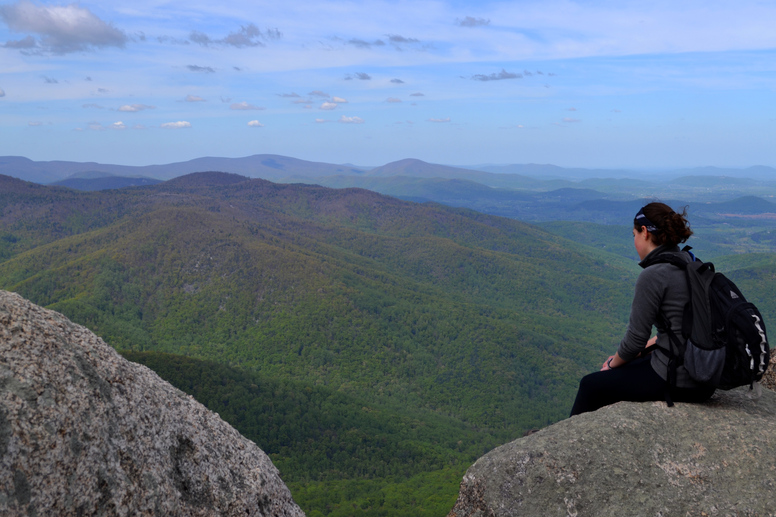
Depression
Psalm 88

Slide 7
Evidence of depression
Response to depression
A strategy to help you battle depression

Slide 8
Psalm 88
3 For my soul is full of troubles,
and my life draws near to Sheol.
4 I am counted among those who go down to the pit;
I am a man who has no strength,
5 like one set loose among the dead,
like the slain that lie in the grave,
like those whom you remember no more,
for they are cut off from your hand.

Slide 9
Psalm 88
3 For my soul is full of troubles,
and my life draws near to Sheol.
4 I am counted among those who go down to the pit;
I am a man who has no strength,
5 like one set loose among the dead,
like the slain that lie in the grave,
like those whom you remember no more,
for they are cut off from your hand.

Slide 10
Psalm 88
3 For my soul is full of troubles,
and my life draws near to Sheol.
4 I am counted among those who go down to the pit;
I am a man who has no strength,
5 like one set loose among the dead,
like the slain that lie in the grave,
like those whom you remember no more,
for they are cut off from your hand.

Slide 11
Psalm 88
3 For my soul is full of troubles,
and my life draws near to Sheol.
4 I am counted among those who go down to the pit;
I am a man who has no strength,
5 like one set loose among the dead,
like the slain that lie in the grave,
like those whom you remember no more,
for they are cut off from your hand.

Slide 12
Psalm 88
3 For my soul is full of troubles,
and my life draws near to Sheol.
4 I am counted among those who go down to the pit;
I am a man who has no strength,
5 like one set loose among the dead,
like the slain that lie in the grave,
like those whom you remember no more,
for they are cut off from your hand.

Slide 13
Psalm 88
3 For my soul is full of troubles,
and my life draws near to Sheol.
4 I am counted among those who go down to the pit;
I am a man who has no strength,
5 like one set loose among the dead,
like the slain that lie in the grave,
like those whom you remember no more,
for they are cut off from your hand.

Slide 14
Psalm 88
3 For my soul is full of troubles,
and my life draws near to Sheol.
4 I am counted among those who go down to the pit;
I am a man who has no strength,
5 like one set loose among the dead,
like the slain that lie in the grave,
like those whom you remember no more,
for they are cut off from your hand.

Slide 15
Psalm 88
3 For my soul is full of troubles,
and my life draws near to Sheol.
4 I am counted among those who go down to the pit;
I am a man who has no strength,
5 like one set loose among the dead,
like the slain that lie in the grave,
like those whom you remember no more,
for they are cut off from your hand.

Slide 16
Psalm 88
6 You have put me in the depths of the pit,
in the regions dark and deep.
7 Your wrath lies heavy upon me,
and you overwhelm me with all your waves.
8 You have caused my companions to shun me;
you have made me a horror to them.
I am shut in so that I cannot escape;
9 my eye grows dim through sorrow.

Slide 17
Psalm 88
6 You have put me in the depths of the pit,
in the regions dark and deep.
7 Your wrath lies heavy upon me,
and you overwhelm me with all your waves.
8 You have caused my companions to shun me;
you have made me a horror to them.
I am shut in so that I cannot escape;
9 my eye grows dim through sorrow.

Slide 18
Psalm 88
6 You have put me in the depths of the pit,
in the regions dark and deep.
7 Your wrath lies heavy upon me,
and you overwhelm me with all your waves.
8 You have caused my companions to shun me;
you have made me a horror to them.
I am shut in so that I cannot escape;
9 my eye grows dim through sorrow.

Slide 19
Psalm 88
6 You have put me in the depths of the pit,
in the regions dark and deep.
7 Your wrath lies heavy upon me,
and you overwhelm me with all your waves.
8 You have caused my companions to shun me;
you have made me a horror to them.
I am shut in so that I cannot escape;
9 my eye grows dim through sorrow.

Slide 20
Psalm 88
6 You have put me in the depths of the pit,
in the regions dark and deep.
7 Your wrath lies heavy upon me,
and you overwhelm me with all your waves.
8 You have caused my companions to shun me;
you have made me a horror to them.
I am shut in so that I cannot escape;
9 my eye grows dim through sorrow.

Slide 21
Psalm 88
6 You have put me in the depths of the pit,
in the regions dark and deep.
7 Your wrath lies heavy upon me,
and you overwhelm me with all your waves.
8 You have caused my companions to shun me;
you have made me a horror to them.
I am shut in so that I cannot escape;
9 my eye grows dim through sorrow.

Slide 22
Psalm 88
6 You have put me in the depths of the pit,
in the regions dark and deep.
7 Your wrath lies heavy upon me,
and you overwhelm me with all your waves.
8 You have caused my companions to shun me;
you have made me a horror to them.
I am shut in so that I cannot escape;
9 my eye grows dim through sorrow.

Slide 23
Psalm 88
1 O LORD, God of my salvation;
I cry out day and night before you.
2 Let my prayer come before you;
incline your ear to my cry!

Slide 24
Psalm 88
1 O LORD, God of my salvation;
I cry out day and night before you.
2 Let my prayer come before you;
incline your ear to my cry!

Slide 25
Psalm 88
1 O LORD, God of my salvation;
I cry out day and night before you.
2 Let my prayer come before you;
incline your ear to my cry!

Slide 26
Psalm 88
1 O LORD, God of my salvation;
I cry out day and night before you.
2 Let my prayer come before you;
incline your ear to my cry!

Slide 27
Psalm 88
1 O LORD, God of my salvation;
I cry out day and night before you.
2 Let my prayer come before you;
incline your ear to my cry!

Slide 28
Psalm 88
9 Every day I call upon you, O LORD;
I spread out my hands to you.
10 Do you work wonders for the dead?
Do the departed rise up to praise you?
11 Is your steadfast love declared in the grave,
or your faithfulness in Abaddon?
12 Are your wonders known in the darkness,
or your righteousness in the land of forgetfulness?

Slide 29
Psalm 88
9 Every day I call upon you, O LORD;
I spread out my hands to you.
10 Do you work wonders for the dead?
Do the departed rise up to praise you?
11 Is your steadfast love declared in the grave,
or your faithfulness in Abaddon?
12 Are your wonders known in the darkness,
or your righteousness in the land of forgetfulness?

Slide 30
Psalm 88
9 Every day I call upon you, O LORD;
I spread out my hands to you.
10 Do you work wonders for the dead?
Do the departed rise up to praise you?
11 Is your steadfast love declared in the grave,
or your faithfulness in Abaddon?
12 Are your wonders known in the darkness,
or your righteousness in the land of forgetfulness?

Slide 31
Psalm 88
9 Every day I call upon you, O LORD;
I spread out my hands to you.
10 Do you work wonders for the dead?
Do the departed rise up to praise you?
11 Is your steadfast love declared in the grave,
or your faithfulness in Abaddon?
12 Are your wonders known in the darkness,
or your righteousness in the land of forgetfulness?

Slide 32
Psalm 88
9 Every day I call upon you, O LORD;
I spread out my hands to you.
10 Do you work wonders for the dead?
Do the departed rise up to praise you?
11 Is your steadfast love declared in the grave,
or your faithfulness in Abaddon?
12 Are your wonders known in the darkness,
or your righteousness in the land of forgetfulness?

Slide 33
Psalm 88
9 Every day I call upon you, O LORD;
I spread out my hands to you.
10 Do you work wonders for the dead?
Do the departed rise up to praise you?
11 Is your steadfast love declared in the grave,
or your faithfulness in Abaddon?
12 Are your wonders known in the darkness,
or your righteousness in the land of forgetfulness?

Slide 34
Psalm 88
9 Every day I call upon you, O LORD;
I spread out my hands to you.
10 Do you work wonders for the dead?
Do the departed rise up to praise you?
11 Is your steadfast love declared in the grave,
or your faithfulness in Abaddon?
12 Are your wonders known in the darkness,
or your righteousness in the land of forgetfulness?

Slide 35
13 But I, O LORD, cry to you;
in the morning my prayer comes before you.
14 O LORD, why do you cast my soul away?
Why do you hide your face from me?
15 Afflicted and close to death from my youth up,
I suffer your terrors; I am helpless.
16 Your wrath has swept over me;
your dreadful assaults destroy me.
17 They surround me like a flood all day long;
they close in on me together.
18 You have caused my beloved and my friend to shun me;
my companions have become darkness.

Slide 36
13 But I, O LORD, cry to you;
in the morning my prayer comes before you.
14 O LORD, why do you cast my soul away?
Why do you hide your face from me?
15 Afflicted and close to death from my youth up,
I suffer your terrors; I am helpless.
16 Your wrath has swept over me;
your dreadful assaults destroy me.
17 They surround me like a flood all day long;
they close in on me together.
18 You have caused my beloved and my friend to shun me;
my companions have become darkness.

Slide 37
13 But I, O LORD, cry to you;
in the morning my prayer comes before you.
14 O LORD, why do you cast my soul away?
Why do you hide your face from me?
15 Afflicted and close to death from my youth up,
I suffer your terrors; I am helpless.
16 Your wrath has swept over me;
your dreadful assaults destroy me.
17 They surround me like a flood all day long;
they close in on me together.
18 You have caused my beloved and my friend to shun me;
my companions have become darkness.

Slide 38
Write a letter to God describing how you really feel.
Make a list of the titles and descriptions of God that give you comfort.
Copy Psalm 88 in your journal and then read it out loud (with emotion).

