Slide 1
evidence & faith

Slide 2
EVIDENCE & CREATION

Slide 3
3 principles of faith & evidence 3 simple & self evident facts

Slide 4
3 principles in evidences: 1. evidence based faith John 5.31ff Luke 5.24 1Peter 3.15 2. backing up to a starting point Acts 13 / Acts 17 3. testimony from nature & scripture Romans 1.20 (cf. Ac.14.17) & Rom.10.17

Slide 5
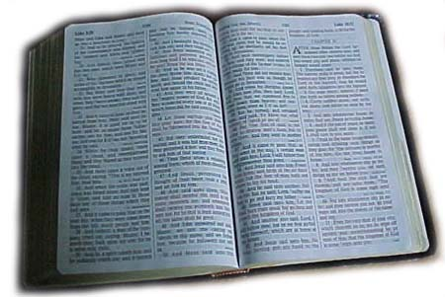
Specific revelation of God’s word & his Son
General revelation of God’s power

Slide 6
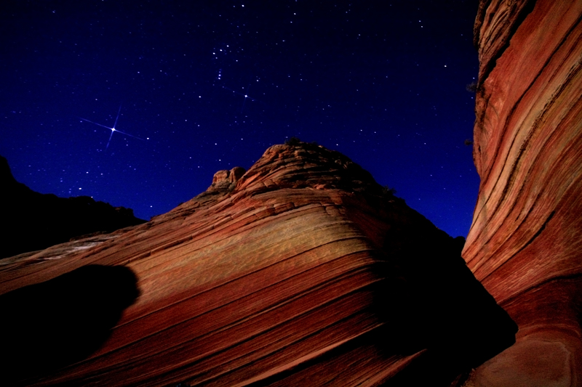
skychasers.net Ps. 19.1 “The heavens declare the glory of God; And the firmament showeth his handiwork.”

Slide 7
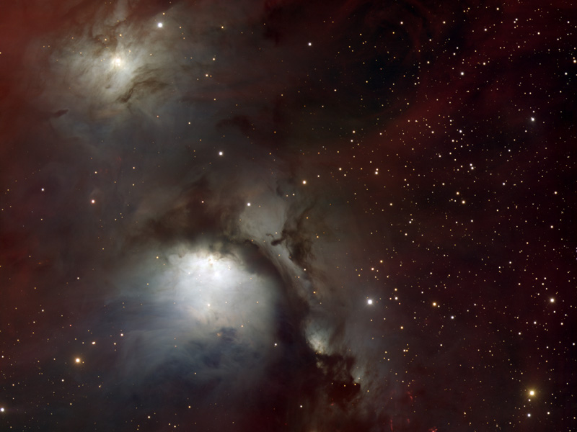
“O LORD, our Lord, How majestic is your name in all the earth, Who have displayed your splendor above the heavens” - PS.8:1 easilyamazed.com

Slide 8
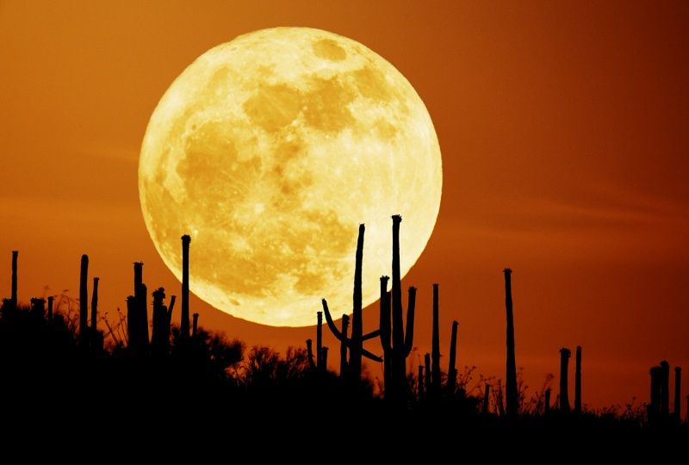
“When I consider your heavens, the work of your fingers, The moon and the stars, which you have ordained” - Ps.8:3 nasa image public domain apod.nasa.gov photo credit: stephan seip

Slide 9
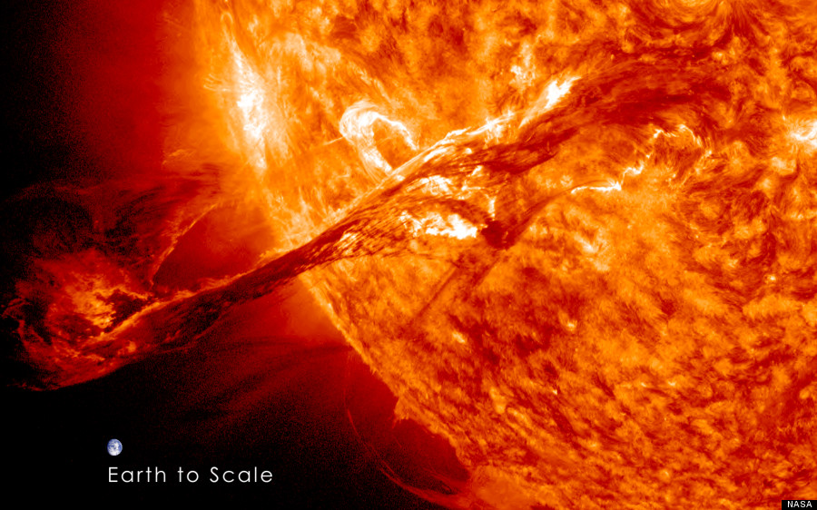
…what is man that you are mindful of him?

Slide 10
Ps. 139.14 “I praise you, for I am fearfully and wonderfully made” public domain image: Vera Kratochvil

Slide 11
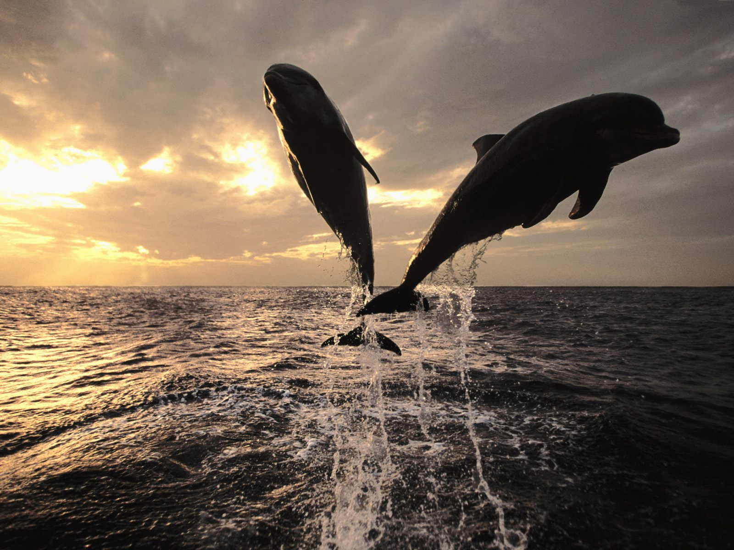
Ps.107:23,24 They that go down to the sea in ships, that do business in great waters, These see the works of the LORD, and his wonders in the deep.

Slide 12
Job 38 & 39 Job 38:4 Where were you when I laid the foundation of the earth?

Slide 13
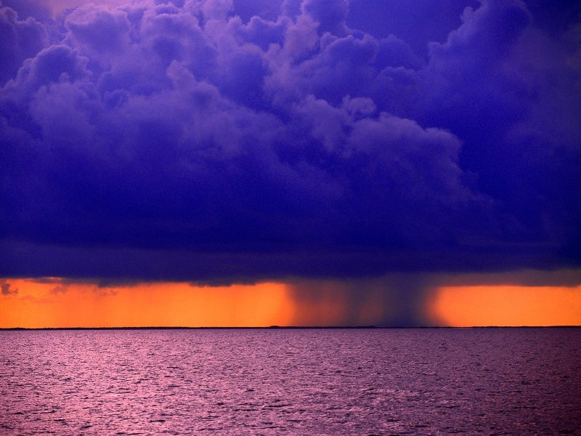
Job 38:34
“Can you lift up your voice to the clouds,
that a flood of waters may cover you? wadih-ghsoubi.com
wadih-ghsoubi.com

Slide 14
Job 38:35
“Can you send forth lightnings, that they may go
and say to you, ‘Here we are’?

Slide 15
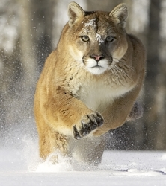
Job 38.39 “Can you hunt the prey for the lion, or satisfy the appetite of the young lions…?”

Slide 16
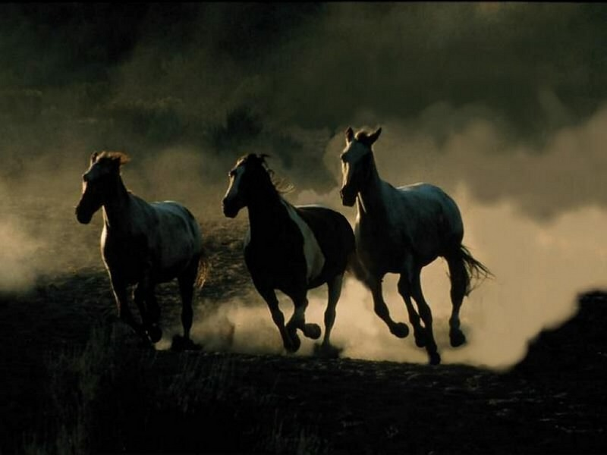
Job 39:19 “Do you give the horse his might? Do you clothe his neck with a mane?

Slide 17
“Since the creation of the world his invisible attributes, his eternal power and divine nature, have been clearly seen, being understood through what is made”
Romans 1:20

Slide 18
“Since the creation of the world his invisible attributes, his eternal power and divine nature, have been clearly seen, being understood through what is made”
Romans 1:20

Slide 19
2 Belief Systems

Slide 20
2 Belief Systems

Slide 21
We do exist. We are alive. We exhibit design.
Here, Now:
how?
why?

Slide 22
3 simple & self evident points

Slide 23
nothing comes
from nothing
1.
life comes
from life
2.
intelligent design comes from an intelligent designer
3.

Slide 24
Nothing comes from nothing

Slide 25
imagine nothing...

Slide 27
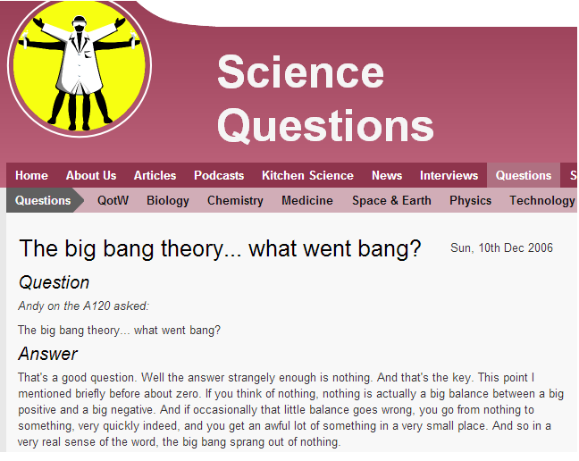
That’s a good question. Well the answer strangely enough is nothing… the big bang sprang out of nothing

Slide 28
bbc.co.uk/news/uk-11161493 Sept/ 2/ 2010
Stephen Hawking: God did not create Universe
The Universe can create itself from nothing, says Prof Hawking
He had previously argued belief in a creator was not incompatible with science but in a new book, he concludes the Big Bang was an inevitable consequence of the laws of physics. ..
Britain's most famous physicist sets out to contest Sir Isaac Newton's belief that the universe must have been designed by God as it could not have sprung out of chaos…
He adds: "Because there is a law such as gravity, the universe can and will create itself from nothing.
"Spontaneous creation is the reason there is something rather than nothing, why the universe exists, why we exist.

Slide 29
Edward P. Tyron professor of physics Hunter College & CUNY “In 1973, I proposed that our Universe had been created spontaneously from nothing” New Scientist, vol. 101, 3/8/’84 p. 14 cited by Morris, p. 24

Slide 30
0 = (-1) + (+1)

Slide 31
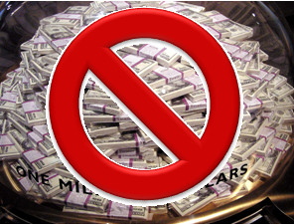
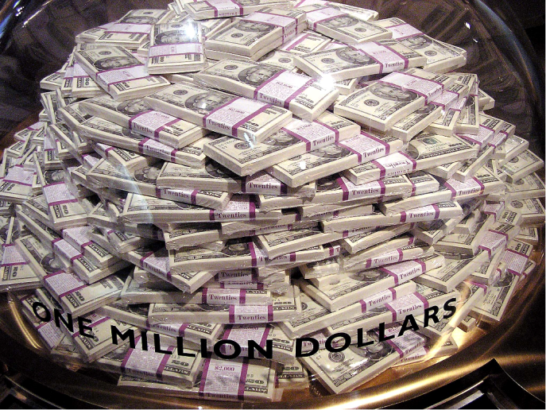
imagine nothing...
man with zero dollars
$1M - $1M = 0

Slide 32
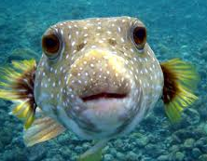
imagine nothing...
$ ?
wikimedia Puffer fish Brocken Inaglory GNU Free Documentation License

Slide 33
NOTHING comes from NOTHING

Slide 34
If there was never nothing… then there was always ...something.

Slide 35
nothing comes
from nothing
1.
life comes
from life
2.
intelligent design comes from an intelligent designer
3.

Slide 36
spontaneous
generation
?

Slide 37
school textbook: spontaneous generation?
the cell?

Slide 38
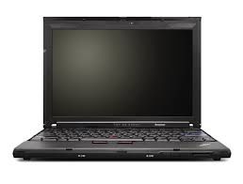
folly of “ingredient” approach:
?

Slide 39
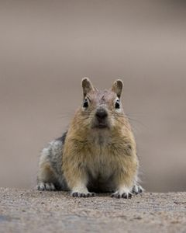
folly of “ingredient” approach:
?

Slide 40
nothing comes
from nothing
1.
life comes
from life
2.
intelligent design comes from an intelligent designer
3.

Slide 41
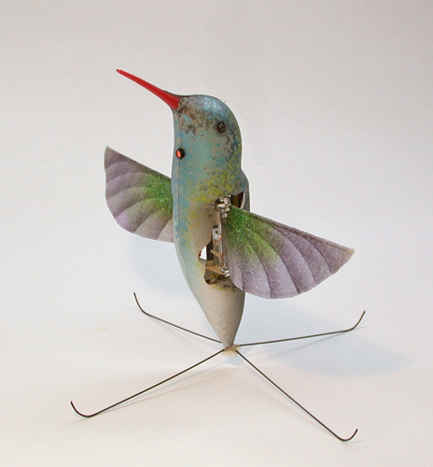
what is it?

Slide 42
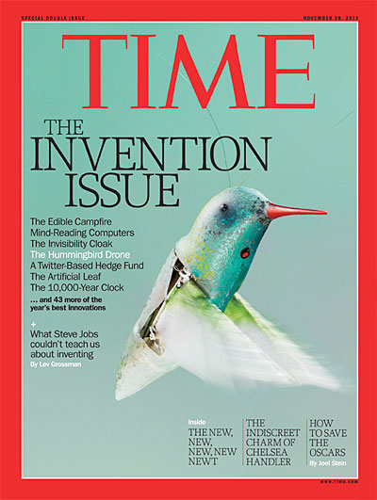
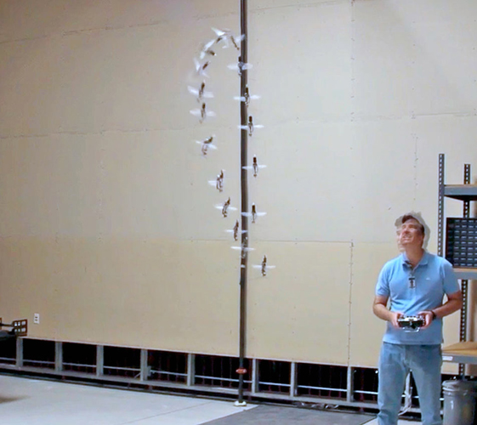
H. sapien designed Humingbird drone Time 11-28-2011
nano hummingbird AeroVironment www.avinc.com/nano
speed:
up to 11 mph
flight time:
c. 5 minutes
maneuvering: fly/ hover/ 360

Slide 43
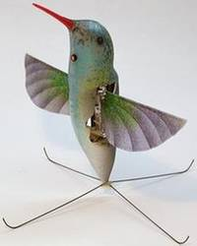
PLANNED combination of parts
showing evidence of a DESIGNER
PLANNED combination of parts
showing evidence of a DESIGNER
?
UNplanned combination of parts
showing NO evidence of a DESIGNER
UNplanned combination of parts
showing NO evidence of a DESIGNER

Slide 44
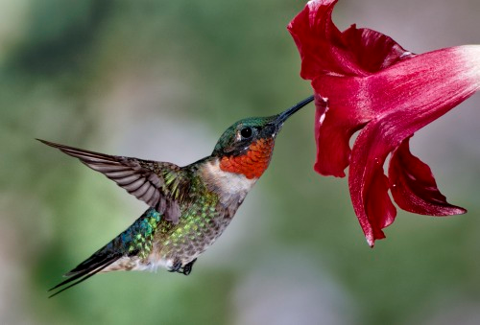
ruby throated hummingbird photo: J.M. Hilliard
hummingbird
Wing speed:
55-75 bpm
Nonstop flight:
500 miles
speed:
30mph; esc:50mph
Weight:
3 grams (= 1 cent)
Like all hummingbirds, ruby-throats are precision flyers with the ability to fly full out and stop in an instant, hang motionless in midair, and adjust their position up, down, sideways, and backwards with minute control. allaboutbirds.org

Slide 45
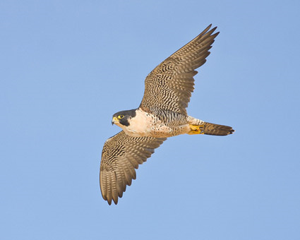
perigrene falcon pallaboutbirds.org
Perigrine falcon
migratory flight
up to 15,000 mi/ yr
dives on prey from 300-3000 ft. above
stoop (dive) speed up to 200mph +

Slide 46
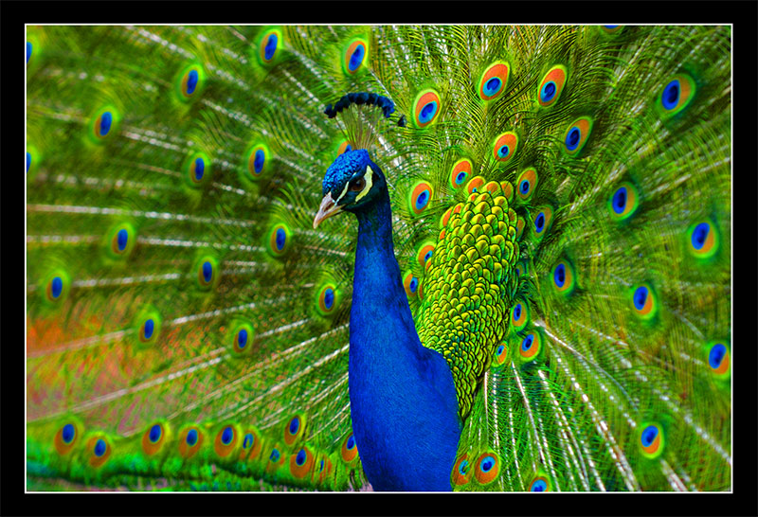
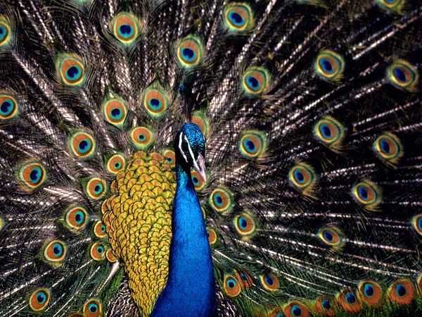
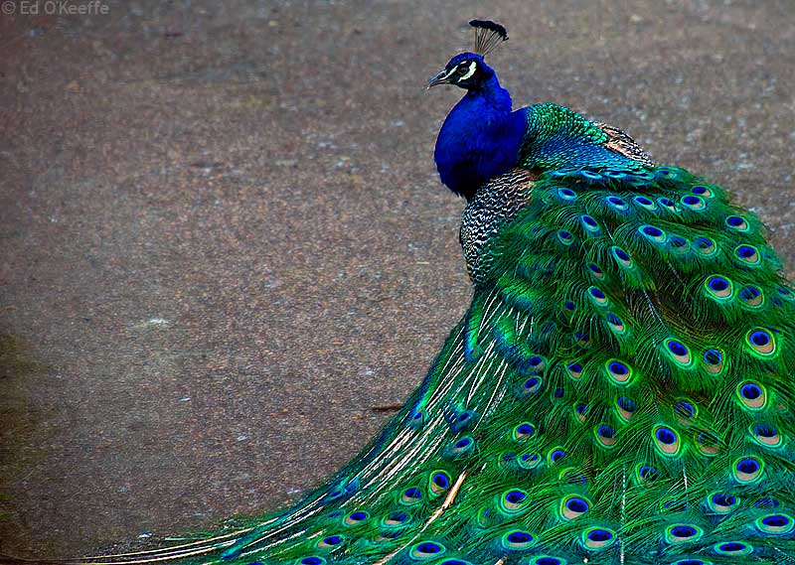
Blue peacock national geographic.com
peacock
iridescent feathers in blue or green
tail feathers 60 % of length
one of the longest birds of flight

Slide 47
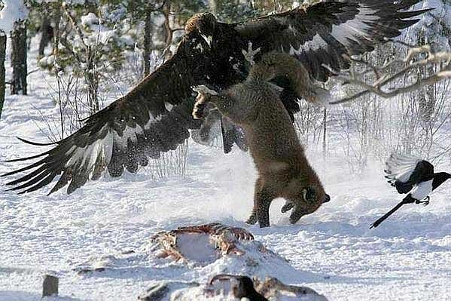
Golden Eagle allaboutbirds.org
eagle
wingspan:
up to 7 ft. +
weight:
up to 13 pounds

Slide 48
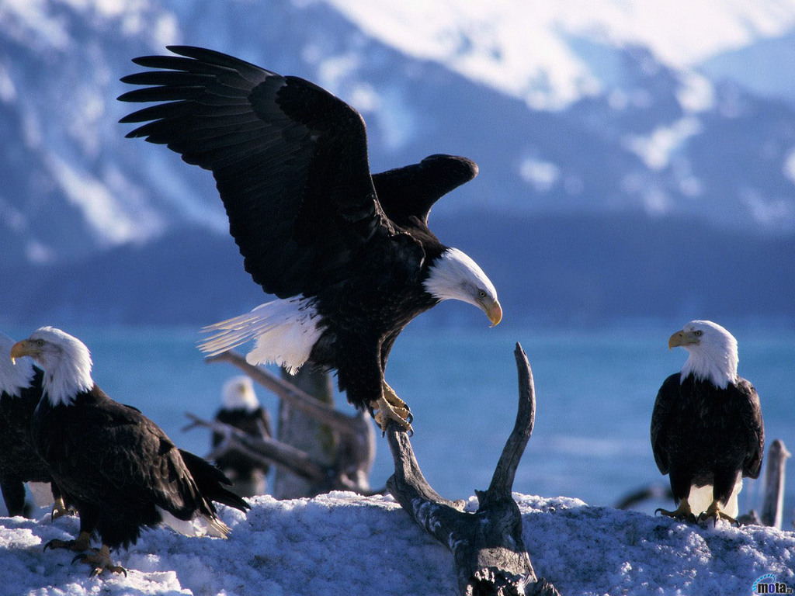
Job 39:27 “Is it at your command that the eagle mounts up and makes his nest on high?

Slide 49
take a look at your finger...al son . . .

Slide 50
2 more illustrations

Slide 51
the prodigal son . . .

Slide 52
“Since the creation of the world his invisible attributes, his eternal power and divine nature, have been clearly seen, being understood through what is made”
Romans 1:20

Slide 53
nothing comes
from nothing
1.
life comes
from life
2.
intelligent design comes from an intelligent designer
3.

Slide 54
“In the beginning, God created the heavens and the earth” Gen.1:1
“God created man” Gen.1:27
“Since the creation of the world his invisible attributes, his eternal power and divine nature, have been clearly seen, being understood through what is made” Rm.1:20

Slide 55
Exod. 3 Acts 17

Slide 56
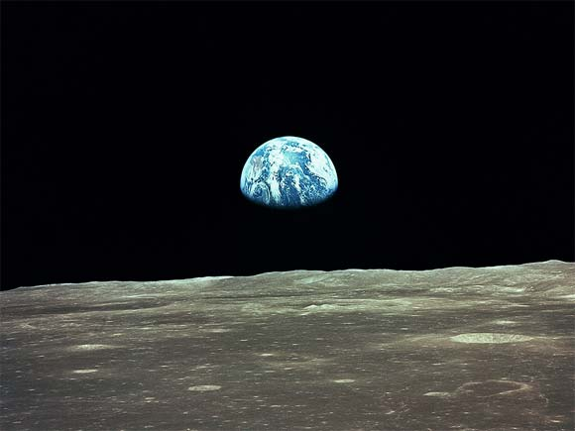
the prodigal son . . .

Slide 57
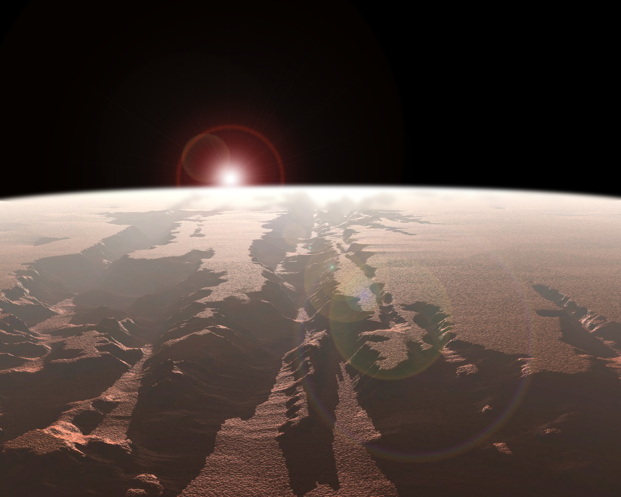
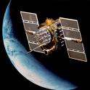
the prodigal son . . .

Slide 58
the prodigal son . . .

Slide 59
fini

Slide 60
Scott, Eugenie C., “Monkey Business,” The Sciences (January/February 1996), pp. 25. Scott is Executive Director of the National Center for Science Education, Berkeley, California, and received her Ph.D. in Anthropology, Missouri University, 1974. Past previous position, Assistant Professor, University of Colorado at Boulder, 1984-86.
“Avoid Debates. If your local campus Christian fellowship asks you to ‘defend evolution,’ please decline. Public debates rarely change many minds... And you probably will get beaten.”

Slide 61
A. acid: TYROSINE Tyr

Slide 62
arranged by chance or by design?

