Slide 1
Sun. morning #1
Different Temperaments
& Birth Order

Slide 2
19. Lowering the bar from the firstborn to the baby
Lk. 15, note the birth order
not always, not necessary, but also not uncommon
why so? (in addition to time %):
pacifier illustration
1st born > into world of adults
youngest > world of children
time 1st born: parents eager
youngest: “my baby”

Slide 3
Temperament
TEMPERAMENT
“pleaser” vs. “strong-willed”
GAL.5:16ff
selfish stubbornness needs to be broken, but principled independence is very valuable
win…
…& your child wins

Slide 4
What about
ADHD?

Slide 5
parenting
& meds

Slide 6
Never spank
your child.
Your son is a problem in class
Don’t be controlling. Let him be himself.
Your son has a behavioral disorder.
Straight correlation? No, not that simple…
Build up his
self esteem.
Here’s a drug
to control the problem.

Slide 7
GOOD PHYSICIANS
a noble profession…
Mark 2.17 “It is not the healthy who need a doctor, but the sick”
Col. 4.14 “Luke, the beloved physician”
LTD. PHYSICIANS
Mark 5.26 “who had suffered much under many physicians, and had spent all that she had, and was no better but rather grew worse.”

Slide 8
two premises:
Biblical premise
we have physical needs
we have moral, spiritual, & social duties
we are
physical
we are
spiritual
We are created by God.
We are to turn from sin.
We will face judgment.

Slide 9
evolutionary premise
biblical premise
some
adapt
easily to social
constructs
some do not adapt easily to
to social
constructs
we are unplanned accumulations of chemicals
ideas of
God, sin, and judgment are irrelevant myths

Slide 10
ADHD
familial
component
training
component
gender
component

Slide 11
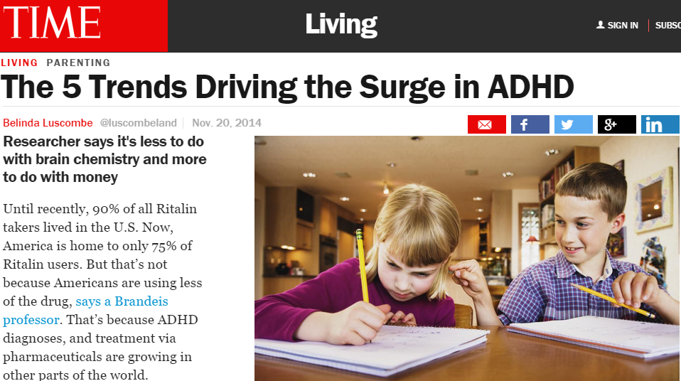
NOV. 2014 http://time.com/3595712/the-5-trends-driving-the-surge-in-adhd/
Until recently, 90% of all Ritalin takers lived in the U.S. Now, America is home to only 75% of Ritalin users.

Slide 12

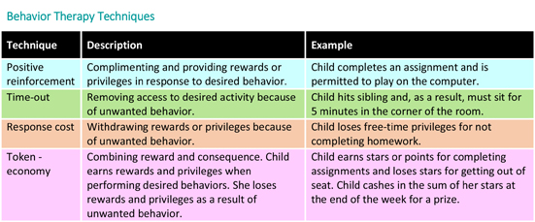
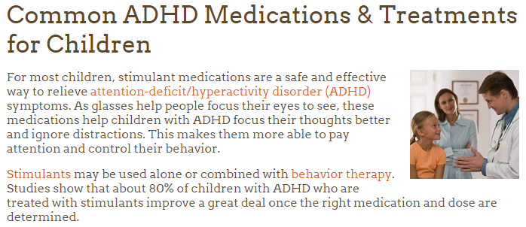
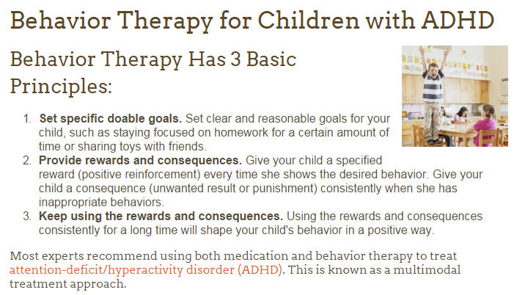
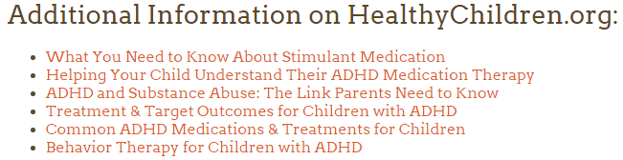
WHY not
use such
therapy for childhood diseases
?
Under this approach, parents, teachers, and other caregivers learn better ways to work with and relate to the child with ADHD. You will learn how to set and enforce rules, help your child understand what he needs to do, use discipline effectively, and encourage good behavior. Your child will learn better ways to control his behavior as a result. You will learn how to be more consistent

Slide 13
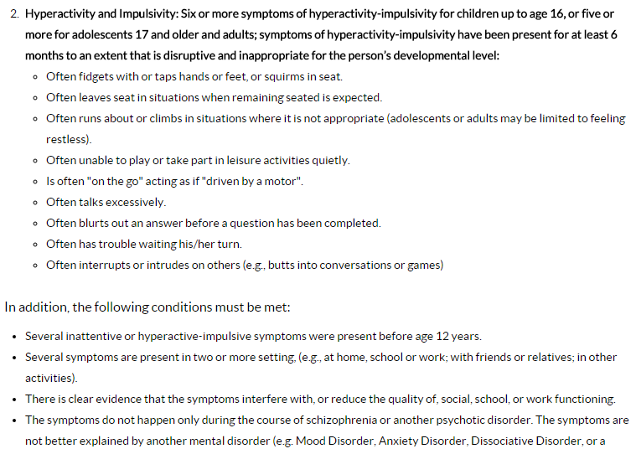
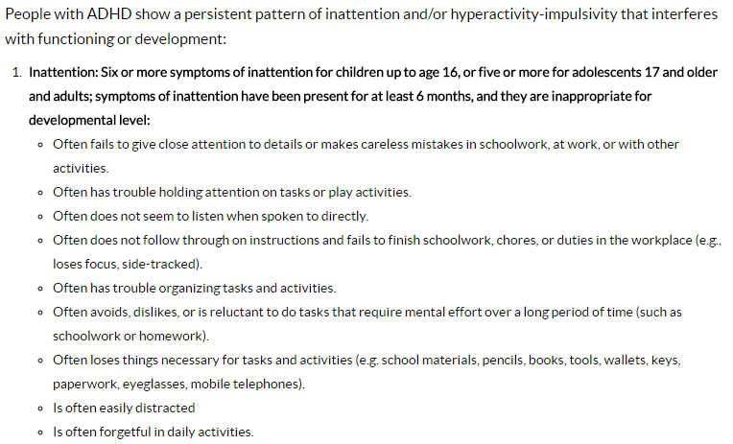
http://www.cdc.gov/ncbddd/adhd/diagnosis.html

Slide 14

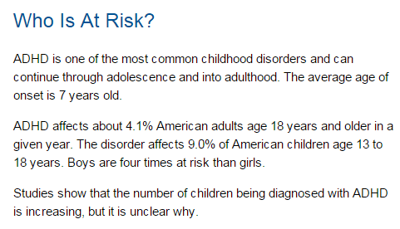

Slide 15

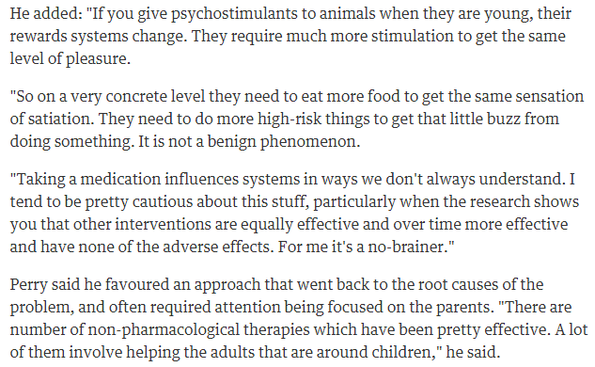
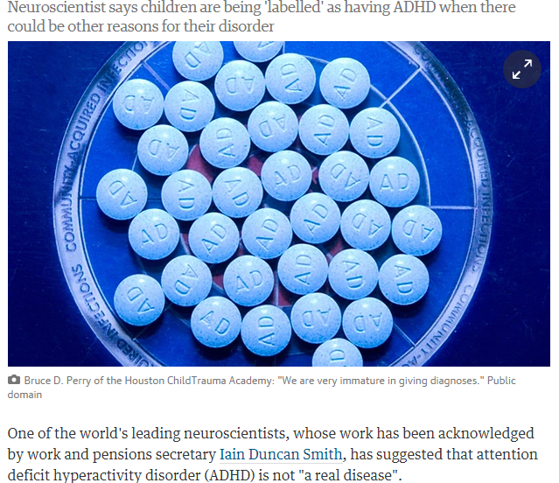
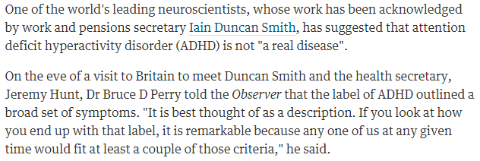

Slide 16
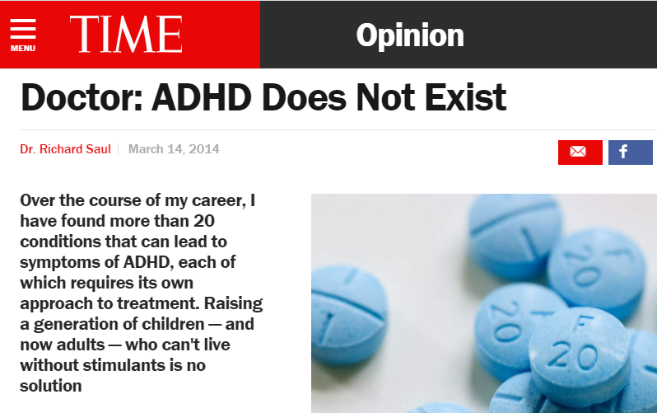
http://time.com/25370/doctor-adhd-does-not-exist/
Over my 50-year career in behavioral neurology and treating patients with ADHD, it has been in the past decade that I have seen these diagnoses truly skyrocket.
Today, the fifth edition of the DSM only requires one to exhibit five of 18 possible symptoms to qualify for an ADHD diagnosis. If you haven’t seen the list, look it up. It will probably bother you. How many of us can claim that we have difficulty with organization or a tendency to lose things; that we are frequently forgetful or distracted or fail to pay close attention to details? Under these subjective criteria, the entire U.S. population could potentially qualify. We’ve all had these moments, and in moderate amounts they’re a normal part of the human condition.
In short, I’ve come to believe based on decades of treating patients that ADHD — as currently defined by the Diagnostic and Statistical Manual of Mental Disorders (DSM) and as understood in the public imagination — does not exist.
Dr. Richard Saul is a behavioral neurologist practicing in the Chicago area. His book, ADHD Does Not Exist, is published by HarperCollins.

Slide 17
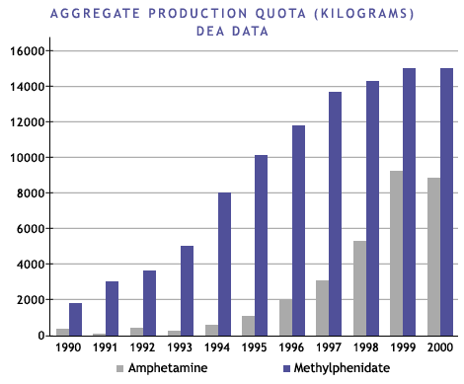
http://www.pbs.org/wgbh/pages/frontline/shows/medicating/drugs/stats.html
The production of methylphenidate (Ritalin) and the legal production of amphetamine in the form of Adderall and Dexedrine in the U.S. has soared since 1990… these drugs are considered to be potential drugs of abuse under the Controlled Substances Act
Source: www.dea.gov/pubs/cngrtest/ct051600.htm

Slide 18
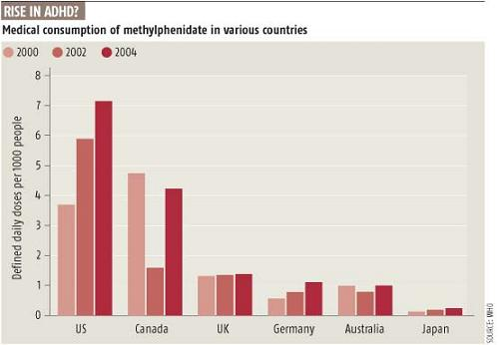
http://scienceblogs.com/retrospectacle/2007/07/27/the-neuroscience-of-adhd-1/

Slide 19

what has emerged in recent years is mounting evidence that the problem runs in families. Among monozygotic (genetically identical) twins, when one twin is diagnosed with ADHD the other also receives the diagnosis 51 percent of the time. In contrast, among dizygotic twins, no more related to each other genetically than ordinary siblings, the concordance rate is only 33 percent. Combined with the fact that adoption studies show that the relationship runs more strongly in genetic families than in the family of upbringing, these data suggest that there is a genetic contribution to whatever is going on in ADHD.
This does not mean, however, that ADHD is genetically determined. If it were, then the concordance rate for monozygotic twins would be 100 percent, as it is for eye color.
It is tempting to view this pattern as suggesting that the ADHD diagnosis provides teachers with a new technique for regaining control of the classroom in a world where many of the traditional methods of control have been eliminated. Drugs have replaced the reprimand.
… Nor is there any mechanism, of the sort one would find in a school-choice-based system of education, for parents to seek out schools tailored to the temperaments and capabilities of their children… when it is difficult or inconvenient to change the environment, we don't think twice about changing the brain of the person who has to live in it…
None of this should be taken to suggest that there are no cases of genuine brain damage or dysfunction that require medical intervention… But difference does not automatically equal disease. Is changing the child's brain chemistry, by prescribing Ritalin-like drugs, really the most appropriate response to the child who doesn't perform well in the modern school environment?
Imagine yourself sitting in a classroom--say, a fourth-grade social-studies class. There is a teacher at the front of the room, but a groundskeeper mowing grass outside captures your attention instead. When the mower moves away, however, you feel bored and restless. Pretty soon your swinging feet slam into the seat in front of you. The attentive student sitting there yelps and the teacher interrupts the class to ask what the problem is. This sudden activity jolts you back into focus; at least something interesting is happening. You're beyond feeling embarrassed about being the center of this kind of attention. It happens all the time, and you have quite a reputation for this sort of thing. And besides, it isn't really your fault. They all say you probably have ADD or ADHD or something like that and can't help but act this way. It's just the way life is for some kids.
There is something odd, if not downright ironic, about the picture of millions of American school children filing out of "drug-awareness" classes to line up in the school nurse's office for their midday dose of amphetamine.

Slide 20

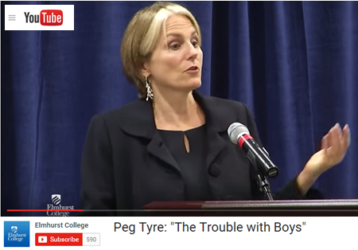
The Trouble with boys, Peg Tyre
2nd graders : hares & tortoises
boys: “reading is kinda girly”
gender & movement
G&B
recess & sitting still
att.: “girls are the gold std. & boys are the defective girls”
teachers: females dominant
maturity rate difference 17vs.26
G
B
< most /\ most >
sedentary avg. active
Developmental Psychology Warren O. Eaton
http://home.cc.umanitoba.ca/~eaton/child-development-motor-activity-level.htm

Slide 21
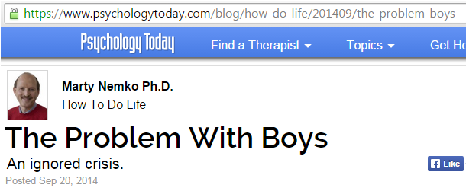
four to eight times as likely to be drugged with Ritalin and other stimulants, which pediatrician Leonard Sax, calls “academic steroids.”
reading much more poorly than are other students.
three times as likely to commit suicide.
2 1/2 times as likely to drop out of high school.
severely underrepresented in college and even more so among college graduates, thereby locking them out of today’s, let alone tomorrow’s professional-level jobs.

Slide 22
DOES NOT MEAN:
Let boys get away with bad behavior
Boys can’t sit still
Boys shouldn’t be disciplined
But:
Girls are girls, and boys are boys
Both need parenting, raising, & training
Pr.22.6
Little boys will not stay little boys. Let’s help them grow to be godly young men.
Little girls will not stay little girls. Let’s help them grow to be godly young women.

Slide 23
CHI LD
TRAINING
Therefore a man shall leave his father and his mother and hold fast to his wife, and they shall become one flesh. Gen. 2.24 esv
You shall love the LORD your God with all your heart and with all your soul and with all your might. And these words that I command you today shall be on your heart. You shall teach them diligently to your children, and shall talk of them when you sit in your house, and when you walk by the way, and when you lie down, and when you rise. Deut. 6.5-6 esv
The rod and reproof give wisdom, But a child who gets his own way brings shame to his mother. Prov. 29.15 nasb
Correct your son, and he will give you comfort; he will also delight your soul. Prov. 29.17 nasb
Train up a child in the way he should go, Even when he is old, he will not depart from it. Prov. 22.6 esv
Older women… teach what is good …train the young women to love their husbands and children… working at ome…submissive to their own husbands Titus 2.4-5 esv
Fathers, do not provoke your children to anger, but bring them up in the discipline and instruction of the Lord. Eph.6.4 esv

Slide 24
Take the time…
Teach them to do right
Train them to do right
EXPECT them to do right

Slide 25
The rod and reproof bring wisdom,
but a child who gets his own way
brings shame to his mother …
Correct your son,
and he will give you comfort;
he will also delight your soul
Prov. 29.15-17

Slide 26
PARENTS
Proverbs 22.6
“Train up a child in the way he should go,
Even when he is old, he will not depart from it”

