Slide 1
Welcome to NORTHWOOD

Slide 2
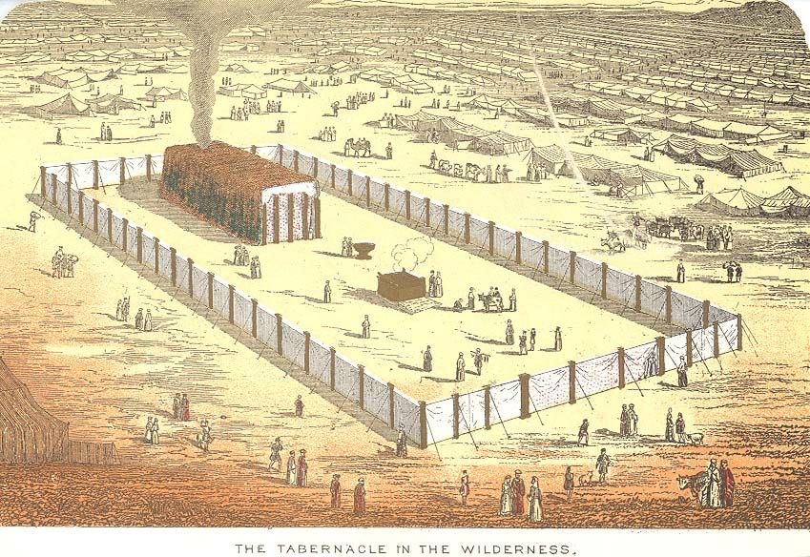
Leviticus
I Will Make My Dwelling Among You

Slide 3
Feb 21, 10:30 The Burnt Offering (ch 1)
Feb 21, 5:00 Burnt, Grain, & Peace Offerings (ch 1-3)
Mar 20, 9:00 Institution of the Priesthood (ch 8-10)
April 17, 5:00 Uncleanness (ch 11-15)
May 15, 9:00 The Day of Atonement (ch 16)
May 15, 5:00 Love Your Neighbor (ch 19)
May 22, 5:00 Feast Days (ch 23)
June 5, 10:30 Jubilee (ch 25)

Slide 4
HOLINESS L 17-27
CLEANNESS Lev 11-16
PRIESTHOOD Lev 8-10
SACRIFICES - Lev 1-7
TABERNACLE - Ex 25-40
COVENANT - Ex 19-24

Slide 5
1 The Lord called Moses and spoke to him from the tent of meeting, saying, 2 “Speak to the people of Israel and say to them, When any one of you brings an offering to the Lord, you shall bring your offering of livestock from the herd or from the flock.

Slide 6
1 The Lord called Moses and spoke to him from the tent of meeting, saying, 2 “Speak to the people of Israel and say to them, When any one of you brings an offering to the Lord, you shall bring your offering of livestock from the herd or from the flock.

Slide 7
1 The Lord called Moses and spoke to him from the tent of meeting, saying, 2 “Speak to the people of Israel and say to them, When any one of you brings an offering to the Lord, you shall bring your offering of livestock from the herd or from the flock.

Slide 8
1 The Lord called Moses and spoke to him from the tent of meeting, saying, 2 “Speak to the people of Israel and say to them, When any one of you brings an offering to the Lord, you shall bring your offering of livestock from the herd or from the flock.

Slide 9
1 The Lord called Moses and spoke to him from the tent of meeting, saying, 2 “Speak to the people of Israel and say to them, When any one of you brings an offering to the Lord, you shall bring your offering of livestock from the herd or from the flock.

Slide 10
1 The Lord called Moses and spoke to him from the tent of meeting, saying, 2 “Speak to the people of Israel and say to them, When any one of you brings an offering to the Lord, you shall bring your offering of livestock from the herd or from the flock.

Slide 11
Sacrifices
Burnt
(ch 1)
Grain
(ch 2)
Purification
(ch 4)
Reparation
(ch 5)
Peace
(ch 3)

Slide 12
Sacrifices
Burnt
(ch 1)
Grain
(ch 2)
Purification
(ch 4)
Reparation
(ch 5)
Peace
(ch 3)
“a food offering with a pleasing aroma to the LORD.” (1:9, 13, 17…)

Slide 13
3 “If his offering is a burnt offering from the herd, he shall offer a male without blemish. He shall bring it to the entrance of the tent of meeting, that he may be accepted before the Lord. 4 He shall lay his hand on the head of the burnt offering, and it shall be accepted for him to make atonement for him.

Slide 14
3 “If his offering is a burnt offering from the herd, he shall offer a male without blemish. He shall bring it to the entrance of the tent of meeting, that he may be accepted before the Lord. 4 He shall lay his hand on the head of the burnt offering, and it shall be accepted for him to make atonement for him.

Slide 15
3 “If his offering is a burnt offering from the herd, he shall offer a male without blemish. He shall bring it to the entrance of the tent of meeting, that he may be accepted before the Lord. 4 He shall lay his hand on the head of the burnt offering, and it shall be accepted for him to make atonement for him.

Slide 16
3 “If his offering is a burnt offering from the herd, he shall offer a male without blemish. He shall bring it to the entrance of the tent of meeting, that he may be accepted before the Lord. 4 He shall lay his hand on the head of the burnt offering, and it shall be accepted for him to make atonement for him.

Slide 18
5 “Then he shall kill the bull before the Lord, and Aaron's sons the priests shall bring the blood and throw the blood against the sides of the altar that is at the entrance of the tent of meeting. 6 Then he shall flay the burnt offering and cut it into pieces, 7 and the sons of Aaron the priest shall put fire on the altar and arrange wood on the fire.

Slide 19
5 “Then he shall kill the bull before the Lord, and Aaron's sons the priests shall bring the blood and throw the blood against the sides of the altar that is at the entrance of the tent of meeting. 6 Then he shall flay the burnt offering and cut it into pieces, 7 and the sons of Aaron the priest shall put fire on the altar and arrange wood on the fire.

Slide 20
5 “Then he shall kill the bull before the Lord, and Aaron's sons the priests shall bring the blood and throw the blood against the sides of the altar that is at the entrance of the tent of meeting. 6 Then he shall flay the burnt offering and cut it into pieces, 7 and the sons of Aaron the priest shall put fire on the altar and arrange wood on the fire.

Slide 21
5 “Then he shall kill the bull before the Lord, and Aaron's sons the priests shall bring the blood and throw the blood against the sides of the altar that is at the entrance of the tent of meeting. 6 Then he shall flay the burnt offering and cut it into pieces, 7 and the sons of Aaron the priest shall put fire on the altar and arrange wood on the fire.

Slide 22
5 “Then he shall kill the bull before the Lord, and Aaron's sons the priests shall bring the blood and throw the blood against the sides of the altar that is at the entrance of the tent of meeting. 6 Then he shall flay the burnt offering and cut it into pieces, 7 and the sons of Aaron the priest shall put fire on the altar and arrange wood on the fire.

Slide 23
8 And Aaron's sons the priests shall arrange the pieces, the head, and the fat, on the wood that is on the fire on the altar; 9 but its entrails and its legs he shall wash with water. And the priest shall burn all of it on the altar, as a burnt offering, a food offering with a pleasing aroma to the Lord.

Slide 24
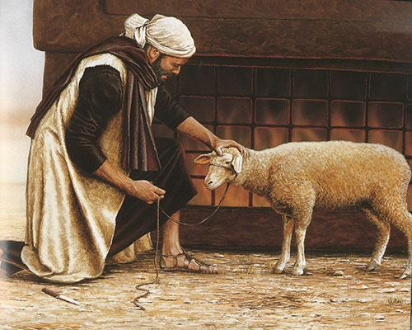

Slide 25
TO MAKE ATONEMENT
“He shall lay his hand on the head”
“pleasing aroma to the LORD”
“that he may be accepted”
“a male without blemish”

Slide 26
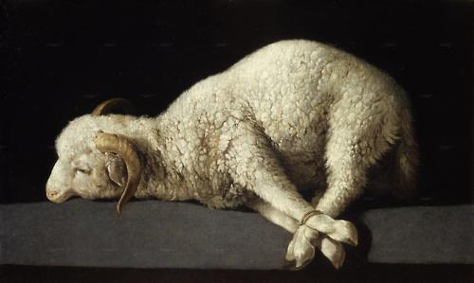
“For even the Son of Man came not to be served but to serve, and to give his life as a ransom for many.”
Mark 10:45

Slide 27
And walk in love, as Christ loved us and gave himself up for us, a fragrant offering and sacrifice to God.
Ephesians 5:2

Slide 28
you were ransomed… not with perishable things such as silver or gold, but with the precious blood of Christ, like that of a lamb without blemish or spot.
1 Peter 1:18-19

Slide 29
He has no need, like those high priests, to offer sacrifices daily, first for his own sins and then for those of the people, since he did this once for all when he offered up himself. Hebrews 7:27

Slide 30
Consider the cost of sin (Rom 6:23).
Make confession of sin a daily practice (1 Jn 1:7-9).
Offer up acceptable sacrifices to God (Heb 13:15-16).

