Slide 1
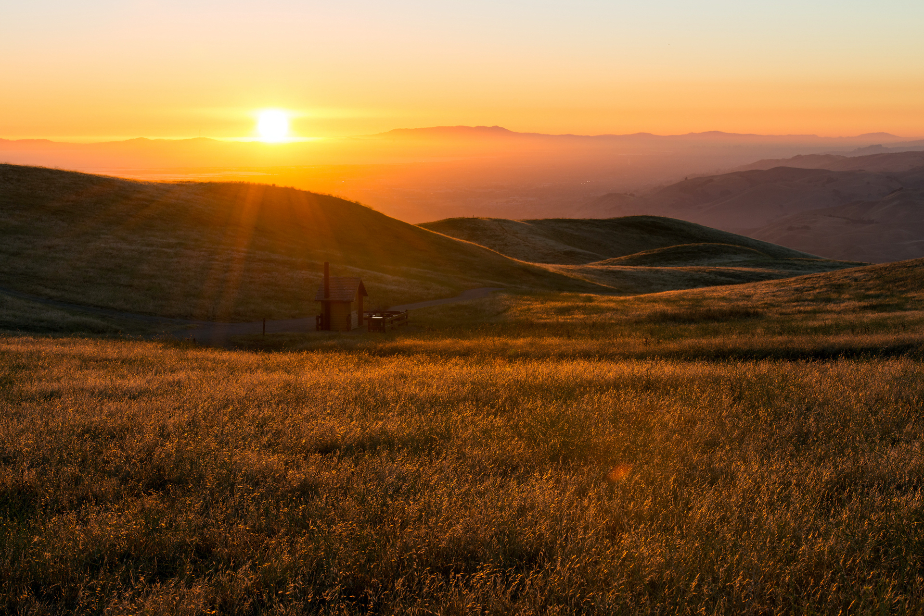
12
minor
Prophets
Hosea Joel Amos Obadiah Jonah Micah
Nahum Habakkuk Zephaniah Haggai Zechariah Malachi

Slide 2
OBADIAH
“Servant of God”
THE MINOR PROPHETS
(who preached a MAJOR message!)
AMOS
“Burden-bearer”
HABAKKUK
“He that embraces”
MICAH
“Who is like God?”
HAGGAI
“My Festival”
931
721
ZEPHANIAH
“Jehovah has treasured”
MALACHI
“My Messenger”
586
Assyrian captivity
597
539
516
445
605
520
Jerusalem
destroyed
Walls
rebuilt
Kingdom divided
Temple work
resumed
2nd Deportation: Ezekiel
Cyrus’ decree
Temple
completed
1st Deportation: Daniel

Slide 3
Mixed Marriages
Malachi 2:11-15
Failure to Tithe
Ezra 9-10; Neh 13:23-27
Malachi 3:8-10
Nehemiah 13:10-14
Corrupt Preists
Malachi 1:6-2:9
Nehemiah 13:1-9
Social Injustice
Malachi 3:5
Nehemiah 5:1-13

Slide 4
Declaration
“Return to me and I will return to you”
Question
“How shall we return?”
Response
“Will a man rob God?

Slide 5
1st Set
God doesn’t love them (1:2-5)
The people don’t honor God (1:6-2:9)
The people don’t honor God (2:10-16)
2nd Set
God is unjust (2:17-3:5)
The people are unjust (3:6-12)
God is unjust (3:13-4:3)

Slide 6
Malachi
THE SUN OF RIGHTEOUSNESS WILL RISE WITH HEALING IN ITS WINGS

Slide 7
Malachi 3
13 “Your words have been hard against me, says the LORD. But you say, ‘How have we spoken against you?’ 14 You have said, ‘It is vain to serve God. What is the profit of our keeping his charge or of walking as in mourning before the LORD of hosts? 15 And now we call the arrogant blessed. Evildoers not only prosper but they put God to the test and they escape.’”

Slide 8
Malachi 3
13 “Your words have been hard against me, says the LORD. But you say, ‘How have we spoken against you?’ 14 You have said, ‘It is vain to serve God. What is the profit of our keeping his charge or of walking as in mourning before the LORD of hosts? 15 And now we call the arrogant blessed. Evildoers not only prosper but they put God to the test and they escape.’”

Slide 9
Malachi 3:13
13 “Your words have been hard against me, says the LORD. But you say, ‘How have we spoken against you?’ 14 You have said, ‘It is vain to serve God. What is the profit of our keeping his charge or of walking as in mourning before the LORD of hosts? 15 And now we call the arrogant blessed. Evildoers not only prosper but they put God to the test and they escape.’”

Slide 10
Malachi 3
16 Then those who feared the LORD spoke with one another. The LORD paid attention and heard them, and a book of remembrance was written before him of those who feared the LORD and esteemed his name. 17 “They shall be mine, says the LORD of hosts, in the day when I make up my treasured possession, and I will spare them as a man spares his son who serves him.

Slide 11
Malachi 3
16 Then those who feared the LORD spoke with one another. The LORD paid attention and heard them, and a book of remembrance was written before him of those who feared the LORD and esteemed his name. 17 “They shall be mine, says the LORD of hosts, in the day when I make up my treasured possession, and I will spare them as a man spares his son who serves him.

Slide 12
Malachi 3
18 “Then once more you shall see the distinction between the righteous and the wicked, between the one who serves God and one who does not serve him.”

Slide 13
Malachi 4
1 “For behold, the day is coming, burning like an oven, when all the arrogant and all evidoers will be stubble. The day that is coming shall set them ablaze, says the LORD of hosts, so that it will leave them neither root nor branch. 2 But for you who fear my name, the sun of righteousness shall rise with healing in its wings. You shall go out leaping like calves from the stall.

Slide 14
Malachi 4
1 “For behold, the day is coming, burning like an oven, when all the arrogant and all evidoers will be stubble. The day that is coming shall set them ablaze, says the LORD of hosts, so that it will leave them neither root nor branch. 2 But for you who fear my name, the sun of righteousness shall rise with healing in its wings. You shall go out leaping like calves from the stall.

Slide 15
Malachi 4
3 “And you shall tread down the wicked, for they will be ashes under the soles of your feet, on the day when I act, says the LORD of hosts.
4 “Remember the law of my servant Moses, the statutes and rules that I commanded him at Horeb for all Israel.

Slide 16
Malachi 4
3 “And you shall tread down the wicked, for they will be ashes under the soles of your feet, on the day when I act, says the LORD of hosts.
4 “Remember the law of my servant Moses, the statutes and rules that I commanded him at Horeb for all Israel.

Slide 17
Malachi 4
5 “Behold, I will send you Elijah the prophet before the great and awesome day of the LORD comes. 6 And he will turn the hearts of the fathers to their children and the hearts of the children to their fathers, lest I come and strike the land with a decree of utter destruction.”

Slide 18
Malachi 4
5 “Behold, I will send you Elijah the prophet before the great and awesome day of the LORD comes. 6 And he will turn the hearts of the fathers to their children and the hearts of the children to their fathers, lest I come and strike the land with a decree of utter destruction.”

