Slide 1
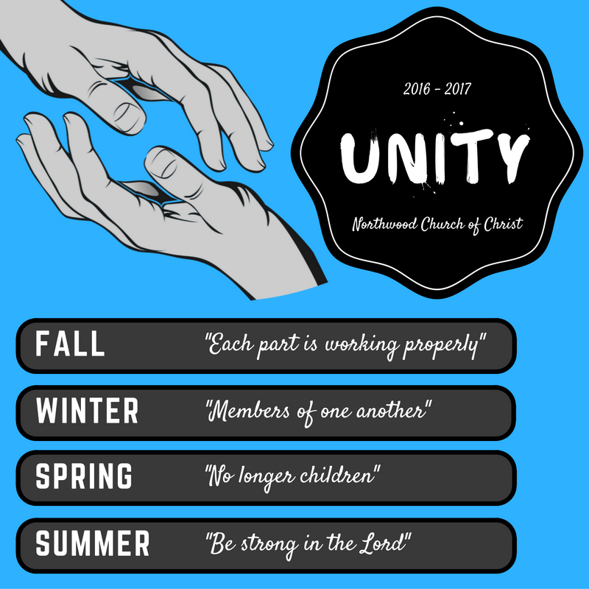

Slide 3
WAR
James 3:13-4:12

Slide 4
Earthly & heavenly wisdom
Our true motives exposed
How the war will end

Slide 5
Earthly & heavenly wisdom
Our true motives exposed
How the war will end

Slide 6
James 3
13 Who is wise and understanding among you? By his good conduct let him show his works in the meekness of wisdom. 14 But if you have bitter jealousy and selfish ambition in your hearts, do not boast and be false to the truth.

Slide 7
James 3
13 Who is wise and understanding among you? By his good conduct let him show his works in the meekness of wisdom. 14 But if you have bitter jealousy and selfish ambition in your hearts, do not boast and be false to the truth.

Slide 8
James 3
13 Who is wise and understanding among you? By his good conduct let him show his works in the meekness of wisdom. 14 But if you have bitter jealousy and selfish ambition in your hearts, do not boast and be false to the truth.

Slide 9
James 3
13 Who is wise and understanding among you? By his good conduct let him show his works in the meekness of wisdom. 14 But if you have bitter jealousy and selfish ambition in your hearts, do not boast and be false to the truth.

Slide 10
James 3
15 This is not the wisdom that comes down from above, but is earthly, unspiritual, demonic. 16 For where jealousy and selfish ambition exist, there will be disorder and every vile practice.

Slide 11
James 3
15 This is not the wisdom that comes down from above, but is earthly, unspiritual, demonic. 16 For where jealousy and selfish ambition exist, there will be disorder and every vile practice.

Slide 12
James 3
15 This is not the wisdom that comes down from above, but is earthly, unspiritual, demonic. 16 For where jealousy and selfish ambition exist, there will be disorder and every vile practice.

Slide 13
James 3
17 But the wisdom from above is first pure, then peaceable, gentle, open to reason, full of mercy and good fruits, impartial and sincere. 18 And a harvest of righteousness is sown in peace by those who make peace.

Slide 14
James 3
17 But the wisdom from above is first pure, then peaceable, gentle, open to reason, full of mercy and good fruits, impartial and sincere. 18 And a harvest of righteousness is sown in peace by those who make peace.

Slide 15
James 3
17 But the wisdom from above is first pure, then peaceable, gentle, open to reason, full of mercy and good fruits, impartial and sincere. 18 And a harvest of righteousness is sown in peace by those who make peace.

Slide 16
James 3
17 But the wisdom from above is first pure, then peaceable, gentle, open to reason, full of mercy and good fruits, impartial and sincere. 18 And a harvest of righteousness is sown in peace by those who make peace.

Slide 17
James 3
17 But the wisdom from above is first pure, then peaceable, gentle, open to reason, full of mercy and good fruits, impartial and sincere. 18 And a harvest of righteousness is sown in peace by those who make peace.

Slide 18
James 3
17 But the wisdom from above is first pure, then peaceable, gentle, open to reason, full of mercy and good fruits, impartial and sincere. 18 And a harvest of righteousness is sown in peace by those who make peace.

Slide 19
James 3
17 But the wisdom from above is first pure, then peaceable, gentle, open to reason, full of mercy and good fruits, impartial and sincere. 18 And a harvest of righteousness is sown in peace by those who make peace.

Slide 20
James 3
17 But the wisdom from above is first pure, then peaceable, gentle, open to reason, full of mercy and good fruits, impartial and sincere. 18 And a harvest of righteousness is sown in peace by those who make peace.

Slide 21
James 3
17 But the wisdom from above is first pure, then peaceable, gentle, open to reason, full of mercy and good fruits, impartial and sincere. 18 And a harvest of righteousness is sown in peace by those who make peace.

Slide 22
Earthly & heavenly wisdom
Our true motives exposed
How the war will end

Slide 23
James 4
1 What causes quarrels and what causes fights among you? Is it not this, that your passions are at war within you? 2 You desire and do not have, so you murder. You covet and cannot obtain, so you fight and quarrel. You do not have, because you do not ask.

Slide 24
James 4
1 What causes quarrels and what causes fights among you? Is it not this, that your passions are at war within you? 2 You desire and do not have, so you murder. You covet and cannot obtain, so you fight and quarrel. You do not have, because you do not ask.

Slide 25
James 4
1 What causes quarrels and what causes fights among you? Is it not this, that your passions are at war within you? 2 You desire and do not have, so you murder. You covet and cannot obtain, so you fight and quarrel. You do not have, because you do not ask.

Slide 26
James 4
1 What causes quarrels and what causes fights among you? Is it not this, that your passions are at war within you? 2 You desire and do not have, so you murder. You covet and cannot obtain, so you fight and quarrel. You do not have, because you do not ask.

Slide 27
James 4
1 What causes quarrels and what causes fights among you? Is it not this, that your passions are at war within you? 2 You desire and do not have, so you murder. You covet and cannot obtain, so you fight and quarrel. You do not have, because you do not ask.

Slide 28
James 4
1 What causes quarrels and what causes fights among you? Is it not this, that your passions are at war within you? 2 You desire and do not have, so you murder. You covet and cannot obtain, so you fight and quarrel. You do not have, because you do not ask.

Slide 29
James 4
3 You ask and do not receive, because you ask wrongly, to spend it on your passions. 4 You adulterous people! Do you not know that friendship with the world is enmity with God? Therefore whoever wishes to be a friend of the world makes himself an enemy of God.

Slide 30
James 4
3 You ask and do not receive, because you ask wrongly, to spend it on your passions. 4 You adulterous people! Do you not know that friendship with the world is enmity with God? Therefore whoever wishes to be a friend of the world makes himself an enemy of God.

Slide 31
James 4
3 You ask and do not receive, because you ask wrongly, to spend it on your passions. 4 You adulterous people! Do you not know that friendship with the world is enmity with God? Therefore whoever wishes to be a friend of the world makes himself an enemy of God.

Slide 32
James 4
3 You ask and do not receive, because you ask wrongly, to spend it on your passions. 4 You adulterous people! Do you not know that friendship with the world is enmity with God? Therefore whoever wishes to be a friend of the world makes himself an enemy of God.

Slide 33
James 4
3 You ask and do not receive, because you ask wrongly, to spend it on your passions. 4 You adulterous people! Do you not know that friendship with the world is enmity with God? Therefore whoever wishes to be a friend of the world makes himself an enemy of God.

Slide 34
James 4
5 Or do you suppose it is to no purpose that the Scripture says, “He yearns jealously over the spirit that he has made to dwell in us”? 6 But he gives more grace. Therefore it says, “God opposes the proud, but gives grace to the humble.”

Slide 35
James 4
5 Or do you suppose it is to no purpose that the Scripture says, “He yearns jealously over the spirit that he has made to dwell in us”? 6 But he gives more grace. Therefore it says, “God opposes the proud, but gives grace to the humble.”

Slide 36
James 4
5 Or do you suppose it is to no purpose that the Scripture says, “He yearns jealously over the spirit that he has made to dwell in us”? 6 But he gives more grace. Therefore it says, “God opposes the proud, but gives grace to the humble.”

Slide 37
Earthly & heavenly wisdom
Our true motives exposed
How the war will end

Slide 38
James 4
7 Submit yourselves therefore to God. Resist the devil, and he will flee from you. 8 Draw near to God, and he will draw near to you. Cleanse your hands, you sinners, and purify your hearts, you double-minded.

Slide 39
James 4
7 Submit yourselves therefore to God. Resist the devil, and he will flee from you. 8 Draw near to God, and he will draw near to you. Cleanse your hands, you sinners, and purify your hearts, you double-minded.

Slide 40
James 4
7 Submit yourselves therefore to God. Resist the devil, and he will flee from you. 8 Draw near to God, and he will draw near to you. Cleanse your hands, you sinners, and purify your hearts, you double-minded.

Slide 41
James 4
7 Submit yourselves therefore to God. Resist the devil, and he will flee from you. 8 Draw near to God, and he will draw near to you. Cleanse your hands, you sinners, and purify your hearts, you double-minded.

Slide 42
James 4
7 Submit yourselves therefore to God. Resist the devil, and he will flee from you. 8 Draw near to God, and he will draw near to you. Cleanse your hands, you sinners, and purify your hearts, you double-minded.

Slide 43
James 4
9 Be wretched and mourn and weep. Let your laughter be turned to mourning and your joy to gloom. 10 Humble yourselves before the Lord, and he will exalt you.

Slide 44
James 4
9 Be wretched and mourn and weep. Let your laughter be turned to mourning and your joy to gloom. 10 Humble yourselves before the Lord, and he will exalt you.

Slide 45
James 4
9 Be wretched and mourn and weep. Let your laughter be turned to mourning and your joy to gloom. 10 Humble yourselves before the Lord, and he will exalt you.

Slide 46
James 4
11 Do not speak evil against one another, brothers. The one who speaks against a brother or judges his brother, speaks evil against the law and judges the law. But if you judge the law, you are not a doer of the law but a judge.

Slide 47
James 4
11 Do not speak evil against one another, brothers. The one who speaks against a brother or judges his brother, speaks evil against the law and judges the law. But if you judge the law, you are not a doer of the law but a judge.

Slide 48
James 4
12 There is only one lawgiver and judge, he who is able to save and to destroy. But who are you to judge your neighbor?

Slide 49
James 4
12 There is only one lawgiver and judge, he who is able to save and to destroy. But who are you to judge your neighbor?

Slide 50
List every reason you’re upset and evaluate (in prayer!) your motives.
List all you have done to contribute to the conflict and pray.
Pray for courage to obey Rom 12:18.

