Slide 1
Pharisees
Matthew 15:1-15

Slide 2
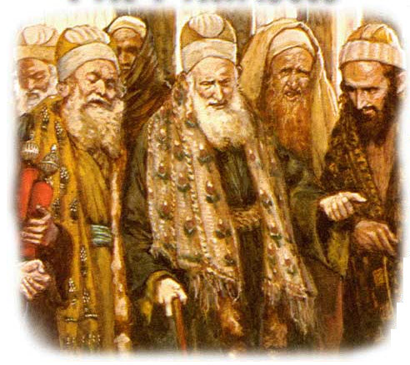
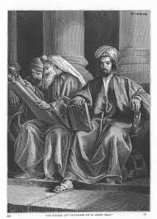
BIRTH OF THE PHARISEES
Alexander the Great takes over Jerusalem
The Seleucid king Antiochus IV enforces Hellenization of the Jews (167 BC)
Many priests and high class Jews support him
These People Become the Sadducees
Groups of mostly lower class peoples gather together to stop the Hellenization process
They become the Pharisees

Slide 3
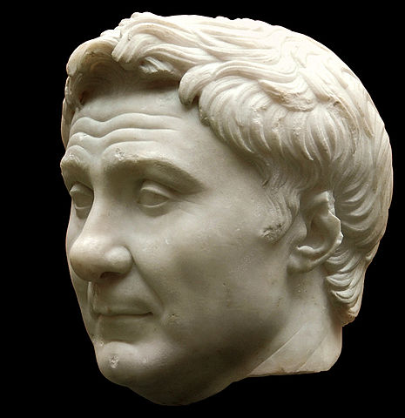
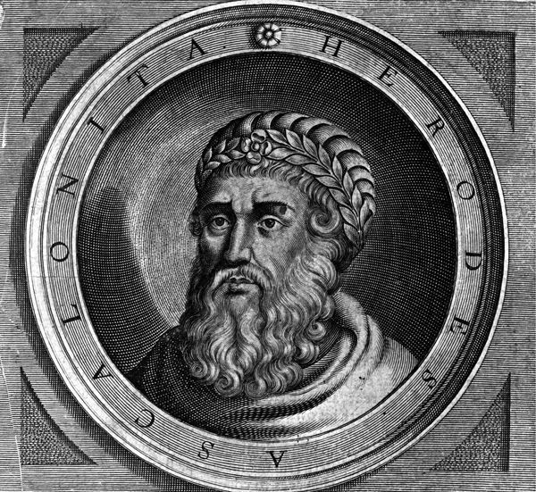
PHARISEES GAIN POWER
Pompey the Great invades Syria in 63 BC
Pharisees aid Pompey in the takeover thinking that he will remove the Sadducees from their priestly positions
Levitical Pharisees replace the positions
Pharisees publicly denounce Herod the Great after he murdered his sons
Herod the Great attacks the Pharisees in 4BC
He removes most of the Pharisees from the temple and replaces them with Sadducees

Slide 4
Washing of the Hands
Pharisees were upset with Jesus for not commanding His disciples to wash their hands before eating
“Why do you transgress the tradition of the elders?” Matt 15:2
Jesus responds, “Why do you also transgress the commandment of God because of your tradition?” Matt 15:3
The Pharisees were guilty of transgressing the commandment of God of “Honor your Father and Mother”
"But you say, 'Whoever says to his father or mother, "Whatever I have that would help you has been given to God,” NASV Matt 5:5

Slide 5
The Main Issue
Pharisees would often choose their traditions over the commandments of God
Rabbinic Jewish tradition of washing the hands
“Blessed art thou Lord, king of the universe, who has sanctified us with His commandments, commanding us to wash the hands.”
God never commanded the Jews to wash their hands before they eat
“And in vain they worship Me, teaching as doctrines the commandments of men” – Matt 5:9, (Paraphrased from Is. 29:13)

Slide 6
Traditions are not the problem
Jesus had customs
Luke 4:16 – “So He came to Nazareth, where He had been brought up. And as His custom was, He went into the synagogue on the Sabbath day, and stood up to read”
The synagogue itself was a tradition
However it aided in the commandments of God
“You shall love the Lord your God with all your heart, with all your soul, and with all your strength.” Deut.6:5

Slide 7
When Traditions or Customs are changed or enforced…
Sometimes God’s commandments get broken
John 13:34 - A new commandment I give to you, that you love one another; as I have loved you, that you also love one another.
1 Peter 4:8 - And above all things have fervent love for one another, for “love will cover a multitude of sins.”
Romans 12:10 - Be kindly affectionate to one another with brotherly love, in honor giving preference to one another;
1 John 4:7 - Beloved, let us love one another, for love is of God; and everyone who loves is born of God and knows God.

Slide 8
But what if I am offended?
Matthew 15:12-14
¹² Then His disciples came and said to Him, “Do You know that the Pharisees were offended when they heard this saying?”¹³ But He answered and said, “Every plant which My heavenly Father has not planted will be uprooted. ¹⁴ Let them alone. They are blind leaders of the blind. And if the blind leads the blind, both will fall into a ditch.”

