Slide 1
Welcome to Northwood!

Slide 2
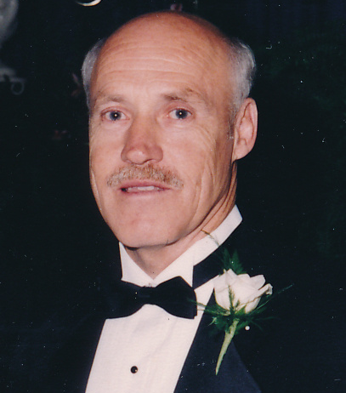
The Marks of a Man

Slide 3
1 Timothy 6:17-18
As for the rich in this present age, charge them not to be haughty , nor to set their hopes on the uncertainty of riches, but on God, who richly provides us with everything to enjoy. They are to good, to be rich in good works, to be generous and ready to share…

Slide 4
1 Timothy 6:17-18
As for the rich in this present age, charge them not to be haughty , nor to set their hopes on the uncertainty of riches, but on God, who richly provides us with everything to enjoy. They are to good, to be rich in good works, to be generous and ready to share…

Slide 5
Proverbs 18:24
A man of many companions may come to ruin, but there is a friend who sticks closer than a brother.

Slide 6
Proverbs 18:24
A man of many companions may come to ruin, but there is a friend who sticks closer than a brother.

Slide 7
Philippians 4:2-3
Many a man proclaims his own steadfast love, but a faithful man who can find?

Slide 8
Philippians 4:2-3
Many a man proclaims his own steadfast love, but a faithful man who can find?

Slide 9
Philippians 4:2-3
Blessed are the poor in spirit, for theirs is the kingdom of heaven.

Slide 10
Philippians 4:2-3
Blessed are the poor in spirit, for theirs is the kingdom of heaven.

Slide 11
Isaiah 40:31
But they who wait for the LORD shall renew their strength, they shall mount up with wings like eagles; they shall run and not be weary; they shall walk and not faint.

Slide 12
Isaiah 40:31
But they who wait for the LORD shall renew their strength, they shall mount up with wings like eagles; they shall run and not be weary; they shall walk and not faint.

Slide 13
Proverbs 14:23
In all toil there is profit, but mere talk tends only to poverty.

Slide 14
Proverbs 14:23
In all toil there is profit, but mere talk tends only to poverty.

Slide 15
Matthew 23:11
“The greatest among you shall be your servant.”

Slide 16
Matthew 23:11
“The greatest among you shall be your servant.”

Slide 17
Numbers 30:2
If a man vows a vow to the LORD, or swears an oath to bind himself by a pledge, he shall not break his word. He shall do according to all that proceeds out of his mouth.

Slide 18
Numbers 30:2
If a man vows a vow to the LORD, or swears an oath to bind himself by a pledge, he shall not break his word. He shall do according to all that proceeds out of his mouth.

