Slide 2
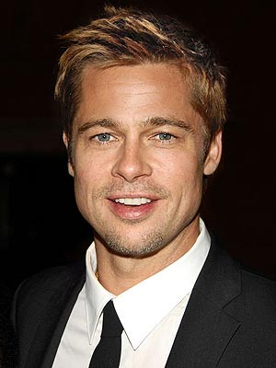

Slide 3
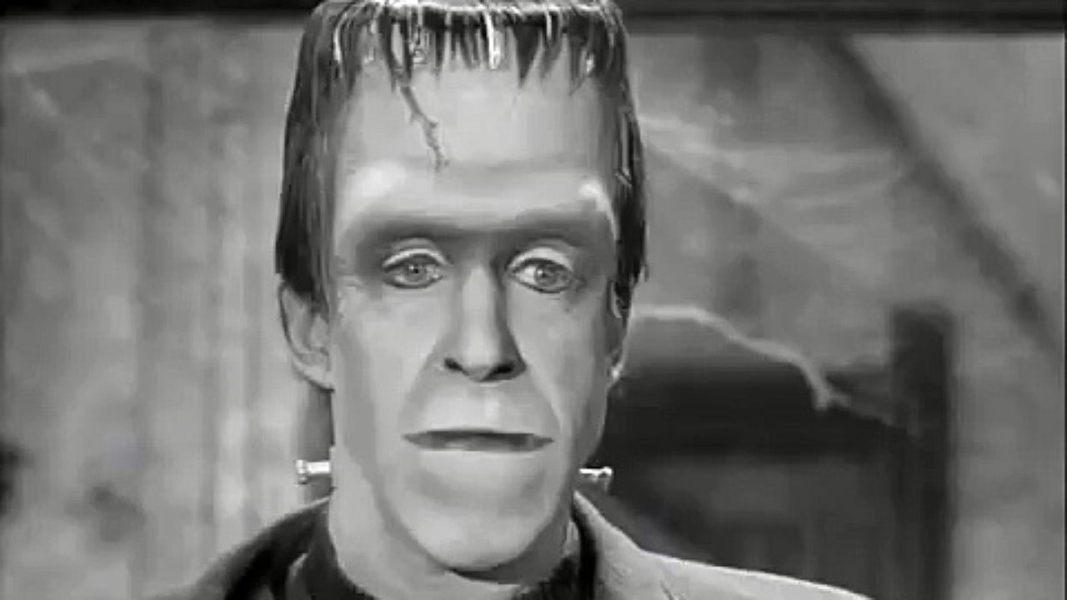

Slide 5
Low self-esteem has been linked to:
Addictions from substance abuse to pornography
Violent behavior
Low academic achievement
Eating disorders
Constant self-criticism
Suicide

Slide 6
Abercrombie and Fitch CEO Mike Jefferies
“In every school there are the cool and popular kids, and then there are the not-so-cool kids. Candidly, we go after the cool kids. We go after the attractive all-American kid with a great attitude and a lot of friends. A lot of people don’t belong [in our clothes], and they can’t belong. Are we exclusionary? Absolutely.”

Slide 7
Raising Self Esteem

Slide 8
Raising Self Esteem
God Formed Us

Slide 9
Raising Self Esteem
God Formed Us
Jeremiah 1:4-5 – The Lord gave me this message: I knew you before I formed you in your mother’s womb. Before you were born I set you apart and appointed you as my prophet to the nations.

Slide 10
Raising Self Esteem
God Formed Us
Jeremiah 1:4-5 – The Lord gave me this message: I knew you before I formed you in your mother’s womb. Before you were born I set you apart and appointed you as my prophet to the nations.
Psalms 139:13 – You made all the delicate, inner parts of my body and knit me together in my mother’s womb.

Slide 11
Raising Self Esteem
God Formed Us
2 Corinthians 12:7 – “… So to keep me from becoming proud, I was given a thorn in my flesh, a messenger from Satan to torment me and keep me from becoming proud.”

Slide 12
Raising Self Esteem
God Formed Us
God Believes in Us

Slide 13
Raising Self Esteem
God Believes in Us
Jeremiah 1:4-8 – The Lord gave me this message: I knew you before I formed you in your mother’s womb. Before you were born I set you apart and appointed you as my prophet to the nations. “O Sovereign Lord,” I said, “I can’t speak for you! I’m too young!” The Lord replied, “Don’t say, ‘I’m too young,’ for you must go wherever I send you and say whatever I tell you.” And don’t be afraid of the pe

Slide 14
Raising Self Esteem
God Believes in Us
1 Peter 2:9 – “But you are not like that, for you are a chosen people. You are royal priests, a holy nation, God’s very own possession. As a result, you can show others the goodness of God for he called you out of darkness into his wonderful light.”

Slide 15
Raising Self Esteem
God Formed Us
God Believes in Us
God Values Us

Slide 16
Raising Self Esteem
God Values Us
Psalms 139:14-18 – Thank you for making me so wonderfully complex! Your workmanship is marvelous – how well I know it. You watched me as I was being formed in utter seclusion as I was woven together in the dark of the womb. You saw me before I was born. Every day of my life was recorded in your book. Every moment was laid out before a single day had passed. How precious are your thoughts about me, O God. I can’t even count them; they outnumber the grains of sand! And when I wake up, you are still with me!

Slide 17
Raising Self Esteem
God Values us
1 Peter 1:18-19 – For you know that God paid a ransom to save you from the empty life you inherited from your ancestors. And it was not paid with mere gold or silver, which lose their value. It was the precious blood of Christ, the sinless, spotless Lamb of God.

Slide 18
Raising Self Esteem
God Values Us
Exodus 12:13 – But the blood on your doorposts will serve as a sign, marking the houses where you are staying. When I see the blood, I will pass over you. This plague of death will not touch you when I strike the land of Egypt.

Slide 19
Raising Self Esteem
God Values Us
Romans 5:6-11 – When we were utterly helpless, Christ came at just the right time and died for us sinners. Now, most people would not be willing to die for an upright person, though someone might perhaps be willing to die for a person who is especially good. But God showed his great love for us by sending Christ to die for us while we were still sinners. And since we have been made right in God’s sight by the blood of Christ, he will certainly save us from God’s condemnation. For since our friendship with God was restored by the death of his Son while we were still his enemies, we will certainly be saved through the life of his Son. So now we can rejoice in our wonderful new relationship with God because our Lord Jesus Christ has made us friends of God.

Slide 20
Raising Self Esteem
God Values Us
Romans 8:37-39 – And I am convinced that nothing can ever separate us from God’s love. Neither death nor life, neither angels nor demons, neither our fears for today nor our worries about tomorrow—not even the powers of hell can separate us from God’s love. No power in the sky above or in the earth below—indeed, nothing in all creation will ever be able to separate us from the love of God that is revealed in Christ Jesus our Lord.

Slide 21
Raising Self Esteem
God Formed Us
God Believes in Us
God Values Us

