Slide 1
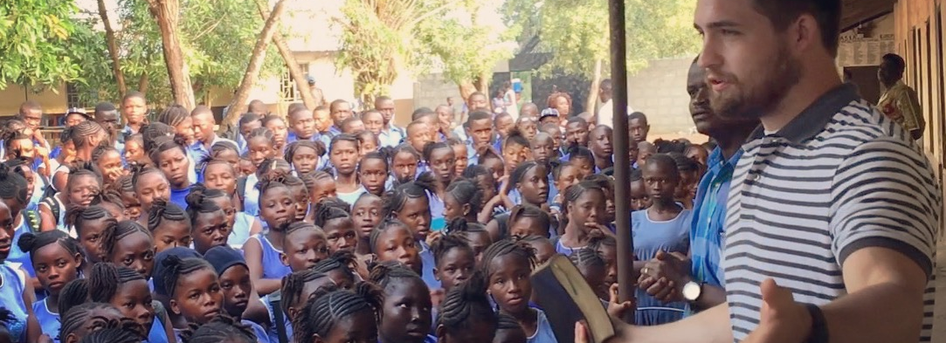
Why we went to Sierra Leone

Slide 2
Authority
Discipleship
Presence

Slide 3
Authority

Slide 4
Matthew 8:3
And Jesus stretched out his hand and touched him, saying, “I will; be clean.” And immediately his leprosy was cleansed.

Slide 5
Matthew 8:3
And Jesus stretched out his hand and touched him, saying, “I will; be clean.” And immediately his leprosy was cleansed.

Slide 6
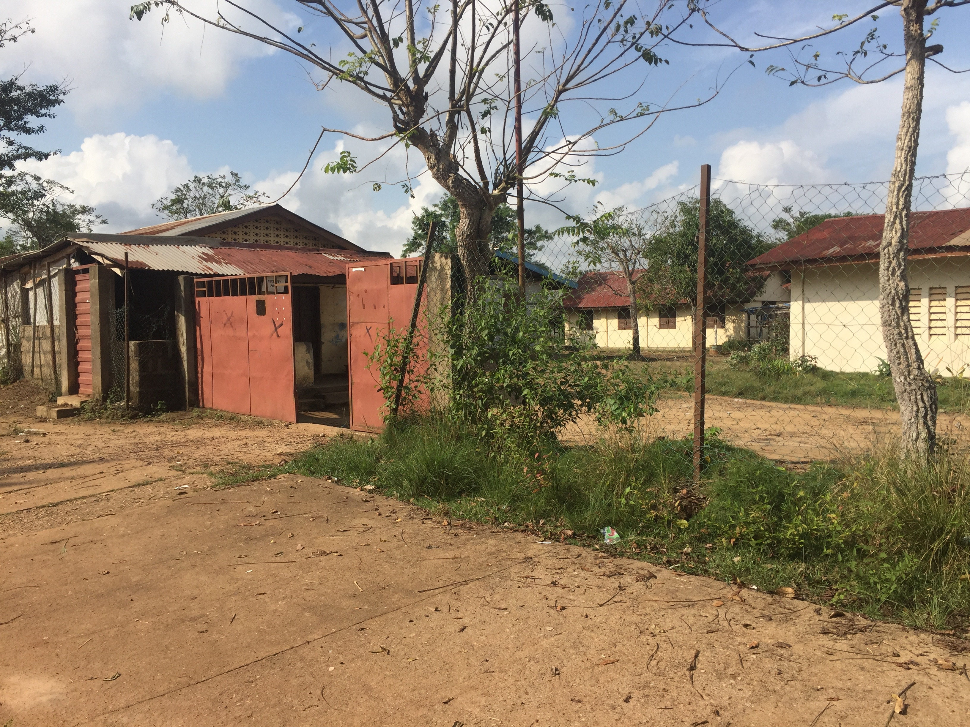

Slide 7
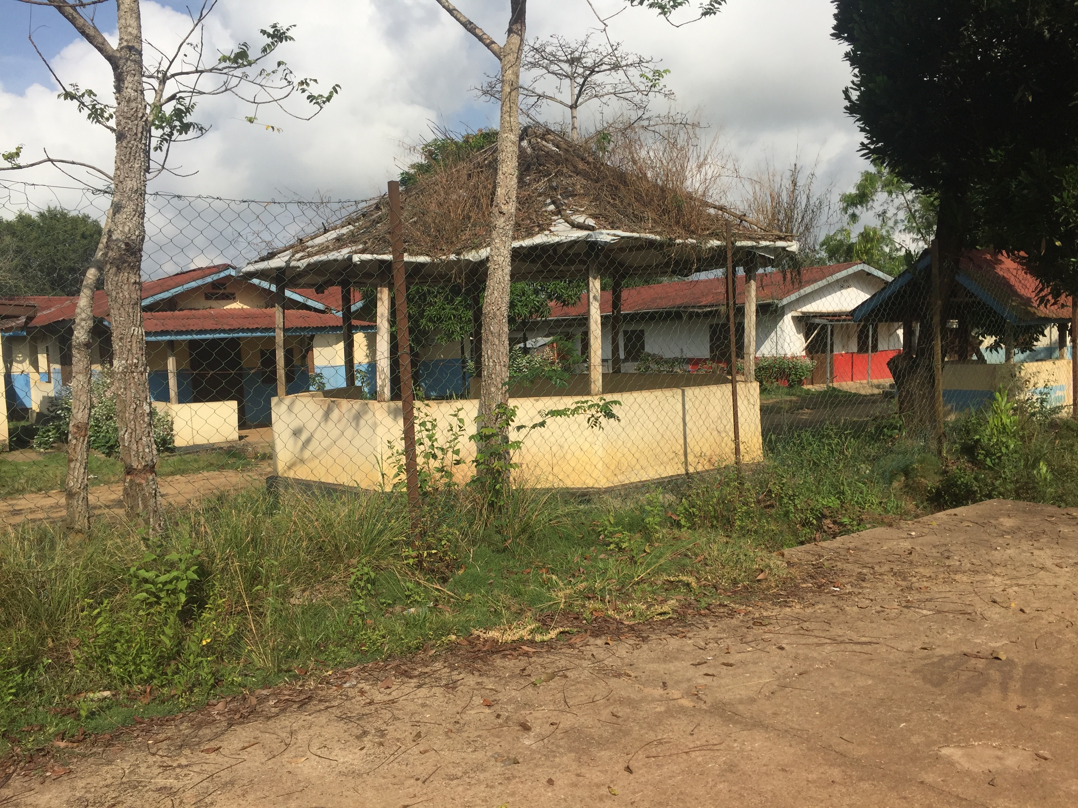

Slide 8
Matthew 8:17
This was to fulfill what was spoken by the prophet Isaiah: “He took our illnesses and bore our diseases.”

Slide 9
Matthew 8:17
This was to fulfill what was spoken by the prophet Isaiah: “He took our illnesses and bore our diseases.”

Slide 10
Matthew 9
6 “But that you may know that the Son of Man has authority on earth to forgive sins”—he then said to the paralytic—“Rise, pick up your bed and go home.” 7 And he rose and went home.

Slide 11
Matthew 9
6 “But that you may know that the Son of Man has authority on earth to forgive sins”—he then said to the paralytic—“Rise, pick up your bed and go home.” 7 And he rose and went home.

Slide 12
Discipleship

Slide 13
Matthew 8
19 And a scribe came up and said to him, “Teacher, I will follow you wherever you go.” 20 And Jesus said to him, “Foxes have holes, and birds of the air have nests, but the Son of Man has nowhere to lay his head.”

Slide 14
Matthew 8
19 And a scribe came up and said to him, “Teacher, I will follow you wherever you go.” 20 And Jesus said to him, “Foxes have holes, and birds of the air have nests, but the Son of Man has nowhere to lay his head.”

Slide 16
Matthew 8:27
Then Peter said in reply, “See, we have left everything and followed you. What then will we have?”

Slide 17
Matthew 8:27
Then Peter said in reply, “See, we have left everything and followed you. What then will we have?”

Slide 18
Presence

Slide 19
Matthew 8
21 Another of the disciples said to him, “Lord, let me first go and bury my father.” 22 And Jesus said to him, “Follow me, and leave the dead to bury their own dead.”

Slide 20
Matthew 8
21 Another of the disciples said to him, “Lord, let me first go and bury my father.” 22 And Jesus said to him, “Follow me, and leave the dead to bury their own dead.”

Slide 21
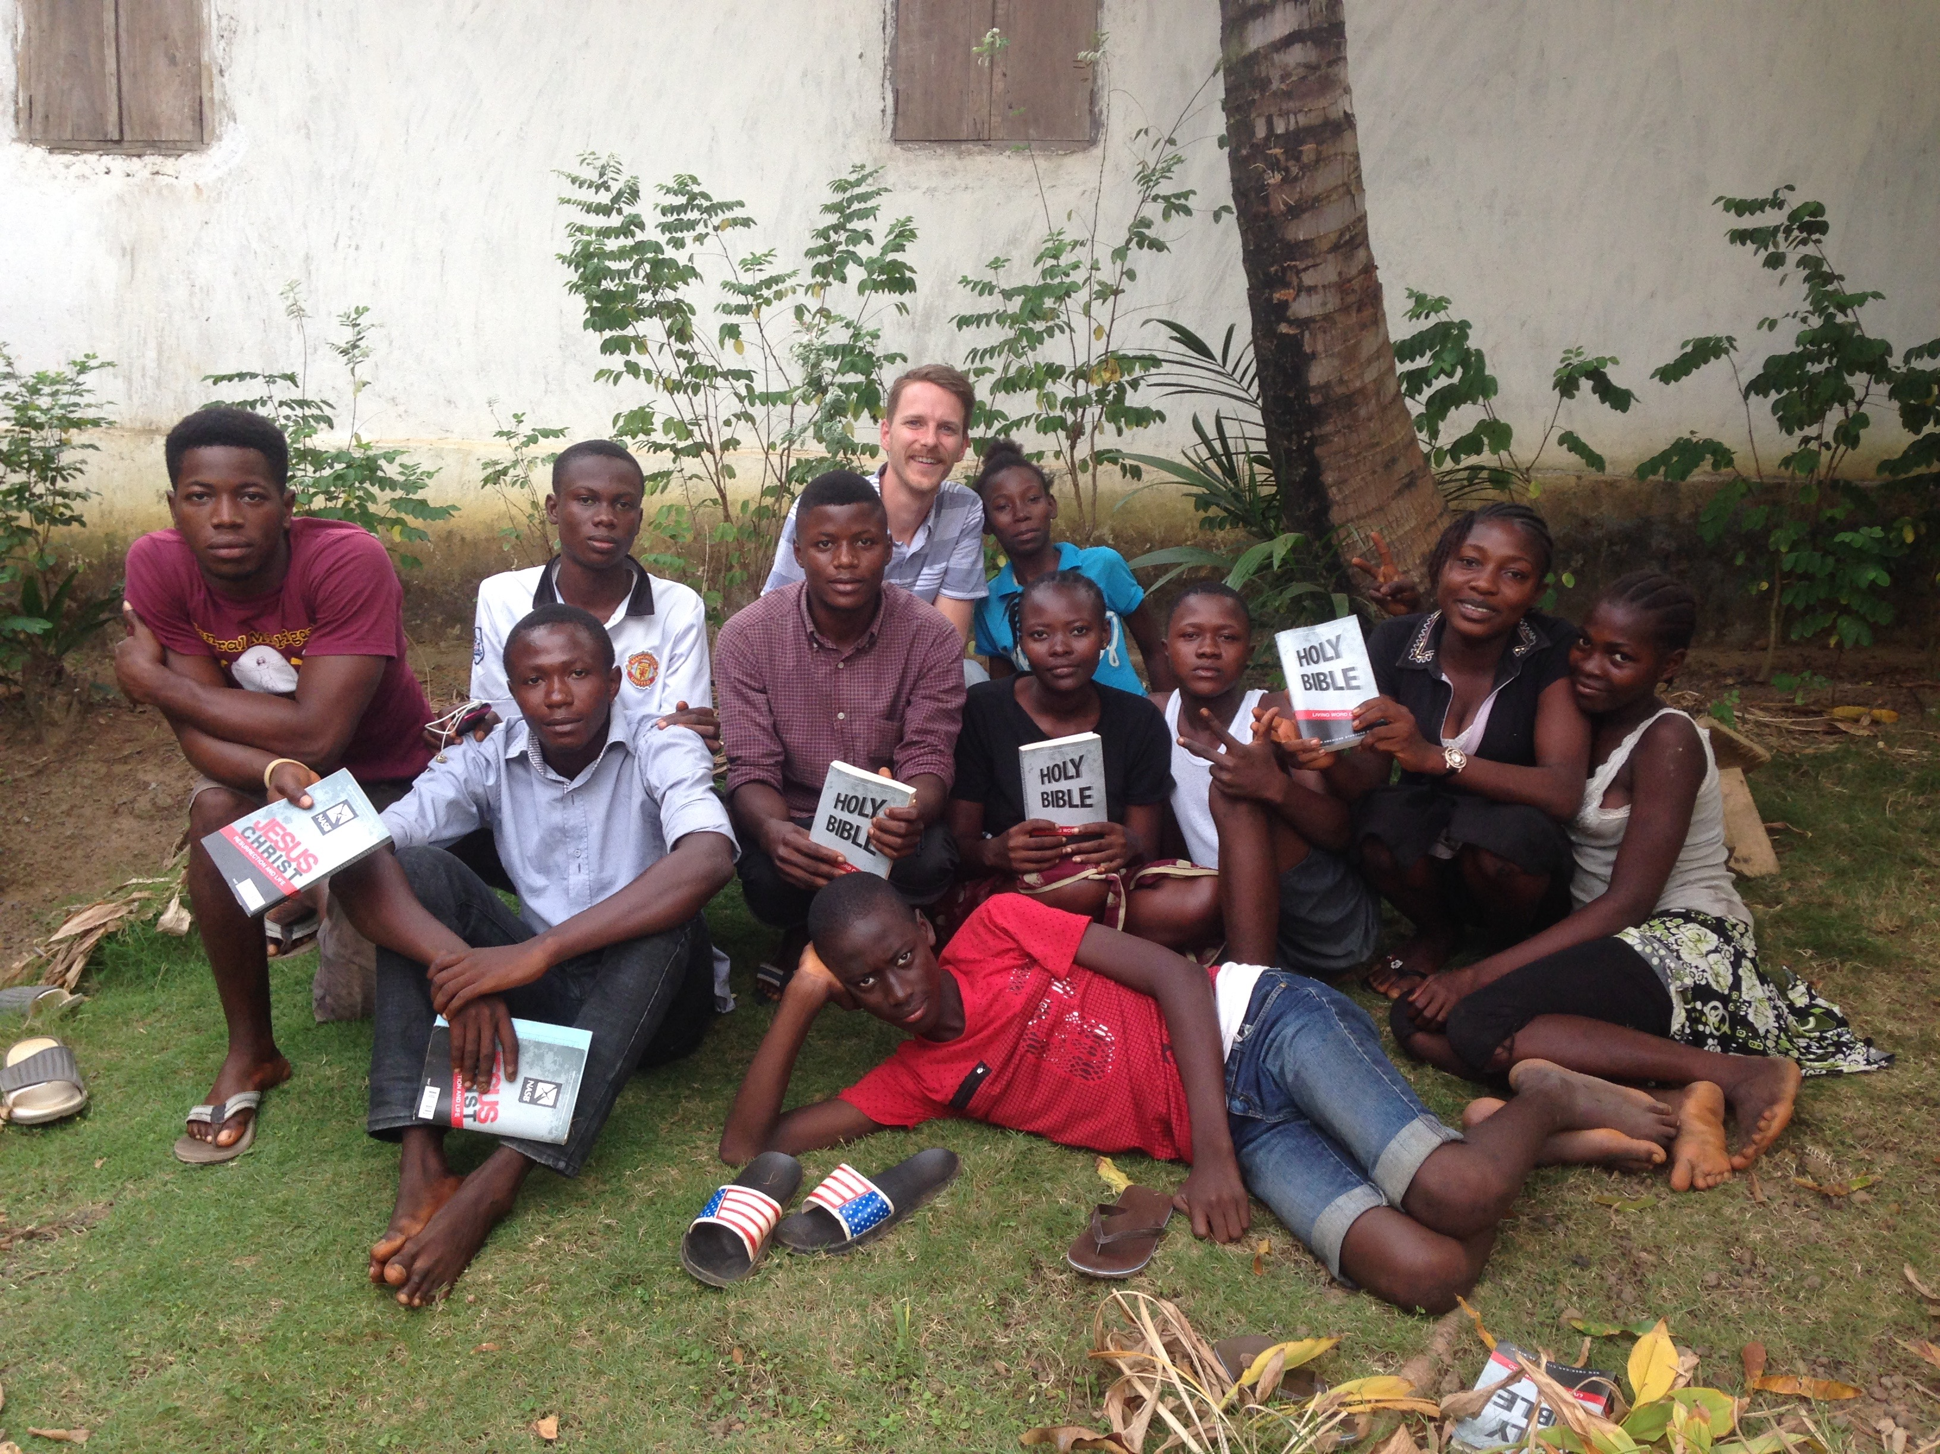

Slide 22
Matthew 12
48 But he replied to the man who told him, “Who is my mother, and who are my brothers?” 49 And stretching out his hand toward his disciples, he said, “Here are my mother and my brothers! 50 For whoever does the will of my Father in heaven is my brother and sister and mother.”

Slide 23
Matthew 12
48 But he replied to the man who told him, “Who is my mother, and who are my brothers?” 49 And stretching out his hand toward his disciples, he said, “Here are my mother and my brothers! 50 For whoever does the will of my Father in heaven is my brother and sister and mother.”

Slide 24
