Slide 2
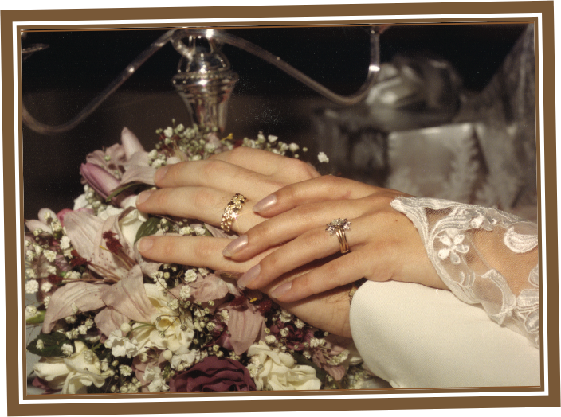
Marriage As God Designed It

Slide 3
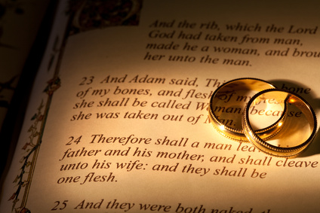
Finding God In Your Marriage

Slide 4
“By all means marry. If you get a good wife, you’ll become happy. If you get a bad one, you’ll become a philosopher.”
-- Socrates

Slide 5
“One of the best wedding gifts God gave you was a Full Length Mirror called your spouse. Had there been a card attached, it would have said, Here’s to helping you discover what you’re really like!”
Gary & Betsy Ricucci

Slide 6
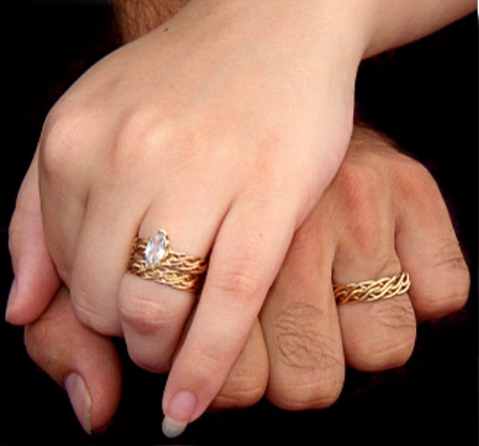
What Is Marriage For?
Happiness Is Not The Goal – Not Even Here On Earth!
Happiness Is The By-Product Or Result Of A Life Properly Lived.
Happiness Is The End Game!

Slide 7
What Is Marriage For?
What If God Designed Marriage To Make Us Holy More Than To Make Us Happy?

Slide 8
It is important to remember that Romance is a relatively modern pursuit in marriage.

Slide 9
Setting The Right
G
O
A
L
S
No Marriage Can Endure On ROMANCE And FEELINGS Alone.
Romantic love has no Elasticity to it!
The kind of love that is needed to sustain a good marriage – must Stretch!

Slide 10
Setting The Right
G
O
A
L
S
When We Strive for Happiness – We Strive for the Wrong Goal!
When We Strive for Happiness From Our Spouse – We Strive for the Wrong Goal and From the Wrong Source !

Slide 11
Marital Analogies
Marital Analogies Teach Us Truths About God!
God Views His People As a Husband Views His Wife
God Rejoices in His People

Slide 12
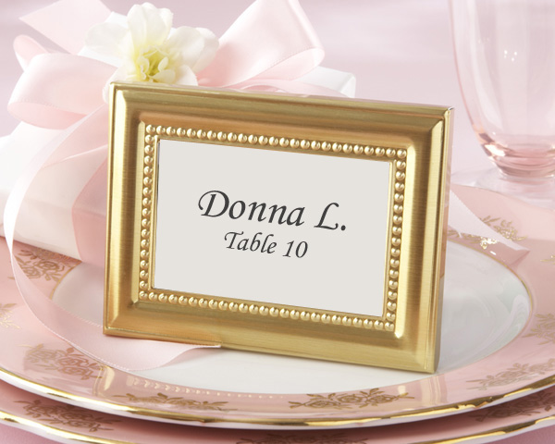
Marriage Is the Divine Picture of Relationship!

Slide 13
G
The Goal in Marriage – As in All Life …
Is To Please God!
O
A
L

