Slide 2
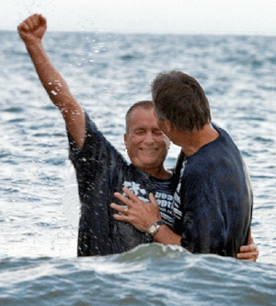
Baptism Doth Also Now Save Us

Slide 3
What the Bible teaches us:
One must believe and be baptized in order to be saved– Mk 16:15-16
¹⁵ And He said to them, “Go into all the world and preach the gospel to every creature. ¹⁶ He who believes and is baptized will be saved; but he who does not believe will be condemned. “

Slide 4
What the Bible teaches us:
One must believe and be baptized in order to be saved– Mk 16:15-16
Believe + Baptism= Saved
Do not believe= Condemned

Slide 5
What the Bible teaches us:
Baptism is “For The Remission of Sins.”
Acts 2:38
³⁸ Then Peter said to them, “Repent, and let every one of you be baptized in the name of Jesus Christ for the remission of sins; and you shall receive the gift of the Holy Spirit.”

Slide 6
What the Bible teaches us:
Baptism is “For The Remission of Sins.”
Acts 2:38
“eis”
“for” a preposition

Slide 7
“eis” the preposition
for [fɔː (unstressed) fə] prep
1. intended to reach; directed or belonging to there's a phone call for you
2. to the advantage of I only did it for you
3. in the direction of heading for the border
4. over a span of (time or distance) working for six days the river ran for six miles
5. in favor of; in support of those for the proposal vote for me
6. in order to get or achieve I do it for money he does it for pleasure what did you do that for?
7. appropriate to; designed to meet the needs of; meant to be used in these kennels are for puppies
8. in exchange for; at a cost of; to the amount of I got it for hardly any money
9. such as explains or results in his reason for changing his job was not given
10. in place of a substitute for the injured player
11. because of; through she wept for pure relief
12. with regard or consideration to the usual characteristics of he's short for a man it's cool for this time of year
13. concerning; as regards desire for money
14. as being we took him for the owner I know that for a fact
15. at a specified time a date for the next evening
16. to do or partake of an appointment for supper
17. in the duty or task of that's for him to say
18. to allow of too big a job for us to handle
19. despite; notwithstanding she's a good wife, for all her nagging
20. in order to preserve, retain, etc. to fight for survival
21. as a direct equivalent to word for word weight for weight
22. in order to become or enter to go for a soldier to train for the priesthood
23. in recompense for I paid for it last week he took the punishment for his crime
for it Brit informal liable for punishment or blame you'll be for it if she catches you
nothing for it no choice; no other course

Slide 8
What the Bible teaches us:
Baptism is “For The Remission of Sins.”
Acts 2:38
“Repent, and let every one of you be baptized in the name of Jesus Christ for the remission of sins; and you shall receive the gift of the Holy Spirit.”
“Repent, and let every one of you be baptized in the name of Jesus Christ for remitted sins; you have received the gift of the Holy Spirit.”

Slide 10
What the Bible teaches us:
What about Matt 26:28?
²⁸ For this is My blood of the new covenant, which is shed for many for the remission of sins.

Slide 11
What the Bible teaches us:
Baptism puts us into the body of Christ
1 Cor 12:12-13
¹² For as the body is one and has many members, but all the members of that one body, being many, are one body, so also is Christ. ¹³ For by one Spirit we were all baptized into one body—

Slide 12
What the Bible teaches us:
Baptism puts us into the body of Christ
Gal 3:27
“²⁷ For as many of you as were baptized into Christ have put on Christ.”

Slide 13
What the Bible teaches us:
In baptism, our old body is “done away” with.
Col 2:11-13

Slide 14
What the Bible teaches us:
¹¹ In Him you were also circumcised with the circumcision made without hands, by putting off the body of the sin of the flesh, by the circumcision of Christ ¹² buried with Him in baptism, in which you also were raised with Him through faith in the working of God, who raised Him from the dead. ¹³ And you, being dead in your trespasses and the uncircumcision of your flesh, He has made alive together with Him, having forgiven you all trespasses,

Slide 15
Baptism Doth Also Now Save Us
1 Pet 3:21,
²¹The like figure whereunto even baptism doth also now save us (not the putting away of the filth of the flesh, but the answer of a good conscience toward God,) by the resurrection of Jesus Christ:
1 Pet 3:21,
²¹The like figure whereunto even baptism doth also now save us (not the putting away of the filth of the flesh, but the answer of a good conscience toward God,) by the resurrection of Jesus Christ:

Slide 16
Baptism Doth Also Now Save Us
Am Std- ²¹ which also after a true likeness doth now save you, even baptism
CEV- ²¹Those flood waters were like baptism that now saves you.
Douay-Rheims 1899-²¹Whereunto baptism being of the like form, now saves you also:
ESV- ²¹Baptism, which corresponds to this, now saves you
God’s Word Translation- ²¹Baptism, which is like that water, now saves you.
NAS- ²¹ Corresponding to that, baptism now saves you
NIV- ²¹ and this water symbolizes baptism that now saves you also
NKJV- ²¹ There is also an antitype which now saves us—baptism
1 Pet 3:21,
²¹The like figure whereunto even baptism doth also now save us (not the putting away of the filth of the flesh, but the answer of a good conscience toward God,) by the resurrection of Jesus Christ:

Slide 17
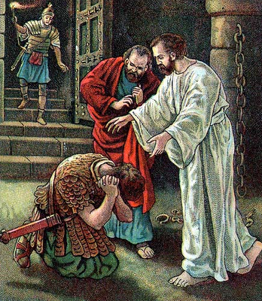
What the Bible teaches us:
Baptism was always immediate
Acts 16:30
³³ And he took them the same hour of the night and washed their stripes. And immediately he and all his family were baptized

Slide 18
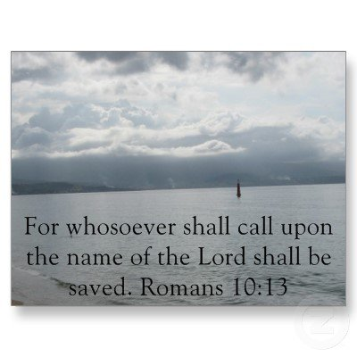
What the Bible teaches us:
At what point do we “call on God?”
Acts 22:16
¹⁶ And now why are you waiting? Arise and be baptized, and wash away your sins, calling on the name of the Lord.’

Slide 19
What the Bible teaches us:
….believe and be baptized to be saved– Mk 16:16
….for the remission of sins-- Acts 2:38
….sins are washed away—Acts 22:16
….the old man is done away with– Col 2 11-13
….puts us in the body of Christ– 1 Cor 12:12-13
….baptism now saves us– 1 Pet 3:21
….is always immediate—Acts 16:30
….one must be born of water and the spirit—John 3:5

Slide 20
Romans 6: 1-9
¹ What shall we say then? Shall we continue in sin that grace may abound? ² Certainly not! How shall we who died to sin live any longer in it? ³ Or do you not know that as many of us as were baptized into Christ Jesus were baptized into His death? ⁴ Therefore we were buried with Him through baptism into death, that just as Christ was raised from the dead by the glory of the Father, even so we also should walk in newness of life. ⁵ For if we have been united together in the likeness of His death, certainly we also shall be in the likeness of His resurrection, ⁶ knowing this, that our old man was crucified with Him, that the body of sin might be done away with, that we should no longer be slaves of sin. ⁷ For he who has died has been freed from sin. ⁸ Now if we died with Christ, we believe that we shall also live with Him, ⁹ knowing that Christ, having been raised from the dead, dies no more.

Slide 21
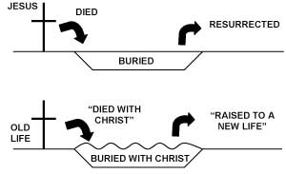
Romans 6: 1-9

Slide 22
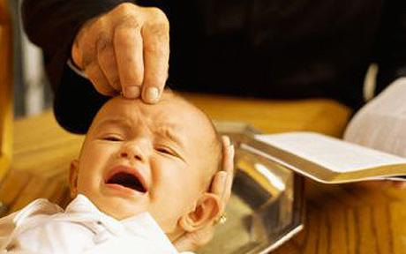
An old man dying to sin?

Slide 23
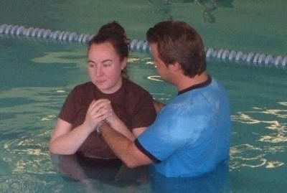
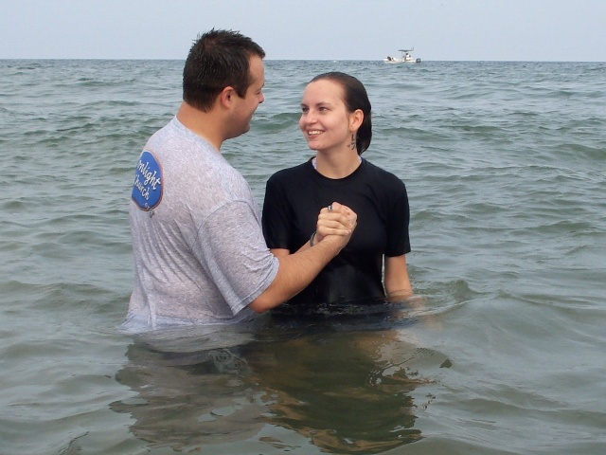
Emphasizing Jesus?

