Slide 1
one
LORD
one
FAITH
one
BAPTISM

Slide 2
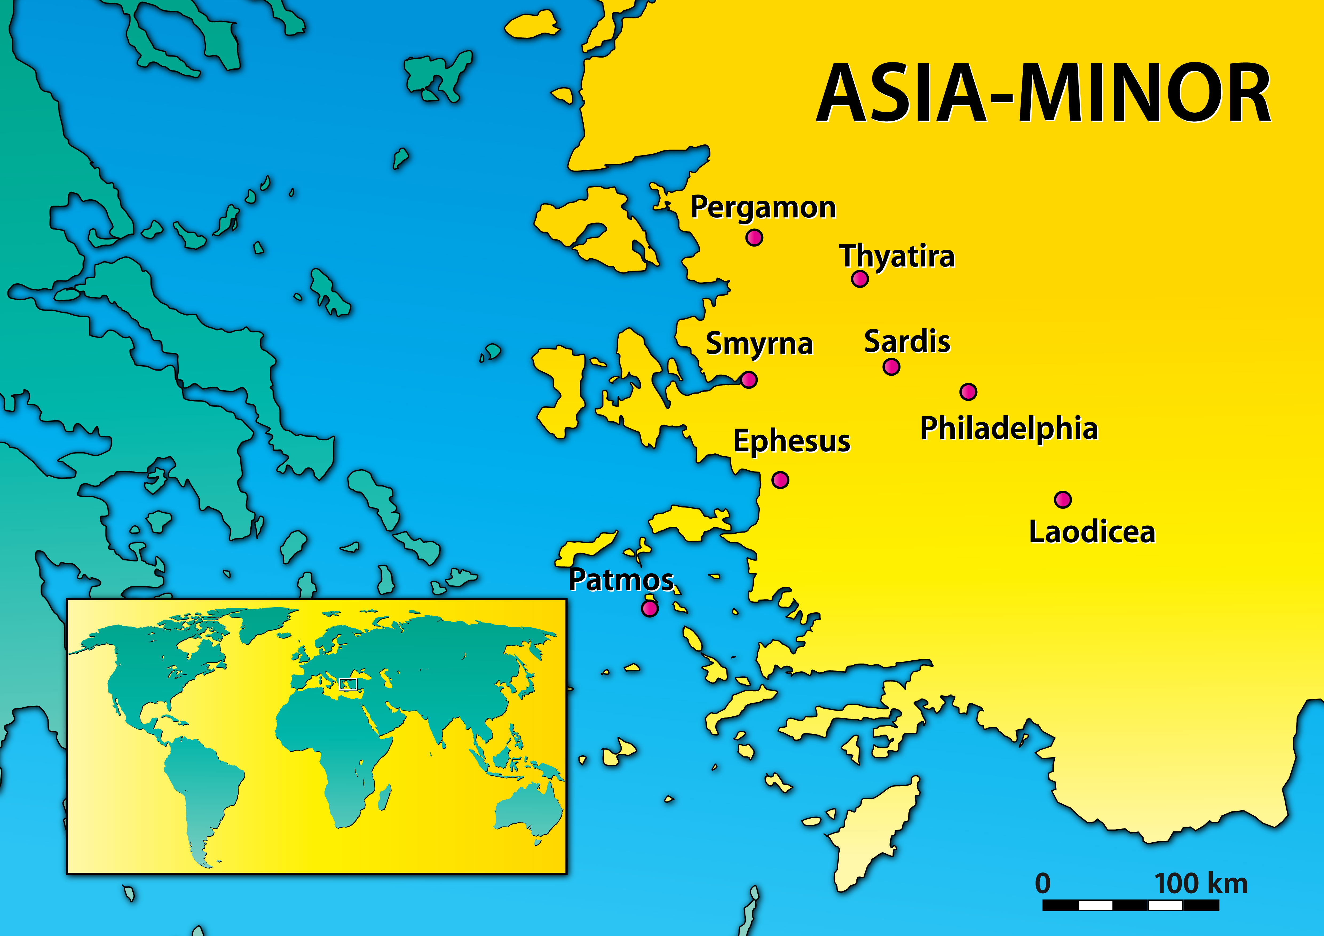
Initial impressions can be deceiving.
We don’t often value the same things the Lord values.
In every church there will be unique challenges for you as an individual.

Slide 3
Remember that you will stand before God as an individual, not with your church family.
There is no perfect church.

Slide 5
One body.
One Spirit.
One hope.
One Lord.
One faith.
One baptism.
One God.

Slide 6
Baptism puts us into Christ (Rom 6:3; Gal 3:26-27)
Baptism is for the forgiveness of sins (Acts 2:38)
Baptism washes away sins (Acts 22:16; Eph 5:26; Titus 3:5; Heb 10:22)
Baptism is for salvation (Mark 16:16; 1 Pet 3:21)
Baptism is when we are born again (John 3:5; Rom 6:3-6; Col 2:11-12)

