Slide 1
Northwood Congregational Meeting
August 27, 2017

Slide 2
Meeting Schedule
9:00-9:30
  Prayer (Brad Cicero)
  2017-18 Theme & Calendar (Neal Huggins)
  Financial Report (Donald Smith)
  Expression of Thanks (Jeff Stricklin)

Slide 3
Meeting Schedule
9:40-10:20
  New Workgroups
    New Organization & emphasis on service (Jeff Stricklin)
    Curriculum (David Maxson)
  Website (Jeff Gray)
  Evangelism plans & college students(Joshua Carter)

Slide 4
Prayer

Slide 6
Make Me a Servant
“But whoever would be great among you must be your servant, and whoever would be first among you must be your slave, even as the Son of Man came not to be served but to serve, and to give his life as a ransom for many.” Matthew 20:26-28

Slide 7
Make Me a Servant
Do nothing from selfish ambition or conceit, but in humility count others more significant than yourselves. Let each of you look not only to his own interests, but also to the interests of others. Have this mind among yourselves, which is yours in Christ Jesus… Phil 2:3-5

Slide 8
Make Me a Servant
Main idea:
  The gospel will naturally make us servants because it develops in us “the mind of Christ.”
Sermon series
  Theme sermon 2nd Sunday of each month
  Fruit of the Spirit: Love, joy, peace, patience, kindness, goodness, faithfulness, gentleness, & self-control
  Discussion in group meeting on same topic

Slide 9
Calendar of Events
Oct 1-4 – A Conversation About Race
  Sun & Wed (Oct 1, 4) sermons from Kevin Clark
  Mon & Tues (Oct 2, 3) Panel Discussion with Kevin, James Newman, & Nate Creekmore
Jan 19-21 – The Christian in the Workplace
  Non-preachers to speak
  Interactive presentations and a panel discussion
Mar 2-4 – Bible Study Weekend
MARK YOUR CALENDARS!

Slide 10
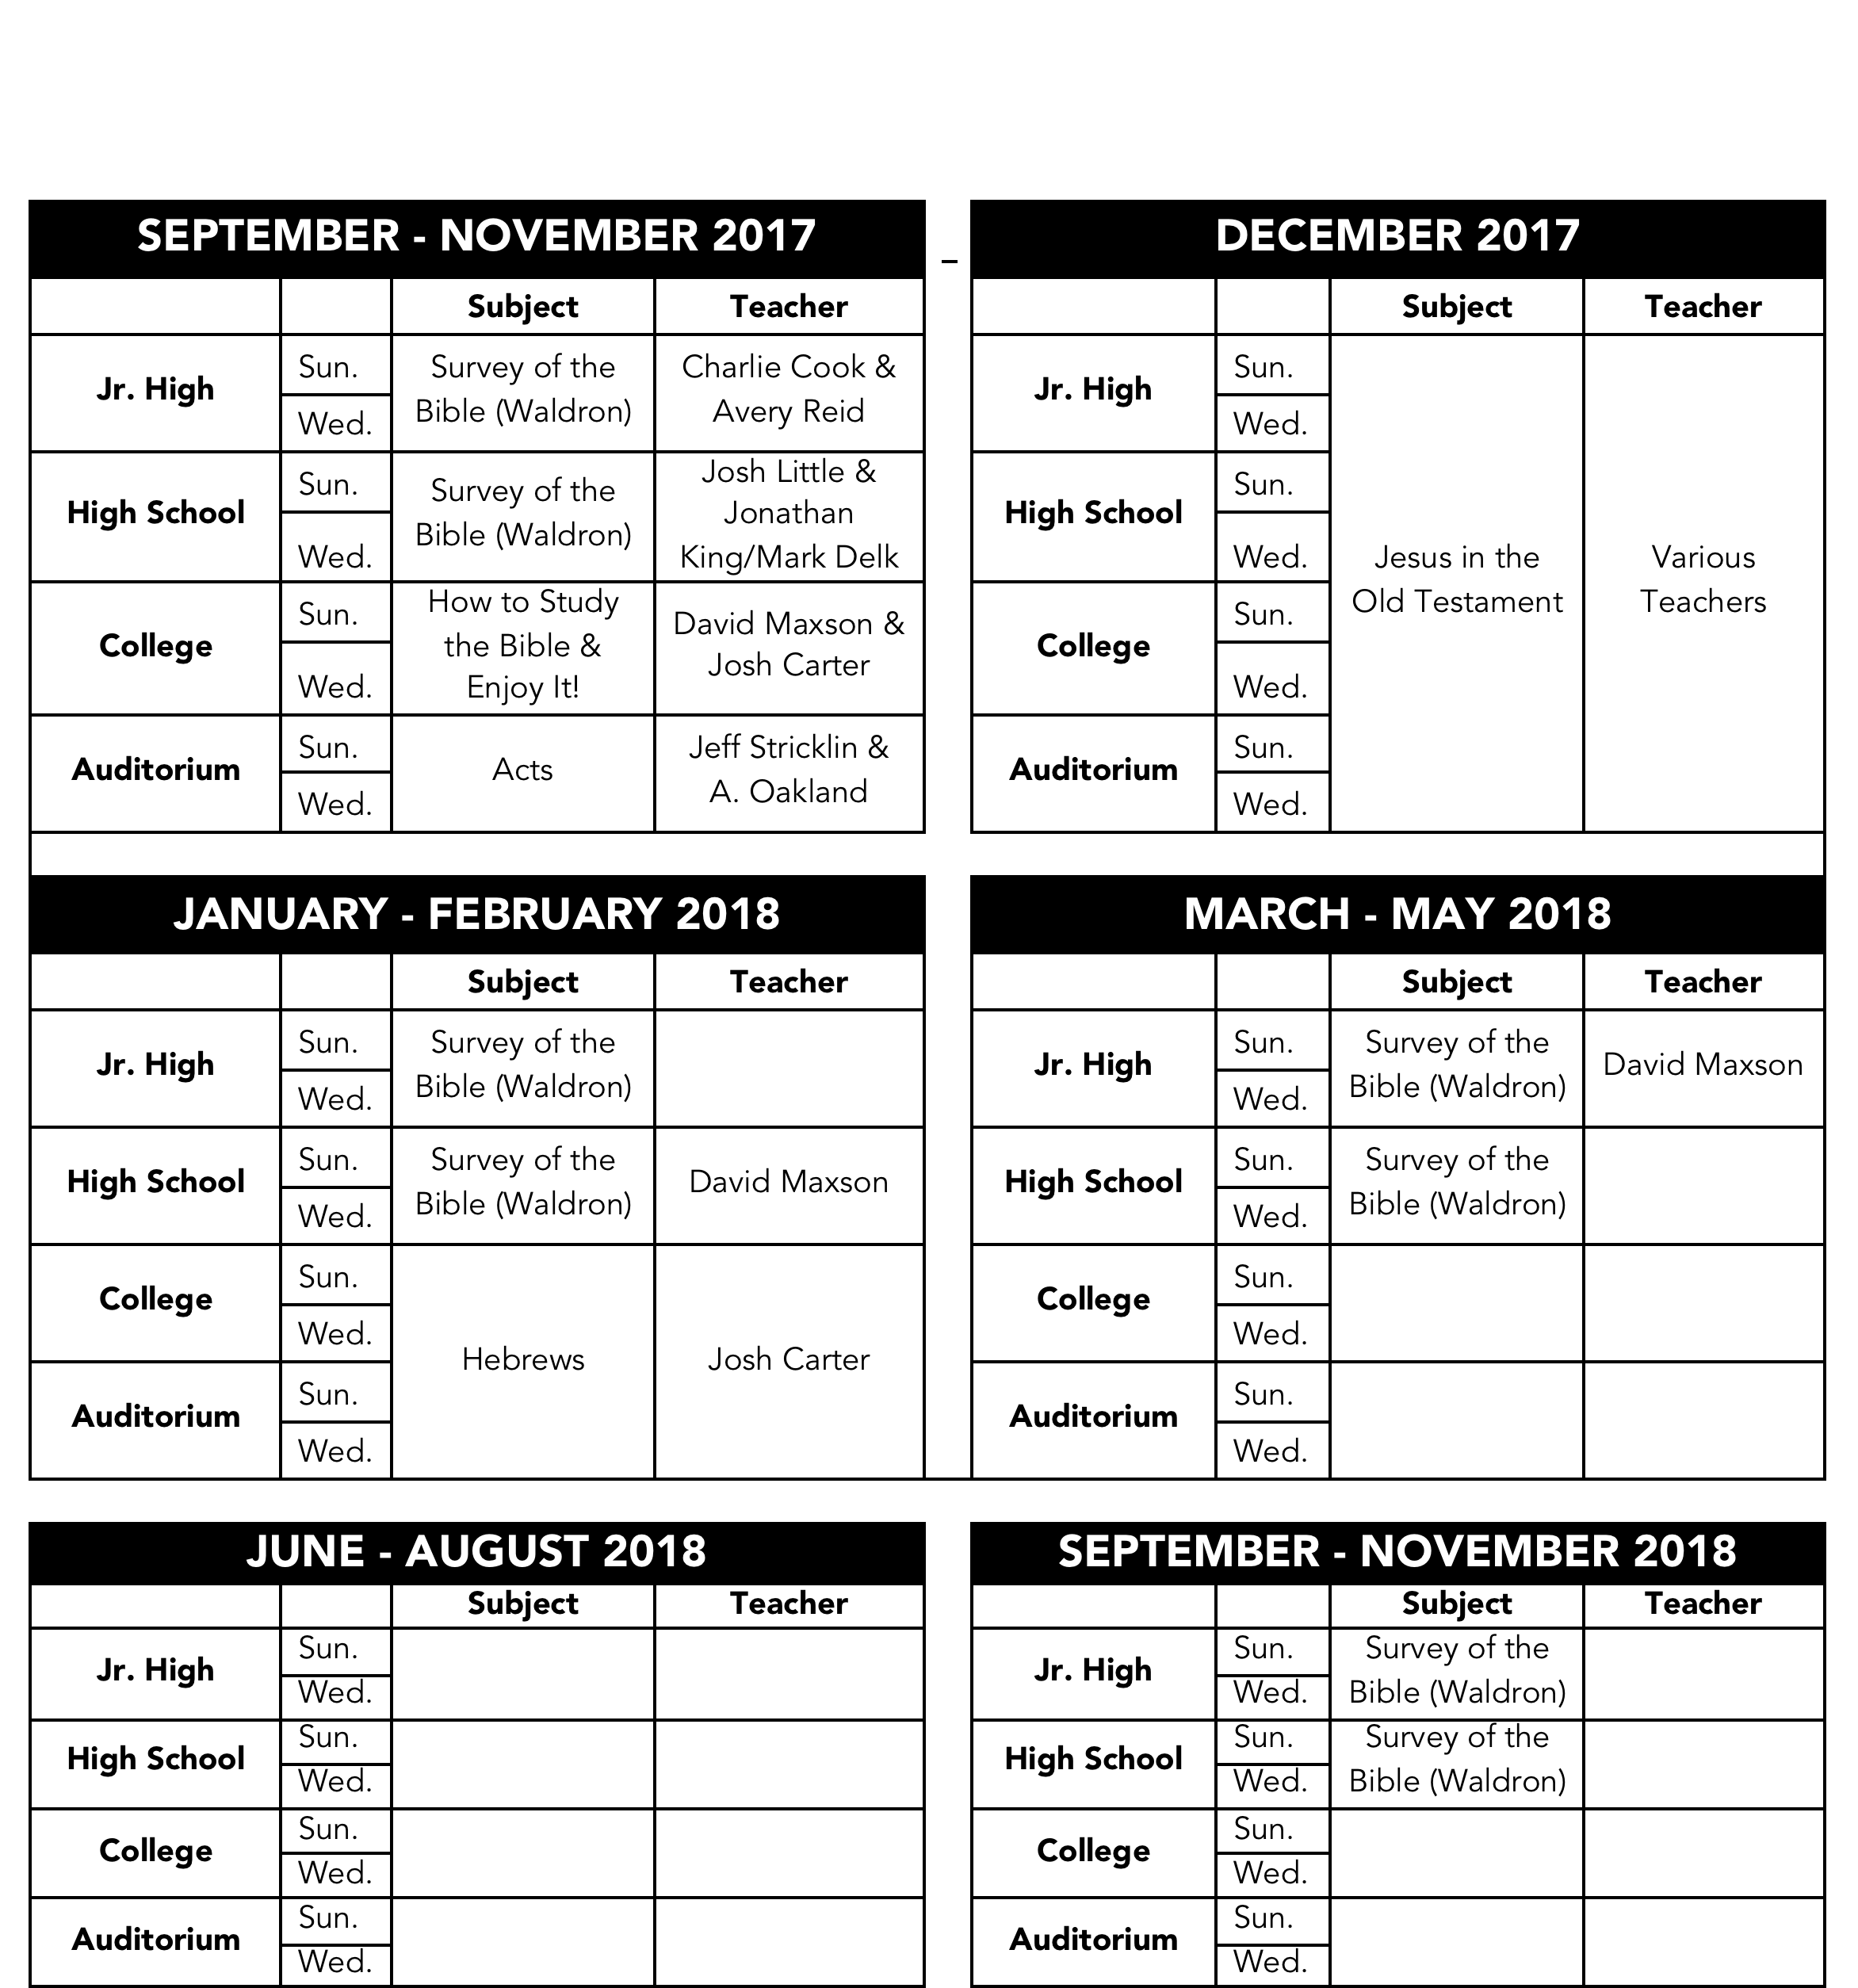

Slide 11
New Teachers & Study Guide

Slide 12
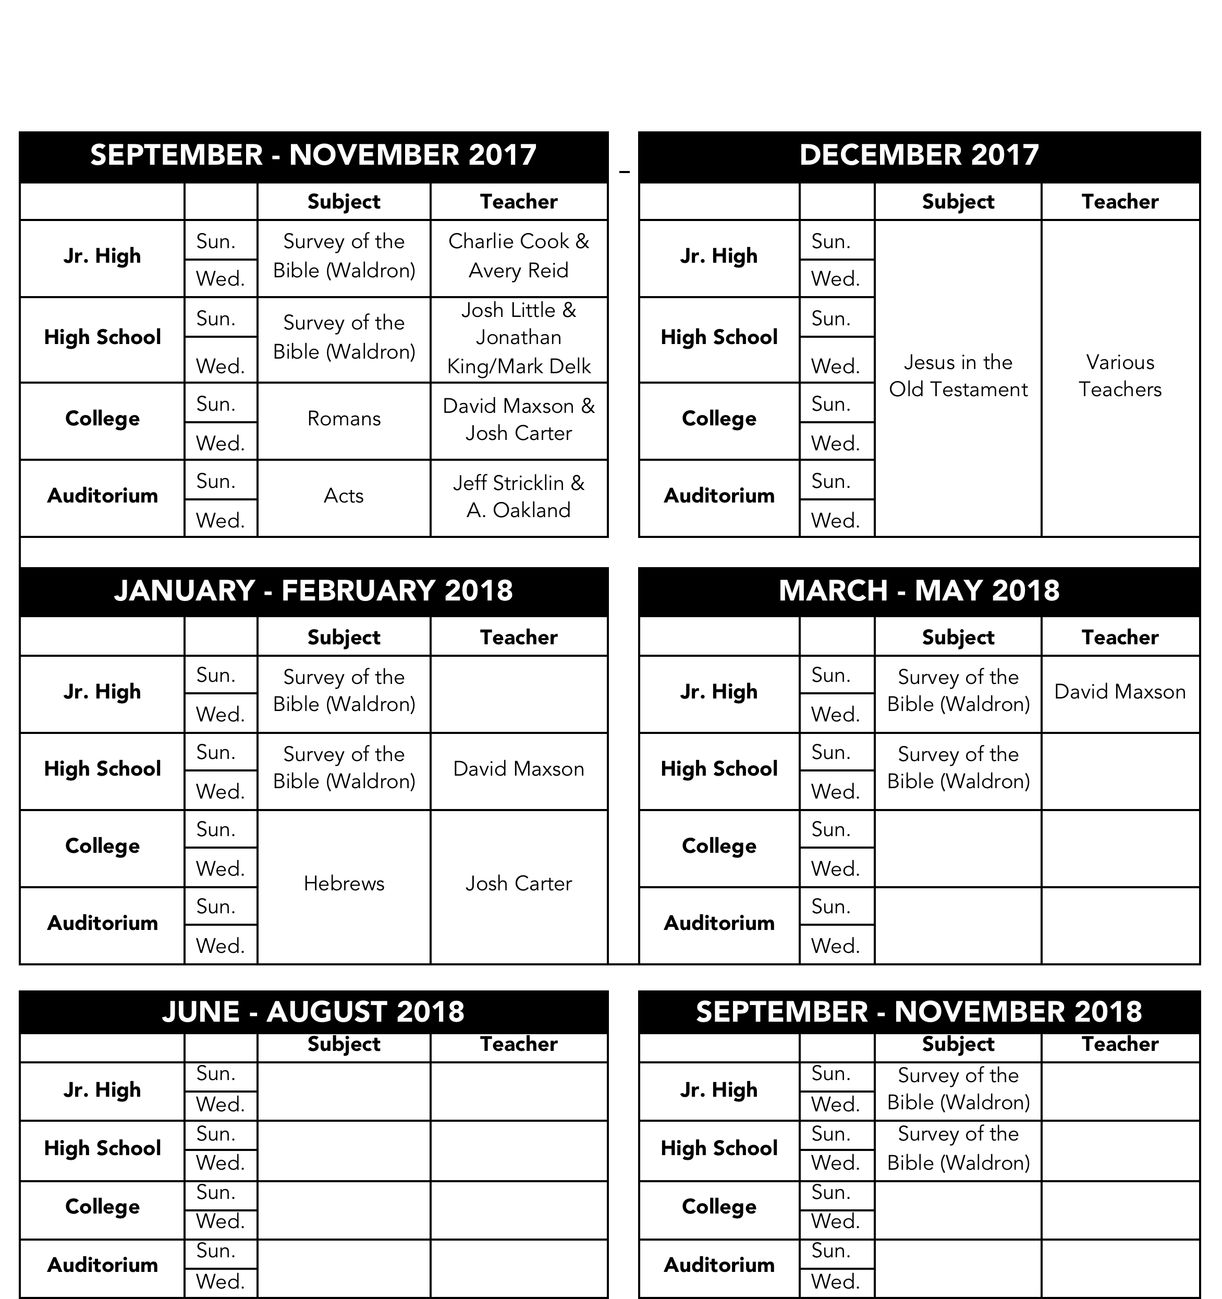

Slide 14
Monthly Opportunities
1st Sunday – Young people’s devo
    Maxson’s house
    Middle School, High School, & College age
2nd Sunday – Work group meetings
3rd Sunday – Elders/members meeting

Slide 15
Comparison of 1st Six Months of 2016 vs. 2017
 | 2016 |  | 2017
Total Contribution for Year to Date | $78,760.37 |  | $96,682.15
Average Weekly Contribution | $3,124.86 |  | $3,718.54
Building | $6,427.95 |  | $6,394.92
Evangelism | $4,000.00 |  | $3,642.57
Salaries | $73,034.00 |  | $67,148.00
Supplies | $6,886.31 |  | $4,036.48
Utilities | $8,594.36 |  | $9,949.02
Total Expenses | $98,942.62 |  | $91,170.99
Excess to Date | $(20,182.25) |  | $5,511.16
Checking Account Balance at end of month | $9,737.44 |  | $47,575.45
Current Cash Balance of CD | $12,724.00 |  | $13,008.47
Total Cash On Hand at end of month | $22,461.44 |  | $60,583.92

Slide 16
Thank You!
Members – Increased contributions
Parents (& grandparents) of college students – One time, monthly, and weekly contributions
ALL GLORY TO GOD!

Slide 17
What This Means
2nd Preacher – Able to support Josh Carter for the remainder of year and future evangelist
Bringing in Outside speakers – Able to continue having events like Fall Focus, Winter Workshop, etc.
Facility improvements – Able to take care of needed upgrades and enhancements to building

Slide 18
Facility Improvements
New Amp – Upgrading our old (and quickly failing) amplifier
Portable Stage – For use when college students are gone; move pulpit closer while maintaining height
New Sign – Replacing old sign underneath marquee listing times of services
New nursery for fathers – Moving auditorium speakers into foyer, hallways, and into new nursery for dads

Slide 19
Northwood Congregational Meeting
August 27, 2017

Slide 20
Meeting Schedule
9:00-9:30
  Prayer (Brad Cicero)
  2017-18 Theme & Calendar (Neal Huggins)
  Financial Report (Donald Smith)
  Expression of Thanks (Jeff Stricklin)

Slide 21
Meeting Schedule
9:40-10:20
  New Workgroups
    New Organization & emphasis on service (Jeff Stricklin)
    Curriculum (David Maxson)
  Website (Jeff Gray)
  Evangelism plans & college students (Joshua Carter)

Slide 22
Organization of Workgroups
Old Format
  Four groups
  College students distributed throughout groups
  Intentionally desegregated (Unity Theme!)
New Format
  Only three groups
  A college only group
  Intentionally segregated by age

Slide 23
Reasons for Change
Three Elders
  Feel strongly that a shepherd should be in each group
Young Families
  Influx of four young couples/families in recent weeks
  Several babies born in last two years
  Need for basic lessons on family life
  Logistical problems with offering these Sun/Wed
  Opportunity for young families to bond with each other outside of assemblies (unique pressures at this critical time of life)

Slide 24
Some Reminders…
We still need those outside of peer groups
  Young families & individuals need the wisdom, experience, & example of older families & older members!
  Older members need the zeal and enthusiasm of those who are younger in the faith!
We must make individual choices to engage
  We choose who we sit next to at services, talk to after services, invite out to eat or invite into our home, etc.
  Mixing with others not like us takes intentional decisions to leave comfort zone

Slide 26
Make Me a Servant
“But whoever would be great among you must be your servant, and whoever would be first among you must be your slave, even as the Son of Man came not to be served but to serve, and to give his life as a ransom for many.” Matthew 20:26-28

Slide 27
Service Emphasis in Groups
Teaching service
  Study based on monthly theme sermon on service from Sunday morning
Doing service
  Discussion in groups about individual opportunities to serve others
  Monthly service project

Slide 28
Curriculum for Groups
Groups 1 & 3
  Study based on monthly theme sermon on service from Sunday morning
Group 2
  Study organized around “The Seven Habits of Successful Families”
  Handouts with questions each month
  Not necessary to purchase book
  Something for everyone in class

Slide 29
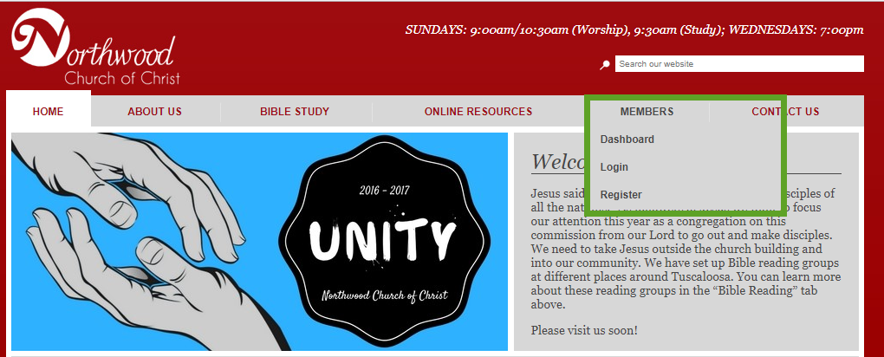
Website
  Website: http://northwoodcoc.org
  Step 1: Registering

Slide 30
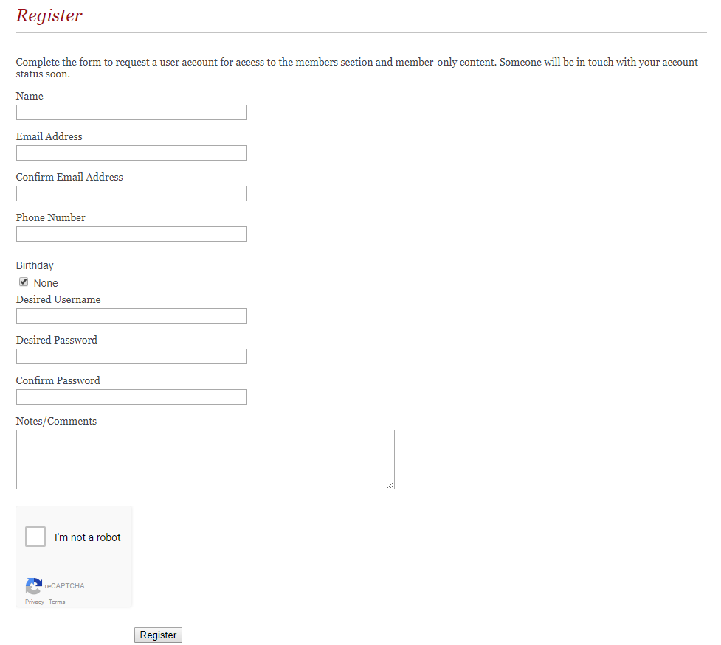
Website

Slide 31
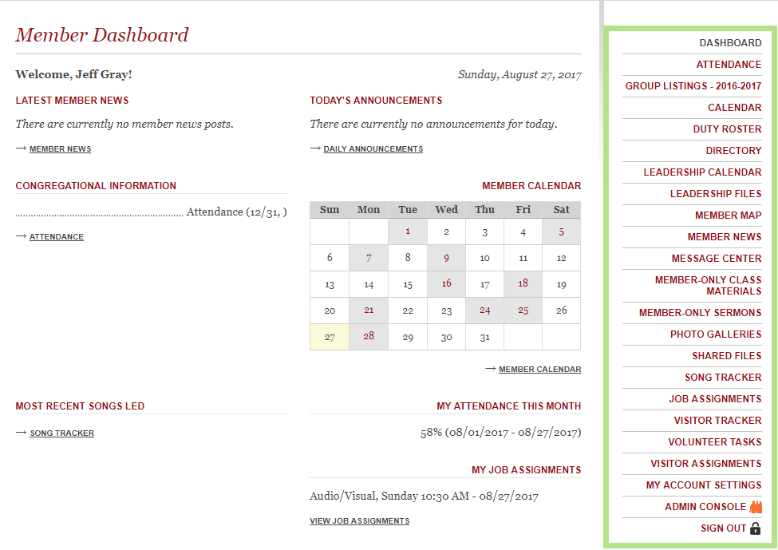
Website

Slide 32
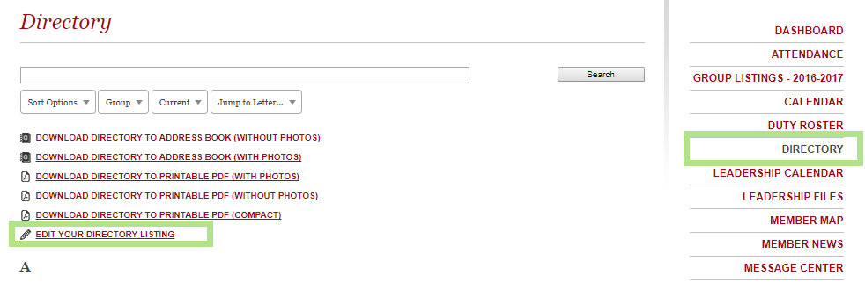
Website
  Website: http://northwoodcoc.org
  Step 2: Edit Directory

Slide 33
Website
  Website: http://northwoodcoc.org
  Step 2: Edit Directory
  Requests:
  Please confirm postal address and personal information updated.
  Confirm email addresses are current. Weekly emails and duty roster assignments sent out each week to email on record.

Slide 34
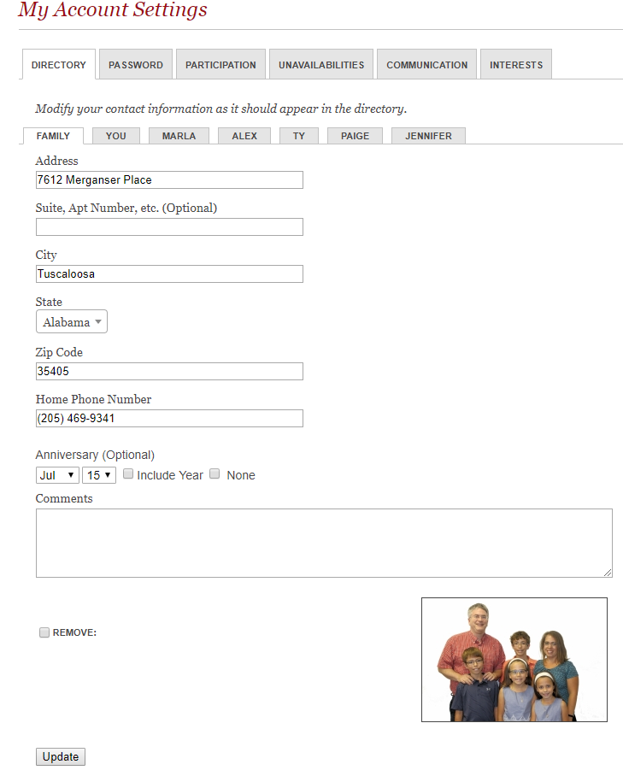
Website

Slide 35
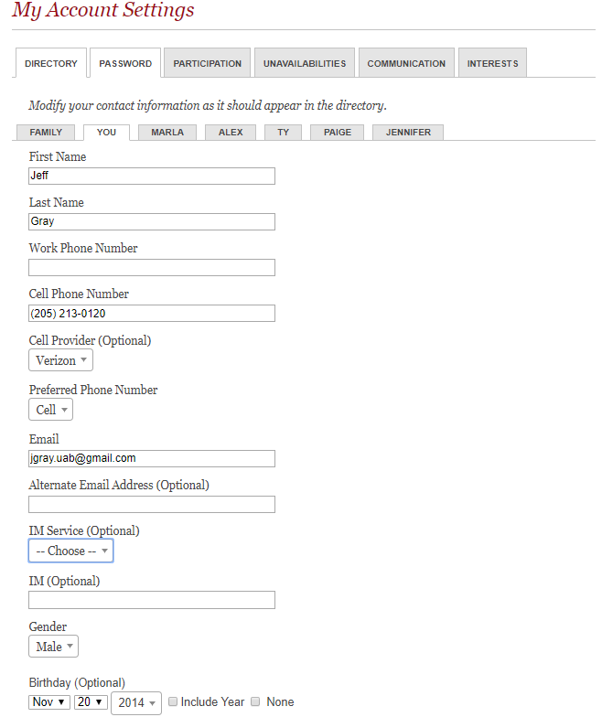
Website

Slide 36
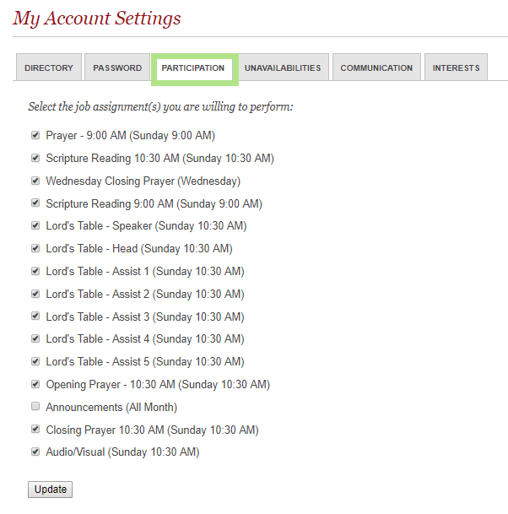
Website
  Men: Duty Roster
  Fill out online or paper (back table)

Slide 37
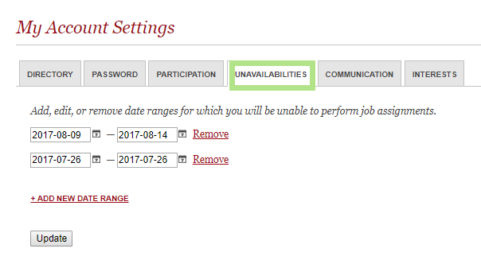
Website
  Men: Duty Roster Unavailibilities
  Add unavailabilities at end of month to assist with duty roster scheduling

Slide 38
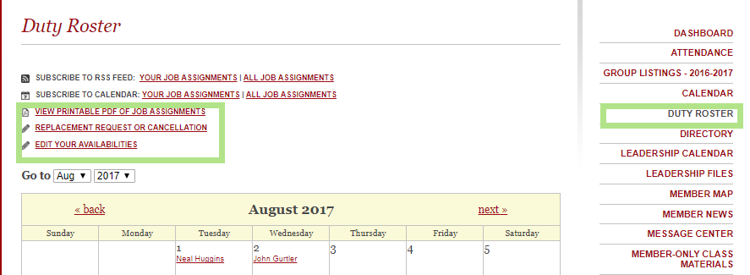
Website
  Duty Roster Details Available
  Website: Calendar, printable PDF
  Email: Reminders (next slide)
  Back Hall Bulletin Board: Updated 1 service prior to start of month

Slide 39
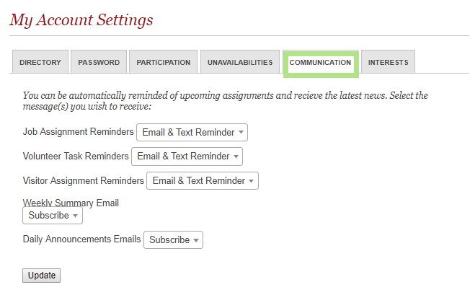
Website
  Reminders/Summaries
  Duty roster assignments
  Weekly summary (bday, anniversary, Bible Studies)
  Email address/cell must be current

Slide 40
Evangelism
Methods
  Acts 17:17
  Individual studies in public places
  Personal studies in public places
  Door-knocking (recent successes)
  Group studies in public places

Slide 41
Evangelism
Group Studies
  Mondays, 7:00 AM, Chick-fil-A (Northport) - Men's study
  Mondays, 7:00 PM, Heritage House (Jack Warner Pkwy.)
  Thursdays, lunchtime, on campus (Ferg)
  Thursdays, 6:30 PM, Chick-fil-A (Northport)
  Fridays, 6:30 AM, Chick-fil-A (Skyland) - Morning study

Slide 42
Evangelism
Additional Opportunities
  Group service projects
  Invite friends to planned church events
  Utilize David & Josh; help make connections
  If you have other ideas, let us know!

Slide 43
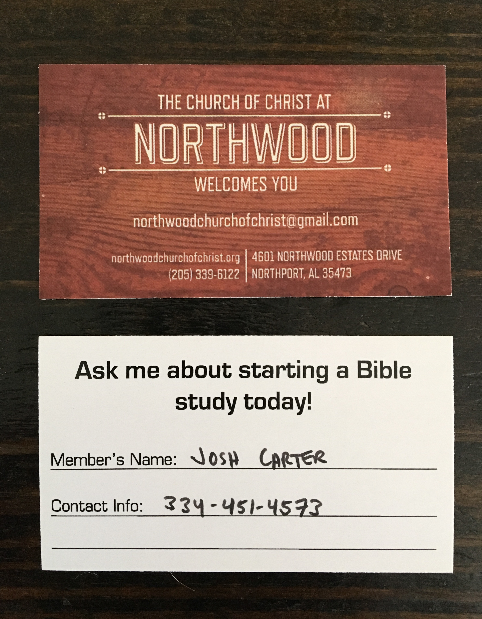

Slide 44

New Card

Slide 45

Vehicle Decal

Slide 46
College Students
Getting Connected
  Adopt-a-Student
  Mentoring Program
  Informal time with each other and with other members
Getting Involved
  1st Sunday – Young People’s Devo (Maxsons’)
  2nd Sunday – Group Meeting (Davises’)
  Thursdays at lunch – Bible Study (Ferg)
  Thursday nights – Student Bible Study (Ferg)

