Slide 1
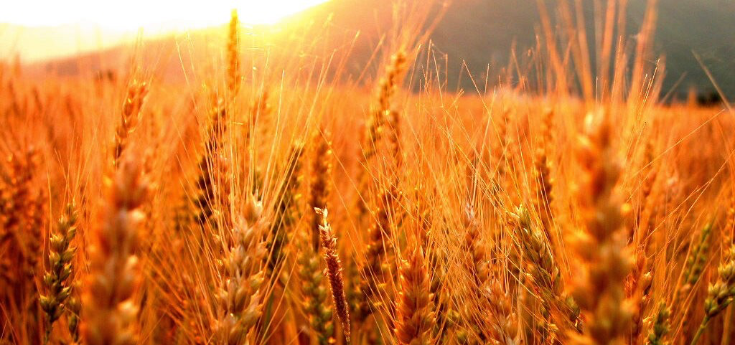
Firstfruits
WHERE GRATITUDE MEETS OBEDIENCE

Slide 2
THE OFFERING

Slide 3
Deuteronomy 26:1-2
“When you come into the land that the Lord your God is giving you for an inheritance and have taken possession of it and live in it, you shall take some of the first of all the fruit of the ground, which you harvest from your land that the Lord your God is giving you, and you shall put it in a basket, and you shall go to the place that the Lord your God will choose, to make his name to dwell there.”

Slide 4
THE RESPONSE

Slide 5
Deuteronomy 26:3-4
“And you shall go to the priest who is in office at that time and say to him, ‘I declare today to the Lord your God that I have come into the land that the Lord swore to our fathers to give us.’ Then the priest shall take the basket from your hand and set it down before the altar of the Lord your God.”

Slide 6
Deuteronomy 26:5-6
“And you shall make response before the Lord your God, ‘A wandering Aramean was my father. And he went down into Egypt and sojourned there, few in number, and there he became a nation, great, mighty, and populous. And the Egyptians treated us harshly and humiliated us and laid on us hard labor.”

Slide 7
Deuteronomy 26:7-8
“Then we cried to the Lord, the God of our fathers, and the Lord heard our voice and saw our affliction, our toil, and our oppression. And the Lord brought us out of Egypt with a mighty hand and an outstretched arm, with great deeds of terror, with signs and wonders.”

Slide 8
Deuteronomy 26:9-10
“And he brought us into this place and gave us this land, a land flowing with milk and honey. And behold, now I bring the first of the fruit of the ground, which you, O Lord, have given me.’”

Slide 9
Deuteronomy 26:10-11
“And you shall set it down before the Lord your God and worship before the Lord your God. And you shall rejoice in all the good that the Lord your God has given to you and to your house, you, and the Levite, and the sojourner who is among you.”

Slide 10
Give thanks…
returning the first and best…
as a sacrifice of praise.

