Slide 2
OCT 15 – DESCRIPTIONS
OCT 22 – ASSEMBLIES
NOV 5 – WOMEN’S ROLES
NOV 19 – MISSION
NOV 26 – LEADERSHIP
DEC 3 – FELLOWSHIP

Slide 3
What is the church?

Slide 4
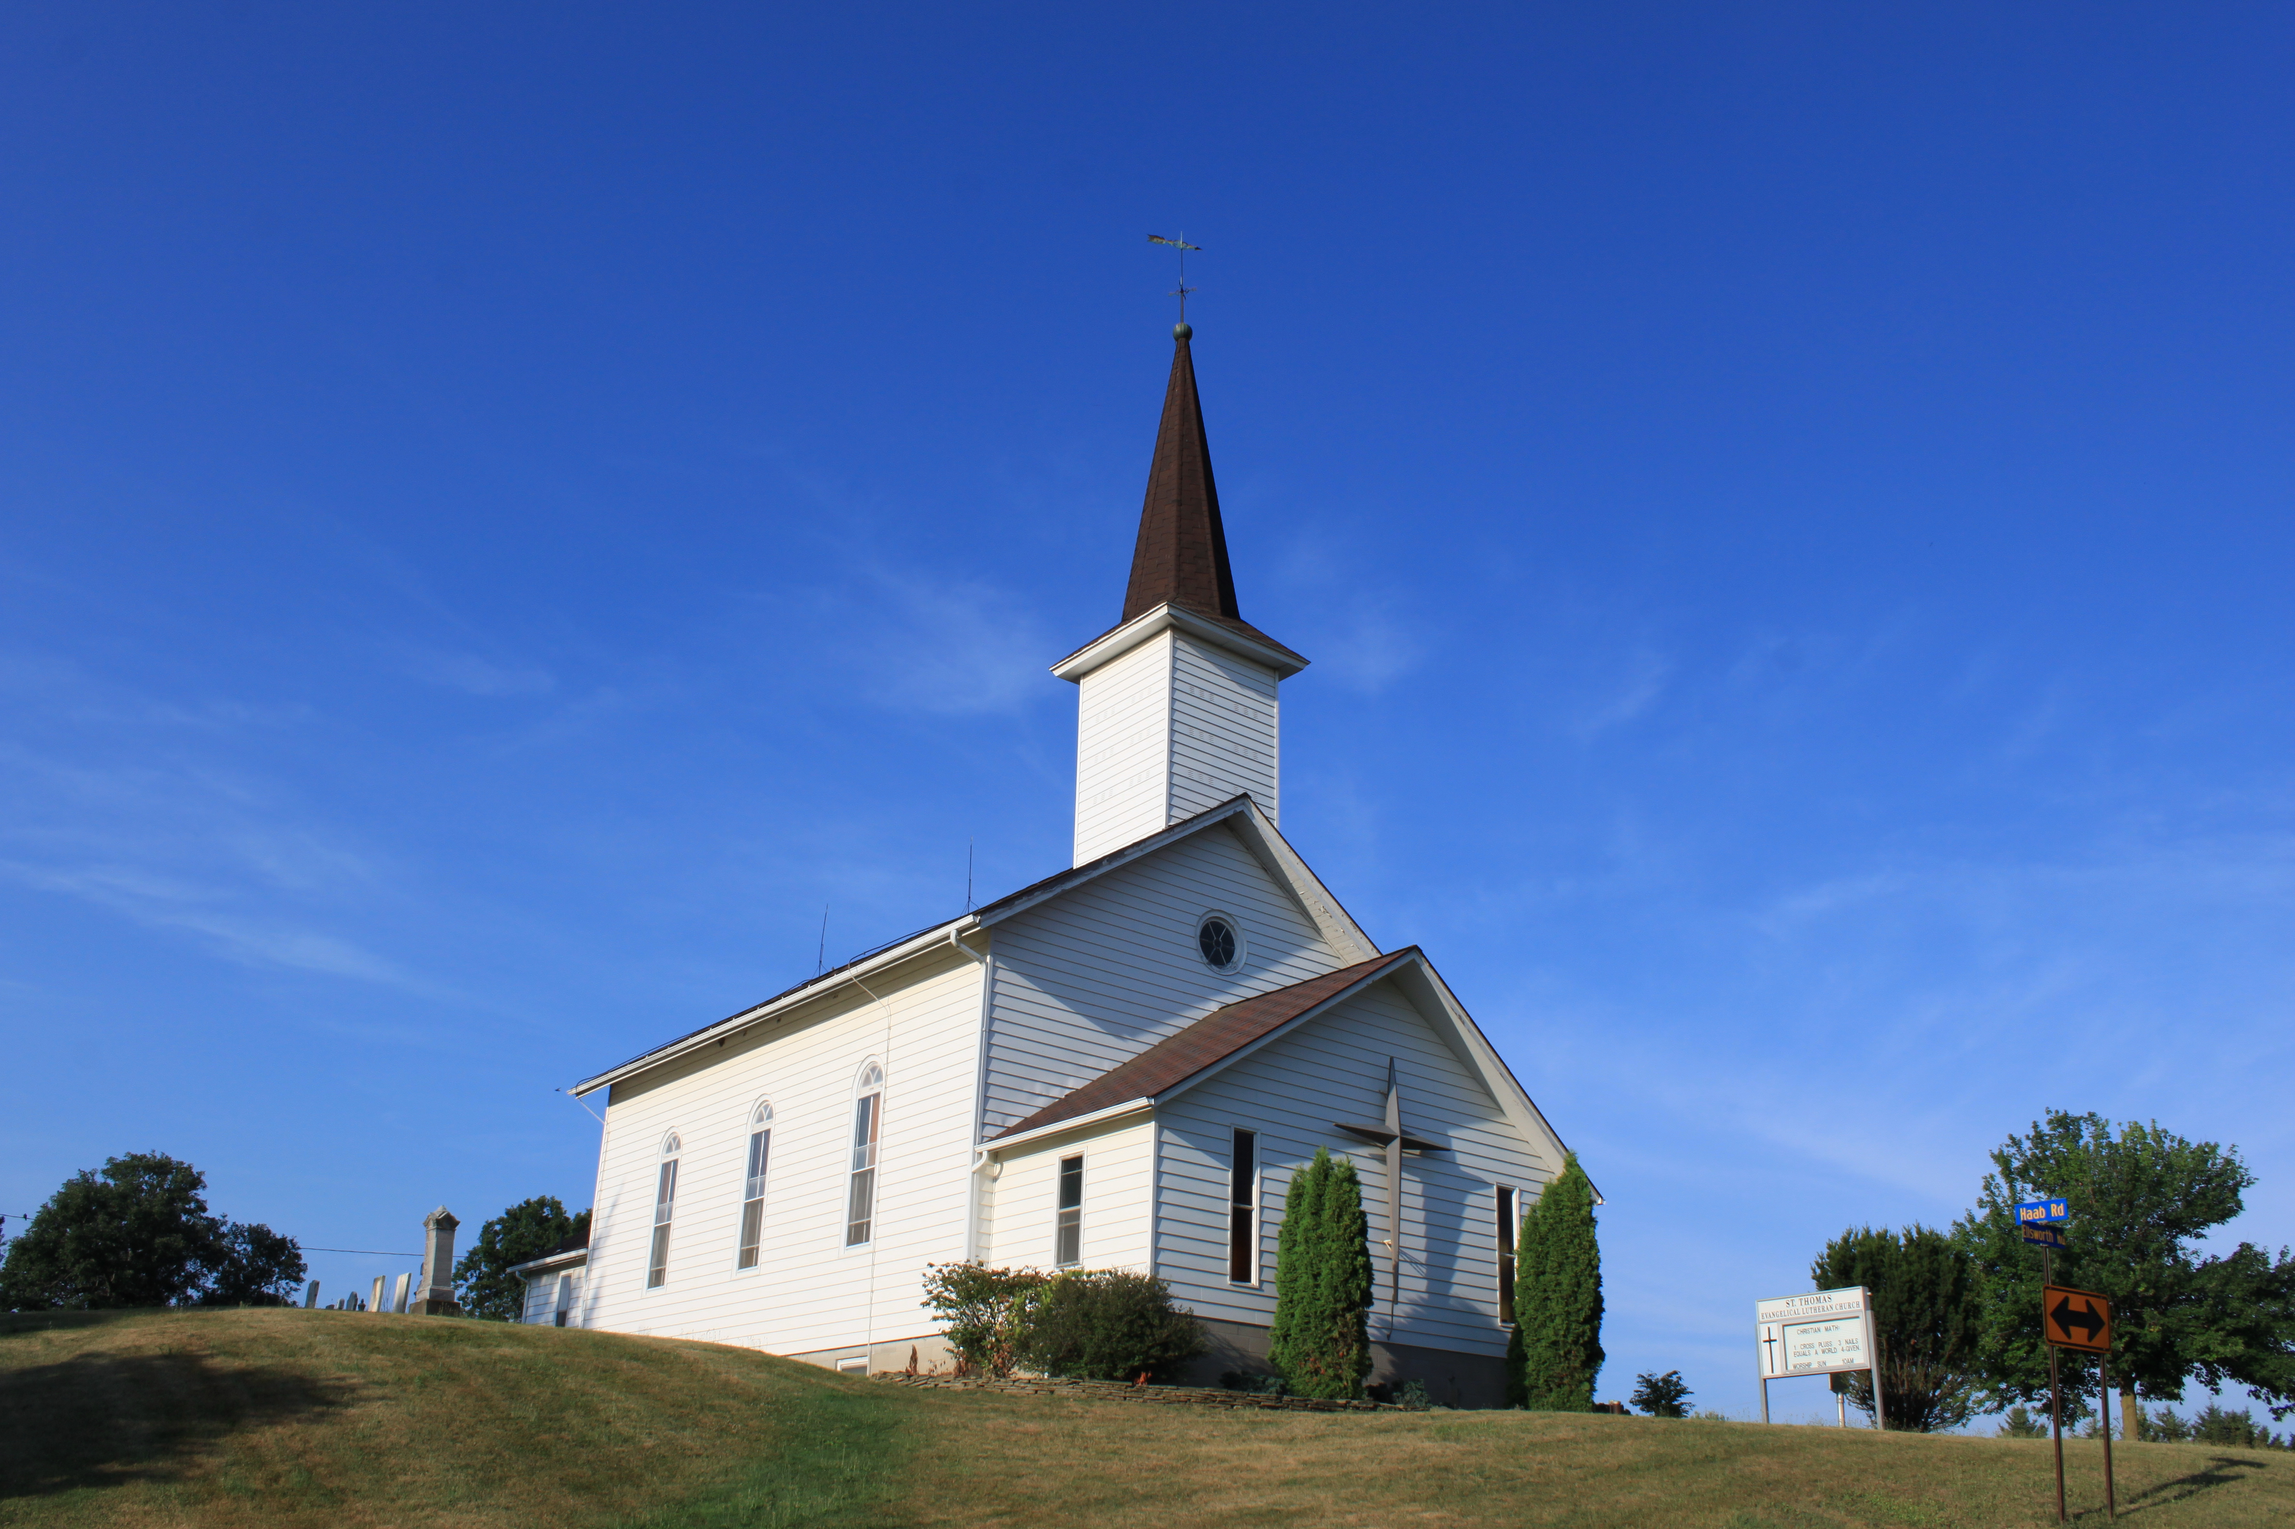
What is the church?

Slide 5
What is the church?

Slide 6
What is the church?

Slide 7
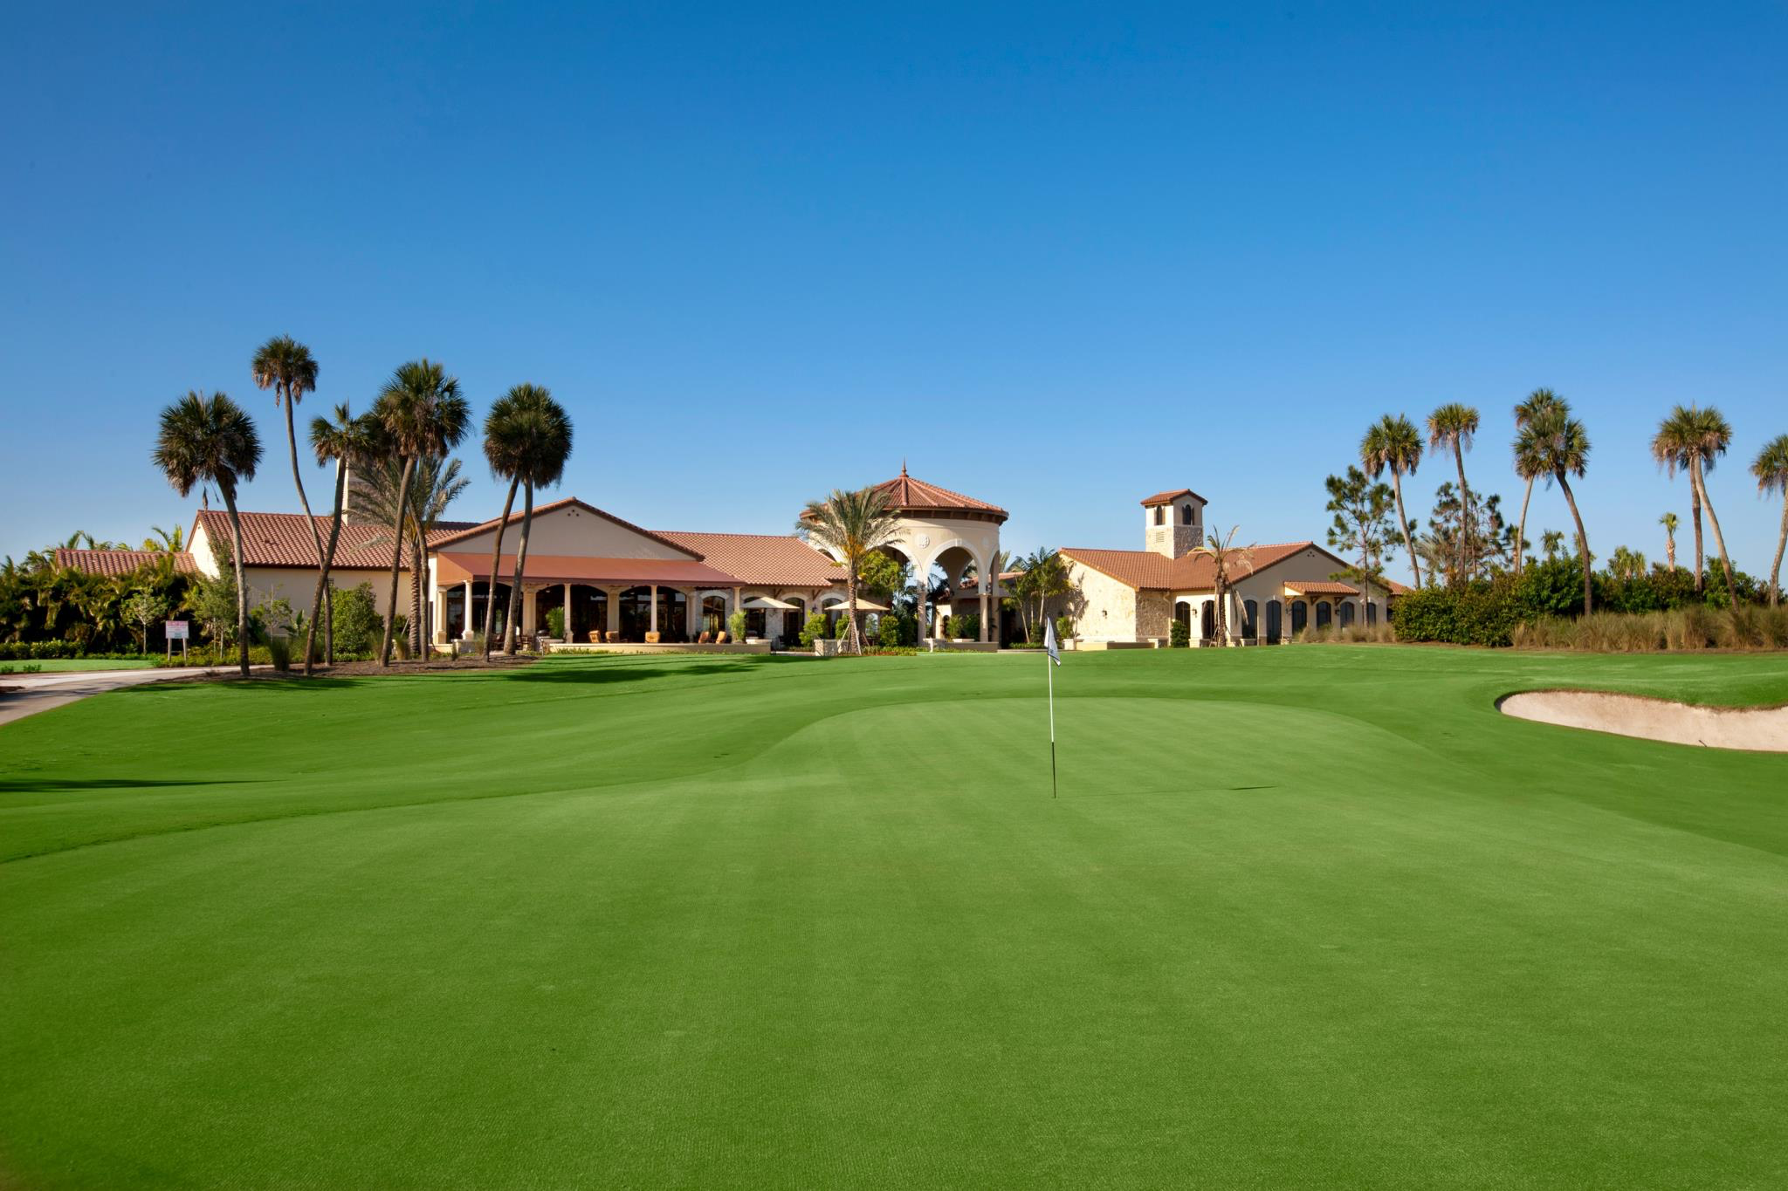
What is the church?

Slide 8
But you are a chosen race, a royal priesthood, a holy nation, a people for his own possession, that you may proclaim the excellencies of him who called you out of darkness into his marvelous light. Once you were not a people, but now you are God’s people; once you had not received mercy, but now you have received mercy. 1 Peter 2:9-10

Slide 9
But you are a chosen race, a royal priesthood, a holy nation, a people for his own possession, that you may proclaim the excellencies of him who called you out of darkness into his marvelous light. Once you were not a people, but now you are God’s people; once you had not received mercy, but now you have received mercy. 1 Peter 2:9-10
ek = “out of”
kaleo = “to call”
Ekklesia

Slide 10
The Body of Christ
The Temple of God
The Bride of Christ
The Flock of God
The Vine & the Branches

Slide 11
The “Denominations” Are People
…so we, though many, are one body in Christ, and individually members of one another. Romans 12:5

Slide 12
The Center is Christ
…and not holding fast to the Head, from whom the whole body… grows with a growth that is from God. Colossians 2:19

Slide 13
The Church Is One
…so we, though many, are one body in Christ, and individually members of one another. Romans 12:5

Slide 14
Our identity is in Christ, not the church.

Slide 15
Our salvation is in Christ, not the church.

Slide 16
Our loyalty is to Christ, not the church.

