Slide 2
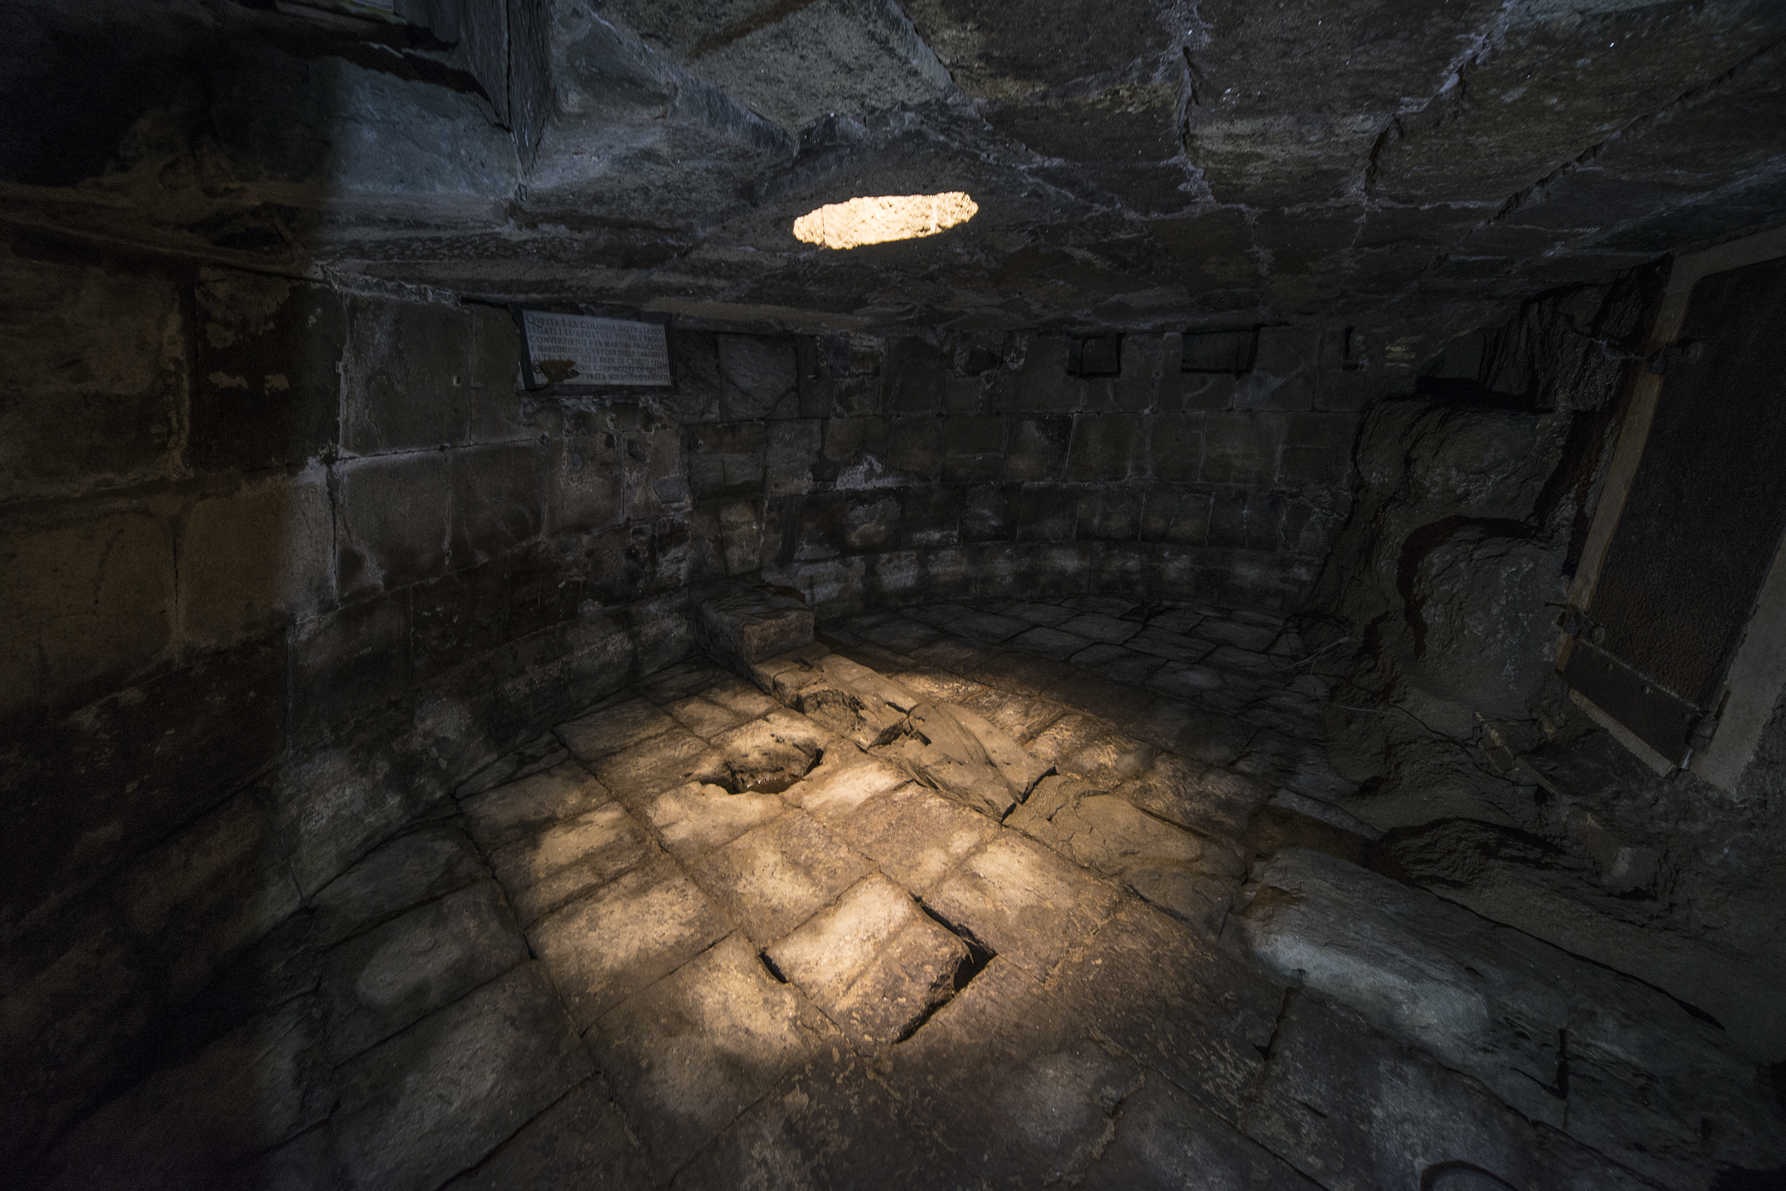
Patience & Service
THE GOSPEL OF MARK (& PETER)

Slide 3
The emotional (and very human) side of Jesus.

Slide 4
Mark 1:41
Moved with pity, he stretched out his hand and touched him and said to him, “I will; be clean.”

Slide 5
Mark 10:14
But when Jesus saw it, he was indignant and said to them, “Let the children come to me…”

Slide 6
Mark 9:36
And he took a child and put him in the midst of them, and taking him in his arms, he said to them…

Slide 7
Mark 4:39
And he awoke and rebuked the wind and said to the sea, “Peace! Be still!”

Slide 8
Mark 4:40
He said to them, “Why are you so afraid? Have you still no faith?”

Slide 9
Mark 7:34
And looking up to heaven, he sighed and said to him, “Ephphatha”

Slide 10
Mark 9:21-22
Jesus asked his father, “How long has this been happening to him?” And he said, “From childhood. And it has often cast him into fire and into water, to destroy him.”

Slide 11
Mark 14:48-49
“Have you come out as against a robber, with swords and clubs to capture me? Day after day I was with you in the temple teaching, and you did not seize me.”

Slide 12
Mark 14:37
And he came and found them sleeping, and he said to Peter, “Simon, are you asleep? Could you not watch one hour?”

Slide 13
Jesus’ threefold call to deny self & serve others.

Slide 14
Mark 8:34
And calling the crowd to him with his disciples, he said to them, “If anyone would come after me, let him deny himself and take up his cross and follow me.”

Slide 15
Mark 9:35
And he sat down and called the twelve. And he said to them, “If anyone would be first, he must be last of all and servant of all.”

Slide 16
Mark 10:43-45
But whoever would be great among you must be your servant, and whoever would be first among you must be slave of all. For even the Son of Man came not to be served but to serve, and to give his life as a ransom for many.”

Slide 17
Peter’s double admonition to service.

Slide 18
1 Peter 4:7-9
Above all, keep loving one another earnestly, since love covers a multitude of sins. Show hospitality to one another without grumbling.

Slide 19
1 Peter 5:1-2
So I exhort the elders among you, as a fellow elder and a witness of the sufferings of Christ, as well as a partaker in the glory that is going to be revealed: shepherd the flock of God that is among you…

