Slide 1
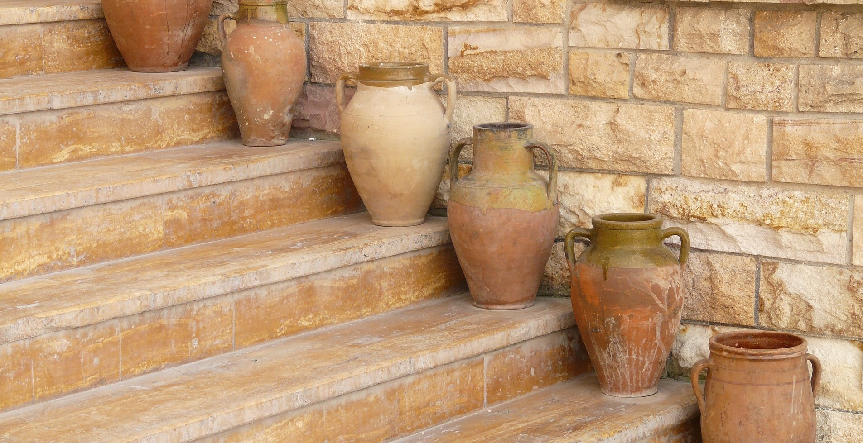
The Weaker Vessel

Slide 2
Weaker, Not Lesser

Slide 3
1 Peter 3:7
Likewise, husbands, live with your wives in an understanding way, showing honor to the woman as the weaker vessel, since they are heirs with you of the grace of life, so that your prayers may not be hindered.

Slide 4
The Strength of Weakness

Slide 5
1 Peter 2:21
For to this you have been called, because Christ also suffered for you, leaving you an example, so that you might follow in his steps.

Slide 6
1 Peter 2:21
He committed no sin, neither was deceit found in his mouth. When he was reviled, he did not revile in return; when he suffered, he did not threaten, but continued entrusting himself to him who judges justly.

Slide 7
Changing Our Vision

Slide 8
1 Peter 3:3
Do not let your adorning be external—the braiding of hair and the putting on of gold jewelry, or the clothing you wear— but let your adorning be the hidden person of the heart with the imperishable beauty of a gentle and quiet spirit, which in God's sight is very precious.

Slide 9
Respect the weaker vessel with:
Your eyes
Your ears
Your mouth
Your hands
Your feet

