Slide 1
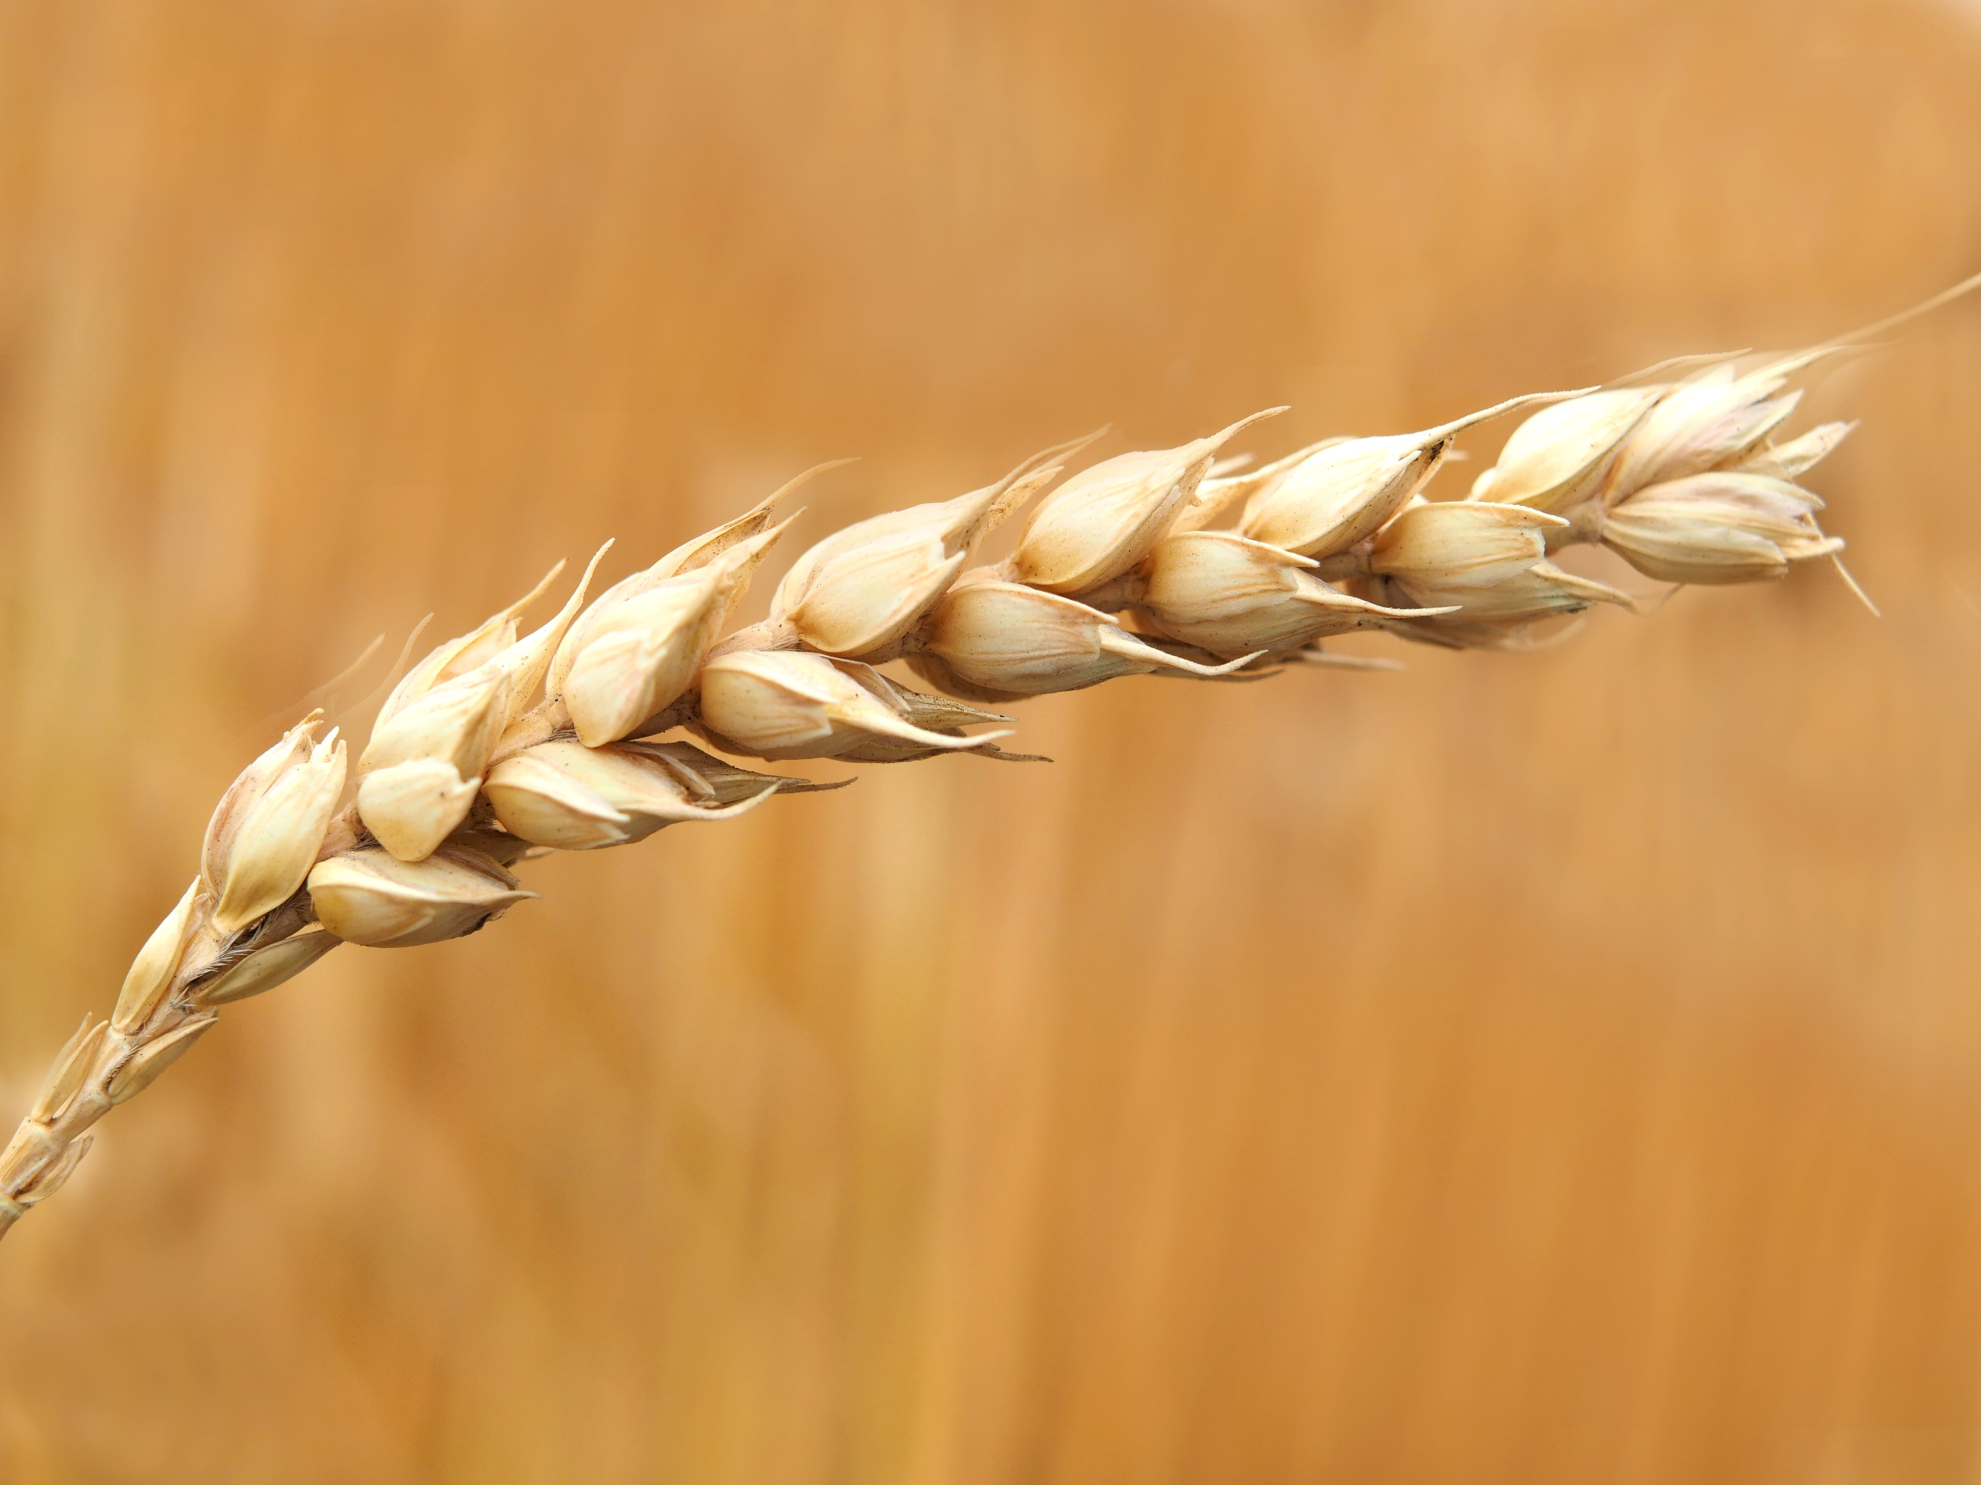
THE KINSMAN
REDEEMER

Slide 2
Desperate immigrants.

Slide 3
Ruth 1:1
In the days when the judges ruled there was a famine in the land, and a man of Bethlehem in Judah went to sojourn in the country of Moab, he and his wife and his two sons.

Slide 4
Ruth 1:1
In the days when the judges ruled there was a famine in the land, and a man of Bethlehem in Judah went to sojourn in the country of Moab, he and his wife and his two sons.

Slide 5
Ruth 1:1
In the days when the judges ruled there was a famine in the land, and a man of Bethlehem in Judah went to sojourn in the country of Moab, he and his wife and his two sons.

Slide 6
Ruth 1:13
“No, my daughters, for it is exceedingly bitter for me for your sake that the hand of the LORD has gone out against me.”

Slide 7
Ruth 1:16-17
But Ruth said, “Do not urge me to leave you or to return from following you. For where you go I will go, and where you lodge I will lodge. your people shall be my people, and your God my God. Where you die I will die, and there will I be buried. May the LORD do so to me and more also if anything but death parts me from you.”

Slide 8
Ruth 1:20-21
She said to them, “Do not call me Naomi; call me Mara, for the Almighty has dealt very bitterly with me. I went away full, and the LORD has brought me back empty. Why call me Naomi, when the LORD has testified against me and the Almighty has brought calamity upon me?”

Slide 9
God provides for the immigrant.

Slide 10
Ruth 2:3
So she set out and went and gleaned in the field after the reapers, and she happened to come to the part of the field belonging to Boaz, who was of the clan of Elimelech.

Slide 11
Ruth 2:8
Then Boaz said to Ruth, “Now, listen, my daughter, do not go to glean in another field or leave this one, but keep close to my young women.”

Slide 12
Ruth 2:10
Then she fell on her face, bowing to the ground, and said to him, “Why have I found favor in your eyes, that you should take notice of me, since I am a foreigner?”

Slide 13
Ruth 2:12
“The LORD repay you for what you have done, and a full reward be given you by the LORD, the God of Israel, under whose wings you have come to take refuge!”

Slide 14
A bold (& risky) proposal.

Slide 15
Ruth 3:9
And she answered, “I am Ruth, your servant. Spread your wings over your servant, for you are a redeemer.”

Slide 16
Ruth 3:11
“And now, my daughter, do not fear. I will do for you all that you ask, for all my fellow townsmen know that you are a worthy woman.”

Slide 17
The immigrant’s inheritance.

Slide 18
Ruth 4:11-12
Then all the people who were at the gate and the elders said, “We are witnesses. May the LORD make this woman, who is coming into your house, like Rachel and Leah, who together built up the house of Israel. May you act worthily in Ephrathah and be renowned in Bethlehem, and may your house be like the house of Perez, whom Tamar bore to Judah, because of the offspring that the LORD will give you by this young woman.”

Slide 19
Ruth 4:17
And the women of the neighborhood gave him a name, saying, “A son has been born to Naomi.” They named him Obed. He was the father of Jesse, the father of David.

