Slide 1
Telling Others

Slide 2
This Weekend: Lessons in Following Jesus
Last Night:
Understanding God’s Great Desire.
God wants to be with His people.
He sent His son to die for us & Show us the way to be in a relationship with the Father

Slide 3
This Weekend: Lessons in Following Jesus
Today:
Telling Others
Serving others
Forgiving Others
Application/Case Study

Slide 4
This Weekend: Lessons in Following Jesus
Sunday:
Ritual or Religion
Following Jesus Home

Slide 5
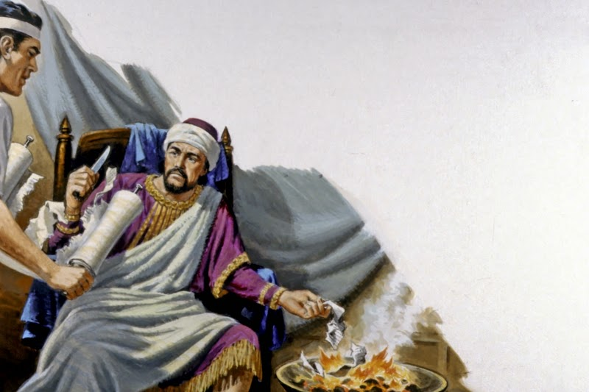
Jeremiah 36: Cutting out the word of god

Slide 6
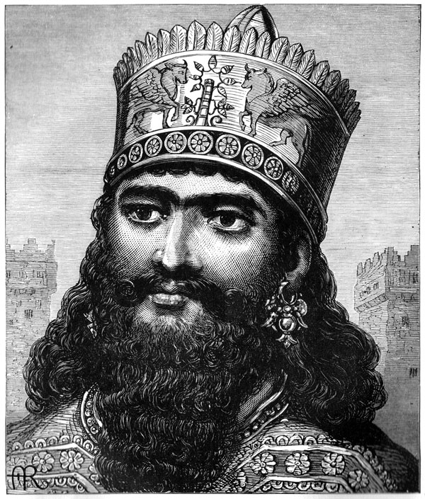
Background
Year is 605 B.C.
Year of the Babylonian invasion by Nebuchadnezzar into Judah.
First of three invasions.

Slide 7
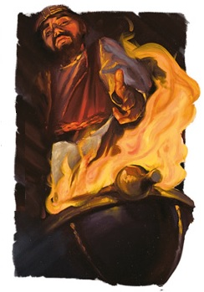
Background
Jehoiakim is king of Judah.
God is going to give his message one more time to warn his people.

Slide 8
Jeremiah 36
Vs 1-8
What is the purpose of god’s word?
To bring man (in his current state) to god.
Why?
Because god’s desire is for man to be saved.

Slide 9
God’s desire for man
2 Peter 3:9 The Lord is not slack concerning His promise, as some count slackness, but is longsuffering toward us, not willing that any should perish but that all should come to repentance.

Slide 10
God’s desire for man
Ezekiel 33:11 "Say to them: 'As I live,' says the Lord GOD, 'I have no pleasure in the death of the wicked, but that the wicked turn from his way and live. Turn, turn from your evil ways! For why should you die, O house of Israel?'

Slide 11
How do we fit into god’s desire?
We are to be the ones who proclaim god’s desire!!!
God is depending on us!!!
John 19 (Joseph of Arimathea/Nicodemus)

Slide 12
How do we fit into god’s desire?
But what does god need us to do?
Follow the example and teachings of His Son!

Slide 13
How do we fit into god’s desire?
Jesus taught and demonstrated the need to tell others about his Father.
Mark 16:15-16 And He said to them, "Go into all the world and preach the gospel to every creature. 16 "He who believes and is baptized will be saved; but he who does not believe will be condemned.

Slide 14
How do we fit into god’s desire?
Romans 10:13-15
Preachers of the Gospel
Messengers of the word
Ambassadors of the faith
Laborers in god’s vineyard

Slide 15
How do we fit into god’s desire?
2Cor 2:14-17
2Cor 5:20, “… we are ambassadors for Christ, as though God were pleading through us; we implore you on Christ’s behalf, be reconciled to God”

Slide 16
If you don’t tell ______… who will?

Slide 17
Here is the good news…
It’s not our thoughts/ideas
It’s not our words
It’s not our reasoning.
It’s god’s thoughts/words/reasoning.
This is what we take to man.

Slide 18
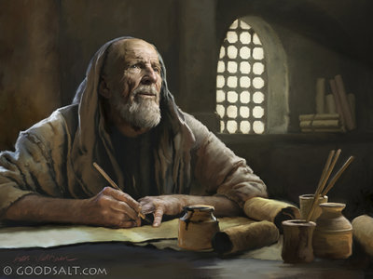
Jeremiah 36:4-10. Baruch complies
Note vs 8

Slide 19
The only two responses to the word
First response: Vs 11-19
Fear… accompanied with action
The right/intended/needed reaction!
The message of the gospel; especially for those that are not right with him is intended to cut them to the heart when properly preached!!!

Slide 20
When properly preached…
Acts 2:37 Now when they heard this, they were cut to the heart, and said to Peter and the rest of the apostles, "Men and brethren, what shall we do?"

Slide 21
When properly preached…
Hebrews 4:12 For the word of God is living and powerful, and sharper than any two-edged sword, piercing even to the division of soul and spirit, and of joints and marrow, and is a discerner of the thoughts and intents of the heart.

Slide 22
The only other reaction to the word
Vs 20-26
What a sad reaction to god’s word.
It didn’t have to be this way!!!
2 kings 22/23.
Who is king Josiah?
Jehoiakim own father!!! (Jer 36:1)

Slide 23
What about our reaction today?
How easy it is for us to cut God’s word and burn the scroll today:
when we never open God’s word and read it.
when we refuse to listen to God’s word.
when we come, hear the message, and then do not change our hearts.

Slide 24
The truth of god’s word.
Vs 27-32
Jeremiah is instructed to write another scroll.
Our response to the gospel doesn’t change god’s truth!

Slide 26
John 12:48 "He who rejects Me, and does not receive My words, has that which judges him--the word that I have spoken will judge him in the last day.

Slide 27
Conclusion/invitation
God’s word is given so our sin can be exposed, so we can turn from our evil ways, in order to be forgiven by God.
we must earnestly desire to hear the word of the Lord so that our hearts will be transformed and our lives will be changed when it is proclaimed.

Slide 28
Conclusion/invitation
Will we Follow Jesus.
Jesus told others about His Father
Jesus Commanded for His Disciples to tell others about His Father.
Jesus’ Disciples went everywhere telling others about the Father.
Do we?

