Slide 1
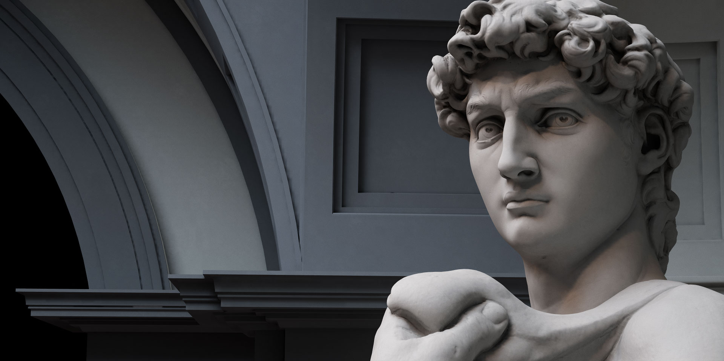
DAVID
A MAN AFTER GOD’S OWN HEART

Slide 2
JUNE 3 A Shepherd King
JUNE 17 A True Giant
JULY 1 A Loyal Friend
JULY 8 A Relentless Enemy
JULY 22 A Tragic Failure
AUG 5 A Wayward Son
AUG 19 An Eternal Investment

Slide 3
JUNE 3 A Shepherd King
JUNE 17 A True Giant
JULY 1 A Loyal Friend
JULY 8 A Relentless Enemy
JULY 22 A Tragic Failure
AUG 5 A Wayward Son
AUG 19 An Eternal Investment

Slide 5
2 Samuel 13:20-21
When King David heard of all these things, he was very angry. But Absalom spoke to Amnon neither good nor bad, for Absalom hated Amnon, because he had violated his sister Tamar.

Slide 6
2 Samuel 13:37-39
But Absalom fled and went to Talmai the son of Ammihud, king of Geshur. And David mourned for his son day after day. So Absalom fled and went to Geshur, and was there three years. And the spirit of the king longed to go out to Absalom, because he was comforted about Amnon, since he was dead.

Slide 8
2 Samuel 14:11
Then she said, “Please let the king invoke the LORD your God, that the avenger of blood kill no more, and my son be not destroyed.” He said, “As the LORD lives, not one hair of your son shall fall to the ground.”

Slide 9
2 Samuel 14:24
And the king said, “Let him dwell apart in his own house; he is not to come into my presence.” So Absalom lived apart in his own house and did not come into the king’s presence.

Slide 11
2 Samuel 15:4
Then Absalom would say, “Oh that I were judge in the land! Then every man with a dispute or cause might come to me, and I would give him justice.”

Slide 12
2 Samuel 15:30
But David went up the ascent of the Mount of Olives, weeping as he went, barefoot and with his head covered. And all the people who were with him covered their heads, and they went up, weeping as they went.

Slide 14
2 Samuel 18:5
And the king ordered Joab and Abishai and Ittai, “Deal gently for my sake with the young man Absalom.” And all the people heard when the king gave orders to all the commanders about Absalom.

Slide 15
2 Samuel 18:33
And the king was deeply moved and went up to the chamber over the gate and wept. And as he went, he said, “O my son Absalom, my son, my son Absalom! Would I had died instead of you, O Absalom, my son, my son!”

Slide 16
Absalom was responsible for his own actions
Though there were obvious flaws, it would be unfair to label David as a bad father

Slide 17
To children, deeds speak louder than words
A lack of consistency leads to frustration in children
God has blessed us with full-length mirrors: our children!

