Slide 1
THE
KINGS
OF
JUDAH

Slide 2
Sept 2 Rehoboam
Sept 9 Asa
Sept 16 Jehoshaphat
Sept 23 Jehoram
Oct 7 Athaliah
Oct 21 Joash
Oct 28 Uzziah
Nov 11 Hezekiah
Nov 18 Manasseh
Nov 25 Josiah
THE
KINGS
OF
JUDAH

Slide 3
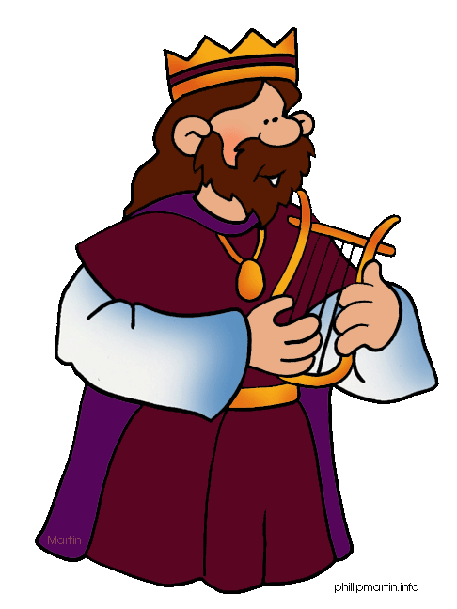
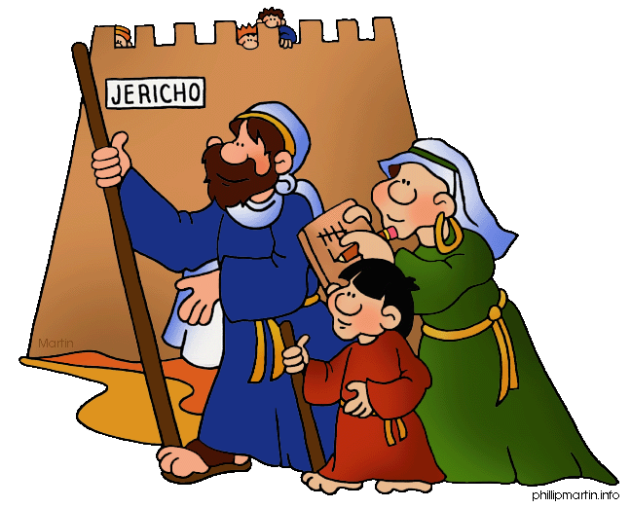
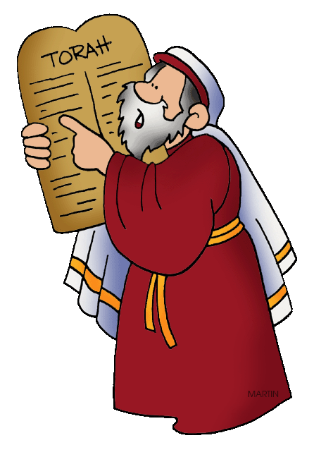
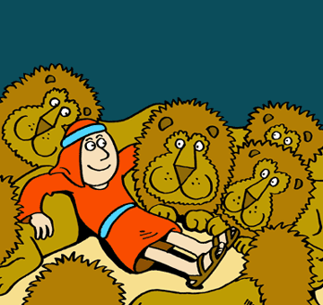
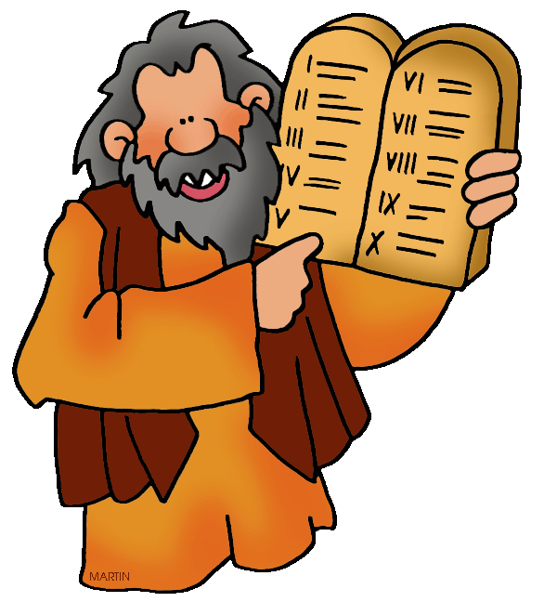
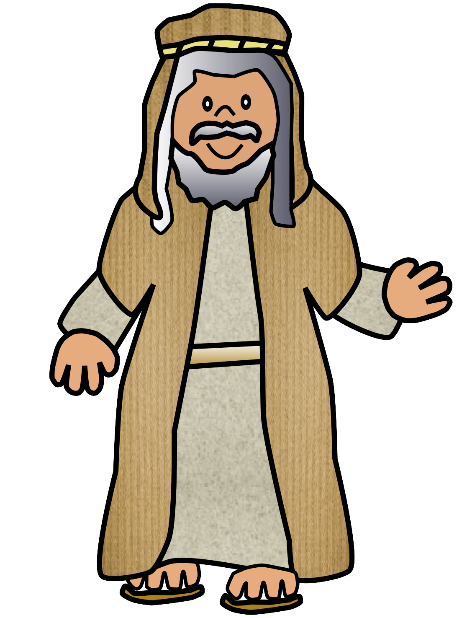
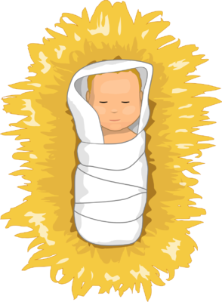
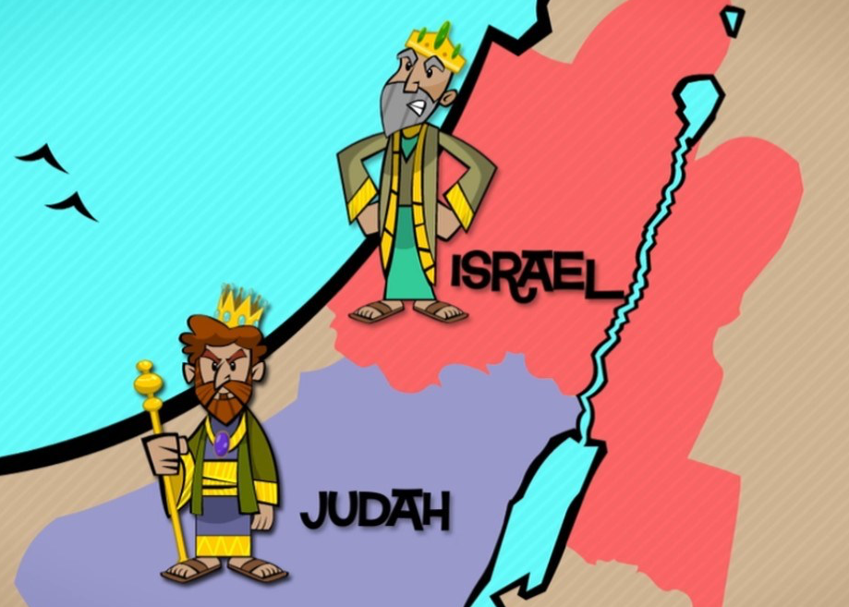
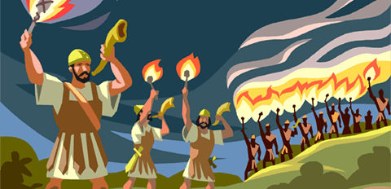
Kings
David
Rehoboam / Jeroboam
Joshua
and
Judges
First Fathers
Big Family
Special Land
Great Blessing
ABRAHAM
CHRIST:
GOD’S
great plan!
Before the world began, GOD made a great plan!
Homeagain Heroes
Ezra
Homesick Heroes
I build on
GOD’S plan!
Moses

Slide 4
THE
KINGS
1 Kings
2 Kings
OF
JUDAH
931 BC
722 BC
2 Samuel
Northern Kingdom:
ISRAEL
1 Samuel
20 Kings in the North and South
586 BC
Saul
David
Solomon
40 yr
40 yr
40 yr
Southern Kingdom:
JUDAH
1 Chronicles
2 Chronicles

Slide 6
2 Chronicles 10:3-4
And they sent and called him. And Jeroboam and all Israel came and said to Rehoboam, “Your father made our yoke heavy. Now therefore lighten the hard service of your father and his heavy yoke on us, and we will serve you.”

Slide 7
2 Chronicles 10:6
Then King Rehoboam took counsel with the old men, who had stood before Solomon his father while he was yet alive, saying, “How do you advise me to answer this people?”

Slide 8
2 Chronicles 10:8
But he abandoned the counsel that the old men gave him, and took counsel with the young men who had grown up with him and stood before him.

Slide 9
2 Chronicles 10:10-11
And the young men who had grown up with him said to him, “Thus shall you speak to the people who said to you, ‘Your father made our yoke heavy, but you lighten it for us’; thus shall you say to them, ‘My little finger is thicker than my father’s thighs. And now, whereas my father laid on you a heavy yoke, I will add to your yoke. My father disciplined you with whips, but I will discipline you with scorpions.’”

Slide 11
2 Chronicles 12:1
When the rule of Rehoboam was established and he was strong, he abandoned the law of the LORD, and all Israel with him.

Slide 12
2 Chronicles 12:6
Then the princes of Israel and the king humbled themselves and said, “The LORD is righteous.”

Slide 13
2 Chronicles 12:8
“Nevertheless, they shall be servants to him, that they may know my service and the service of the kingdoms of the countries.”

Slide 14
Proverbs 1:7
The fear of the LORD is the beginning of knowledge;
Fools despise wisdom and instruction.

