Slide 1
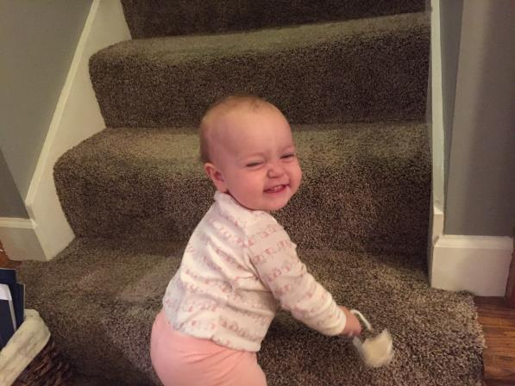

Slide 2
What Happens When I Die?
Preparing For The Next Step

Slide 3
1. Our Faith In Jesus Will be Confirmed

Slide 4
Funeral Procession 1
The Only Son Of A Widow

Slide 5
Luke 7
¹¹ Soon afterward he went to a town called Nain, and his disciples and a great crowd went with him. ¹² As he drew near to the gate of the town, behold, a man who had died was being carried out, the only son of his mother, and she was a widow, and a considerable crowd from the town was with her. ¹³ And when the Lord saw her, he had compassion on her and said to her, “Do not weep.”

Slide 6
Luke 7
¹⁴ Then he came up and touched the bier, and the bearers stood still. And he said, “Young man, I say to you, arise.” ¹⁵ And the dead man sat up and began to speak, and Jesus gave him to his mother. ¹⁶ Fear seized them all, and they glorified God, saying, “A great prophet has arisen among us!” and “God has visited his people!” ¹⁷ And this report about him spread through the whole of Judea and all the surrounding country.

Slide 7
Funeral Procession 2
The 12 Year Old Daughter

Slide 8
Luke 8
⁴⁰ Now when Jesus returned, the crowd welcomed him, for they were all waiting for him. ⁴¹ And there came a man named Jairus, who was a ruler of the synagogue. And falling at Jesus' feet, he implored him to come to his house, ⁴² for he had an only daughter, about twelve years of age, and she was dying… ⁴⁹ While he was still speaking, someone from the ruler's house came and said, “Your daughter is dead; do not trouble the Teacher anymore.”⁵⁰ But Jesus on hearing this answered him, “Do not fear; only believe, and she will be well.”

Slide 9
Luke 8
⁵¹ And when he came to the house, he allowed no one to enter with him, except Peter and John and James, and the father and mother of the child. ⁵² And all were weeping and mourning for her, but he said, “Do not weep, for she is not dead but sleeping.” ⁵³ And they laughed at him, knowing that she was dead. ⁵⁴ But taking her by the hand he called, saying, “Child, arise.” ⁵⁵ And her spirit returned, and she got up at once. And he directed that something should be given her to eat. ⁵⁶ And her parents were amazed, but he charged them to tell no one what had happened.

Slide 10
Funeral Procession 3
His Friend Lazarus

Slide 11
John 11
32 Now when Mary came to where Jesus was and saw him, she fell at his feet, saying to him, “Lord, if you had been here, my brother would not have died.” 33 When Jesus saw her weeping, and the Jews who had come with her also weeping, he was deeply moved in his spirit and greatly troubled. 34 And he said, “Where have you laid him?” They said to him, “Lord, come and see.” 35 Jesus wept. 36 So the Jews said, “See how he loved him!” 37 But some of them said, “Could not he who opened the eyes of the blind man also have kept this man from dying?”

Slide 12
John 11
38 Then Jesus, deeply moved again, came to the tomb. It was a cave, and a stone lay against it. 39 Jesus said, “Take away the stone.” Martha, the sister of the dead man, said to him, “Lord, by this time there will be an odor, for he has been dead four days.” 40 Jesus said to her, “Did I not tell you that if you believed you would see the glory of God?” 41 So they took away the stone. And Jesus lifted up his eyes and said, “Father, I thank you that you have heard me. 42 I knew that you always hear me, but I said this on account of the people standing around, that they may believe that you sent me.” 43 When he had said these things, he cried out with a loud voice, “Lazarus, come out.” 44 The man who had died came out, his hands and feet bound with linen strips, and his face wrapped with a cloth. Jesus said to them, “Unbind him, and let him go.”

Slide 13
1. Our Faith In Jesus Will Be Confirmed
His Compassion

Slide 14
Job 2
¹¹ Now when Job's three friends heard of all this evil that had come upon him, they came each from his own place, Eliphaz the Temanite, Bildad the Shuhite, and Zophar the Naamathite. They made an appointment together to come to show him sympathy and comfort him.

Slide 15
Colossians 3
¹¹ Here there is not Greek and Jew, circumcised and uncircumcised, barbarian, Scythian, slave, free; but Christ is all, and in all.
¹² Put on then, as God's chosen ones, holy and beloved, compassionate hearts, kindness, humility, meekness, and patience,

Slide 16
1. Our Faith In Jesus Will Be Confirmed
His Compassion
His Wiping Away Tears

Slide 17
Psalm 42:3- My tears have been my food day and night, while they say to me all the day long, “Where is your God?”
Psalm 56:8- You have kept count of my tossings; put my tears in your bottle. Are they not in your book?

Slide 18
1. Our Faith In Jesus Will Be Confirmed
His Compassion
His Wiping Away Tears
His Conquering The Grave

Slide 19
Revelation 7:17
For the Lamb in the midst of the throne will be their shepherd, and he will guide them to springs of living water, and God will wipe away every tear from their eyes.”

Slide 20
Romans 6
⁸ Now if we have died with Christ, we believe that we will also live with him. ⁹ We know that Christ, being raised from the dead, will never die again; death no longer has dominion over him.

Slide 21
John 11
⁴⁵ Many of the Jews therefore, who had come with Mary and had seen what he did, believed in him,
⁴⁶ but some of them went to the Pharisees and told them what Jesus had done. ⁴⁷ So the chief priests and the Pharisees gathered the council and said, “What are we to do? For this man performs many signs. ⁴⁸ If we let him go on like this, everyone will believe in him, and the Romans will come and take away both our place and our nation…
⁵³ So from that day on they made plans to put him to death.

Slide 22
2. Are You Ready For Your Reward?

Slide 23
Loved ones will weep o’er my silent face, Dear ones will clasp me in sad embrace, Shadows and darkness will fill the place, Five minutes after I die.
Never to repair the good I lack, Fixed to the goal of my chosen track, No room to repent; no turning back, Five minutes after I die.
Mated forever with my chosen prong, Long is eternity, Oh so long, Then woe is me if my soul be wrong, Five minutes after I die.

Slide 24
The Context Of Luke 16
There is a common thread in chapter 16 that makes this lesson especially needed for us today.
Luke 16:1,13,14,19

Slide 25
2. Are You Ready For Your Reward?
Our Time On Earth Is Over.

Slide 26
2. Are You Ready For Your Reward?
Our Time On Earth Is Over.
My Physical Body Is Buried And Mourned.

Slide 27
2. Are You Ready For Your Reward?
Our Time On Earth Is Over.
My Physical Body Is Buried And Mourned.
I Will Receive Torment Or Comfort.

