Slide 1
The Gospel of Mark

Slide 2
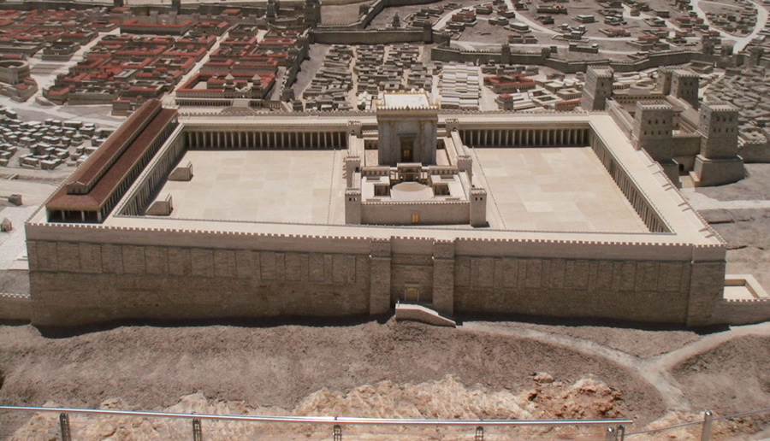

Slide 3
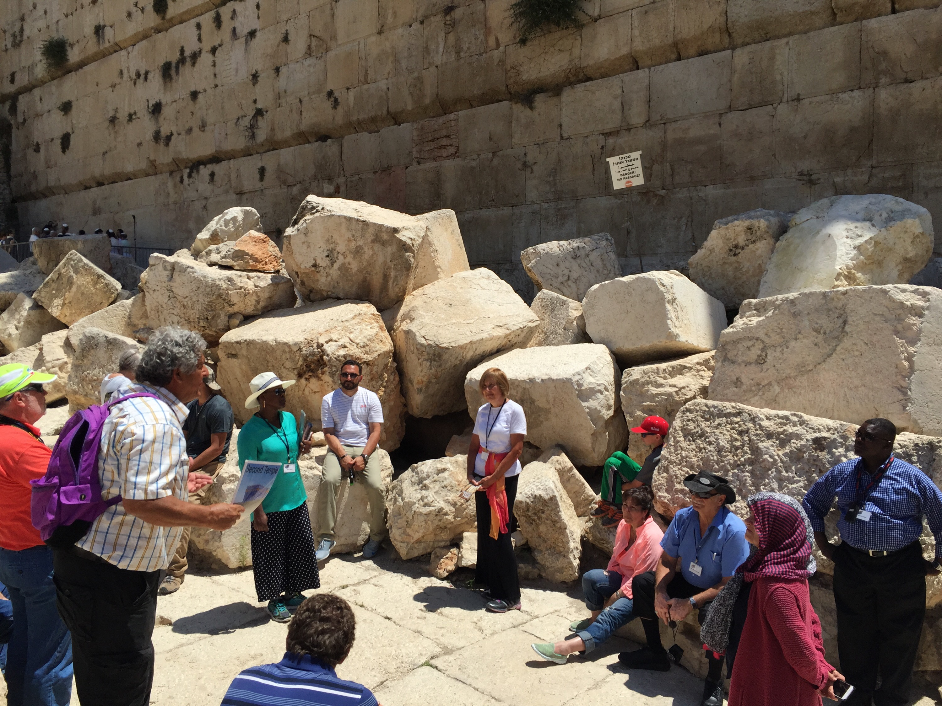

Slide 4
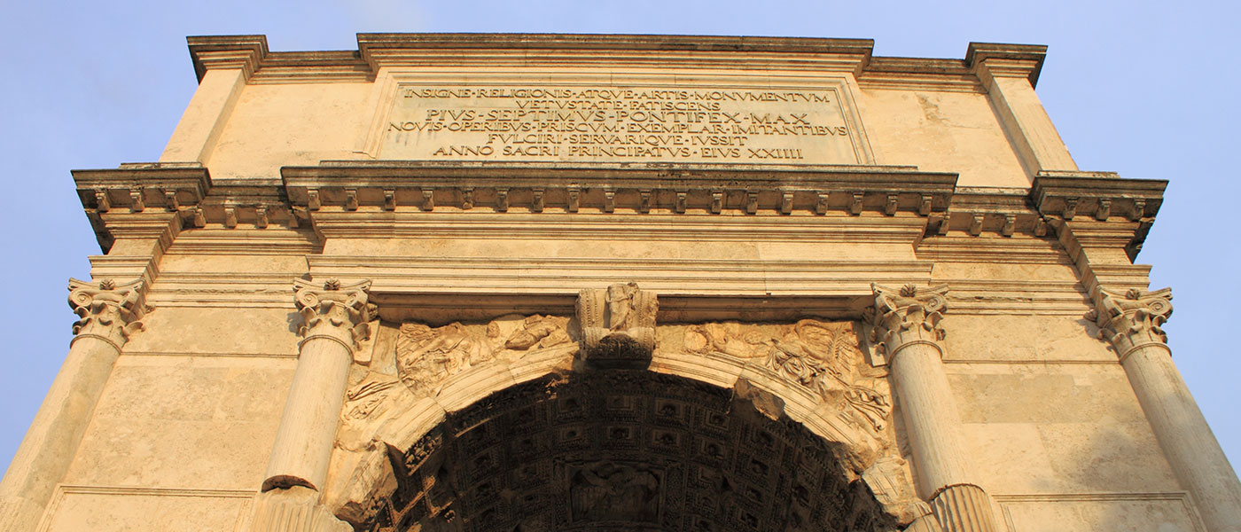

Slide 5
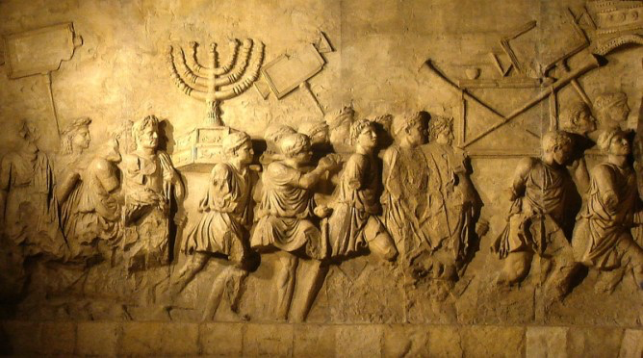

Slide 6
Mark 13:4
“Tell us, when will these things be, and what will be the sign when all these things are about to be accomplished?”

Slide 7
Mark 13:5-6
“See that no one leads you astray. Many will come in my name, saying, ‘I am he!’ and they will lead many astray.”

Slide 8
Mark 13:7-8
“And when you hear of wars and rumors of wars, do not be alarmed. This must take place, but the end is not yet. For nation will rise against nation, and kingdom against kingdom. There will be earthquakes in various places; there will be famines. These are but the beginning of the birth pains.”

Slide 10
Mark 13:9-11
“But be on your guard. For they will deliver you over to councils, and you will be beaten in synagogues, and you will stand before governors and kings for my sake, to bear witness before them. And the gospel must first be proclaimed to all nations. And when they bring you to trial and deliver you over, do not be anxious beforehand what you are to say, but say whatever is given you in that hour, for it is not you who speak, but the Holy Spirit.”

Slide 11
Mark 13:9-11
“But be on your guard. For they will deliver you over to councils, and you will be beaten in synagogues, and you will stand before governors and kings for my sake, to bear witness before them. And the gospel must first be proclaimed to all nations. And when they bring you to trial and deliver you over, do not be anxious beforehand what you are to say, but say whatever is given you in that hour, for it is not you who speak, but the Holy Spirit.”

Slide 12
Mark 13:9-11
“But be on your guard. For they will deliver you over to councils, and you will be beaten in synagogues, and you will stand before governors and kings for my sake, to bear witness before them. And the gospel must first be proclaimed to all nations. And when they bring you to trial and deliver you over, do not be anxious beforehand what you are to say, but say whatever is given you in that hour, for it is not you who speak, but the Holy Spirit.”

Slide 13
Mark 13:12-13
“And brother will deliver brother over to death, and the father his child, and children will rise against parents and have them put to death. And you will be hated by all for my name’s sake. But the one who endures to the end will be saved.”

Slide 15
Mark 13:14
“But when you see the abomination of desolation standing where he ought not to be (let the reader understand), then let those who are in Judea flee to the mountains.”

Slide 17
Mark 13:30-33
“Truly, I say to you, this generation will not pass away until all these things take place. Heaven and earth will pass away, but my words will not pass away. But concerning that day or that hour, no one knows, not even the angels in heaven, nor the Son, but only the Father. Be on guard, keep awake. For you do not know when the time will come.”

Slide 18
Mark 13:30-33
“Truly, I say to you, this generation will not pass away until all these things take place. Heaven and earth will pass away, but my words will not pass away. But concerning that day or that hour, no one knows, not even the angels in heaven, nor the Son, but only the Father. Be on guard, keep awake. For you do not know when the time will come.”

Slide 19
Mark 13:30-33
“Truly, I say to you, this generation will not pass away until all these things take place. Heaven and earth will pass away, but my words will not pass away. But concerning that day or that hour, no one knows, not even the angels in heaven, nor the Son, but only the Father. Be on guard, keep awake. For you do not know when the time will come.”

