Slide 1
The Gospel of Mark

Slide 2
Mark 14:6-9
“Leave her alone. Why do you trouble her? She has done a beautiful thing to me. For you always have the poor with you, and whenever you want, you can do good for them. But you will not always have me. She has done what she could; she has anointed my body beforehand for burial. And truly, I say to you, wherever the gospel is proclaimed in the whole world, what she has done will be told in memory of her.”

Slide 3
Mark 14:10-11
Then Judas Iscariot, who was one of the twelve, went to the chief priests in order to betray him to them. And when they heard it, they were glad and promised to give him money. And he sought an opportunity to betray him.

Slide 5
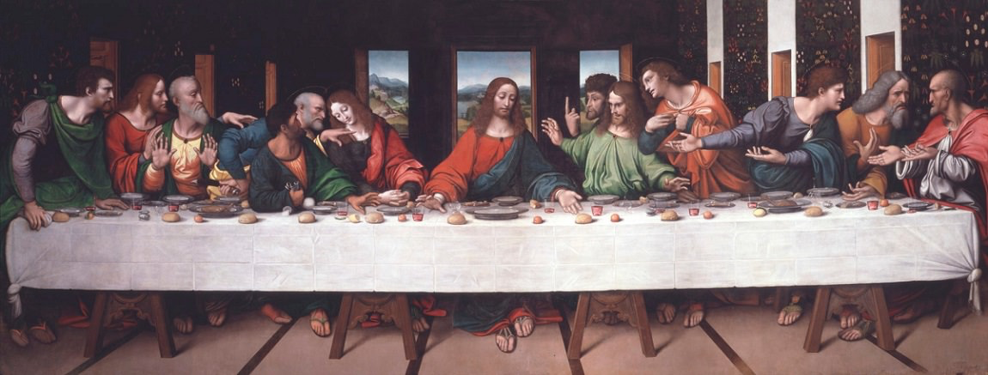

Slide 6
Mark 14:18-21
“Truly, I say to you, one of you will betray me, one who is eating with me.” They began to be sorrowful and to say to him one after another, “Is it I?” He said to them, “It is one of the twelve, one who is dipping bread into the dish with me. For the Son of Man goes as it is written of him, but woe to that man by whom the Son of Man is betrayed! It would have been better for that man if he had not been born.”

Slide 7
Mark 14:18-21
“Truly, I say to you, one of you will betray me, one who is eating with me.” They began to be sorrowful and to say to him one after another, “Is it I?” He said to them, “It is one of the twelve, one who is dipping bread into the dish with me. For the Son of Man goes as it is written of him, but woe to that man by whom the Son of Man is betrayed! It would have been better for that man if he had not been born.”

Slide 8
Mark 14:18-21
“Truly, I say to you, one of you will betray me, one who is eating with me.” They began to be sorrowful and to say to him one after another, “Is it I?” He said to them, “It is one of the twelve, one who is dipping bread into the dish with me. For the Son of Man goes as it is written of him, but woe to that man by whom the Son of Man is betrayed! It would have been better for that man if he had not been born.”

Slide 9
Mark 14:22-25
And as they were eating, he took bread, and after blessing it broke it and gave it to them, and said, “Take; this is my body.” And he took a cup, and when he had given thanks he gave it to them, and they all drank of it. And he said to them, “This is my blood of the covenant, which is poured out for many. Truly, I say to you, I will not drink again of the fruit of the vine until that day when I drink it new in the kingdom of God.”

Slide 10
Mark 14:22-25
And as they were eating, he took bread, and after blessing it broke it and gave it to them, and said, “Take; this is my body.” And he took a cup, and when he had given thanks he gave it to them, and they all drank of it. And he said to them, “This is my blood of the covenant, which is poured out for many. Truly, I say to you, I will not drink again of the fruit of the vine until that day when I drink it new in the kingdom of God.”

Slide 11
Mark 14:22-25
And as they were eating, he took bread, and after blessing it broke it and gave it to them, and said, “Take; this is my body.” And he took a cup, and when he had given thanks he gave it to them, and they all drank of it. And he said to them, “This is my blood of the covenant, which is poured out for many. Truly, I say to you, I will not drink again of the fruit of the vine until that day when I drink it new in the kingdom of God.”

Slide 12
“Is it I, Lord?”

