Slide 1
Welcome to Northwood

Slide 2
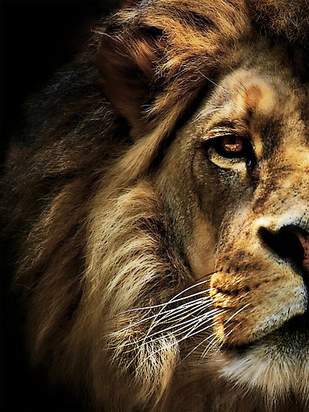
The Book of Daniel

Slide 3
Preserving Our Identity in Babylon

Slide 4
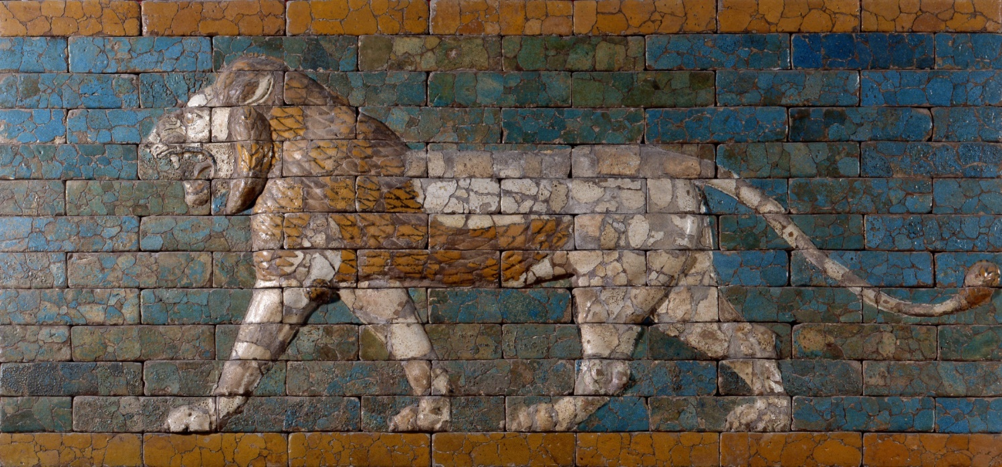
How Babylon tried to change Daniel

Slide 5
Daniel 1:2
And the Lord gave Jehoiakim king of Judah into his hand, with some of the vessels of the house of God. And he brought them to the land of Shinar, to the house of his god, and placed the vessels in the treasury of his god.

Slide 6
Daniel 1:5
The king assigned them a daily portion of the food that the king ate, and of the wine that he drank. They were to be educated for three years, and at the end of that time they were to stand before the king.

Slide 7
Daniel 1:6-7
Among these were Daniel, Hananiah, Mishael, and Azariah of the tribe of Judah. And the chief of the eunuchs gave them names: Daniel he called Belteshazzar, Hananiah he called Shadrach, Mishael he called Meshach, and Azariah he called Abednego.

Slide 8
Hebrew name | Meaning | Babylonian name | Meaning
Hananiah | “The Lord is gracious” | Shadrach | “Command of Aku”
Mishael | “Who is what God is?” | Meshach | “Who is what Aku is?”
Azariah | “The Lord has helped” | Abednego | “Servant of Nebo”
Daniel | “God is my Judge” | Belteshazzar | “May Balak protect”

Slide 9
How Daniel maintained his identity

Slide 10
Daniel 1:2
And the Lord gave Jehoiakim king of Judah into his hand, with some of the vessels of the house of God.

Slide 11
Daniel 6:10
When Daniel knew that the document had been signed, he went to his house where he had windows in his upper chamber open toward Jerusalem.

Slide 12
Daniel 1:8
But Daniel resolved that he would not defile himself with the king's food, or with the wine that he drank.

Slide 13
How we can maintain our identity

Slide 14
1 Peter 1:1-2
Peter, an apostle of Jesus Christ,
To those who are elect exiles of the Dispersion

Slide 15
1 Peter 1:1-2
Peter, an apostle of Jesus Christ,
To those who are elect exiles of the Dispersion in Pontus, Galatia, Cappadocia, Asia, and Bithynia, according to the foreknowledge of God the Father

Slide 16
When you know who you are, you can be different…
In what you wear
In what you drink
In your sexual purity

Slide 17
