Slide 1
1st PETER
SOJOURNERS & EXILES

Slide 2
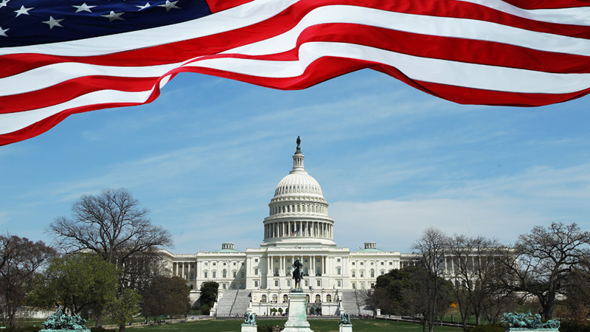
Christians and Politics

Slide 3
3 Events Shaping the History of Christianity in American Politics Today
The Cold War
American Patriotism melded with Christian beliefs
American Christianity vs. Communistic Antichrist
Increasing amount of court cases discussing the separation of Church and State: Roe v. Wade
Christians felt their way of life was being threatened by the very Government they held dear
Presidential Terms of Jimmy Carter and Ronald Reagan
Campaigned towards the Christians of America
The birth of the Evangelical Christian “Lobbyist” group

Slide 4
Text: Jeremiah 29:4-14
Section 1: Our role to the Rulers of Earth
Section 2: Our role towards God

Slide 5
Ambassadors of God
This world is our “Home away from Home”
We are Ambassadors, representing God’s eternal kingdom to the nations of this present world.
Romans 13:1-7
God establishes governing authorities
Fear should only be present in the hearts of those who do evil
Pay taxes, follow customs, and honor those who are to be honored
Titus 3:1-11
Being subject to our Earthly authority is a fundamental building block of living a Godly lifestyle
I Peter 2:11-17
Silence the ignorance of foolish men

Slide 6
Citizens of God’s Kingdom
We have a true, eternal home waiting for us
God still has sovereignty over the Earthly kingdoms
I Timothy 2:1-8
We should pray for all men, including the ones in power
All are welcome citizens of the heavenly kingdom
Psalm 22:25-31
The Eternal Kingdom

Slide 7
Applications: Daniel 2:20-30
Relationships with our Fellow Man
Relationships with God
Patriotism is a good trait to have, but can become an idol
We are all still made in the image of God
All our deeds here upon the Earth should be to glorify our one true ruler: God
We should not abuse our citizenship in God’s Kingdom to gain Earthly power

