Slide 1
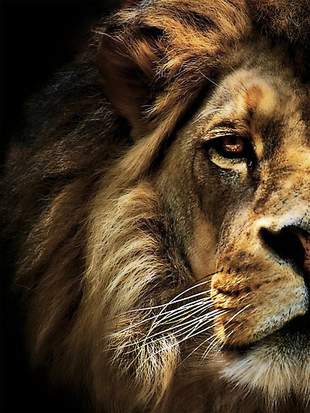
The Book of Daniel

Slide 2
How to Survive in a Postmodern World

Slide 3
Pluralism
A condition in which numerous distinct ethnic, religious, or cultural groups are present and tolerated in a society.
The belief that such a condition is desirable or socially beneficial.

Slide 4
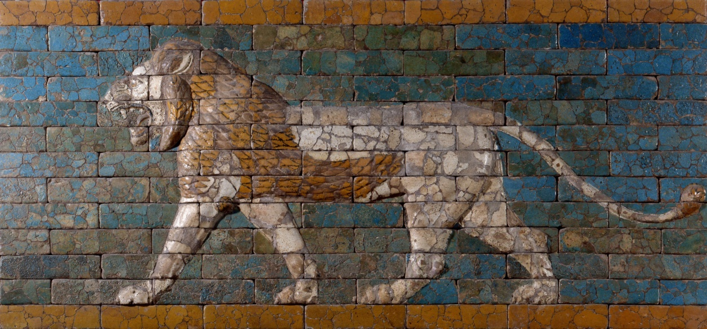
They knew what they believed.

Slide 5
Daniel 3:18
“These men, O king, pay no attention to you; they do not serve your gods or worship the golden image that you have set up.”

Slide 6
Psalm 1:1-3
Blessed is the man who walks not in the counsel of the wicked,
Nor stands in the way of sinners,
Nor sits in the seat of scoffers;
But his delight is in the law of the LORD, and on his law he meditates day and night.
He is like a tree planted by streams of water.

Slide 7
Luke 8:13
And the ones on the rock are those who, when they hear the word, receive it with joy. But these have no root; they believe for a while, and in time of testing fall away.

Slide 8
Colossians 2:6-8
Therefore, as you received Christ Jesus the Lord, so walk in him, rooted and built up in him and established in the faith, just as you were taught, abounding in thanksgiving. See to it that no one takes you captive by philosophy and empty deceit, according to human tradition…

Slide 9
Colossians 2:6-8
Therefore, as you received Christ Jesus the Lord, so walk in him, rooted and built up in him and established in the faith, just as you were taught, abounding in thanksgiving. See to it that no one takes you captive by philosophy and empty deceit, according to human tradition…

Slide 10
Colossians 2:6-8
Therefore, as you received Christ Jesus the Lord, so walk in him, rooted and built up in him and established in the faith, just as you were taught, abounding in thanksgiving. See to it that no one takes you captive by philosophy and empty deceit, according to human tradition…

Slide 11
They stood for what they believed.

Slide 12
Daniel 3:18
“But if not, be it known to you, O king, that we will not serve your gods or worship the golden image that you have set up.”

Slide 13
Joshua 24:15
“And if it is evil in your eyes to serve the LORD, choose this day whom you will serve… But as for me and my house, we will serve the LORD.”

Slide 14
1 Corinthians 16:13
Be watchful, stand firm in the faith, act like men, be strong.

Slide 15
They trusted in the One whom they believed.

Slide 16
Daniel 3:17
“If this be so, our God whom we serve is able to deliver us from the burning fiery furnace, and he will deliver us out of your hand, O king.”

Slide 17
1 Corinthians 15:58
Therefore, my beloved brothers, be steadfast, immovable, always abounding in the work of the Lord, knowing that in the Lord your labor is not in vain.

Slide 18
Make Bible study a priority
Lead by example
Stay connected
Be aware
Give them roots and wings

